Slide 1
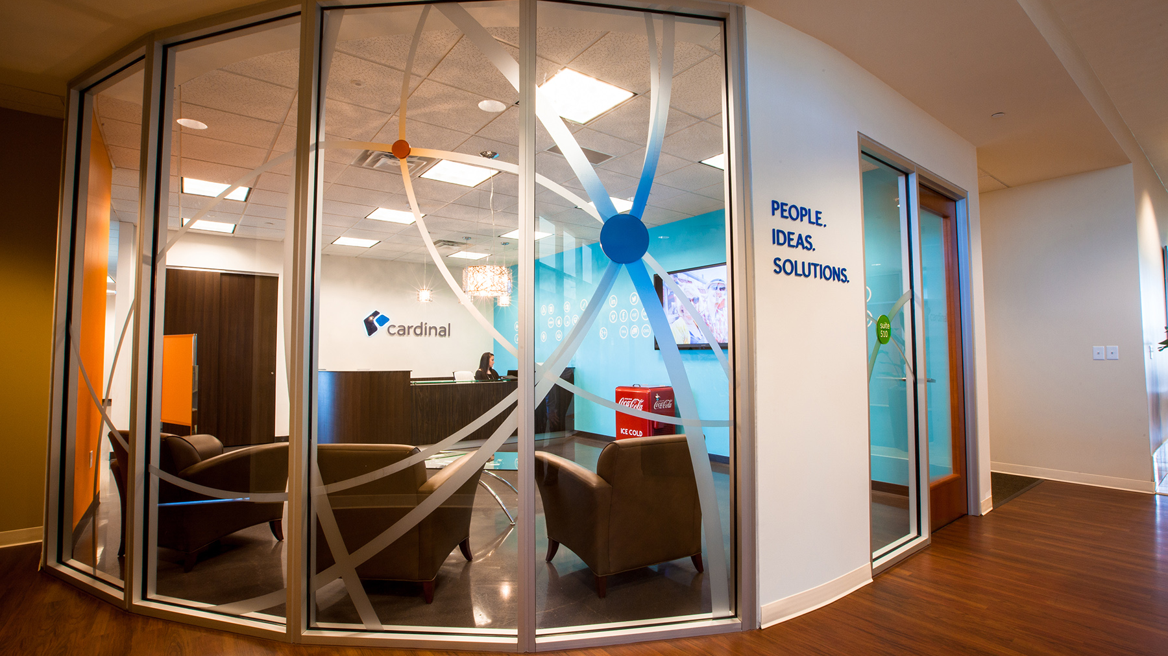

DevOps & Azure
Global Azure Bootcamp
Nick Martin
4/22/2017

Slide 2
Agenda
DevOps & Azure
Primer
Azure Resource Manager (ARM)
ARM Templates
Deployment Options
Monitoring & Support
Case Studies
Notes:
Divided into 3 parts
Primer will not be about Azure at all – level setting what DevOps is and what those teams often work toward
Azure topics will just be scratching the tip of the iceberg
-Hundreds of services, options, and variations
Case studies of how these concepts are actually applied

Slide 3
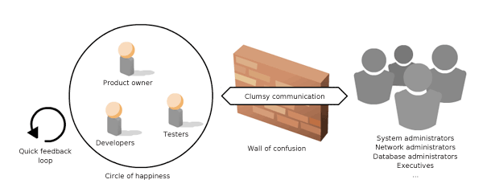
DevOps Breaks Down the “Wall of Confusion”
Primer
Notes:
DevOps means we break down the ‘wall of confusion’ between the “circle of happiness” of functioning agile teams and traditional Infrastructure/Operations teams.

Slide 4

Common Goal of DevOps: Continuous Delivery
Primer
Key pattern is Delivery Pipeline
Run on every change that may impact the system
Traditional Source Code
Infrastructure as Code
Configuration as Code
Validation via Tests
Automation………………
Notes:
Common goal of many DevOps teams
Data as Code too
Give use case (insurance discount table load)
Does not apply to “data processing”
Pertains to data that is inextricable tied to the business logic (tax tables, pricing rules)

Slide 5
Example Delivery Pipeline
Primer
Notes:
Example Delivery Pipeline
All changes go at least as far into the pipeline as is automated
Organization must be structured around the pipeline:
Product team needs to own this pipeline. (might be more than 1 dev team)
Each product gets its own pipeline.
Requires input/collaboration across many disciplines (DevOps)
Cloud architectures are HUGE help to “Provision & Configure Environment”

Slide 6
DevOps Encompasses Everything in a Solution
Primer
Automation
Scripted Releases
Unit / Integration / Acceptance / etc. Testing
Continuous Integration
Monitoring / Support
Configuration Management
Resource Provisioning
Notes:
DevOps is not just about deployments
DevOps isn’t just about having developers carry pagers
DevOps is an evolution in how solutions are built
Automate it all! (as is feasible)
These are just some aspects/best practices – there are many more
Azure has good story for all of these!

Slide 7

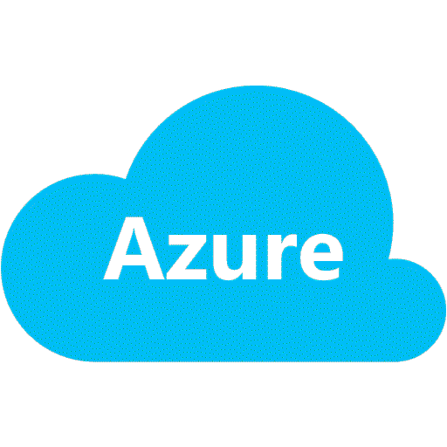
Azure
WHERE’S THE AZURE?

Slide 8
Azure Resource Manager
Azure Resource Manager
Means to manage logically related or dependent resources
Resource Container: Resource Group
Shared lifetime resources
Delete the resource group, all contains resources go with it
Great for managing temporary environments
Underpins much of how Azure is managed today
PowerShell & Xplat CLI APIs
REST APIs
Latest Azure Portal is built around Resource Manager

Slide 9
Architecture
Azure Resource Manager
Notes:
Any operation to provision/update/delete a resource goes through RM
Sit on top of specific resource providers
Each provider has its own deployment cycle:
Resource Manager defines consistent interface
Allows Microsoft to iterate rapid releases at provider level

Slide 10
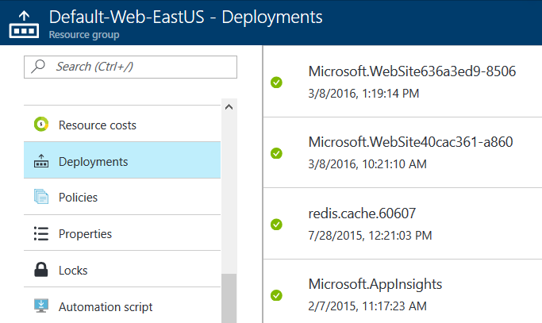
Portal is Built on Resource Manager
Azure Resource Manager
Notes:
Every provisioning action you take in the portal equates to a “deployment”
Full traceability of what happens in your Resource Group
Deployments themselves are Azure resources you can look at

Slide 11
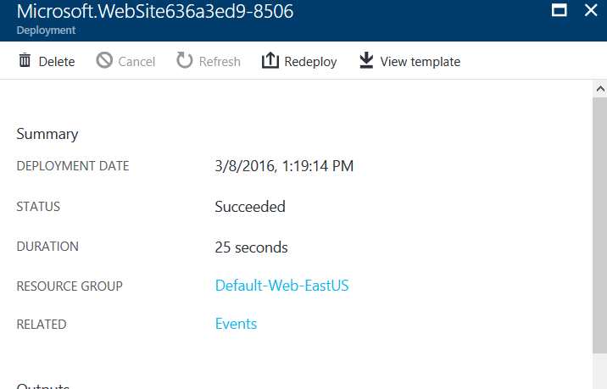
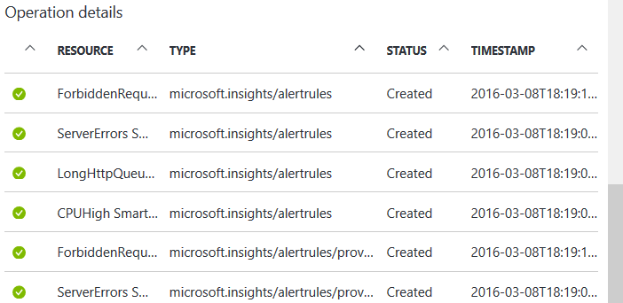
Viewing a Past Deployment
Azure Resource Manager
Notes:
Can drill into a specific deployment to see what happened
We are only seeing a small portion of this panel – lots of other details about the deployment
Inputs
Outputs
Operations

Slide 12
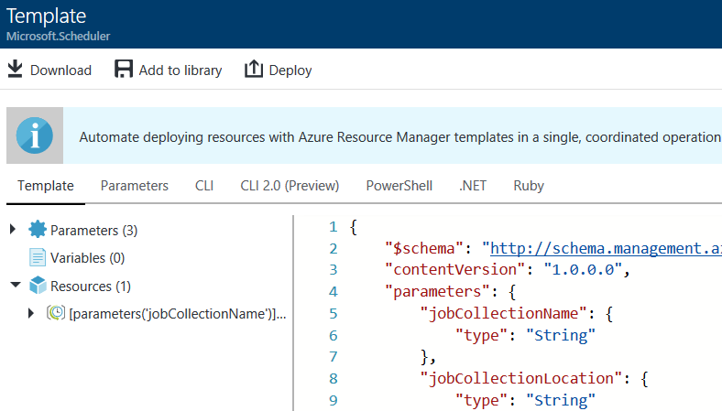
Viewing the Template Behind the Deployment
Azure Resource Manager
Notes:
Behind every RM deployment is a template
If you really want to know goes on behind the scenes with Resource Manager – learn the templates

Slide 13
ARM Templates
ARM Templates
Declarative language for describing resources to be provisioned in Azure
Can describe an entire resource group
Incremental update mode
Previously deployed resources missing from your template are ignored
Only apply deltas to declared resources
Complete update mode
Makes resource group exactly match template
Well-defined JSON schema (APIs to validate)
Infrastructure as Code for Azure (Configuration as Code to some degree, too)
Notes:
Incremental updates is how you can tweak resources within a template, re-run the same template and only apply the deltas
Enables version control over your Azure resources!
Template error will not undo any already completed operations
Have a rollback strategy (usually fixing the template and re-deploying)
Deleting and starting over might work, too
Be sure to validate your template!
Some resources are annoyingly not compatible with ARM Templates
Example: SendGrid can be described in ARM, but needs manual EULA acceptance to be created

Slide 14
Running the ARM Template
ARM Templates
Login-AzureRmAccount
New-AzureRmResourceGroup -Name ExampleGroup -Location "South Central US"
New-AzureRmResourceGroupDeployment -Name ExampleDeployment `
-ResourceGroupName ExampleResourceGroup `
-TemplateFile c:\MyTemplates\storage.json `
-storageNamePrefix contoso -storageSKU Standard_GRS
az login
az group create --name ExampleGroup --location "Central US"
az group deployment create \
--name ExampleDeployment \
--resource-group ExampleGroup \
--template-file storage.json \
--parameters "{\"storageNamePrefix\":{\"value\":\"contoso\"},\"storageSKU\":{\"value\":\"Standard_GRS\"}}"
Notes:
Top is PowerShell
Bottom is Azure CLI

Slide 15
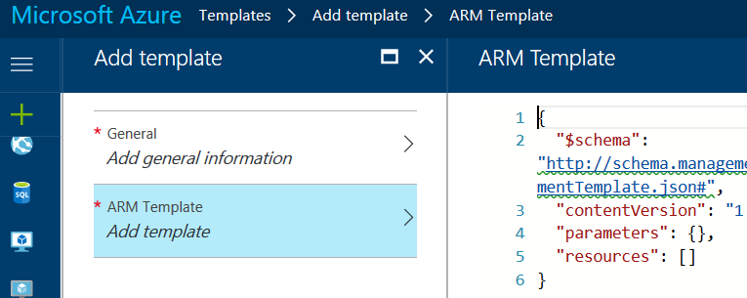
Managing Templates in the Azure Portal
ARM Templates
Notes:
This is a preview feature, but you can save templates to the portal for deployment
You can edit saved templates over time
Portal acts as source repository

Slide 16
Authoring ARM Templates
ARM Templates
Basic Structure:
{
"$schema": "",
"contentVersion": "",
"parameters": { },
"variables": { },
"resources": [ ],
"outputs": { }
}
← Can be used to link across templates
Notes:
Parameters – inputs into the templates
Things like resource names, scale levels, instance counts
Any “knob” you want to control between deployments
Variables – values computed within template, or referenced multiple places
Resources – the meat, definition of resources to be provisioned
Outputs – data about the provisioned resources
Access keys, URLs, etc.
Can be parameter inputs to other templates for very complex deployments

Slide 17
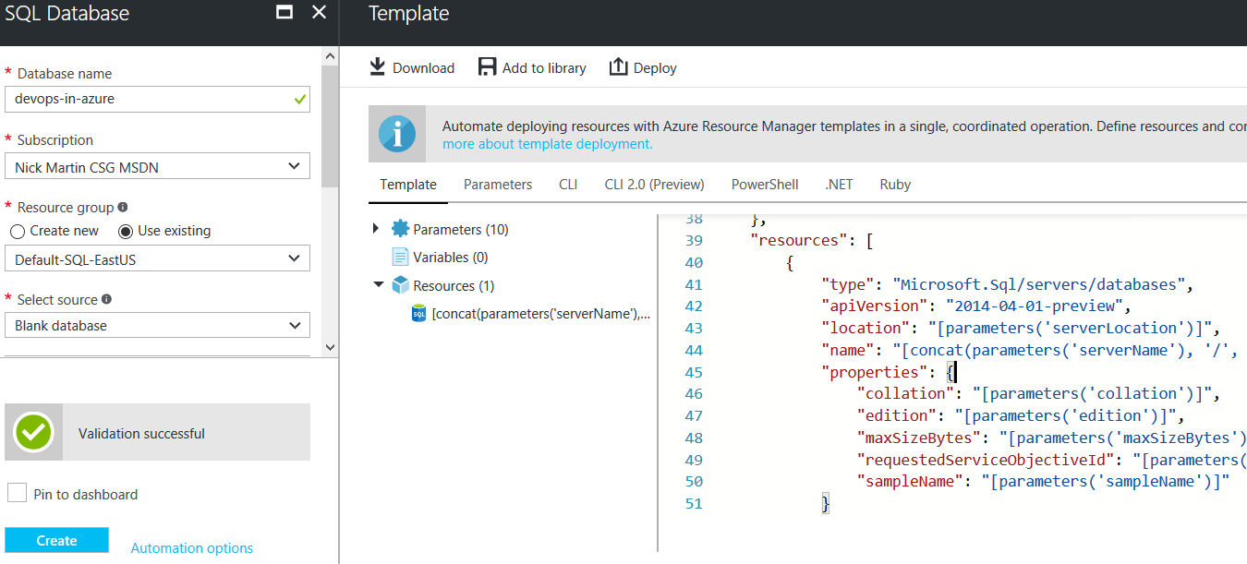
Generating ARM Templates in the Azure Portal
ARM Templates
Notes:
When creating resources, instead of clicking “Create”, generate the template
Template can then be added to automation process
Can even export an entire resource group!
Good way of starting with ARM templates from existing deployments
Although you can generate a template from a resource group, adapting it for use is complex
Tool can’t know what parameterization/etc. makes sense for you

Slide 18
VSTS Build/Release
Deployment Options
Azure-hosted Team Foundation Server as a Service
Enables building robust Delivery Pipeline
Can link directly into your Azure Subscription
Has convenient Build / Release tasks for Azure resources
Deploy Azure SQL Database / App Services / Service Fabric Clusters / etc.
Run Azure PowerShell scripts or scripts against remote VMs
App Service operations (Start / Stop / Swap Slots)
Provision with ARM Templates
+ more
Notes:
Obviously, VSTS is not the only option
With Azure PowerShell and Xplat CLI, any build/CD system can do all these things

Slide 19
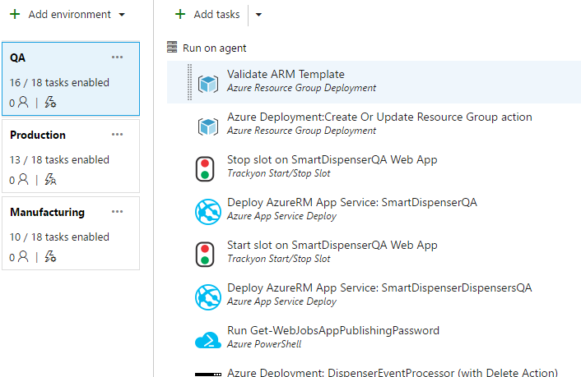
Real-world Example
Deployment Options
Notes:
The most effective teams pursue continuous delivery – with cloud architectures this is very achievable.
Days before launch told by client that we need a new manufacturing environment
Effort of creating new environment:
Clone/tweak VSTS environment
Create new parameters file
Had it up and running within an afternoon

Slide 20
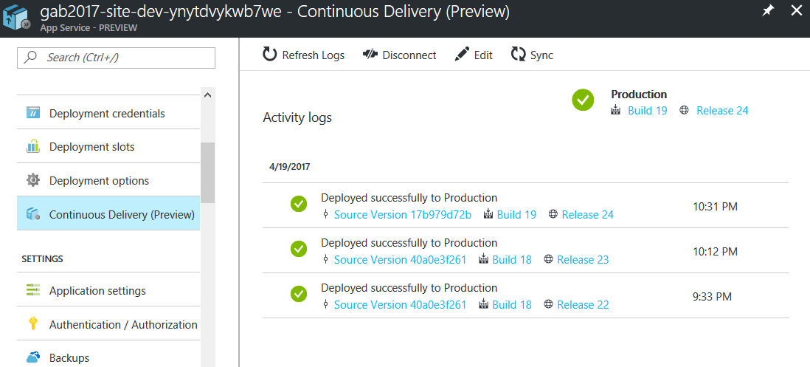
App Service Integrating with Continuous Delivery Pipeline
Deployment Options
Notes:
This is a preview feature, but you can save templates to the portal for deployment
You can edit saved templates over time
Portal acts as source repository

Slide 21
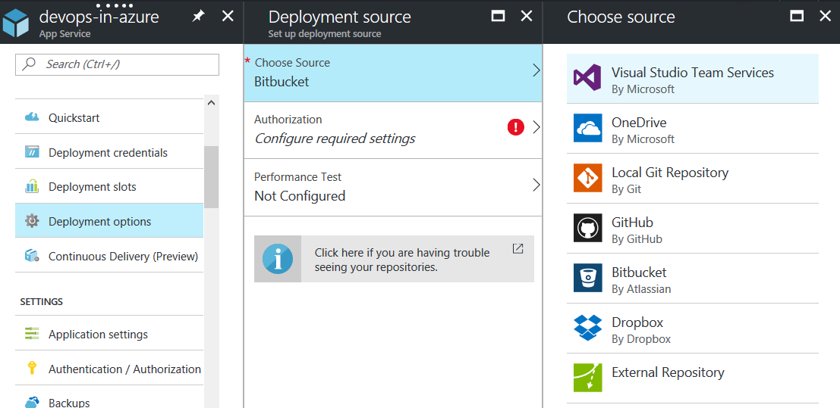
Continuous Deployment (App Service + few more)
Deployment Options
Notes:
Can also set up continuous deployment from a variety of repositories
Limitations are not having robust pipeline
(unless pipeline exists BEFORE repository)
Azure Automation (GitHub only)

Slide 22
Monitoring & Support in the Cloud
Monitoring & Support
Trust in Azure, but verify
Lots of fear about lack of control/visibility in the cloud
In the early days, but no more!
Remote resources need even more traceability and control hooks than on-premises
DevOps teams maintain ownership over maintenance/support
Notes:
Obviously, VSTS is not the only option
With Azure PowerShell and Xplat CLI, any build/CD system can do all these things

Slide 23
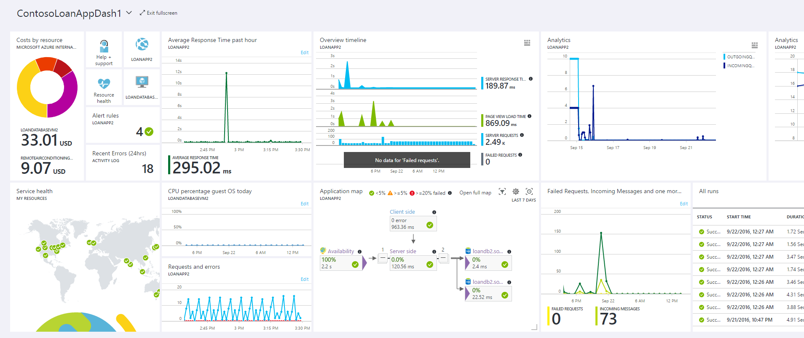
Notes:
Azure Monitor – new capability to tap into metrics across all Azure services into one “pane of glass”
Rich dashboards for quick view into health of deployed system

Slide 24
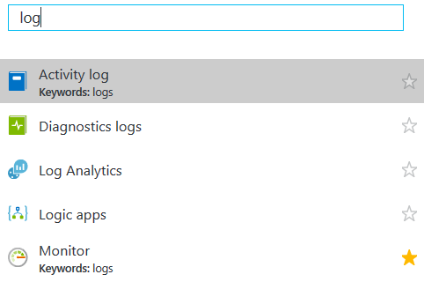
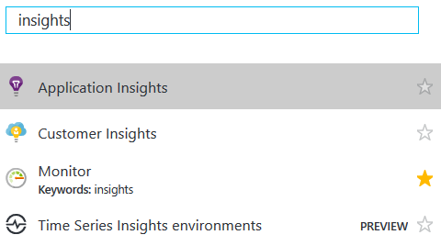
Dedicated Azure Services
Monitoring & Support
Notes:
There are a number of services *dedicated* to keeping visibility into your Azure workloads

Slide 25
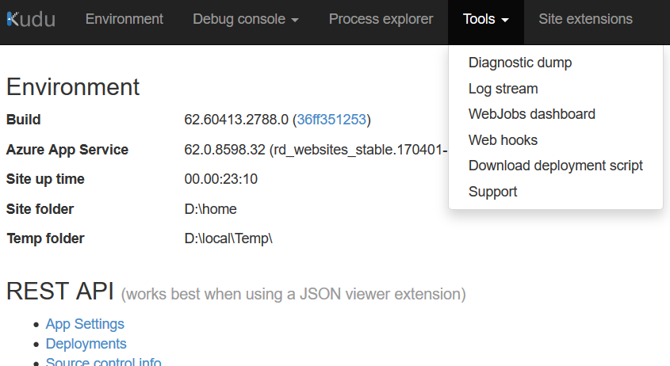
Project Kudu
Monitoring & Support
Notes:
For your App Service deployments, there are also advanced admin tools
Project Kudu is open source (not only for Azure)
Helps you make sure your application is running smoothly, and address issues if they come up

Slide 26

Challenge
Massive video ingestion needs
Evidence management for body camera video
Custom IoT device/firmware
Multi-agency support
Strategy
DevOps!
Per-agency resources provisioning
Shared deployment resources
Update/rollback version
Results
Admin can manage versioned software per agency
High compliance security via Azure Gov Cloud
Notes:
NOTE: Camera in image is generic, not necessarily from this client
VSTS was utilized for both CI for deployment and test runs, and the Agile board to handle user stories.
Deployed on AzureGovCloud, besides the IoTHub, which is not available on GovCloud.
Entire application built with microservices architecture, utilizing Azure Service Fabric to handle the scaling and integration of the services.

Slide 27

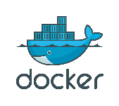
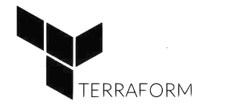
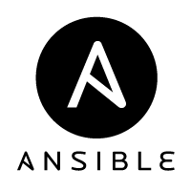
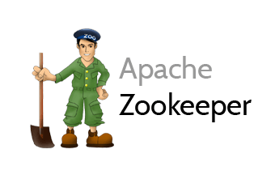


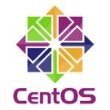

Challenge
Determine claims exposure from major disaster
Provide high-compute software to insurers without complex install
24/7 Dev Cycle
Strategy
DevOps!
Moved from AWS to Microsoft Azure
Deployed open source architecture to be cloud-agnostic as well as support on-prem
Results
Met customer requirements to support on-prem as well as SaaS
Drastically reduced costs vs hosting in AWS
End-to-End Automation
Notes:
Offer as SaaS product
Cloud-agnostic requirement
Linux and Windows workloads
200+ developers, worldwide, working 24x7 poses unique challenges
Some environments are 1000’s of cores – FAR too big to run solution on anyone’s laptop
Delivery pipeline using CirclCI and Jenkins

Slide 28

Thanks!
DevOps with Azure
Experience DevOps & Azure yourself:
https://github.com/COAzure/global-azure-boot-camp-2017/tree/master/DevOps

