Slide 1
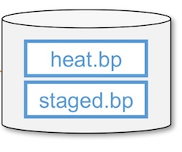

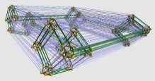

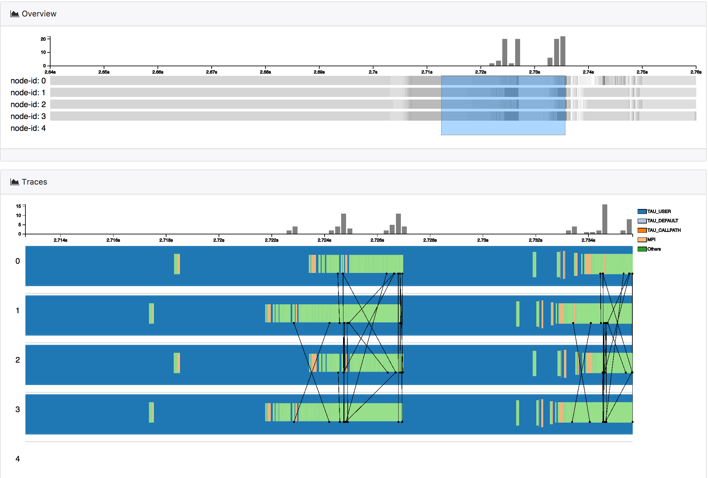
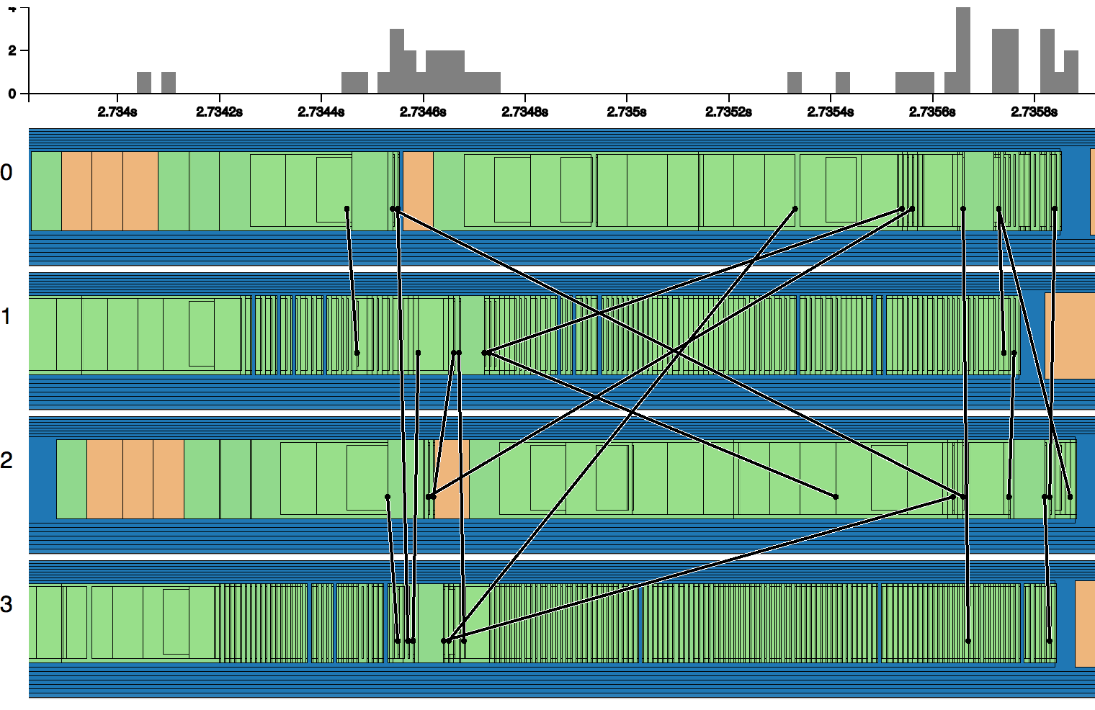

Chimbuko - Performance Analysis for Workflows
LQCD
Supports performance driven design studies for workflows, emphasis on enabling trade off studies for online analysis workflows for exascale applications
Research Details
Systematically captures, stores and correlates provenance and performance metrics of workflows and systems – ability to plug in various performance tools incl. ECP TAU
Visual Analytics interface to query and display workflow performance
Initial performance analysis routines developed.
Chimbuko tested on workflow use cases for ECP NWChemEX and QCD projects, baseline studies ongoing in preparation for initial trade off studies.
Provenance Capture
Performance Analysis Tools
Information Extraction and Wrapping
1
2
4
3
Notes:
Unique capability to capture, analyze and visualize workflow performance evolution over time

Slide 2
Assumptions
The Heat Equation is available from https://github.com/CODARcode/Example-Heat_Transfer
Install Savanna as indicated. It will access the heat equation.
ADIOS 1.12 is also accessed

Slide 3
Install pdt 3.24, TAU 2.26.2p1 with the following configs
tau 2.26.2p1 release 6/28/2017
https://www.cs.uoregon.edu/research/tau/tau_releases/
Tau config
Tau makefile
-adios=/home/pouchard/Install/adios-1.12.0
-pdt=/home/pouchard/Install/pdtoolkit-3.24
-c++=mpicxx
-cc=mpicc
-fortran=mpif90
/home/pouchard/Install/tau-2.26.2p1/x86_64/lib/Makefile.tau-mpi-pdt

Slide 4
Configure TAU
adding the -adios=/path/to/adios/installation flag at the configure step
Add /path/to/tau/$arch/bin to your PATH/path environment variable (where “/path/to/tau” is your TAU installation location)
set the TAU_MAKEFILE to the Makefile that matches your TAU configuration, located in /path/to/tau/$arch/lib/Makefile.tau-*

Slide 5
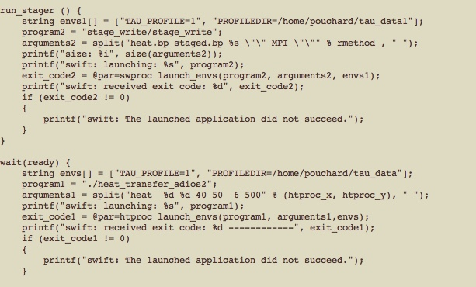
Changes to Heat Equation files
workflow.swift

Slide 6
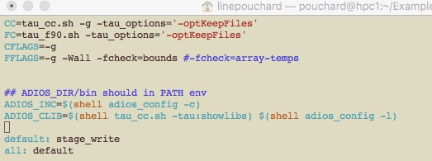
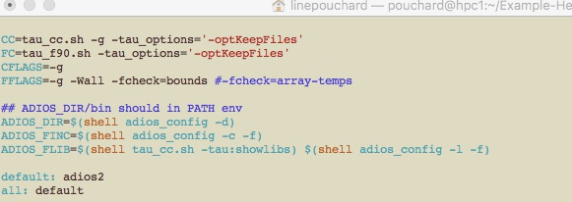
Heat Equation: change compiler flags to tau wrappers (cc, fcc flags) Tell them where tau_adios implementation is – adios_clib and adios_flib
Notes:
Swift + ADIOS
no spack install
1 Makefile per
component

Slide 7
run heat equation
./run-workflow.sh 20
run the py script to produce a merged profile
./feat_extraction_9_13_V2.py –o output.json [dir1] [dir2]

Slide 8
produce viz with merged profile

Slide 9
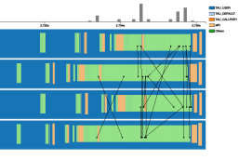
LQCD
Performance Analysis
Information Extraction and Wrapping
Hybrid data store
Analysis
CHIMBUKO

