Slide 1
CODAR Hands-on Session ECP
Project: CODAR (Co-design Center for Online Data Analysis and Reduction)
Speakers: Kshitij Mehta @ ORNL, Igor Yakushin @ ANL
ORNL, ANL, BNL, Brown U., Rutgers, Stony Brook U.
February 6, 2020

Slide 2
Need for data reduction/compression at Exascale
At extreme scale, applications could generate multi-petabytes or exabytes of data
Multiple use cases across the simulation, experimental, and observation data domains
Impossible to store all the data to PFS
Capacity and bandwidth restrictions
Need to reduce/compress data
Analyze data in situ
Post-processing will become prohibitive

Slide 3
Questions/Issues around Online Data Compression
What are the libraries available for compressing/reducing data?
How do I use them?
What are the tradeoffs (accuracy, cost of compression)?
How to best orchestrate simulation with compression and online analysis?
Run analysis codes post-hoc? How to run them online?
Compress synchronously or asynchronously?
On-node or off-node?

Slide 4
Objective of this Tutorial
Learn about CODAR tools: libraries and tools to reduce/compress data generated by simulation code
Core CODAR infrastructure including compression libraries
Learn how to use Cheetah to run a campaign to study different possible ways to compress data
Test different compression libraries
Test Synchronous vs. asynchronous reduction
How to couple simulation and analysis codes
Test Offline vs. online analysis
Test On-node vs. off-node analysis

Slide 5
Core CODAR Infrastructure
ADIOS
Pub-sub data management and I/O library
Cheetah and Savanna
Experiment harness for CODAR studies
SZ, ZFP, MGARD, Zlib and more
Compression/reduction libraries
Zchecker
Assessing quality of lossy compression
FTK
Feature tracking toolkit
Tau
Profiling and tracing
Chimbuko
Performance analysis

Slide 6
ADIOS: High-Performance Publisher/Subscriber I/O framework
A high performance I/O abstraction to allow for on-line/off-line memory/file data subscription service
Research Details
Declarative, publish/subscribe API is separated from the I/O strategy and use of multi-tier storage
Multiple implementations (engines) provide functionality and performance in different use cases
Data reduction techniques are incorporated to decrease storage cost
<adios-config>
<io name=”CROutput">
File I/O
<engine type="BP4">
<parameter key="SubStreams” value=”512"/>
</engine>
Compression
<variable name="U">
<operation type="sz">
</operation>
</variable>
</io>
<io name=”diagnostics">
Staging
<engine type=”SST">
</engine>
</io>
https://github.com/ornladios/ADIOS2

Slide 7



Compression/In Situ Pipeline based on ADIOS
Readers
Simulation
ADIOS
subscriber
publish
data
compressed
data
Storage
persist
sz, zfp, mgard,
blosc, zlib
synchronous
asynchronous
on-node
off-node
post-process
in situ
BP4, SST, WAN
accuracy tolerance

Slide 8
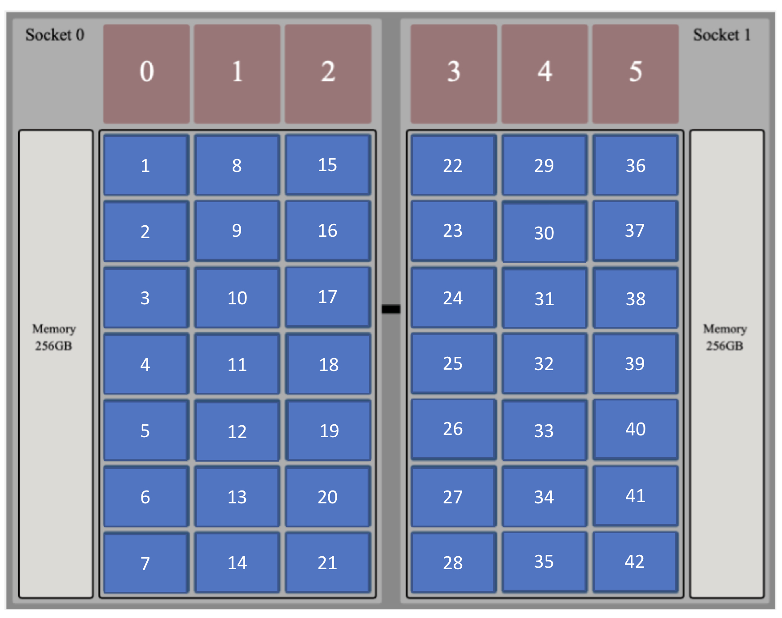
How do you effectively orchestrate a reduction workflow on Summit?
How many ranks per node?
Separate nodes for the simulation and analysis?
Share compute nodes amongst different applications?
Different supercomputers have different schedulers
Orchestrating a workflow to explore process pinning is quite cumbersome
Differs for different applications
How do I test various options?

Slide 9
What is Cheetah
An experiment harness / campaign management system to explore online data analysis and reduction
Provides the ability to conduct parameter sweeps
Centered around ADIOS, allows easy setup and exploring different compression schemes
Study offline vs online, synchronous vs. asynchronous, on-node vs. off-node reduction of large data
Fine-grained process placement on different architectures

Slide 10
Core Features
An interface to compose and orchestrate complex, multi-application, coupled workflows
Python-based specification file to describe your collection of runs
Setup a coupled workflow
Setup complex process placement
Abstraction over scheduler interfaces
Handles campaign management for you
Isolated experiment workspaces
The Virtual Node interface allows fine-grained binding of ranks to resources
Utilizes the Savanna runtime engine for managing experiments
Monitor a running campaign
Re-submit a partially run campaign
Generate a performance report of a completed campaign

Slide 11
Installing Cheetah
Spack
`spack install codar-cheetah@develop`
OR
Git clone and setup PATH
`git clone https://github.com/CODARcode/cheetah`

Slide 12
Interaction with Applications
Cheetah runs as an external tool
No instrumentation of applications required to use Cheetah (not for current version of Cheetah)

Slide 13
Architecture - Cheetah and Savanna

Slide 14
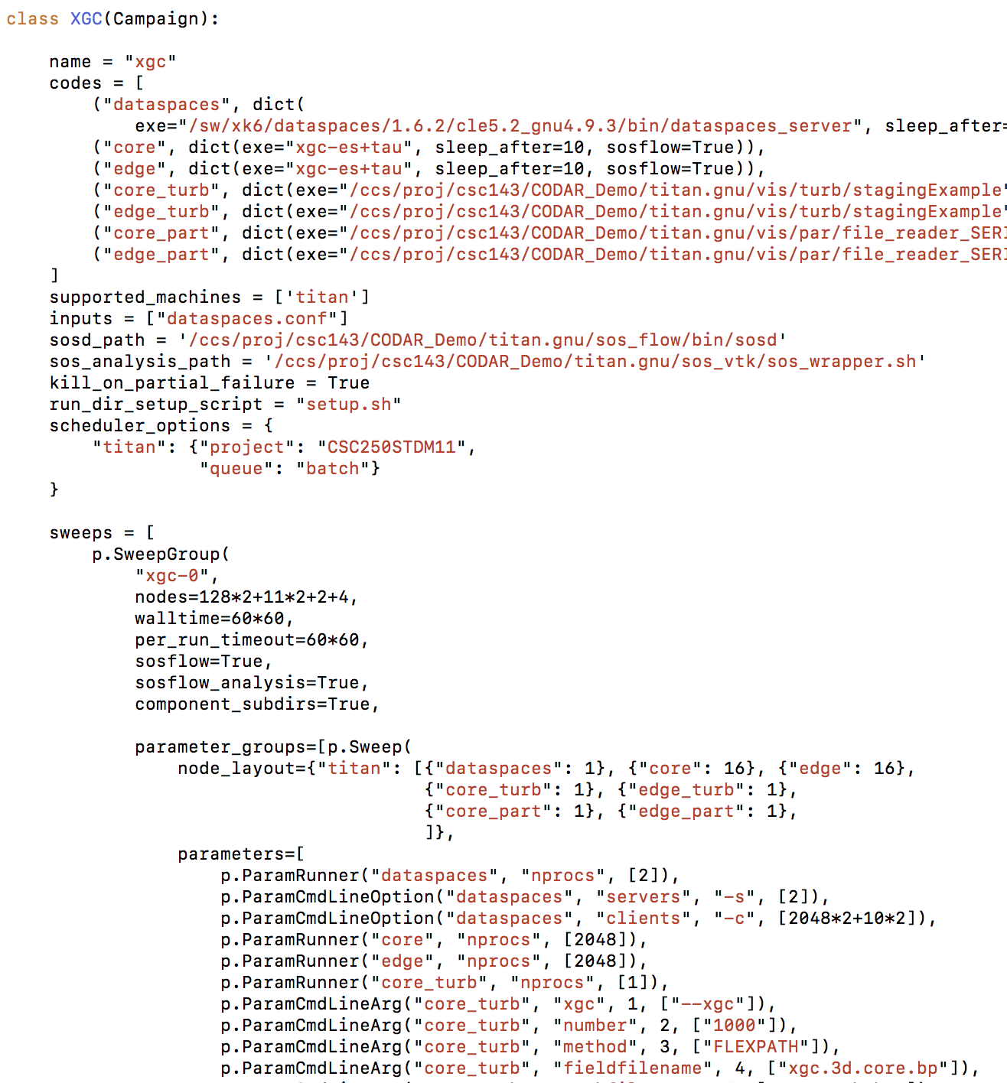

Four steps of running a Campaign
1
2
3
Sweep Specification
Campaign
Job Management
Job scheduling
Job Monitoring
Run-000
Dedicated nodes or Co-location
Runtime controls
4
Run-001
Report
Generation
Performance
Report
Code Config
Machine Config
Workflow Config
Run-002
…
Run-xxx

Slide 15
1. Creating a Campaign Specification File

Slide 16
Cheetah Object Model
The ability to ‘sweep’ over parameters of interest
Sweep – collection of parameters to explore
Sweep Group - collection of sweeps
Equivalent of batch jobs
Use VirtualNode to obtain fine-grained workflow orchestration and process placement

Slide 17
Spec file Outline
class GrayScott(Campaign):
name = "gray_scott"
codes =
run_post_process_script =
scheduler_options =
app_config_scripts =
sweep1_parameters = [ .. ]
sweep1 = Sweep (sweep1_parameters)
shared_virtual_node = SummitNode()
my_layout = [shared_virtual_node]
sweep1.node_layout = my_layout
sg1 = SweepGroup(sweep1, ...)

Slide 18
Creating a Sweep object
sweep1 = Sweep (parameters = sweep1_parameters,
node_layout={'summit’:my_separate_node_layout})
sweep2 = Sweep (parameters = sweep1_parameters,
node_layout={'summit’:my_shared_node_layout})

Slide 19
Creating a Parameter List for a Sweep
ParamRunner ('simulation', 'nprocs', [64] )
ParamRunner ('pdf_calc’, 'nprocs’, [4,8,16,32] )
ParamADIOS2XML ('pdf_calc’, 'compression’, 'PDFAnalysisOutput’, 'var_operation’, [ {"U": {"zfp”, “sz”, “mgard”} ])

Slide 20
The Virtual Node Interface for Process Placement
An interface for obtaining fine-grained process placement
Separate nodes for separate applications
Sharing nodes between ranks from different applications
Can be difficult with the default scheduler interfaces
jsrun on Summit, SLURM options with env vars on Cori
Node-sharing currently supported by Summit and Cori
Not supported by Titan, Theta

Slide 21
Examples of node-sharing
Separate sockets
Shared sockets

Slide 22
Virtual Node example creating separate nodes for different applications
sim_node = SummitNode()
for i in range(32):
sim_node.cpu[i] = "simulation:{}".format(i)
pdf_node = SummitNode()
for i in range(32):
pdf_node.cpu[i] = "pdf_calc:{}".format(i)
my_separate_layout = [sim_node, pdf_node]
sweep.node_layout = {'summit’:my_separate_layout}
cpu[0] = “simulation:0”
cpu[1] = “simulation:1”
cpu[2] = “simulation:2”
cpu[3] = “simulation:3”
…

Slide 23
Virtual Node example for node-sharing
shared_node = SummitNode()
for i in range(32):
shared_node.cpu[i] = "simulation:{}".format(i)
for i in range(8):
shared_node.cpu[i+32] = "pdf_calc:{}".format(i)
my_shared_layout = [shared_node]
sweep.node_layout = {'summit’:my_shared_layout}
cpu[0] = “simulation:0”
cpu[1] = “simulation:1”
cpu[2] = “simulation:2”
cpu[3] = “simulation:3”
…
cpu[32] = “pdf_calc:0”
…
cpu[39] = “pdf_calc:7”
Describe the layout of one node. Depending upon the nprocs property, Cheetah will determine the no. of nodes required.

Slide 24
How are Virtual Nodes implemented?
Cheetah’s runtime engine, Savanna, translates Virtual Node specification into concrete scheduler code
ERF files on Summit
Env var and SLURM options for Cori

Slide 25
SweepGroup
sg1 = SweepGroup (“sg-compression”,
walltime = 7200,
per_run_timeout = 1200,
nodes = 1024,
parameter_groups = [sweep1, sweep2],
launch_mode = ‘default’ # or ‘mpmd’,
component_inputs = {},
run_repetitions = 2 )

Slide 26
2. Generating a Campaign Endpoint

Slide 27
Generating a Campaign Endpoint
cheetah create-campaign –a /path/to/exe –e specfile.py –m summit –o /path/to/campaign
Creates a campaign endpoint at the path specified by –o
By default creates /path/to/campaign/username
Multiple users can run under the same campaign endpoint, as they have independent workspaces

Slide 28
The Campaign Directory Tree
Sweep Groups
|____campaign
| |____kmehta
| | |____SG-1
| | | |____fobs.json
| | | |____run-0.iteration-0
| | | |____run-0.iteration-1
| | | |____run-0.iteration-2
| | | |____run-1.iteration-0
| | | |____run-1.iteration-1
| | | |____run-1.iteration-2
| | | |____submit.sh
| | |____SG-2
| | |____run-all.sh
Experiments

Slide 29
3. Running and Monitoring a Campaign
Savanna

Slide 30
Running and monitoring a Campaign
Submit a campaign:
Execute submit.sh to submit a sweep group
Execute run-all.sh to submit all sweep groups
re-submit campaign or group to resume if job times out
Monitoring a campaign:
cheetah status /path/to/campaign
to see the status of currently running experiments
Depending on the size of the allocation, Savanna automatically runs experiments
Decides how many experiments to run concurrently depending on nodes available

Slide 31
Savanna – workflow engine for in situ data management

Slide 32
Cheetah experiment directory structure
Every experiment runs independently in its own, isolated workspace
|____run-0.iteration-0
| |____adios2-config.xml
| |____960GB-write-read-config.txt
| |____writer.erf_input
| |____data.bp/
| |____codar.workflow.stdout.writer
| |____codar.workflow.stderr.writer
| |____codar.workflow.return.writer
| |____codar.workflow.walltime.writer
| |____codar.cheetah.fob.json
| |____.codar.cheetah.pre_submit_dir_size.out
| |____.codar.adios_file_sizes.out.json
| |____codar.cheetah.run-params.json
| |____tau.conf
Input files
Output files
app info (output)
More metadata

Slide 33
Sweep Group Metadata
| ___ SG1/
| |____fobs.json
| |____run-0.iteration-0/
| |____run-0.iteration-1/
| |____codar.workflow.status.json
| |____codar.FOBrun.log

Slide 34
4. Generating a Performance Report

Slide 35
How to generate a performance report
cheetah generate-report /path/to/campaign
Creates campaign-results.csv with the following information:
Parameter information
Exit status
Runtime of individual applications
Name and size of all output adios files
Ability to provide user function to retrieve more information. See ‘cheetah generate-report –h’

Slide 36
Resources
Main repo: https://github.com/CODARcode/cheetah
Examples: https://github.com/CODARcode/cheetah/examples
Documentation: https://codarcode.github.io/cheetah
Support: Using github issues
See examples/04-gray-scott-summit for a real example on using Cheetah on an HPC machine

