Slide 1


The Landscape of Academic Research Computing
Rob Quick <rquick@iu.edu>
Director Cyberinfrastructure Integration Research Center
Some Slides Contributed by the University of Wisconsin HTCondor Team, Scot Kronenfeld, and Kyle Gross

Slide 2
Who Am I?
Director Cyberinfrastructure Integration Research Center
NSF PI – A Gateway for the Event Horizon Telescope
NSF Co-PI – Cyberwater – Interop of hydrology, biology, environmental engineering and climate datasets.
NIH Co-PI - Informing mechanistic rules of agent-based models with single-cell multi-omics
Co-chair CODATA School of Research Data Science Initiative
Co-chair of the Technical and Organizational Advisory Boards for RDA
Steering Committee FAIR Digital Object Forum
12+ Years - Chief Operations Officer of the Open Science Grid and the Software Assurance Marketplace

Slide 3
Protein Docking Project at the IU School of Medicine
SPLINTER - Structural Protein-Ligand Interactome
Used autodock-vina – “…open-source program for drug discovery, molecular docking and virtual screening…”
Frist run in 2013 - docked ~3900 Proteins with 5000 Ligands for a total of ~19M docked pairs.
Submitted via command line to Condor using Pegasus on the OSG-XSEDE submission node
Infrastructure is set and new runs can be easily started
To date more than 6.3B dockings completed

Slide 4
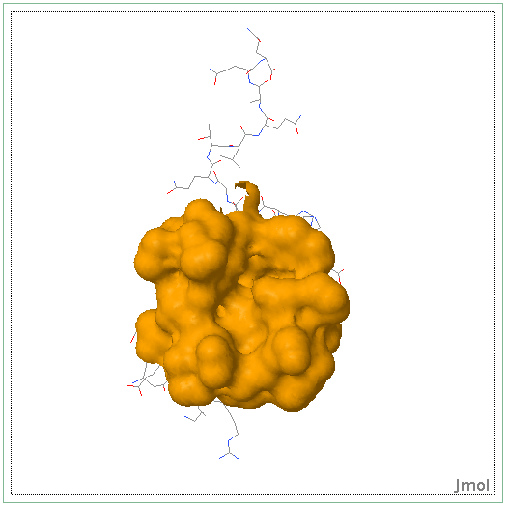
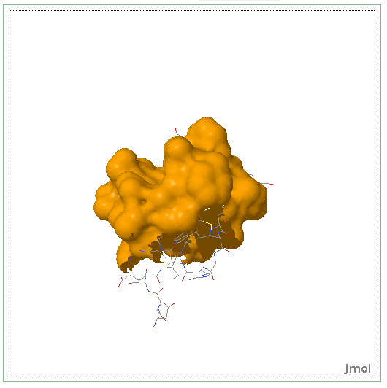
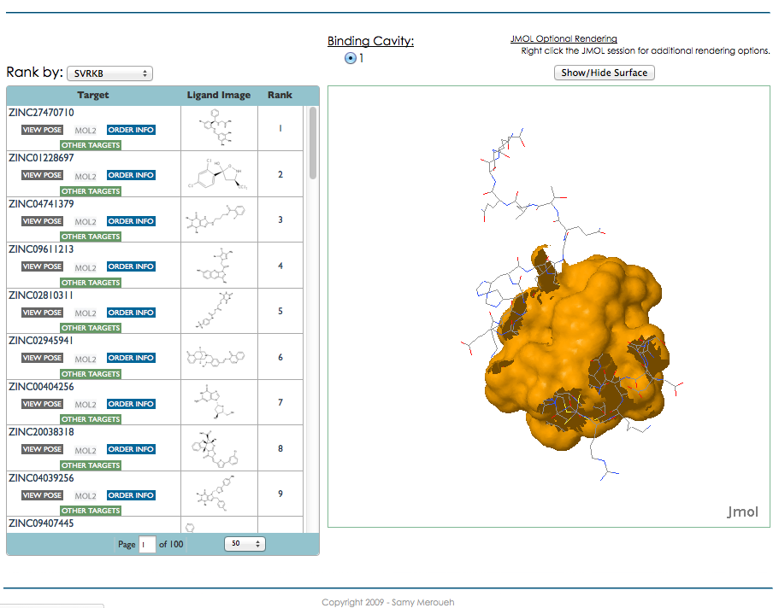
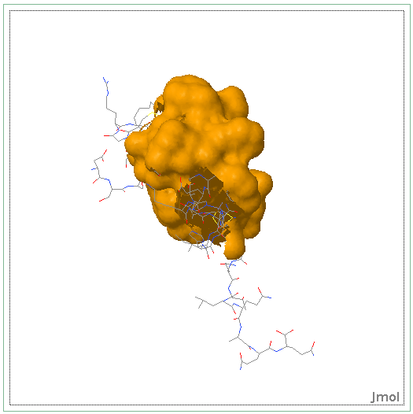
Various rotations of Protein CBFA2T1 (Cyclin-D-related protein) (Eight twenty one protein) (Protein ETO) (Protein MTG8) (Zinc finger MYND domain-containing protein 2)

Slide 5
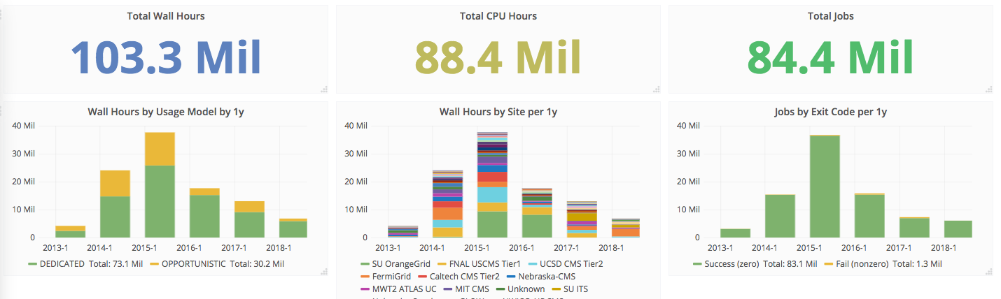
Some Numbers
Amazon EC2 Computing $0.046/hour
$4.066M Compute Only
Data Transfer and Storage Not Included
Notes:
Replace this

Slide 6
Follow Along at:
https://github.com/CODATA-RDA-DataScienceSchools/Materials/blob/master/docs/DataTrieste2025/CI/SoRDS-Trieste-2025-CI-Intro.pptx
Or

Slide 7
Some thoughts on the exercises
It’s okay to move ahead on exercises if you have time
It’s okay to take longer on them if you need to
If you move along quickly, try the “On Your Own” sections and “Challenges”

Slide 8
Most important!
Please ask questions!
…during the lectures
…during the exercises
…during the breaks
…during the meals
…over dinner
…via email after we depart (rquick@iu.edu)
If I don’t know, I’ll find the right person to answer your question.

Slide 9
Goals for this session
Define Local, Clustered, High Throughput Computing (HTC), High Performance Computing (HPC), Cloud Computing (XaaS), and Containers
Shared, Allocated, and Purchased

Slide 10
The setup: You have a problem
Your science computing is complex!
Monte carlo, image analysis, genetic algorithm, simulation, ML or AI algorithms…
It will take a year (CPU time) to get the results on your laptop, but your paper is due in a week.
What do you do?

Slide 11

Option 1: Wait a year

Slide 12
Option 2: Local Clustered Computing
Easy access to additional nodes
Local support for porting to environment (maybe)
Often a single type of resource
Often running at capacity

Slide 13
Option 3: Use a “supercomputer” aka High Performance Computing(HPC)
“Clearly, I need the best, fastest computer to help me out”
Maybe you do…
Do you have a highly parallel program?
i.e. individual modules must communicate
Do you require the fastest network/disk/memory?
Are you willing to:
Port your code to a special environment?
Request and wait for an allocation?

Slide 14
Option 4: Use lots of commodity computers
Instead of the fastest computer, lots of individual computers
May not be fastest network/disk/memory, but you can access a lot of them
Job can be broken down into separate, independent pieces
If I give you more computers, you run more jobs
You care more about total quantity of results than instantaneous speed of computation
This is high-throughput computing

Slide 15
Option 5: Buy (or Borrow) some computing from a Cloud Provider
Unlimited resources (if you can afford them)
Full administrative access to OS of the resources you ‘buy’
Specialized VM images reducing effort in porting
XaaS Business Model

Slide 16
These are All Valid Options
Remember the problem you have one week to publish results for your conference
Option 1: You will miss your deadline
Option 2: You might miss your deadline – But if your lucky you’ll make it (or if you know the admin)
Option 3: If you have parallelized code and can get an allocation you have a good chance
Option 4: If you can serialize your workflow you have a good chance
Option 5: You can meet your deadline for a price. Though academic clouds are becoming more available.

Slide 17
Computing Infrastructures
Local Laptop/Desktop – Short jobs with small data
Local Cluster – Larger jobs and larger data but subject to availability
HPC – Prime performance with parallelized and optimized code
HTC – Sustained computing over a long period for serialized workflows
Cloud – Need deeper permission on an OS and have deeper pockets

Slide 18
Why focus on high-throughput computing? (HTC)
An approach to distributed computing that focuses on long-term throughput, not instantaneous computing power
The lessons learned in HTC environments and HTCondor are easily applied to other clustered or HPC systems
We have access to an international HTC system to show the power of distributed computing

Slide 19
New Technologies
Only that shall happen
Which has happened,
Only that occur
Which has occurred;
There is nothing new
Beneath the sun!
Ecclesiastes Chapter 1 verse 9

Slide 20
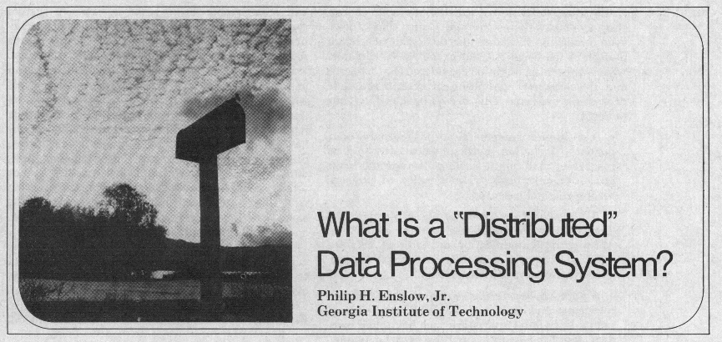
Phillip H Enslow

Slide 21
HPC vs HTC
You’ve decided you want to bake a cake large enough to break the World’s Record for wedding cakes.
Currently WR 6.818 tonnes (15,032 lb)
You could approach this two ways…

Slide 22
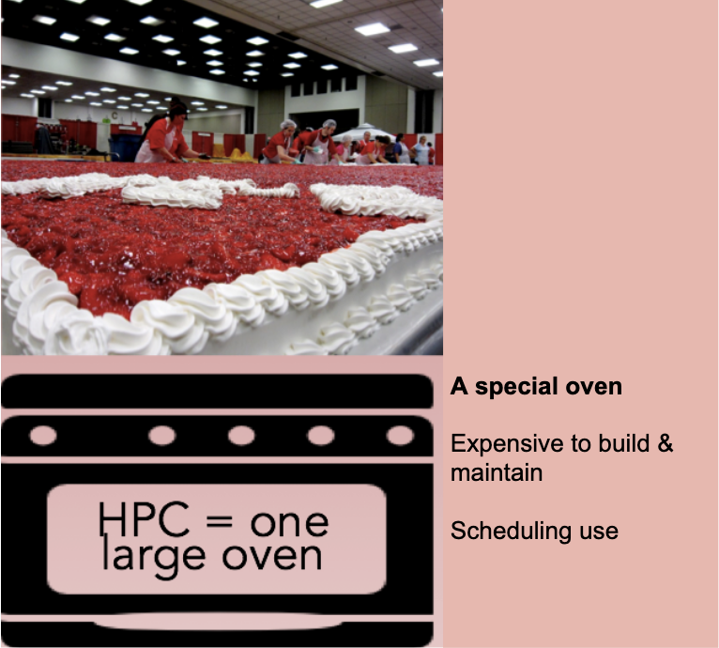
The HPC Approach

Slide 23
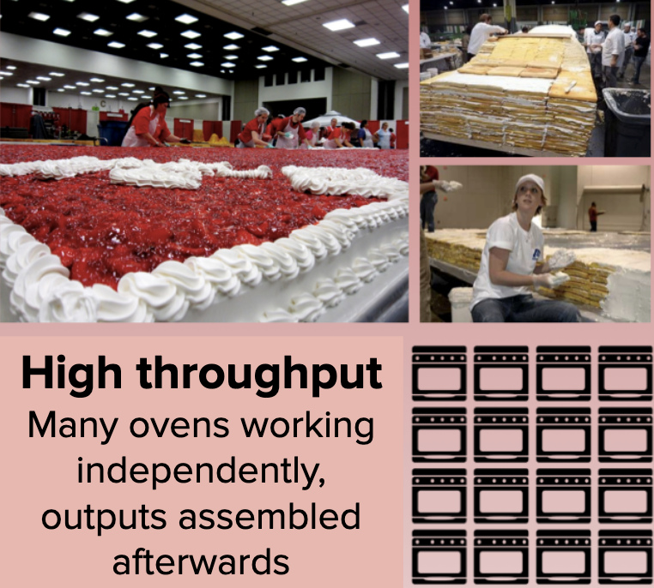
The HTC Approach

Slide 24
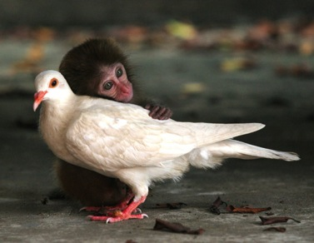
Discussion
For 5 minutes, talk to a neighbor: If you want to run a 100 job parameter sweep in a local environment:
What do you (the user) need to provide so a single job can be run?
What does the system need to provide so your single job can be run?
Think of this as a set of processes: what needs happen when the job is given? A “process” could be a computer process, or just an abstract task.

Slide 25
What does the user provide?
A “headless job”
Not interactive/no GUI: how could you interact with 1000 simultaneous jobs?
A set of input files
A scheme of output
A set of parameters (command-line arguments)
Requirements:
Ex: My job requires at least 2GB of RAM
Ex: My job requires 2 CPUs
Control/Policy:
Ex: Send me email when the job is done
Ex: Job 2 is more important than Job 1
Ex: Kill my job if it runs for more than 6 hours

Slide 26
What does the system provide?
Methods to:
Submit/Cancel job
Check on state of job
Check on state of available resources
Processes to:
Reliably track set of submitted jobs
Reliably track set of available resources
Decide which job runs on which resource
Manage a single computer
Start up a set of jobs

Slide 27
Questions?
Questions? Comments?
Feel free to ask me questions now or later:
Rob Quick rquick@iu.edu
Exercises start here:
https://github.com/access-ci-org/Operations-STEP-2025/tree/main/CI
Slides are also available from this URL.

