Slide 1


Profiling Applications to Choose the Right Computing Infrastructure plus Batch Management with HTCondor
Rob Quick <rquick@iu.edu>
OSG Operations Officer
Indiana University
Content Contributed by the University of Wisconsin Condor Team and Scot Kronenfeld

Slide 2
Follow Along at:
https://opensciencegrid.github.io/dosar/Materials/TriesteMaterials/

Slide 3
Some thoughts on the exercises
It’s okay to move ahead on exercises if you have time
It’s okay to take longer on them if you need to
If you move along quickly, try the “On Your Own” sections and “Challenges”

Slide 4
Most important!
Please ask me questions!
…during the lectures
…during the exercises
…during the breaks
…during the meals
…over dinner
…via email after we depart (rquick@iu.edu)
If I don’t know, I’ll find the right person to answer your question.

Slide 5
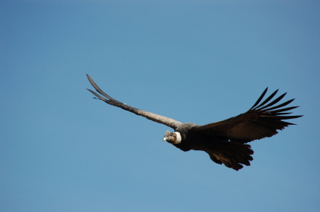
Goals for this session
Profiling your application
Picking the appropriate resources
Understand the basics of HTCondor

Slide 6
Let’s take one step at a time
Small
Large
Local
Distributed
Can you run one job on one computer?
Can you run one job on another computer?
Can you run 10 jobs on a set of computers?
Can you run a multiple job workflow?
How do we put this all together?
This is the path we’ll take in the school

Slide 7
What does the user provide?
A “headless job”
Not interactive/no GUI: how could you interact with 1000 simultaneous jobs?
A set of input files
A set of output files
A set of parameters (command-line arguments)
Requirements:
Ex: My job requires at least 2GB of RAM
Ex: My job requires Linux
Control/Policy:
Ex: Send me email when the job is done
Ex: Job 2 is more important than Job 1
Ex: Kill my job if it runs for more than 6 hours

Slide 8
What does the system provide?
Methods to:
Submit/Cancel job
Check on state of job
Check on state of available computers
Processes to:
Reliably track set of submitted jobs
Reliably track set of available computers
Decide which job runs on which computer
Manage a single computer
Start up a single job

Slide 9
Gedankenexperiment
Let’s assume you have a ‘large job’
What factors could make it large?
Large Data Input or Output or both
Needs to do heavy calculation
Needs a lot of memory
Needs to communicate with other jobs (whether required or not)
Reads and writes a lot of data/files
Heavy graphics processing
Any combination of any of the above

Slide 10
There is no “One Size Fits All Solution”
But some solutions are more ”Open” than others.
Local Laptop/Desktop
Local Cluster
HPC System
Shared HTC Resources
Clouds

Slide 11
Why is CI hard?
The system has to keep track of:
Individual tasks (a.k.a. jobs) & their inputs
Computers that are available
The system has to recover from failures
There will be failures! Distributed computers means more chances for failures.
You have to share computers
Sharing can be within an organization, or between orgs
So you have to worry about security
And you have to worry about policies on how you share
If you use a lot of computers, you have to handle variety:
Different kinds of computers (arch, OS, speed, etc..)
Different kinds of storage (access methodology, size, speed, etc…)
Different networks interacting (network problems are hard to debug!)

Slide 12
HTCondor does this (and more)
Methods to:
Submit/Cancel job. condor_submit/condor_rm
Check on state of job. condor_q
Check on state of avail. computers. condor_status
Processes to:
Reliably track set of submitted jobs. schedd
Reliably track set of avail. computers. collector
Decide which job runs on where. negotiator
Manage a single computer startd
Start up a single job starter

Slide 13
But not only Condor
You can use other systems:
PBS/Torque
Oracle Grid Engine (né Sun Grid Engine)
LSF
SLURM
…
But I won’t cover them.
My experience is with Condor
My bias is with Condor
Overlays exist
What should you learn at the school?
How do you think about Computing Resources?
How can you do your science with HTC?
… For now, learn it with Condor, but you can apply it to other systems.

Slide 14
A brief introduction to Condor
Please note, we will only scratch the surface of Condor:
We won’t cover MPI, Master-Worker, advanced policies, site administration, security mechanisms, submission to other batch systems, virtual machines, cron, high-availability, computing on demand, containers.
Notes:
----- Meeting Notes (6/24/14 13:44) -----
Introduction to HTC not all scientific research computing. You will not be experts but will know the concepts and considerations.

Slide 15
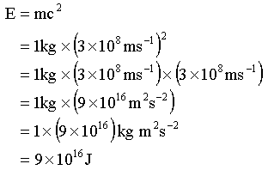
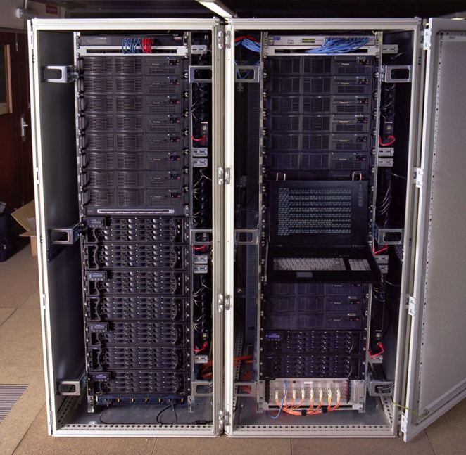
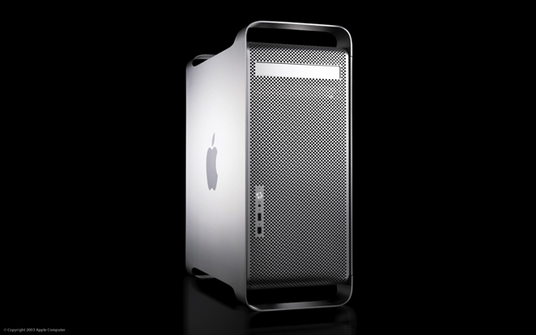
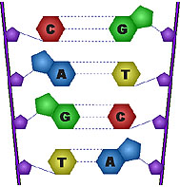
Condor Takes Computers…
…And jobs
…And matches them
I need a Mac!
Dedicated Clusters
Desktop Computers
Matchmaker
I need a Linux box
with 2GB RAM!

Slide 16
Quick Terminology
Cluster: A dedicated set of computers not for interactive use
Pool: A collection of computers used by Condor
May be dedicated
May be interactive
Remember:
Condor can manage a cluster in a machine room
Condor can use desktop computers
Condor can access remote computers
HTC uses all available resources

Slide 17
Matchmaking
Matchmaking is fundamental to Condor
Matchmaking is two-way
Job describes what it requires:
I need Linux && 8 GB of RAM
Machine describes what it requires:
I will only run jobs from the Physics department
Matchmaking allows preferences
I need Linux, and I prefer machines with more memory but will run on any machine you provide me

Slide 18
Why Two-way Matching?
Condor conceptually divides people into three groups:
Job submitters
Computer owners
Pool (cluster) administrator
All three of these groups have preferences
}
May or may not
be the same
people

Slide 19

ClassAds
ClassAds state facts
My job’s executable is analysis.exe
My machine’s load average is 5.6
ClassAds state preferences
I require a computer with Linux
ClassAds are extensible
They say whatever you
want them to say

Slide 20
Example ClassAd
MyType = "Job"
TargetType = "Machine"
ClusterId = 1377
Owner = "roy“
Cmd = “analysis.exe“
Requirements =
(Arch == "INTEL")
&& (OpSys == "LINUX")
&& (Disk >= DiskUsage)
&& ((Memory * 1024)>=ImageSize)
…
String
Number
Expression

Slide 21
Schema-free ClassAds
Condor imposes some schema
Owner is a string, ClusterID is a number…
But users can extend it however they like, for jobs or machines
AnalysisJobType = “simulation”
HasJava_1_6 = TRUE
ShoeLength = 10
Matchmaking can use these attributes
Requirements = OpSys == "LINUX"
&& HasJava_1_6 == TRUE

Slide 22
Don’t worry
You won’t write ClassAds (usually)
You’ll create a simple submit file
Condor will write the ClassAd
You can extend the ClassAd if you want to
You won’t write requirements (usually)
Condor writes them for you
You can extend them
In some environments you provide attributes instead of requirements expressions

Slide 23

Matchmaking diagram
Matchmaker
Matchmaking
Service
Information
service
Negotiator
Collector
2
1
condor_schedd
3
Job queue service
Queue

Slide 24
Why do jobs fail?
The computer running the job fails
Or the network, or the disk, or the OS, or…
Your job might be preempted:
Condor decides your job is less important than another, so your job is stopped and another started.
Not a “failure” per se, but it may feel like it to you.

Slide 25
Reliability
When a job fails or is preempted:
It stays in the queue (on the schedd)
A note is written to the job log file
It reverts to “idle” state
It is eligible to be matched again
Relax! Condor will run your job again

Slide 26
Access to data in Condor
Option #1: Shared filesystem
Simple to use, but make sure your filesystem can handle the load
Option #2: Condor’s file transfer
Can automatically send back changed files
Atomic transfer of multiple files
Can be encrypted over the wire
Most common for small applications and data
Option #3: Remote I/O

Slide 27
Condor File Transfer
ShouldTransferFiles = YES
Always transfer files to execution site
ShouldTransferFiles = NO
Rely on a shared filesystem
ShouldTransferFiles = IF_NEEDED
Will automatically transfer the files if needed
Universe = vanilla
Executable = my_job
Log = my_job.log
ShouldTransferFiles = YES
Transfer_input_files = dataset$(Process), common.data
Queue 600

Slide 28
Condor File Transfer with URLs
Transfer_input_files can be a URL For example:
transfer_input_files = http://www.example.com/input.data

Slide 29
Clusters & Processes
One submit file can describe lots of jobs
All the jobs in a submit file are a cluster of jobs
Yeah, same term as a cluster of computers
Each cluster has a unique “cluster number”
Each job in a cluster is called a “process”
A Condor “job ID” is the cluster number, a period, and the process number (“20.1”)
A cluster is allowed to have one or more processes.
There is always a cluster for every job

Slide 30
The $(Process) macro
The initial directory for each job can be specified as run_$(Process), and instead of submitting a single job, we use “Queue 600” to submit 600 jobs at once
The $(Process) macro will be expanded to the process number for each job in the cluster (0 - 599), so we’ll have “run_0”, “run_1”, … “run_599” directories
All the input/output files will be in different directories!

Slide 31
Example of $(Process)
# Example condor_submit input file that defines
# a cluster of 600 jobs with different directories
Universe = vanilla
Executable = my_job
Log = my_job.log
Arguments = -arg1 –arg2
Input = my_job.stdin
Output = my_job.stdout
Error = my_job.stderr
InitialDir = run_$(Process) run_0 … run_599
Queue 600 Creates job 3.0 … 3.599

Slide 32
More $(Process)
You can use $(Process) anywhere:
Universe = vanilla
Executable = my_job
Log = my_job.$(Process).log
Arguments = -randomseed $(Process)
Input = my_job.stdin
Output = my_job.stdout
Error = my_job.stderr
InitialDir = run_$(Process)
Queue 600

Slide 33
Sharing a directory
You don’t have to use separate directories.
$(Cluster) will help distinguish runs
Universe = vanilla
Executable = my_job
Arguments = -randomseed $(Process)
Input = my_job.input.$(Process)
Output = my_job.stdout.$(Cluster).$(Process)
Error = my_job.stderr.$(Cluster).$(Process)
Log = my_job.$(Cluster).$(Process).log
Queue 600

Slide 34
Not Only Programming Language
You ran a C program this morning
You can also run scripting languages such as bash, python, and perl
You can also executing programs via the command like R

Slide 35
Day One Wrap Up Notes
There are several different computing environments
There is a very diverse set of computing jobs
Matching jobs to resources is key to not wasting resources
Not all of the available environments are open environments
Research Computing is Complex

Slide 36
Quick UNIX Refresher Before We Start
$
nano, vi, emacs, cat >, etc.
source, module, chmod, ls

Slide 37

That was a whirlwind tour!
Enough with the presentation: let’s use HTCondor!
Goal: Extend the diversity of our jobs and add some data to the mix.

Slide 38
Questions?
Questions? Comments?
Feel free to ask me questions now or later:
Rob Quick rquick@iu.edu
Exercises start here:
https://opensciencegrid.github.io/dosar/Materials/TriesteMaterials/
Presentations are also available from this URL.

