Slide 1
The CODATA-RDA School of Research Data Science (SoRDS) – July 14 to July 25, 2025

Slide 2

Local Support
Naeem Muhammad
Willeke de Haan
Jan Van Dierdonck

Slide 3
MUHAMMAD, Naeem (KU Leuven) BEZUIDENHOUT, Louise (University of Oxford) COBE, Raphael (UNESP) SHANAHAN, Hugh (Royal Holloway)
Your Data Trieste
Lecturers

Slide 4
CODATA Initiative
ALFARO-CORDOBA, Marcela
BEZUIDENHOUT, Louise
COBE, Raphael
EL-JADID, Sara
GANDHI, Shaily
PETERSON, Bianca
QUICK, Rob
SHANAHAN, Hugh
SHANMUGASUNDARAM, Venkat
VAN DER EYNDEN, Veerle
OKORAFOR, Ekpe
EXECUTIVE DIRECTOR
HODSON, Simon
ADMINISTRATIVE SUPPORT
ALLISON, Rosie

Slide 5


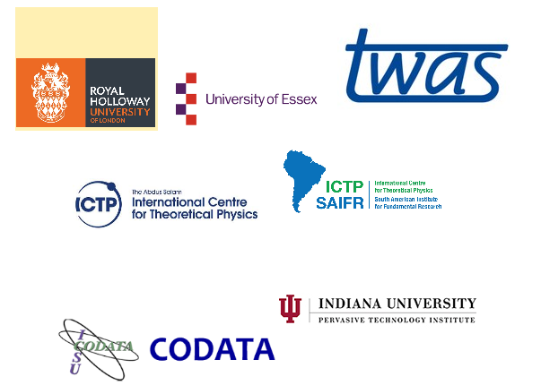
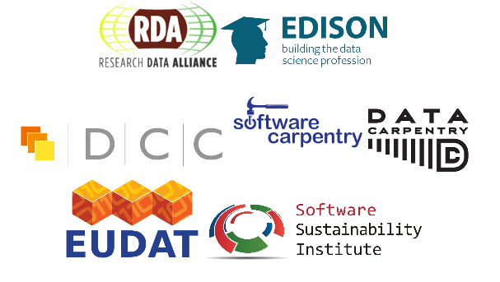



Slide 6

What’s Next?
Use What You’ve Learned
Communicate - Network
Thank Our Sponsors and Think About Their Contributions
Patronize the Organizations that Contributed
Collaborate
Seek Collaborative Funding
Look for Regional Opportunities
Join and contribute to SWC, RDA, SIGHPC-RCE, OSG, or EGI
Evangelize Open Science, Open Data, FAIR Concepts and Ethical Data Use

Slide 7
Pay It Forward
Think about future students and how you can make the Data Science environment better for them
Building a foundation
Ethical use of data
Practice and evangelize open data and science
Always provide open honest feedback
Think globally and introduce diversity to your projects whenever possible
Keep us informed!

Slide 8
“What should young people do with their lives today? Many things, obviously. But the most daring thing is to create stable communities…” – Kurt Vonnegut

Slide 9
