Slide 1

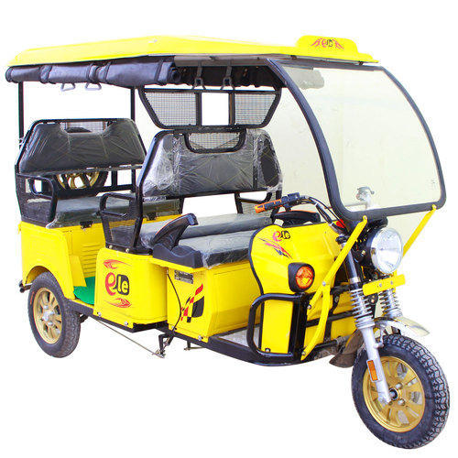
E-RICKSHAW
START-UP PLAN
Go Green ,RIDE Green
Submitted by:
Submitted To:
Team-CodeAvatar
Green-a-thon Judging Panel

Slide 2

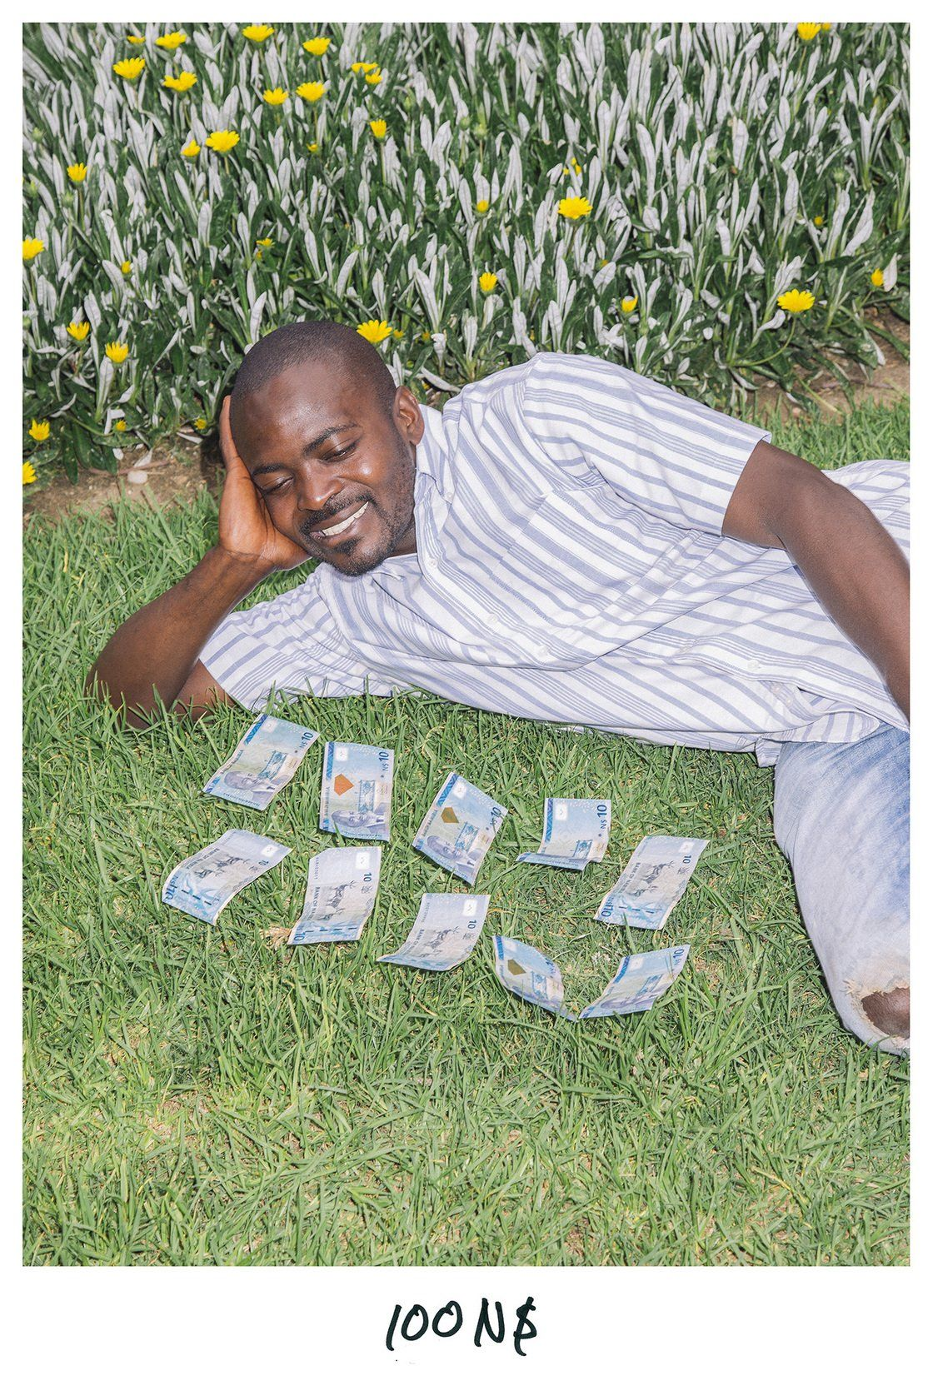
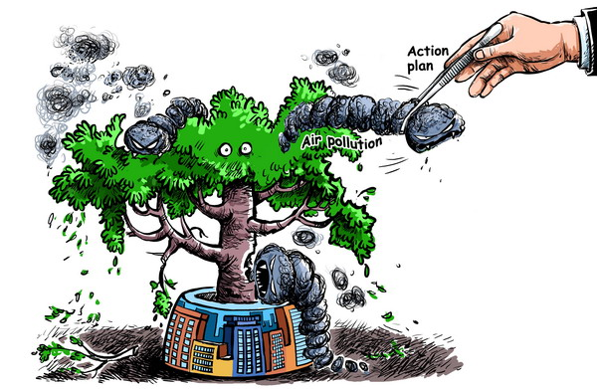
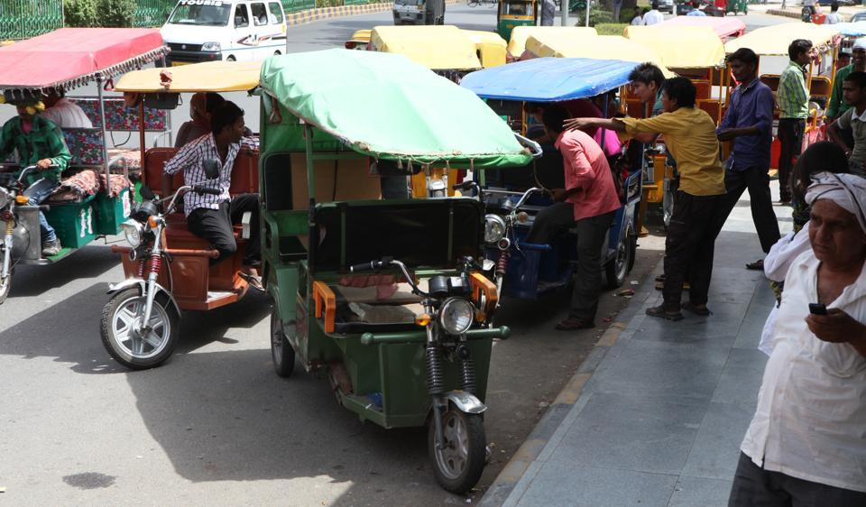
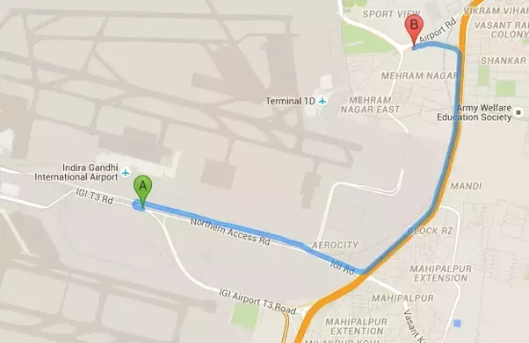
Problem And Opportunity We Are Addressing -
Unorganized Management Of E-rickshaws.
Chaotic Situations And Unnecessary Traffic Jams.
Day By Day Increase In Air Pollution.
Unavailability Of Vehicles To Travel Nearby At An Affordable Cost.
No Direct Connectivity To Metro Stations And Bus Stands At Low Cost.

Slide 3
What We Are Doing :-
We Are Making An E-rickshaw App .
To Manage The E-rickshaw In An Organized Way To Generate Employment.
Uplifting/Reducing The Load Of Public Transport.
Allowing All Classes(especially lower class) To Have Sustainable Ride To Travel Nearby.
Creating AWARENESS Regarding Usage Of Electric Vehicle.
Reducing The Air Pollution.

Slide 4

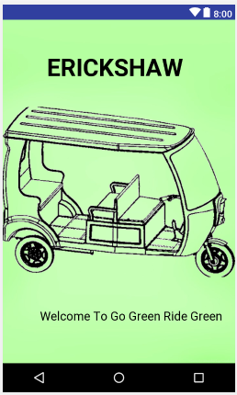
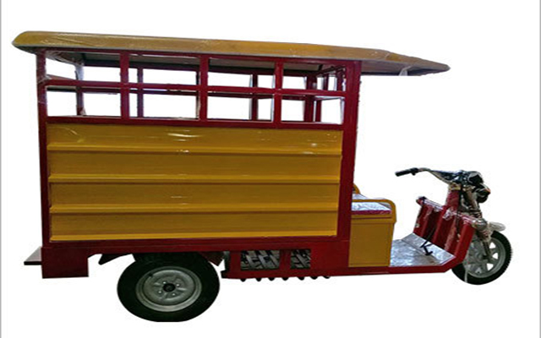
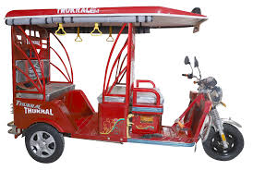
OUR IDEA
For Goods Transportation
For Riding
With And Without Pooling Facility

Slide 5
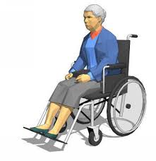


OUR USP(Unique Selling Proposition)
Combining The Technology With Automation.
Providing Reasonable Rides .
Good Network In Jaipur Market.
Creating An User Friendly App Under The Guidance Of Expert Developers (GOOGLERS).
On Ride Chatting Assistance.
Direct Beneficiaries Of Our Service :

Slide 6

Our Competition In Future
OLA CHARGE
Rupees 25 for first 2 km and further Rupees 8 per km ( In Delhi)
Rupees 20 for first km and further Rupees 8 per km (In Lucknow)
Our Edge Over Ola
We Charge Rupees 20 for First 3 km and further rupees 5 per km .
We have Goods Transportation service also Where As OLA Doesn’t.
We have pooling service also .

Slide 7
LEGAL PROVISIONS
“The Central government orders that the provisions of Sub-Section I of Section 66 of the Act [Motor Vehicles Act, 1988] shall not apply to any transport vehicle of the category e-cart and e-rickshaw...for the purpose of carriage of goods and passengers with their personal luggage,” according to a notification issued
Removing legal hurdles in the way of running of electric rickshaws as last-mile connectivity, the Union Transport Ministry has exempted such vehicles from requiring permits for plying on roads.

Slide 8

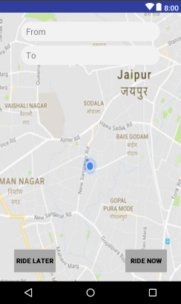
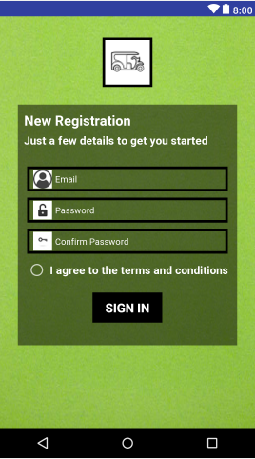
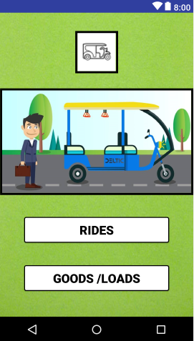
Current Progress
Our APP
We Have Talked 123 E-Rickshaws Drivers Till Now.
Out Of 123 Drivers 92 Are Ready To Work With Us.
We Are Also Trying To Get JMRC Onboard With Us.
78%
55%
STILL SEARCHING
SOON

Slide 9
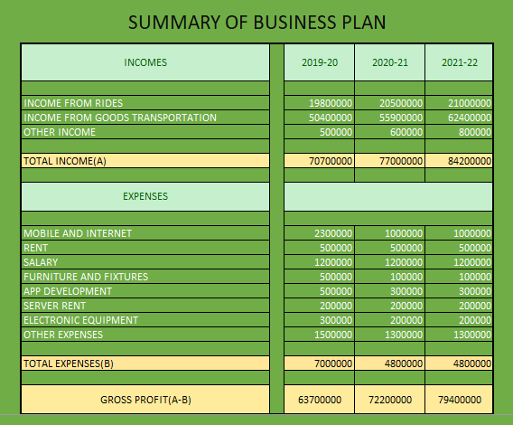

Slide 10
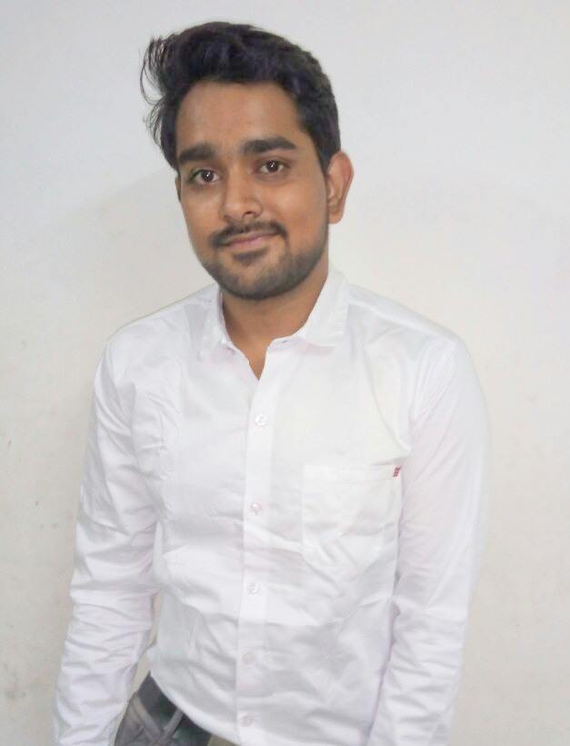
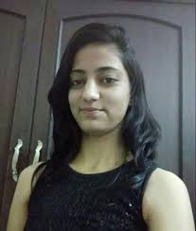
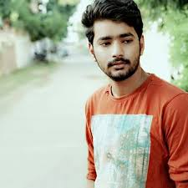




TEAM -CODEAVATAR
BHARTI BHATIA
AASHISH SHARMA
AYUSHI KHANDAL
HARSH RATHORE
( IDEA FOUNDER )
( CO-FOUNDER )
( CO-FOUNDER )
( CO-FOUNDER )
Role-
Front End
Developer
Layout & APP
Designer
Role-
Back End
Developer
Role-
Front End
Developer
Website & Logo Designer
Role-
Back End
Developer
Market Analyst
DBA
(Database Administrator)
Java And Android
Developer
Java And Android
Developer
Java And Android
Developer
Java And Android
Developer

Slide 11



OUR SUPPORT
Technical Support And Association With Codeavatar Pvt. Ltd.
Field Support From SM Express Logistics And Zubrex Lubricants LLP.
THANKING YOU
(Ready To Address Your Queries)

