Slide 1
Using D alongside a typical game engine
With Manu of Brisbane

Slide 2
D is awesome… but can it be used in a commercial game?
Let me tell you a story...

Slide 3

“How did we come to this?”, I hear you ask...
We need a scripting language!
C++ is way too slow!
Gosh, he’s right!

Slide 4

“How did we come to this?”, I hear you ask...
We should use C!
Lua?
Mono?
LLVM?
Game Monkey?

Slide 5

Considerations
 | Light weight | Modern | Performance
Lua | ★★★★★ | ★★★ | D
C# | D | ★★★★★ | ★★★
C++ | ★★★★ | D | ★★★★★
D | ★★★☆ | ★★★★★ | ★★★★★
 | Light weight | Modern | Performance
Lua | ★★★★★ | ★★★ | D
C# | D | ★★★★★ | ★★★
C++ | ★★★★ | D | ★★★★★
We should use D!
Hmm…

Slide 6
So we took it to the team…
We should use D!
Someone buy this man a drink!
What is this D thing?
Is it ready?
Gosh, he’s right!
Interesting…

Slide 7
Is it ready?
This is a fair concern…
D has little experience in the commercial space.
Hedge our bets:
Initial plan was to use C-in-a-DLL
Build a framework that works with either language
If D doesn’t work out, fall back to C/C++

Slide 8
And thus it begins…

Slide 9





Requirements
Windows/Visual Studio workflow
Visual-D!
Target x64/Win64
Symbolic Debugging
No DMD! (only supports Win32)
+
+

Slide 10

Options?
LDC?
No Win64 exceptions or debug info
GDC?
Working Win64 build!
2 enthusiastic developers
Good for prototype…
We really need DMD
I’ve always wanted to support Win64!

Slide 11
So we have a compiler
What do we do with it?

Slide 12
Goals
Rapid iteration
Dynamic linkage
Interact with the engine
Offer new functionality to the engine
Retain objects state across update cycle

Slide 13

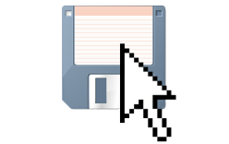


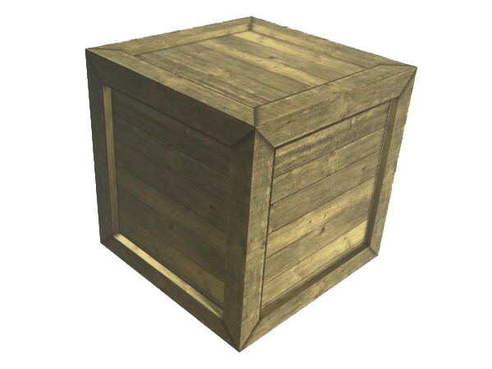

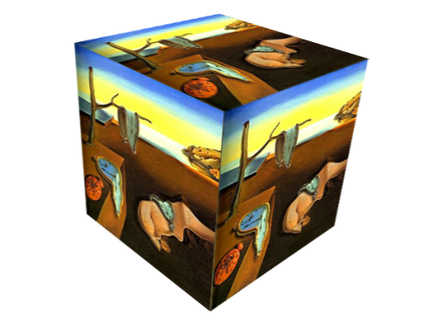

1. Rapid iteration
Filesystem monitor service
!

Slide 14



1. Rapid iteration
Filesystem monitor service
!
.D
.D

Slide 15



1. Rapid iteration
Lots of code... How do we build?
core
vector.d
matrix.d
engine
heap.d
entity.d
renderer.d
plugins
enemy.d
hud.d
.D
.D
.D
.D
.D
→ enemy.dll
→ hud.dll
.D
.D
.D
.D

Slide 16


1. Rapid iteration
Compiling performed in 2 passes
Deps list
heap.d
vector.d
entity.d
.D
~2 seconds!
Debug
.D
.D
Release
.D

Slide 17
2. Dynamic Linkage
We now have ‘plugin’ DLL’s, we need to load them…
We wrote a fairly simple PluginManager, which:
Scans for any plugins and loads them on startup
When it receives an update signal:
Save the state of all object instances created by the plugin
Unload the DLL
Reload the rebuilt DLL
Recreate object instances from the saved state
The implementation is not particularly interesting.
…and we’ll talk about the state management later.

Slide 18
3. Interact with the engine
So we have a system that will manage our plugins.
To be useful, they need access to the engine…
Which it turns out is not so simple!
D needs access to C++:
Structs
Static functions
Classes
We’ll look at each of these...

Slide 19
3. Interact with the engine
Structs
Mirror definition in D
No way to assert that C++ and D definitions remain in synch…
I’m open to suggestion!

Slide 20
3. Interact with the engine
Functions
D supports C/C++ ABI
C++ registry of functions to share with D
D stubs which link on module load
Not so hard right?

Slide 21

3. Interact with the engine
In practise - Uh oh, code!
C++
experiment.cpp
void engineFunc(int x, float y)
{
// awesome functionality!
}
EXPORT_FUNCTION(engineFunc) // you don’t wanna know!
D
experiment.d
__gshared extern (C) void function(int x, float y) engineFunc;
mixin RegisterModule;
shared static this()
{
registerImports(
(EngineImport imports[]) {
engineFunc = findFunction(imports, "engineFunc");
}
);
}

Slide 22
3. Interact with the engine
Surely we can do better than that…
__gshared extern (C) void function(int x, float y) engineFunc;
mixin RegisterModule;
void engineFunc(int x, float y);
mixin RegisterModule;
shared static this()
{
registerImports(
(EngineImport imports[]) {
engineFuncPtr = findFunction(imports, "engineFunc");
}
);
}
private __gshared extern (C) void function(int, float) engineFuncPtr;
void engineFunc(int x, float y);
{
engineFuncPtr(x, y);
}
shared static this()
{
registerImports(
(EngineImport imports[]) {
engineFunc = findFunction(imports, "engineFunc");
}
);
}
Now we can prototype and declare in the same module…
Enhance the mixin to generate a stub

Slide 23
3. Interact with the engine
Supporting overloads - on the C++ side
void engineFunc(int x, int y)
{
// awesome functionality!
}
EXPORT_FUNCTION(engineFunc)
void engineFunc(int x, int y)
{
// awesome functionality!
}
void engineFunc(int x, float y)
{
// even more awesome functionality!
}
EXPORT_FUNCTION(engineFunc, void, int, int) // you RELLY don’t wanna see this now!
EXPORT_FUNCTION(engineFunc, void, int, float)
void engineFunc(int x, int y)
{
// awesome functionality!
}
void engineFunc(int x, float y)
{
// even more awesome functionality!
}
EXPORT_FUNCTION(engineFunc) // problem!
EXPORT_FUNCTION(engineFunc)
#RET_TYPE "(" #__VA_ARGS__ ")" == "void(int, float)"
Supply the argument information to disambiguate
Use stringification to generate a function signature string

Slide 24
3. Interact with the engine
Supporting overloads - on the D side
void engineFunc(int x, int y);
void engineFunc(int x, float y);
mixin RegisterModule;
shared static this() {
registerImports(
(EngineImport imports[]) {
engineFuncPtr = findFunction(imports, "engineFunc");
engineFuncPtr = findFunction(imports, "engineFunc");
}
);
}
private __gshared extern (C) void function(int, int) engineFuncPtr;
void engineFunc(int x, int y) {
engineFuncPtr(x, y);
}
private __gshared extern (C) void function(int, float) engineFuncPtr;
void engineFunc(int x, float y) {
engineFuncPtr(x, y);
}
shared static this() {
registerImports(
(EngineImport imports[]) {
engineFuncPtr = findFunction(imports, "engineFunc", "void(int,int)");
engineFuncPtr = findFunction(imports, "engineFunc", "void(int,float)");
}
);
}
private __gshared extern (C) void function(int, int) engineFuncPtr;
void engineFunc(int x, int y) {
engineFuncPtr(x, y);
}
private __gshared extern (C) void function(int, float) engineFuncPtr;
void engineFunc(int x, float y) {
engineFuncPtr(x, y);
}
shared static this() {
registerImports(
(EngineImport imports[]) {
engineFunc_int_int = findFunction(imports, "engineFunc", "void(int,int)");
engineFunc_int_float = findFunction(imports, "engineFunc", "void(int,float)");
}
);
}
private __gshared extern (C) void function(int, int) engineFunc_int_int;
void engineFunc(int x, int y) {
engineFunc_int_int(x, y);
}
private __gshared extern (C) void function(int, float) engineFunc_int_float;
void engineFunc(int x, float y) {
engineFunc_int_float(x, y);
}
Generate a similar string from the D type info
Mangle the function pointer names

Slide 25
3. Interact with the engine
Attributes!
void engineFunc(int *things, size_t numThings);
mixin RegisterModule;
private void engineFunc(int *things, size_t numThings);
void engineFunc(int[] things)
{
engineFunc(things.ptr, things.length);
}
mixin RegisterModule;
private @Import void engineFunc(int *things, size_t numThings);
void engineFunc(int[] things)
{
engineFunc(things.ptr, things.length);
}
mixin RegisterModule;
Provide nice D API’s with trivial wrappers
RegisterModule recognises functions marked @Import
Awesome! Maybe we’re done here?

Slide 26
3. Interact with the engine
Classes
D does not interact with C++ classes very well.
Can’t extern to C++ methods
Virtuals are tricky

Slide 27
3. Interact with the engine
Static methods
class EngineClass
{
void method(int x);
}
EXPORT_METHOD(EngineClass, engineFunc, void, int, float)
struct EngineClass
{
@Import void method(int x);
mixin RegisterClass;
}
mixin RegisterModule;
private extern (C) __gshared void function(EngineClass* _this, int x) method_int;
void method(int x)
{
method_int(&this, x); // explicitly call with ‘this’
}
Export a C++ member function pointer
Declare just like other functions, but we have some new magic…
Abuse our knowledge of the ABI. Not portable!

Slide 28
3. Interact with the engine
And finally, virtuals…
class EngineClass
{
virtual void virtualMethod();
}
extern (C++) interface IEngineClass
{
void virtualMethod();
}
struct EngineClass
{
@property IEngineClass _vtable() { return cast(IEngineClass)&this; }
alias _vtable this;
}
We don’t need to do anything in C++!
Use an ‘extern(C++) interface’ to mirror the vtable
Use ‘alias this’ to incorporate it into a struct

Slide 29
4. Making use of plugins
The game needs to make use of this somehow!
Same features in reverse
But no existing code, we can make restrictions
Static functions
Opaque classes
Use interfaces
Let’s look at these in practise… (more code, sorry!)

Slide 30
4. Making use of plugins
Static functions
@Export extern (C++) void dFunc(int x)
{
// do something amazing!
}
mixin RegisterModule; // RegisterModule handles @(Export) too!
void somewhere()
{
DFunc<int> dFunc = PluginManager::findFunction("dFunc");
if(dFunc)
dFunc(42);
}
Find functions by name
DFunc implements a smart pointer to handle module reload
C++ can’t assert the signature matches
Perhaps a template solution is possible?

Slide 31
4. Making use of plugins
Classes - on the D side
@Export extern (C++) interface IFeature
{
void doSomething();
}
mixin RegisterModule;
@Export extern (C++) interface IFeature
{
void doSomething();
}
@Export class Feature : IFeature
{
extern (C++) void doSomething()
{
// do something…
}
}
mixin RegisterModule;
shared static this()
{
exportInterface("IFeature", (Object o) => cast(IFeature)o);
}
shared static this()
{
exportInterface("IFeature", (Object o) => cast(IFeature)o);
exportClass(
/+ name: +/ "Feature",
/+ create: +/ () => new Feature,
/+ destroy: +/ (Object o) => delete cast(Feature)o
);
}
Interface registers cast function
Class registers create/destroy functions

Slide 32
4. Making use of plugins
Classes - on the C++ side
class IFeature
{
virtual void doSomething() = 0;
}
void somewhere()
{
DClass *pClass = PluginManager::newClass("Feature");
IFeature *pFeature = pClass->queryInterface("IFeature");
if(pFeature)
pFeature->doSomething();
pClass->deleteClass();
}
Declare a mirror of the exported interface
Create new class instance by name
Query the opaque DClass object for interfaces
If the class implements that interface, we can use it

Slide 33

4. Making use of plugins
We have everything we need!
We can create new entities that exist in the game world…
But what happens when a live class definition is changed?
Hint: It crashes spectacularly!
Which leads to our final goal…
Yay!

Slide 34
5. Retain object state
Runtime code iteration is the principle goal…
What if we modify a data structure?
Existing objects are incompatible with rebuilt code.
We can use serialisation to migrate the data...
class Dude
{
vector position;
float health;
}
class Dude
{
vector position;
vector velocity; // add a new variable…
float health;
}

Slide 35
5. Retain object state
Approach:
PluginManager keeps registry of all instances
RegisterModule mixin produces serialisation functions for structs/classes
Reload process:
All instances are serialised to text
Destroy all instances
Unload/reload plugin
Recreate instances from text
New members take on default values
If variable changes meaning, we may still crash!
But this is rare

Slide 36
Afterthoughts & improvements
We have a system that’s working well.
But there are a few rough edges…
Every module requires mixin RegisterModule
Classes require additional mixin RegisterClass
Be nice if attributes had a method of introducing code…
Can’t assert that structures or virtuals remain in synch
D -> C++ function sharing can’t assert the signature
These are really deficiencies in C++
Can C++ templates help us?

Slide 37
We have a system
So, what cool things does it offer?

Slide 38
Stuff programmers love…
We have D as an extension language!
But what makes it cool, and worth all that effort?
1. Coders love ranges, and foreach
Seriously, slices are awesome!
foreach should not be under-estimated
2. Event based programming
Game devs often have C# experience
Proper delegates facilitate nice event frameworks
C++ FastDelegate is compatible with D! (I’ll bet this isn’t a coincidence…)

Slide 39
Stuff programmers love…
3. Vector maths
Standardised SIMD!
opDispatch can be used for shader-style swizzling
Game devs often have HLSL/GLSL experience
Perhaps experiment with DSLs in future?
Theoretically, pure should offer some nice wins…
vector cross(vector v1, vector v2)
{
return v1.yzx*v2.zxy - v1.zxy*v2.yzx;
}

Slide 40
Stuff programmers love…
4. Attributes are awesome!
Really help to simplify code
Great to see what class members can do at a glance
Some attributes we use:
@SaveGame
Control variables that are written to save data
@Profile
Variables will be tracked and charted on realtime graphs
@Tweakable
Variables will be added to a runtime ‘tweakable’ menu
@Editor(“Enemy colour”, Colour.Red, Type.ColourPicker)
Variable is exposed to the editor, where property grids are automatically populated

Slide 41
Final thoughts
Video games industry still stuck with C++!
Native code is a requirement.
High-risk industry, allergic to change.
Aggressive schedules; C++ wastes time & sanity.
Industry desperate for salvation.
Using this approach, if D proves successful, we can ween ourselves towards D in the future…
…and may we all live happily ever after.

Slide 42
That’s it
Questions?

