Slide 1

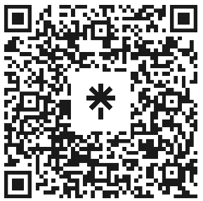

Welcome to Code Crunch!
Attendance
linktr.ee/CODE.CRUNCH

Slide 2
Welcome to Code Crunch!
•Code Crunch is your go-to platform for collaboration, networking, and hands-on projects. We welcome freshmen, graduates, and alumni from any university, regardless of major or experience level.
•Join us virtually via Zoom or in person at Florida International University. Together, we’ll break down barriers in technology, learn through immersive workshops, and build innovative solutions.

Slide 3
Our Mission & Vision
Mission:
Our mission is to equip students with the technical skills and professional connections needed to excel in coding interviews and beyond. We provide a platform where students can collaborate, learn, and grow professionally while emphasizing the importance of diversity and inclusion in the tech industry
Vision:
We strive to bridge the gap between academia and the tech industry by offering hands-on workshops, technical interview preparation, hackathons, and networking opportunities with experts from leading companies. Our vision is to empower students from all backgrounds to achieve their full potential, foster an inclusive tech community, and build a strong, supportive alumni network. By covering a wide range of technical areas, we aim to prepare students for success in a variety of tech careers.

Slide 4
What We Offer
• Hands-On Workshops: Topics include Python, JavaScript, React, and more.
• LeetCode Prep: Weekly sessions to master technical interviews.
• Hackathons: Collaborate on innovative projects in a competitive setting.
• Panel Discussions: Industry leaders from tech giants and startups share insights.
• Global Access: Code Crunch Global launches in October for worldwide participation!

Slide 5
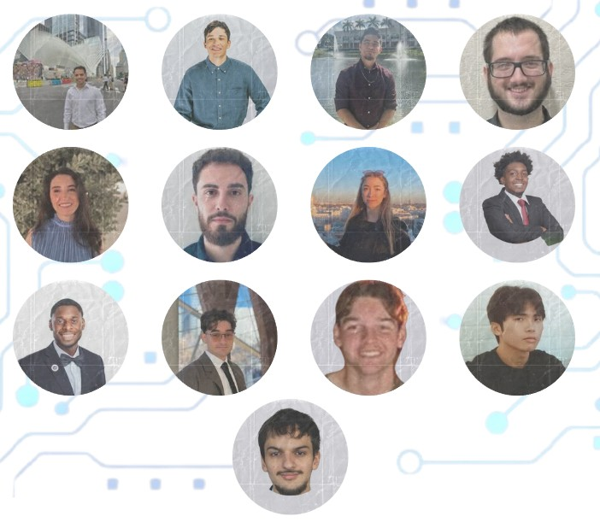
Meet the E-Board
President: Brian Bazurto
Vice President: Amilcar Pena
Treasurer: Bryan Garcia
Marketing/Logistics: Henry Cruz
Logistics: Jason Liang
Tech Leads:
Alvise Carpin
Arnold Miranda
Daniel Hernandez
Gabriel Nogueras
Justin Joseph
Mariana Phelan
Sara Salvatierra
Thierry Laguerre
Notes:
Our leadership team is dedicated to creating a supportive and inclusive space for all members. Join our team and make an impact! Apply for open roles today!

Slide 6
Why Join Code Crunch?
• Collaborate with peers and mentors.
• Develop technical and leadership skills.
• Network with professionals from top companies.
• Build impactful projects and gain hands-on experience.
A welcoming and inclusive space for underrepresented groups in tech.

Slide 7
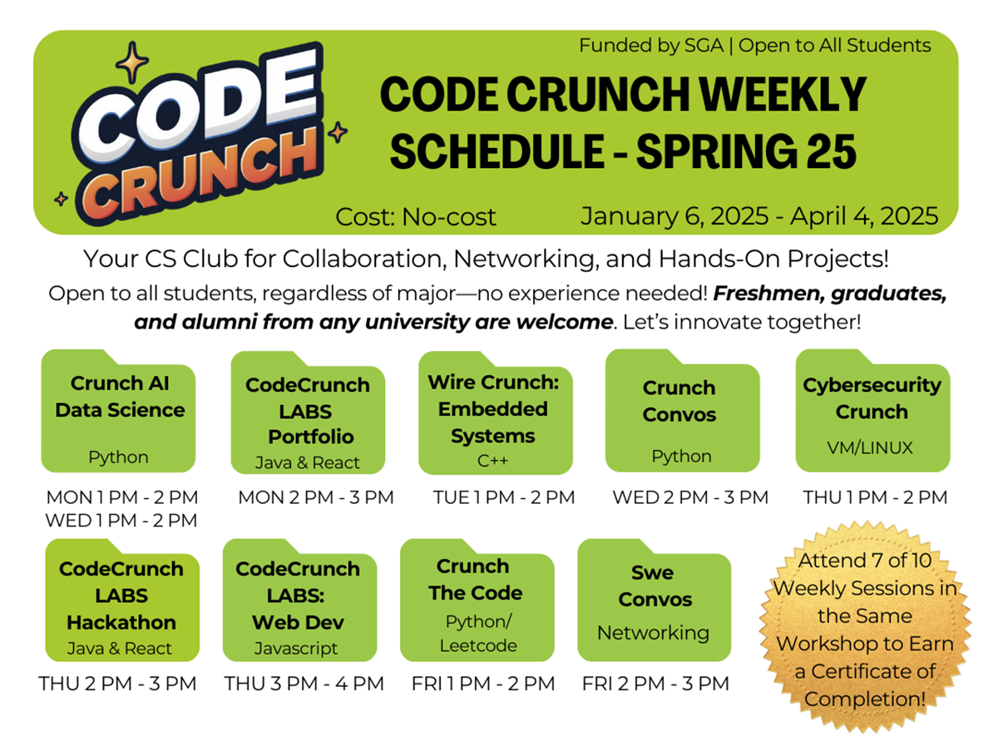
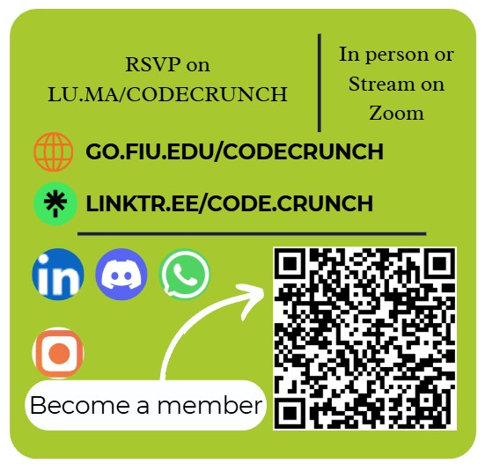
Spring 2025 Weekly Schedule

Slide 8
Be Part of the Code Crunch Community
1. RSVP for sessions at go.fiu.edu/codecrunch.
2. Follow us on LinkedIn, Instagram, and Discord for updates.
3. Become a member using the QR code on this slide.
4. Attend workshops, participate in events, and join our leadership team.
Together, we innovate and grow.

Slide 9
AI & Data Science
What to expect
Python
Different libraries
pandas, matplotlib, etc…
Data Processing
Data Modeling

Slide 10
AI & Data Science
Topics:
Data Collection
Data Handling
Exploratory Data Analysis
Modeling
Classification models
Regression models
Clustering Techniques
Association Techniques
Outlier Detection Techniques
Deep Learning

Slide 11
Environment
Python Version:
Python 3.10.11
Libraries:
numpy: 1.26.4
scikit learn: 1.6.0
matplotlib: 3.8.0
pandas: 2.2.2
seaborn: 0.13.2
torch: 2.3.1 + cu121
keras: 3.5.0

Slide 12
Project
Task:
create an AI model using the following datasets:
Spotify Songs Dataset (Provided)
A Dataset of your choosing (You Choose)
Goal:
construct a model of your choosing (Classification, Regression, etc…), using the algorithm of your choosing (linear regression, KNN, CNN).
The best model will be evaluated based on the difficulty of the task given to the model, and the performance of the model
i.e,
classification - number of classes
regression - data pattern (linear, polynomial, non-linear)

Slide 13
Let’s Innovate Together!
Thank you for joining us on this exciting journey! Code Crunch is redefining tech education and fostering inclusivity in technology. Let’s collaborate, innovate, and create a brighter future together.
RSVP for sessions today. Follow us on social media. Spread the word about Code Crunch!
#CodeCrunch #CodeCrunchFIU #DiversityInTech #InclusiveTech #LeadershipOpportunities #FIUTechCommunity #WomenInSTEM #LGBTQInTech #LatinxInTech #BlackInTech #AAPIsInTech #TechLeadership #JoinOurTeam #FIUInnovation #TechForEveryone #EmpowerTech #FutureLeaders #HackerCulture #CodeYourFuture #TechDiversity #FIUPanthers #STEMOpportunities #BuildYourFuture #LeadWithCode #PanthersInTech

Slide 14
Q&A Session

Slide 15





Attendance
Join us for the upcoming weekly sessions this Spring 2025!
Monday: 1PM & 2PM
Tuesdays: 1PM
Wednesdays: 2PM
Thursdays: 1PM , 2PM & 3PM
Friday: 2PM & 3PM
RSVP LU.MA/CODECRUNCH
Your feedback helps us improve. Share your thoughts! Go to our website: go.fiu.edu/codecrunch

