Slide 1



CodeWarriorZ
Home
Service
About Us
Contact
CodeWarriorZ

Slide 2
TEAM NAME: CodeWarriorZ
Members:
1. Deepak Mehta
2. Karan Mondal
3. Rishabh Dave
4. Prashant Sharma
College:
Thadomal Shahani Engineering College

Slide 3
Component Descriptions :(Each Component Has Been Used Only Once)
ESP32-S3 Dev Module – Dual-core, Wi-Fi, Bluetooth 5, USB-OTG, 44 GPIOs, ADC, DAC, I2C, SPI.
MQ-135 Gas Sensor – Detects gases, air quality, analog output, adjustable sensitivity, pollution monitoring.
Sound Sensor Module – Detects noise, analog/digital output, microphone-based, adjustable sensitivity, audio applications.
Voltage Booster – Steps up voltage, efficient, compact, DC-DC converter, battery-powered circuits.
Dust Sensor – Detects dust, air quality monitoring, optical sensing, analog output, pollution control.

Slide 4
6.Hall Effect Sensor – Detects magnetic fields, contactless, digital/analog output, motor speed, proximity sensing.
7.MAX471 Current & Voltage Sensor – Measures voltage/current, bidirectional, high precision, analog output, power monitoring.
8.OLED Display – Compact, high contrast, I2C/SPI interface, 128x64 pixels, low power consumption.
9.BME280 Environmental Sensor – Measures temperature, humidity, pressure, I2C/SPI, weather monitoring, low power.
10.Solar Panel – Converts sunlight, renewable energy, portable, efficient, powers small electronics, eco-friendly.

Slide 5
11.Rechargeable Module (TP4056) – Charges Li-ion batteries, 3.7V, overcharge protection, USB input, compact.
12.IR Flame Sensor – Detects fire, infrared-based, digital/analog output, fast response, safety applications.
13.Battery 3.7V 2500mAh (18650) – Rechargeable, lithium-ion, high capacity, 3.7V, portable, energy-efficient.
14.Water Flow Sensor – Measures water flow, pulse output, plastic body, used in pipelines.
15.DHT11 Temperature & Humidity Sensor – Measures temperature/humidity, digital output, low-cost, I2C, weather monitoring.

Slide 6
16.Soil Moisture Sensor – Detects soil moisture, analog/digital output, agriculture, irrigation systems, plant monitoring.
17.Relay Module – Switches high-power devices, electrically isolated, microcontroller compatible, automation, safety.
18.Rain Sensor – Detects rain, analog/digital output, weather monitoring, smart irrigation, waterproof.
19.RTC DS3231 Module – Real-time clock, highly accurate, I2C, battery-backed, temperature compensated, low power.

Slide 7
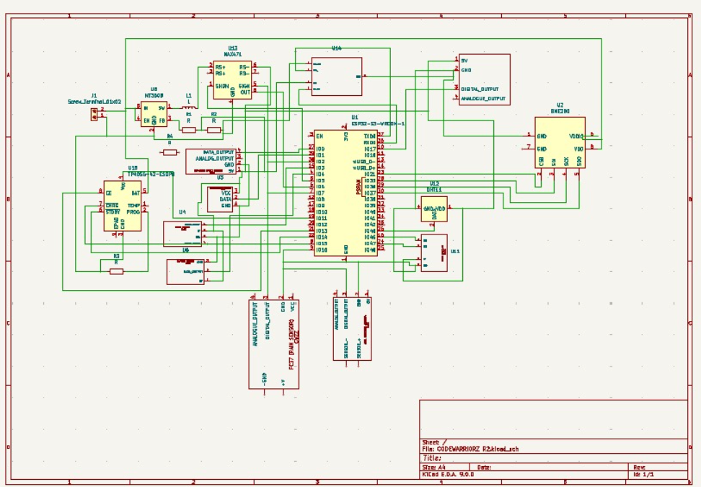
SCHEMATIC DIAGRRAM:

Slide 8
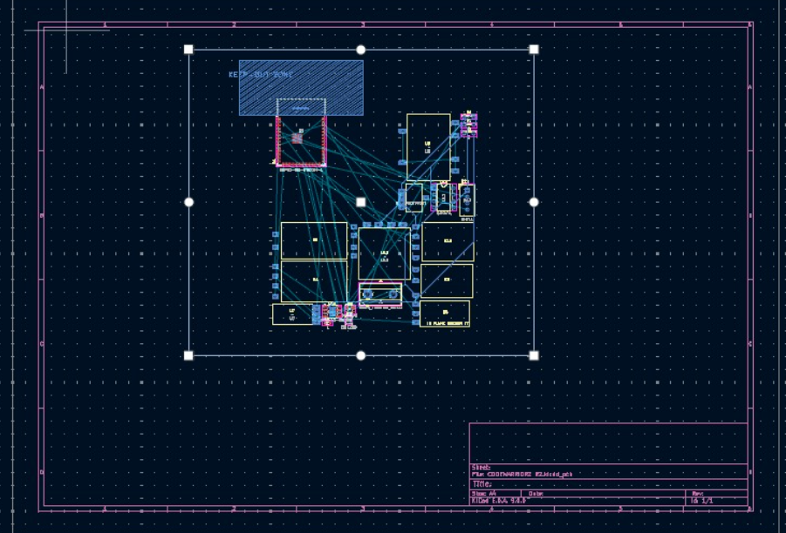
PCB DIAGRAM:

Slide 9
References:
Google.com
ChatGPT
Availability Of Components:
ESP32-S3 Dev Module - Espressif
MQ-135 Gas Sensor - Instructables
Sound Sensor Module - 29 Free Guides for Sensors and Modules
Voltage Booster - 29 Free Guides for Sensors and Modules
Dust Sensor - 29 Free Guides for Sensors and Modules
Hall Effect Sensor - 29 Free Guides for Sensors and Modules
MAX471 Current and Voltage Sensor - 29 Free Guides for Sensors and Modules
OLED Display - 29 Free Guides for Sensors and Modules
BME280 Environmental Sensor - 29 Free Guides for Sensors and Modules
Solar Panel - 29 Free Guides for Sensors and Modules
Rechargeable Module (TP4056) - 29 Free Guides for Sensors and Modules

Slide 10
-IR Flame Sensor - 29 Free Guides for Sensors and Modules
Battery 3.7V 2500mAh (18650) - 29 Free Guides for Sensors and Modules
Water Flow Sensor - 29 Free Guides for Sensors and Modules
DHT11 Temperature and Humidity Sensor - 29 Free Guides for Sensors and Modules
Soil Moisture Sensor - 29 Free Guides for Sensors and Modules
Relay Module - 29 Free Guides for Sensors and Modules
Rain Sensor - 29 Free Guides for Sensors and Modules
RTC DS3231 Module - 29 Free Guides for Sensors and Modules

Slide 11
CodeWarriorZ
THANK YOU

