Slide 1
TEXT COMPRESSOR

Slide 2
TABLE OF CONTENTS
01
04
Introduction
Final Output
02
05
Tech Stack & Algorithm
Resources
03
06
Our Code
Our Team

Slide 3
Objective
The objective of this project is to understand the working of Huffman Coding theoretically and then implement it to create real world projects. Here, our aim will be to discuss data compression algorithms and their real-life applications, create a File Zipper website using Huffman coding.

Slide 4
Data Compression
Data compression, also known as source coding in computer science and communication theory, is the art of encoding original data with a specific mechanism to fewer bits .

Slide 5
Compression Techniques
Instant Compression and non-instant compression
Data compression and file compression
Lossy and Lossless Compression
There are two types of data compression techniques: lossless and lossy.
● Lossless techniques allow for the exact reconstruction of the original document from compressed data, whereas lossy techniques do not.
● Lossless techniques include run-length, Huffman, and Lempel-Ziv, whereas JPEG and MPEG are lossy.

Slide 6
HUFFMAN CODING
Huffman coding is a popular lossless algorithm used in entropy encoding. This algorithm's process is to assign VLC (variable-length code) to characters (using different arrangements of 0 or 1 to represent characters).
The idea is to assign variable-length codes to input characters, with the lengths of the assigned codes determined by the frequency of the corresponding characters. The most frequently occurring character is assigned the smallest code, while the least frequently occurring character is assigned the largest code.

Slide 7
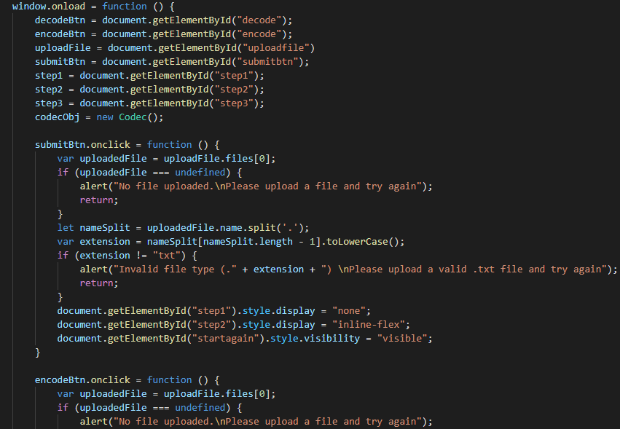
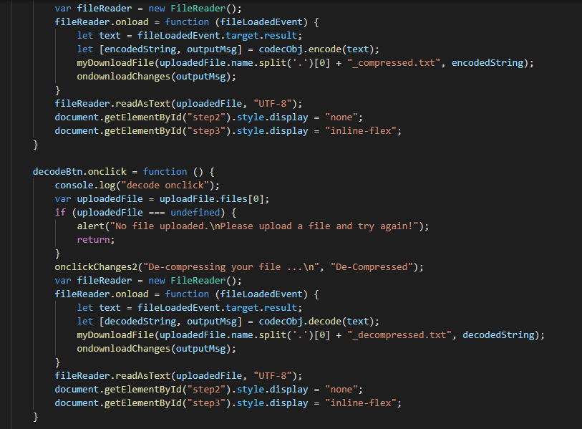
Reading Input Data Stream

Slide 8
Counting The Frequency
A Building Frequency Table
Symbol | Frequency
D | 1
A | 2
T | 3
S | 2
R | 2
U | 2
C | 1
E | 1
“ “ | 1
Data Structures

Slide 9
Sorting Input Characters
TASRUDCE” “(15)
1
0
RUDCE” “(8)
1
TAS(7)
DCE” “
(4)
0
1
0
1
0
AS(4)
RU(4)
DC(2)
E” “(2)
0
1
0
1
1
0
1
0
T(3)
A(2)
S(2)
R(2)
U(2)
D(1)
C(1)
E(1)
“ “(1)

Slide 10
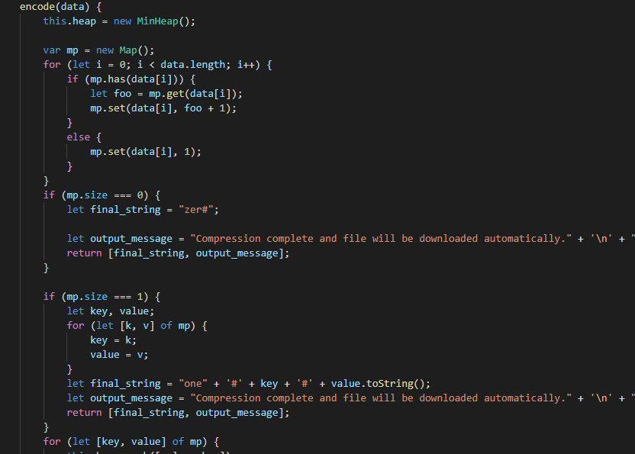
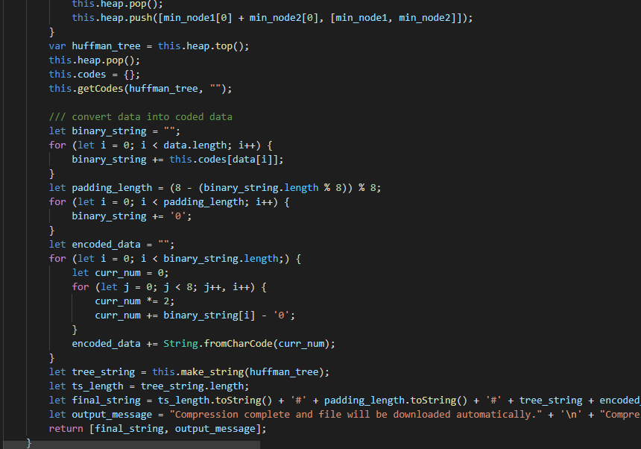
Encoding Input Characters

Slide 11
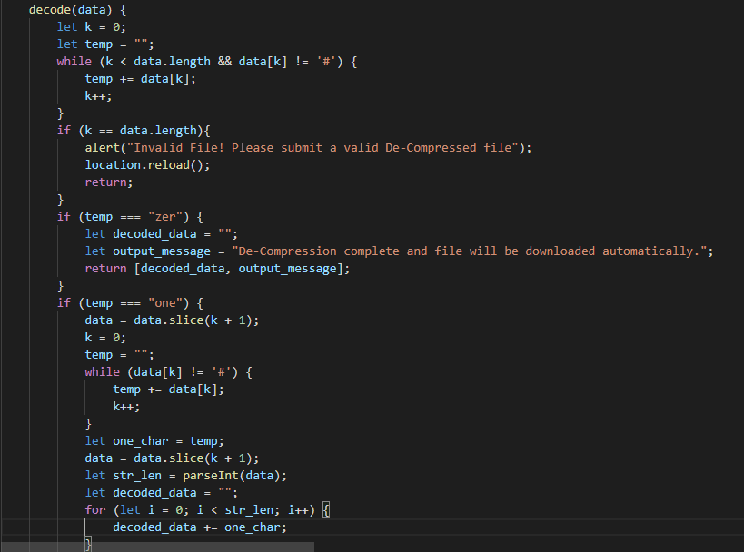
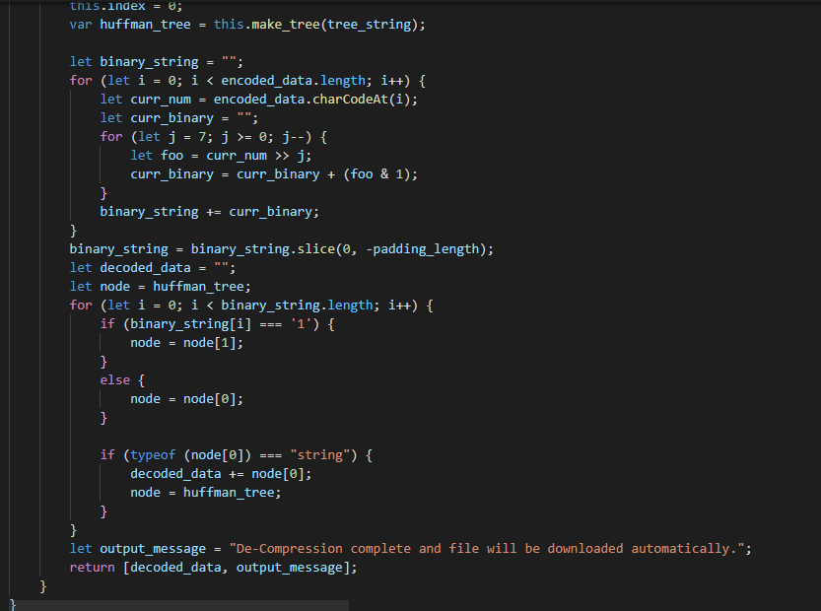
Decoding The Characters

Slide 12
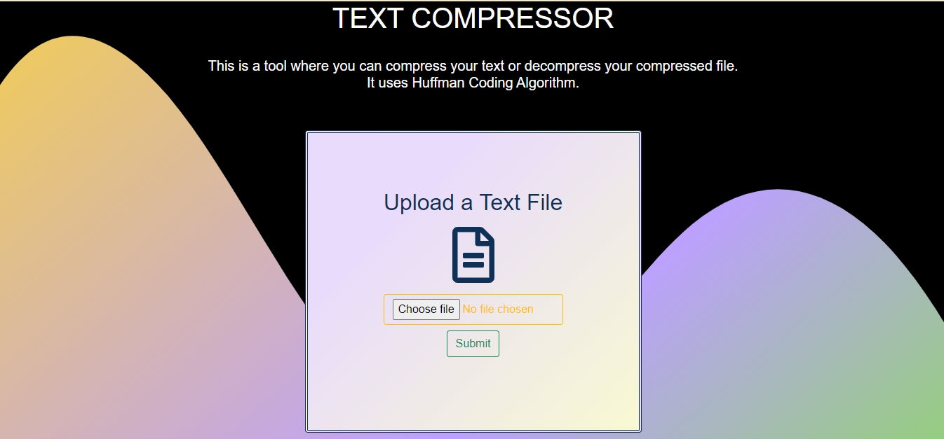
Final Implementaion

Slide 13
THANKS!
Harshal Chowdhary
2K19/EC/071
Priti Gangwar
2K19/EC/134

