Slide 1

SENTINEL CORE
Offline Facial Recognition
& Liveness Detection System
Zero connectivity. Zero compromise. Real-time identity verification for any environment.
NHAI Hackathon 2025 | Team: Sentinel Labs

Slide 2

The Problem
No Internet, No Entry?
Spoofing Vulnerabilities
Remote toll booths, border crossings & disaster zones lose authentication capability when connectivity drops.
Photo attacks, video replay, and deepfake injections fool traditional face-match systems.
Privacy & Data Exposure
Operational Downtime
Cloud-dependent systems transmit sensitive biometric data—risking breaches & regulatory violations.
Every minute offline = vehicles stranded, workers locked out, and revenue lost.
Existing solutions fail when it matters most.

Slide 3





Our Solution
Sentinel Core — a fully offline-capable biometric authentication platform combining on-device face recognition with active liveness detection, encrypted local data storage, and smart sync when connectivity returns.
On-Device
Face Recognition
Active Liveness
Detection
Encrypted Local
Data Queue
Smart Cloud
Sync
100% local inference
No cloud dependency
Anti-spoofing via depth
& gesture challenges
AES-256 offline storage
Auto-sync on reconnect
Intelligent batch upload
Conflict resolution
Works on Android & iOS · Raspberry Pi · Edge Devices · Toll Gate Hardware

Slide 4
System Architecture
PRESENTATION LAYER
Mobile App (React Native / Flutter)
Offline-first UI
Biometric Capture Module
CLOUD
SYNC
PROCESSING LAYER
Face Detection (MediaPipe)
Liveness Engine (Depth + Blink + Gesture)
Feature Extraction (FaceNet/ArcFace)
DATA LAYER
SQLite Encrypted DB
Offline Event Queue
Background Sync Service (REST/gRPC)
All processing runs locally. Cloud sync is optional and encrypted end-to-end.

Slide 5

Authentication Workflow
01
02
03
04
05
06
App Launch
Face Capture
Liveness Check
Matching
Result & Queue
Cloud Sync
Splash → Login
Operator credentials verified locally
Camera activates
Face detection & alignment
Blink / head-turn challenge
Depth map anti-spoof
Feature vector vs local DB
Cosine similarity ≥ threshold
Auth success/failure logged
Queued for sync
Auto-sync on connectivity
Encrypted batch upload
✓ Steps 01–05 work fully OFFLINE
↑ Step 06 syncs when connectivity restores

Slide 6
Tech Stack
AI / ML
Mobile
TensorFlow Lite
MediaPipe Face Mesh
React Native / Flutter
Camera2 API
ArcFace / FaceNet
OpenCV
Secure Enclave / TEE
SQLCipher
Backend
Security
FastAPI (Python)
PostgreSQL
AES-256 Encryption
JWT + HMAC Auth
Redis Queue
Docker / K8s
TLS 1.3
FIDO2 Aligned

Slide 7



What Makes Us Innovative
Multi-Modal Liveness
True Offline-First Architecture
Combines passive depth analysis with active behavioral challenges (blink, head-turn) to defeat photo, video, and deepfake attacks — even on low-end cameras.
Encrypted SQLite event queue stores all auth events locally. No stub, no degraded mode — full-featured operation without any network dependency.
Edge-Optimized ML Models
Biometric Privacy by Design
INT8 quantized TFLite models run at 15 FPS on a Raspberry Pi 4. Face recognition completes in <300ms on mid-range Android hardware.
Face embeddings (512-dim vectors) stored instead of raw images. Embeddings are non-reversible — fully GDPR & IT Act 2000 Section 43A compliant.
Built for NHAI's remote toll infrastructure where connectivity is unreliable.

Slide 8


Security Architecture
Data at Rest
▸ AES-256 SQLCipher database
▸ Key stored in Android Keystore / iOS Secure Enclave
▸ Face embedding vectors (non-reversible)
Data in Transit
▸ TLS 1.3 for all cloud sync
▸ HMAC-SHA256 signed payloads
▸ Certificate pinning
Anti-Spoofing
▸ Passive: depth map liveness analysis
▸ Active: blink + head-turn gesture challenge
▸ Replay attack detection via timestamp nonce
Compliant: ISO/IEC 30107 (Biometric PAD) · GDPR · IT Act 2000 §43A

Slide 9

Scalability & Deployment
<300ms
50K+
15 FPS
99.7%
Recognition Latency
(mid-range device)
Face Templates
per Device
Real-time Processing
on Raspberry Pi 4
Matching Accuracy
(LFW Benchmark)
Deployment Targets
Toll Gates
Field Agents
Raspberry Pi 4 + IR Camera
Android / iOS mobile app
Border Posts
Smart Cities
Edge device + local server
Kubernetes microservices cluster

Slide 10

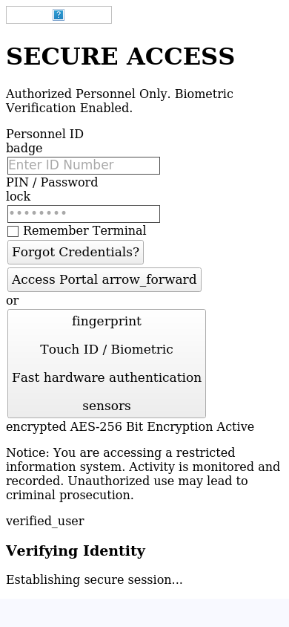
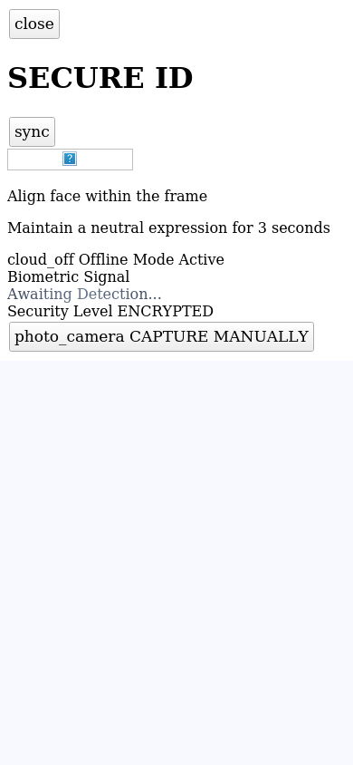

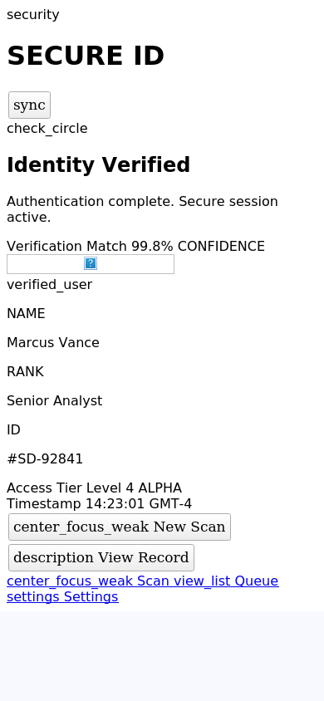
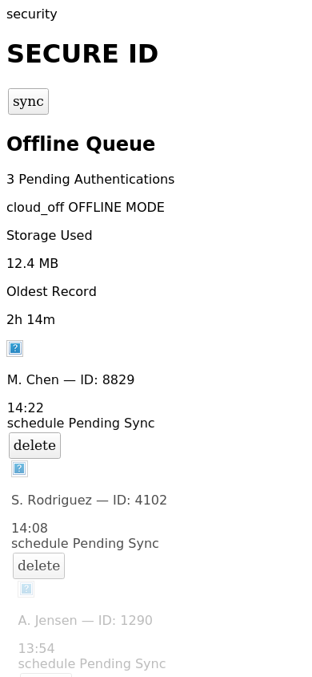
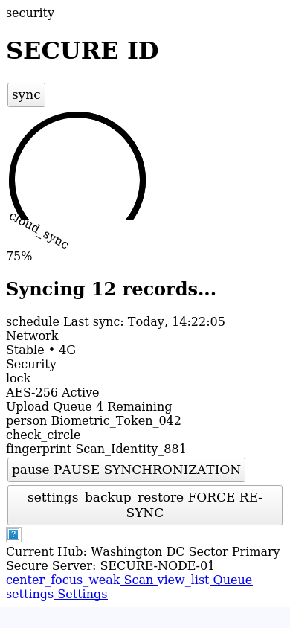
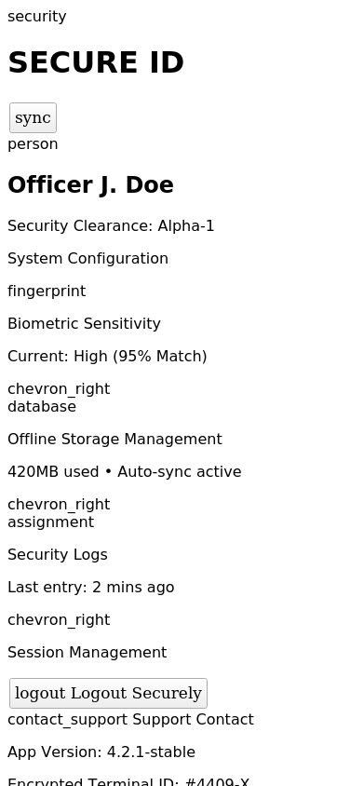
Application Workflow & UI Screens
1. Splash Screen
2. Login
3. Face Auth
4. Liveness Check
5. Auth Success
6. Offline Queue
7. Sync Status
8. Settings

Slide 11

Future Scope
→ Multi-face detection for crowd authentication
Phase 1 (0–6 months)
→ Voice + fingerprint multi-modal fusion
→ Watchlist & deny-list matching
→ FASTag integration for seamless toll clearance
Phase 2 (6–18 months)
→ Federated learning across toll nodes
→ ANPR + Face cross-validation
→ Aadhaar-linked identity verification (offline OKYC)
Phase 3 (18+ months)
→ Emotional state detection for driver safety
→ National biometric grid interoperability
Roadmap targets deployment across 900+ NHAI toll plazas nationwide.

Slide 12


SENTINEL CORE
Secure. Offline. Unstoppable.
Fully offline facial recognition — zero network dependency
Active liveness detection defeats all known spoofing vectors
AES-256 encrypted local storage with smart cloud sync
Scalable from a single toll booth to a national network
Built for NHAI · Ready for India · Designed for Scale

