Slide 1

ORDB - Object–relational database
Sebastian & Kathrin

Slide 2
What is it?
(In a nutshell)
Database management system
Combines advantages of relational DB and object-oriented DB
Relational database functions
Mandatory!
Functions of object-orientated database model
Not mandatory!
DB type to bridge the gap between RDB and object-oriented modeling techniques

Slide 3
Combination of ...
(In a nutshell)
Advantages of RDB
Data stored in traditional database
Manipulated and accessed using SQL queries
Advantages of ODB
Supports extension of the data model with custom data types and methods
Database is considered an object store
objects, classes and inheritance are directly supported in database schemas and in the query language

Slide 4
Advantages?
Disadvantages?
Inheritance
Complex data types
Extensibility
Complicated and difficult to handle
Notes:
Advantages of Object Relational model
The advantages of the Object Relational model are −
Inheritance
The Object Relational data model allows its users to inherit objects, tables etc. so that they can extend their functionality. Inherited objects contains new attributes as well as the attributes that were inherited.
Complex Data Types
Complex data types can be formed using existing data types. This is useful in Object relational data model as complex data types allow better manipulation of the data.
Extensibility
The functionality of the system can be extended in Object relational data model. This can be achieved using complex data types as well as advanced concepts of object oriented model such as inheritance.
Disadvantages of Object Relational model
The object relational data model can get quite complicated and difficult to handle at times as it is a combination of the Object oriented data model and Relational data model and utilizes the functionalities of both of them.

Slide 5
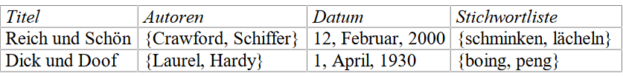
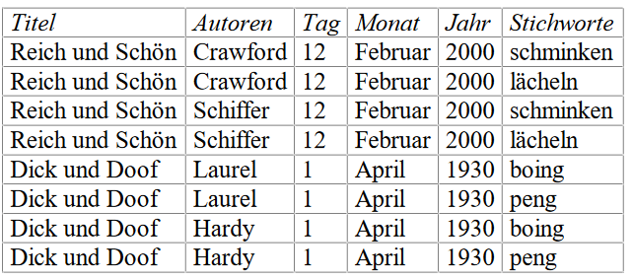
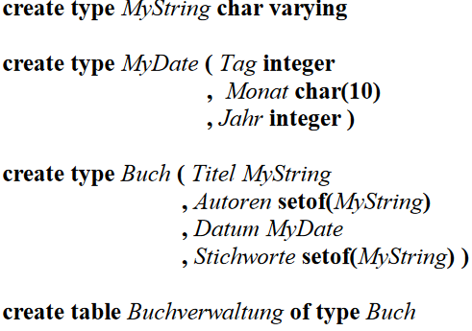
Examples
Difference between ORDB and RDB

Slide 6
Where is it used?
Areas of application are systems for recording geographic data (GIS) in which coordinates are linked to one another.

