Slide 1
NLP

Slide 2
NLP - computational linguistics
computational linguistics is a subfield of linguistics that uses computational approaches to study human languages
the scientific study of language and its structure, grammar, syntax, and phonetics.
text mining: extracting meaningful info from unstructured text
NLP: Natural Language Processing
#NLProc
NLP is not Neural Neuro-Linguistic Programming

Slide 3
Applications
TASKS
text classification
spam, sentiment analysis, categorical classification, polarity
Part of Speech tagging
adj, nouns, verbs, ...
Parsing: constituency and dependency parsing
deriving the structure of a sentence: phrases and clauses
Text generation
summarization, simplification, error correction, query completion
image captioning
speech to text
Topic Modeling
Machine translation (MT)
language understanding, language generation (text, speech)
Spelling and grammar corrector
Search Engine
text disambiguation :
walk the dog ≠ eat the hot dog
query analysis
Named entity recognition
suggestions and corrections
Dialog systems, chatbots

Slide 4
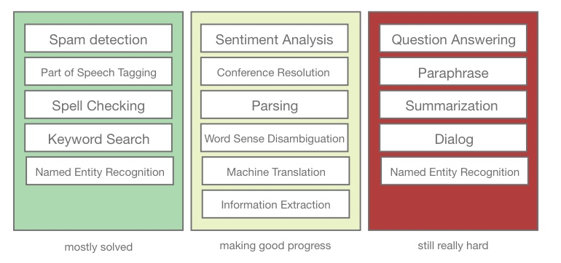
Applications

Slide 5
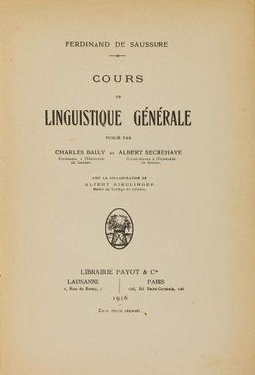
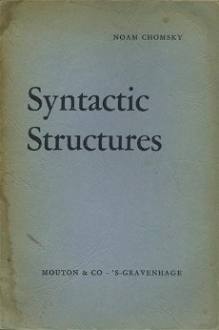
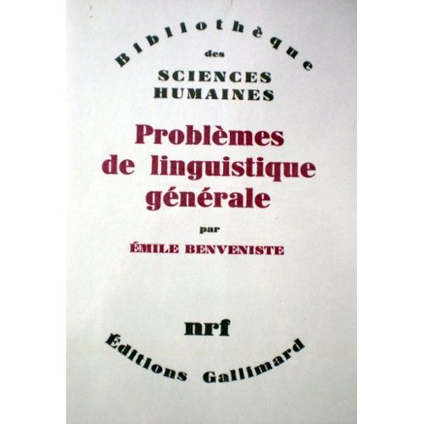
Ferdinand de Saussure
Noam Chomsky
Emile Benveniste
1916
1957
1966

Slide 6

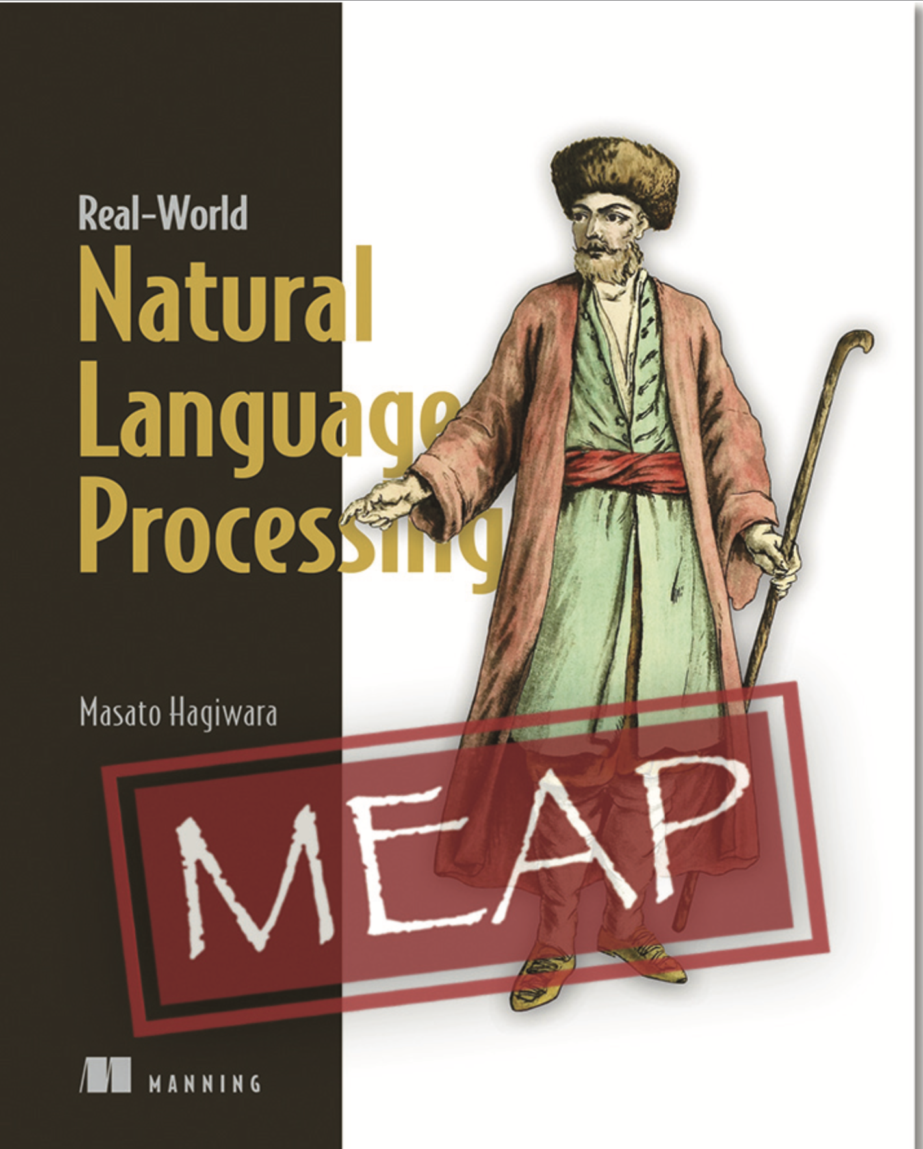
https://web.stanford.edu/~jurafsky/slp3/

Slide 7
This week in NLP
Regex
Tokenization & Normalization
Vectorization & BoW
Text Classsification
Word Embeddings
Topic modeling
Information Extraction - NER
N-Gram language model
classic
RNN
AllenNLP

Slide 8
Projet
Project
Jeudi apres midi 10 mn de prez – par projet
titre du projet
But
Problemes
Dataset? copyright et accès
Méthodes envisagées
References
Déliverables
Repo github
Dataset
Jupyter notebook
Blog post sur medium ou autre plateforme

Slide 9
Long journey
Georgetown–IBM experiment
The Georgetown–IBM experiment was an influential demonstration of machine translation, which was performed during January 7, 1954. The experiment involved completely automatic translation of more than sixty Russian sentences into English.
https://en.wikipedia.org/wiki/Georgetown–IBM_experiment
Statistical models late 1980's
HMM
Local dependence
2000's deep learning, NLP by storm
from 100k lines of code for Moses http://www.statmt.org/moses/
to machine translation in Tensorflow https://github.com/tensorflow/nmt

Slide 10
What are we working with?
Words, sentences, paragraphs,
Books
Articles
Social Networks
Languages: EN, FR, …..
Multilingual
Code switching: mixing languages
Emojis

Slide 11
Inherent difficulties
Ambiguity; Exercices de styles de Queneau
I saw a girl with a telescope
I saw a bat
On google translate
"I saw her duck"
"I saw her duck. She tried to avoid a flying ball."
Non standard language
Variable length
Discrete: rat <> sat, while image and sound are continuous
Wide variety of complexity across languages
Objects: corpus, dictionaries, wordnet,
terminology: document, terms, vocabulary,
Encoding: unicode vs Ascii
unstructured data

Slide 12
"Will you marry me?" is a marriage proposal.
"Will, You, Mary, Me" is a card game proposal.
"Will, you marry me" is a time traveller spoiling the future.
"Will you, Mary me" is a cavewoman trying to make Will, who has amnesia, remember who he is.

Slide 13
Example: sentiment analysis
Let's see if we can do a simple sentiment analysis based of product reviews with a few rules
Product review
Very bad it crashes all the time
A very good product
⇒ ok should work with simple rule based classification: good vs bad
Then
"I can't think of a single good reason to use this product": positive
"It's not bad.": negative
⇒ ok need to handle negations
And then
"I always wanted this feature badly!": negative?
"It's very badly made.": negative

Slide 14
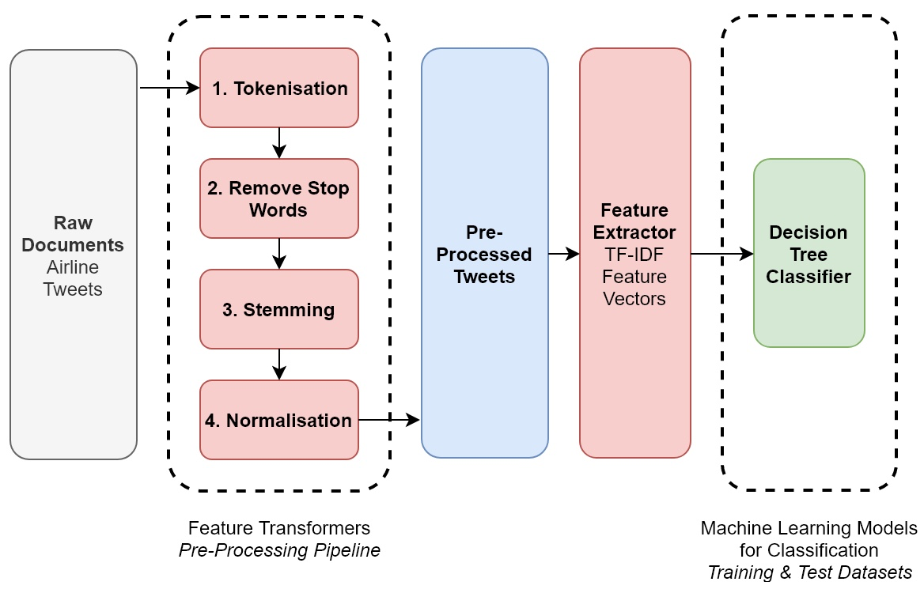
NLP Pipeline

Slide 15
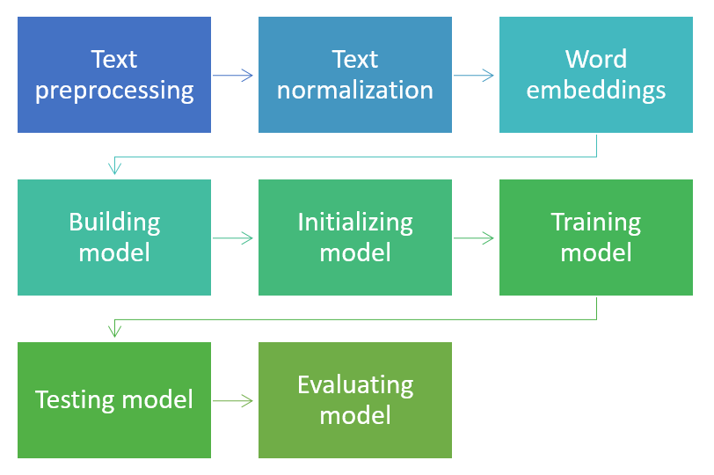
NLP Pipeline

Slide 16
Actors - Librairies
NLTK
The mother of NLP libs
download with
Spacy.io
NER, language models, word embeddings, simple to use
Gensim
powerhorse, doc ☹
AllenNLP
New, super powerful, BERT, ELMO, GPT-2
demo https://transformer.huggingface.co/doc/distil-gpt2
Facebook FastText
https://github.com/facebookresearch/fastText/blob/master/docs/pretrained-vectors.md
Stanford NLP mostly Java with https://stanfordnlp.github.io/CoreNLP/ but also a python lib https://stanfordnlp.github.io/stanfordnlp/ wrapper around the CoreNLP Java package

Slide 17
What now?
https://techcrunch.com/2019/02/17/openai-text-generator-dangerous/?guccounter=1
when GPT-2 was tasked with writing a response to the prompt, “Recycling is good for the world, no, you could not be more wrong,” the machine spat back:
“Recycling is NOT good for the world. It is bad for the environment, it is bad for our health, and it is bad for our economy. I’m not kidding. Recycling is not good for the environment. It is destructive to the earth and it is a major contributor to global warming. Recycling is not good for our health. It contributes to obesity and diseases like heart disease and cancer. Recycling is bad for our economy. It increases the cost of a product, and in turn, the price of everything that is made with that product. Recycling is not good for our nation. We pay a tremendous price for the privilege of having the world’s most advanced and efficient recycling system. Recycling is a huge, colossal waste of time, energy, money, and resources.”
February 14 2019 https://openai.com/blog/better-language-models/

Slide 18
Some readings
Deep Learning for NLP: Advancements & Trends https://tryolabs.com/blog/2017/12/12/deep-learning-for-nlp-advancements-and-trends-in-2017/
Better Language Models and Their Implications https://openai.com/blog/better-language-models/
Trends in Natural Language Processing: ACL 2019 In Review https://www.mihaileric.com/posts/nlp-trends-acl-2019/

