Slide 1
Tokenization

Slide 2
Jurasfsky chap 2

Slide 3
Tokenization
Given a character sequence and a defined document unit, tokenization is the task of chopping it up into pieces, called tokens, perhaps at the same time throwing away certain characters, such as punctuation.
Words
Sentences
Characters
Syllables
Music notes
Simple concept yet complex implementation!

Slide 4
How?
Splitting on spaces gives a good approximation.
Regex is better but can get very messy and complex
text = "Le #tilleul: une floraison essentielle pour la production d'un #miel de #paris #mellifère #abeilles #apiculture http://www.apisurbanica.com"
Compare:
re.split("\W+", text)
re.split("[\s]+",text)
re.split("[\s,]+",text)
re.split("[\s,:]+",text)

Slide 5
We want to keep punctuations as tokens.
useful for grammatical parsing,
periods and questions marks are useful for sentence tokenization
What is a good tokenization strategy?
aren't
are, n't
aren, t
arent
Mr. O'Neill thinks that the boys' stories about Chile's capital aren't amusing.

Slide 6
Space splitting
Tokenizing on space is too simple
Does not recognize bigrams like United States, Louis Vuitton or San Francisco, New York.
Merges the punctuation with the words
But then new problems arise. What about?
Clitic Contractions: I'm, she's, ...
French: aujourd'hui, ...
Special words: m.p.h, Ph.D., AT&T,
Abbreviations: Mr. Dr. Ms.
Urls, emails,
dates (10/04/1980 or 04.08.1980)
Numbers (10,000.00 or 10.000,00)
Hashtags, smileys, ...
Tokenization algorithms may also tokenize multiword expressions like New York or rock ’n’ roll as a single token, which requires a multiword expression dictionary of some sort.
Tokenization is thus intimately tied up with named entity detection, the task of detecting names, dates, and organizations — Jurasky chap 2.4

Slide 7
Sentence tokenization
Similar difficulties for sentence tokenization.
All sentences do not end with a . ? ! or start with an uppercase letter.
Tokenization algorithms may also tokenize multiword expressions like New York or rock ’n’ roll as a single token, which requires a multiword expression dictionary of some sort.
Tokenization is thus intimately tied up with named entity detection, the task of detecting names, dates, and organizations — Jurasky chap 2.4

Slide 8
Spacy - tokenization
import spacy from spacy.lang.en import English nlp = English() doc = nlp("Apple is looking at buying U.K. startup for $1 billion") for token in doc: print(token.text)
Apple
is
looking
at
buying
U.K.
startup
for
$
1
billion
Create your own tokenizer https://spacy.io/api/tokenizer

Slide 9
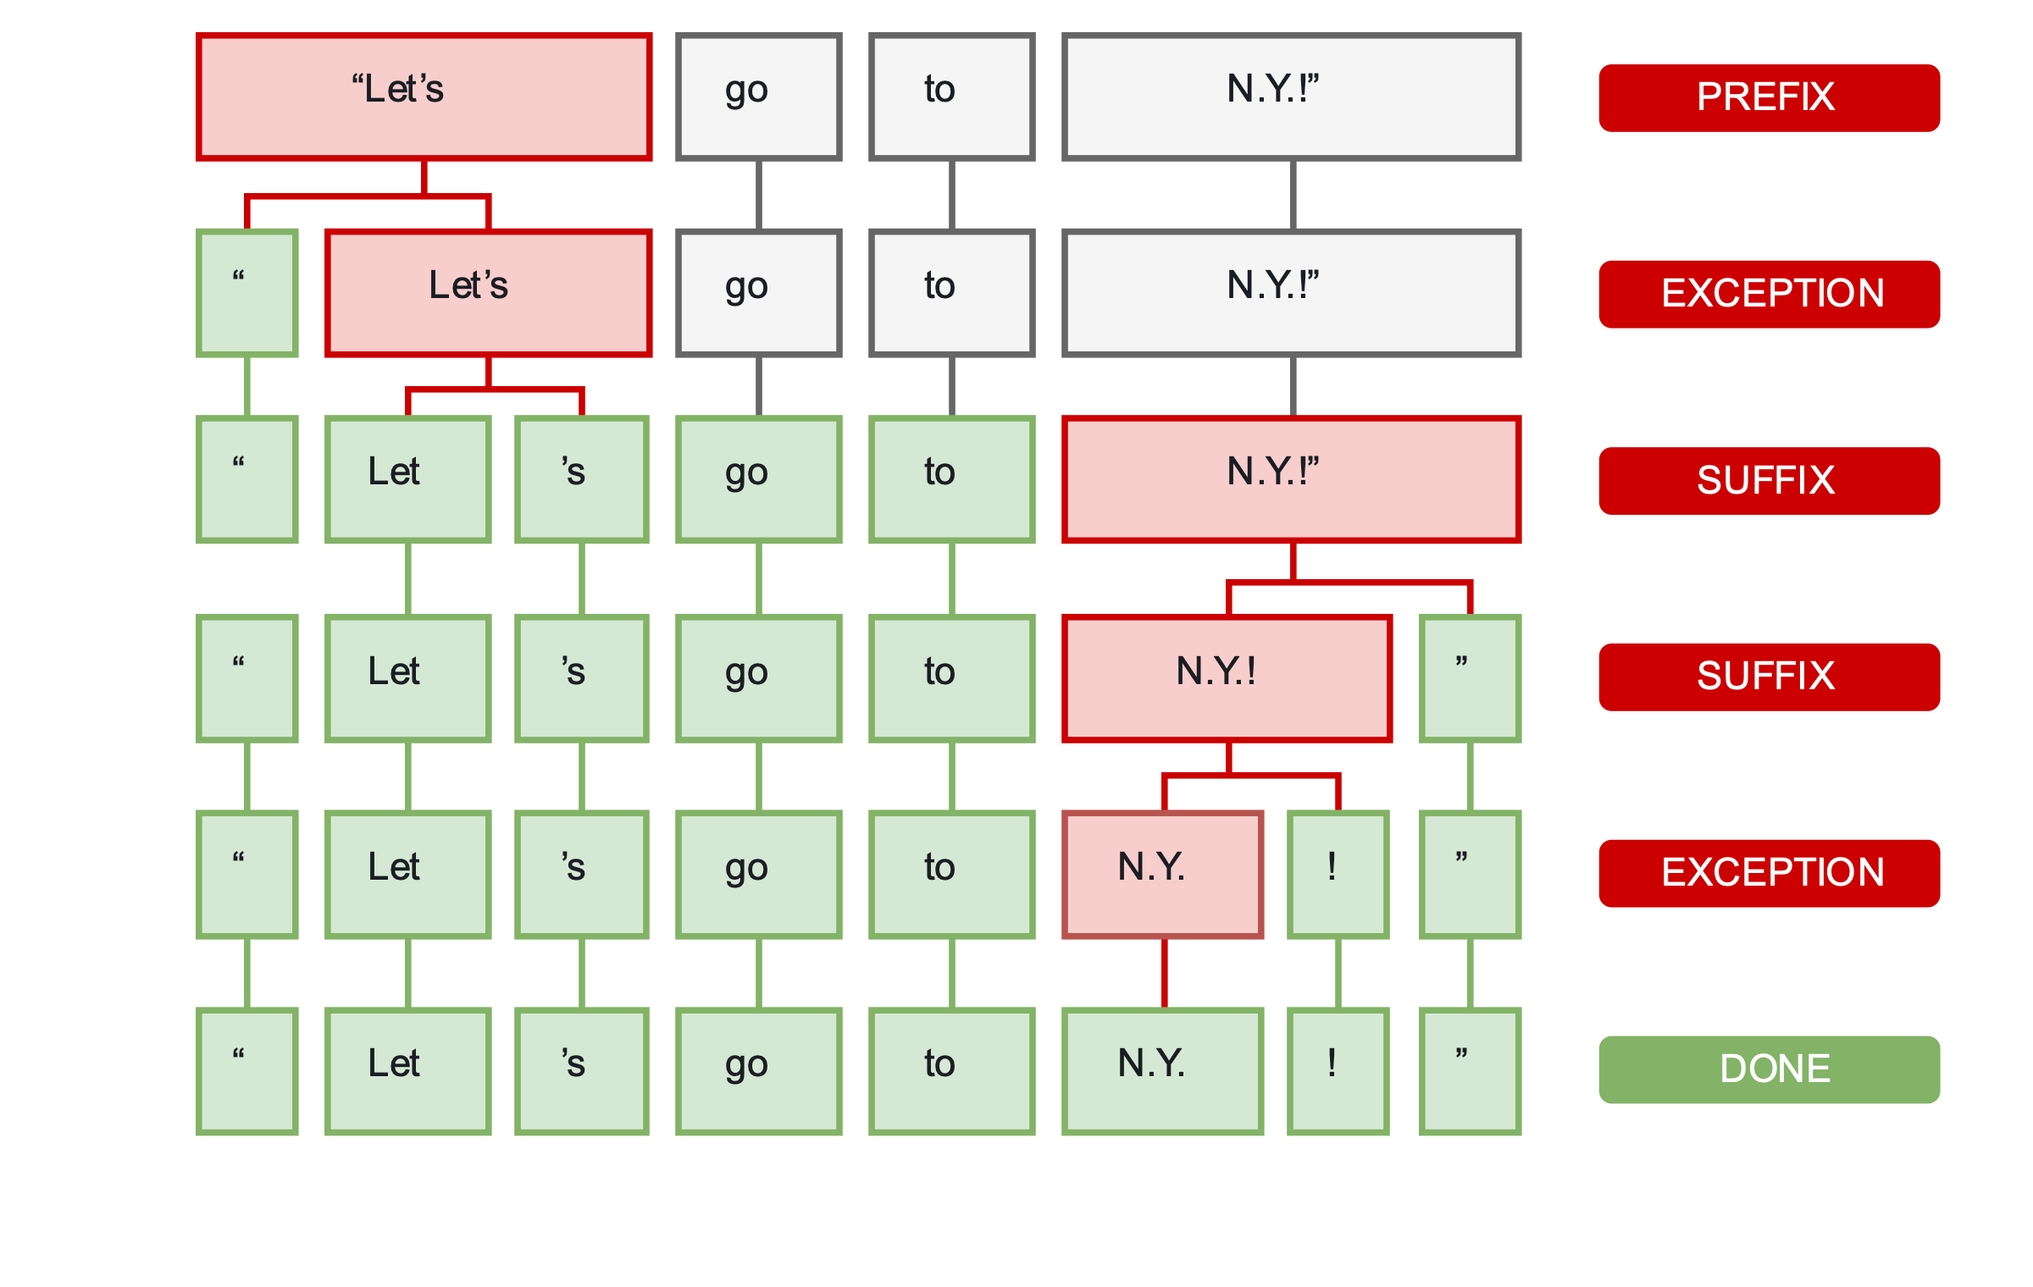
Spacy Tokenizer
"Let's go to N.Y.!"
During processing, spaCy first tokenizes the text, i.e. segments it into words, punctuation and so on. This is done by applying rules specific to each language. For example, punctuation at the end of a sentence should be split off – whereas “U.K.” should remain one token. https://spacy.io/usage/spacy-101#annotations-token

Slide 10
Spacy - Languages
Quick start: Loading language https://spacy.io/usage/models
Supported Languages: https://spacy.io/usage/models#languages
Adding languages: https://spacy.io/usage/adding-languages
Ex: Arabic https://github.com/explosion/spaCy/tree/master/spacy/lang/ar

Slide 11
NLTK - Tokenizer
https://www.nltk.org/book/ch03.html
with nltk https://www.nltk.org/api/nltk.tokenize.html
from nltk.tokenize import sent_tokenize, word_tokenize
data = "All work and no play makes jack a dull boy, all work and no play" print(word_tokenize(data)) data = "All work and no play makes jack dull boy. All work and no play makes jack a dull boy." print(sent_tokenize(data))

Slide 12
Sentence tokenizer with NLTK punkt model
NLTK comes with tokenizers models in several languages.
$> locate tokenizers
Punkt Sentence Tokenizer
This tokenizer divides a text into a list of sentences by using an unsupervised algorithm to build a model for abbreviation words, collocations, and words that start sentences. It must be trained on a large collection of plaintext in the target language before it can be used.
The NLTK data package includes a pre-trained Punkt tokenizer for English.
import nltk.data
text = ''' Punkt knows that the periods in Mr. Smith and Johann S. Bach do not mark sentence boundaries. And sometimes sentences can start with non-capitalized words. i is a good variable name. '''
sent_detector = nltk.data.load('tokenizers/punkt/english.pickle')
print('\\n-----\\n'.join(sent_detector.tokenize(text.strip())))

Slide 13
NLTK other tokenizers
https://www.nltk.org/api/nltk.tokenize.html
nltk.tokenize.casual.TweetTokenizer
Demo multiple NLTK tokenizers
http://text-processing.com/demo/tokenize/

Slide 14
Exercise
Tweet tokenizer vs Standard tokenizer vs Spacy vs Manual on French corpus of tweets
take corpus tweets abeilles.csv
load French tokenizer in NLTK
Join 10 random tweets with "\n." to create the text
text = '.\n'.join(df.main.sample(5).values)
Compare
nltk.tokenize.TweetTokenizer
nltk.tokenize.word_tokenize
spacy tokenizer
What tokenizer is better in terms of hashtags, punctuations, urls, ... ?

Slide 15
How many tokens
How many tokens for a newpaper article?
For a book? Download a book from Gutenberg https://www.gutenberg.org/browse/scores/top
for instance https://www.gutenberg.org/files/84/84-0.txt
For Wikipedia?

Slide 16
Arabic resources
Farasa consists of the segmentation/tokenization module, POS tagger, Arabic text Diacritizer, and Dependency Parser.
http://qatsdemo.cloudapp.net/farasa/
Arabic Tokenization System https://pdfs.semanticscholar.org/c43a/ddb32a4da6cecce91f7b8891b930b554a9ba.pdf
http://nlp.ldeo.columbia.edu/madamira/

