Slide 1
Normalization

Slide 2
Stop words
removing words that are too frequent to bring any information
import nltk from nltk.corpus import stopwords stopwords.words('english')
179 stopwords
from spacy.lang.en.stop_words import STOP_WORDS
STOP_WORDS
305 stopwords

Slide 3
Stemming
Stemming is a text normalization technique that cuts off the end or beginning of a word by taking into account a list of common prefixes or suffixes that could be found in that word
It is a rudimentary rule-based process of stripping the suffixes (“ing”, “ly”, “es”, “s” etc) from a word
Stemming is a process to identify word stems. A word stem is the main part of a word after stripping off its affixes (prefixes and suffixes). For example, the word stem of “apples” (plural) is “apple”. The stem of “meets” (with a third person singular s) is “meet”. The word step of “unbelievable” is “believe”.
PorterStemmer

Slide 4
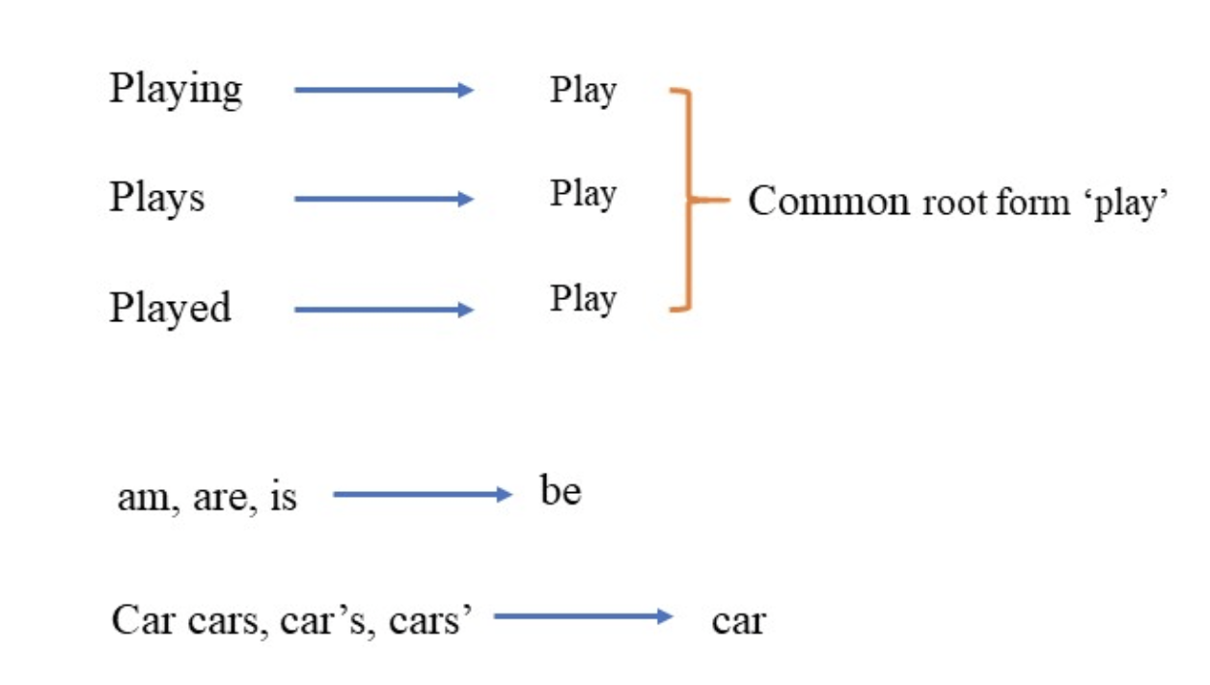
Lemmatization
A lemma is the original form of a word that you often find as a head word in a dictionary.
It is also the base form of the word before inflection.
For example, the lemma of “meetings” (as a plural noun) is “meeting”.
The lemma of “met” (a verb past form) is “meet”.
Notice that it differs from stemming, which simply strips off affixes of a word and cannot deal with such irregular verbs and nouns.
https://www.datacamp.com/community/tutorials/stemming-lemmatization-python

Slide 5
NLTL, Spacy
WordNetLemmatizer in NLTK treats everything as a noun by default, which is why you see many unlemmatized words in the result (“agreed”, “owned”, etc.).
On the other hand, spaCy automatically infers parts of speech from the word form and the context, which is why most of the lemmatized

Slide 6
Normalization
tokenization
(stemming) or lemmatization
stop words
Greatly reduces the size of the vocabulary
Spacy tokenizes and lemmatizes in one go with doc = nlp(text)

