Slide 1
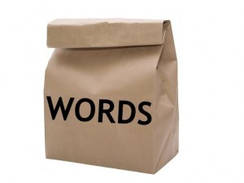
Vectorization & Bag of Words

Slide 2
Supervised learning on unstructured text
The challenge with text:
Different lengths of text
Millions of tokens
Typos, out of vocabulary words
un / Supervised learning requires
numerical values
fixed number of features
?
=> we need to vectorize the text
- Supervised learning
- Unsupervised learning

Slide 3
Bag of Words
Vocabulary = all unique tokens
Count frequency of tokens
disregard any other information: order and grammar
The text
is represented as
John likes to watch movies. Mary likes movies too. Mary also likes to watch football games.
"John":1,
"likes":3,
"to":2,
"watch":2,
"movies":2,
"Mary":2,
"too":1,
"also":1,
"football":1,
"games":1

Slide 4
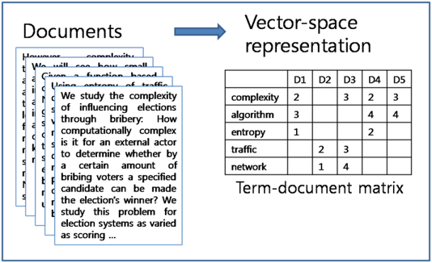
CountVectorizer – Document – Term matrix
counting the occurrences of tokens
building a sparse matrix of documents x tokens.
N rows with N = |vocabulary|
D columns, D = number of documents
documents such as
emails
tweets
articles, news
episodes
books, chapters, …

Slide 5
Document – term Matrix
 | D1 | D2 | D3
John | 2 | 0 | 1
likes | 2 | 1 | 1
to | 1 | 0 | 1
watch | 1 | 0 | 1
movies | 1 | 1 | 0
Mary | 1 | 1 | 1
…
games | 1 | 0 | 1
3 documents:
John likes to watch movies and games. John likes Mary.
Mary likes movies too.
Mary likes to watch football games with John.

Slide 6
Scikit-learn to the rescue
https://scikit-learn.org/stable/modules/generated/sklearn.feature_extraction.text.CountVectorizer.html
class sklearn.feature_extraction.text.CountVectorizer(input=’content’, encoding=’utf8’, decode_error=’strict’,
strip_accents=None,
lowercase=True,
preprocessor=None,
tokenizer=None,
stop_words=None,
token_pattern=’(?u)\b\w\w+\b’,
ngram_range=(1, 1), analyzer=’word’,
max_df=1.0,
min_df=1, max_features=None,
vocabulary=None, binary=False, dtype=<class ‘numpy.int64’>)
=> Demo, count vectorizer on Simpson's or other dataset

Slide 7
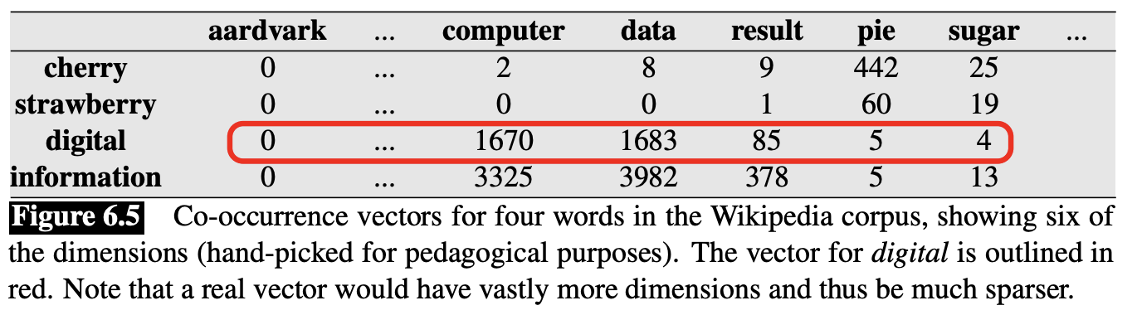
word-word matrix
each cell records the number of times the row (target) word and the column (context) word co-occur in some context in some training corpus. small context. For instance 4 words to the left and 4 words to the right
is traditionally followed by cherry pie, a traditional dessert often mixed, such as strawberry rhubarb pie. Apple pie computer peripherals and personal digital assistants. These devices usually a computer. This includes information available on the internet
|V| x |V| matrix
=> Word vectors!
Jurafsky chap 6.3.2

Slide 8
Hashing vectorizer
p33 / 37 Deep Learning for NLP The hashing. trick
The hashing trick is an algorithm for reducing the dimensionality of large feature vectors, by applying a hashing function to the features in the vectors. The hashing function maps every feature to an index, and the algorithm updates the information at those indices only.
Hashing Vectorizer
https://www.coursera.org/lecture/machine-learning-applications-big-data/hashing-trick-GswXH

Slide 9
class sklearn.feature_extraction.text.HashingVectorizer(input=’content’, encoding=’utf-8’, decode_error=’strict’, strip_accents=None, lowercase=True, preprocessor=None, tokenizer=None, stop_words=None, token_pattern=’(?u)\b\w\w+\b’, ngram_range=(1, 1), analyzer=’word’, n_features=1048576, binary=False, norm=’l2’, alternate_sign=True, dtype=<class ‘numpy.float64’>)[source]¶
https://scikit-learn.org/stable/modules/generated/sklearn.feature_extraction.text.HashingVectorizer.html#sklearn.feature_extraction.text.HashingVectorizer

Slide 10
Paradox
Words that occur nearby frequently (maybe pie nearby cherry) are more important than words that only appear once or twice.
Yet words that are too frequent —ubiquitous, like the or a— are unimportant.
=> Normalize by the document frequency
words that appear in few docs should be less important
TF-IDF

Slide 11
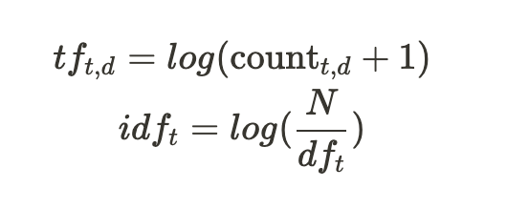
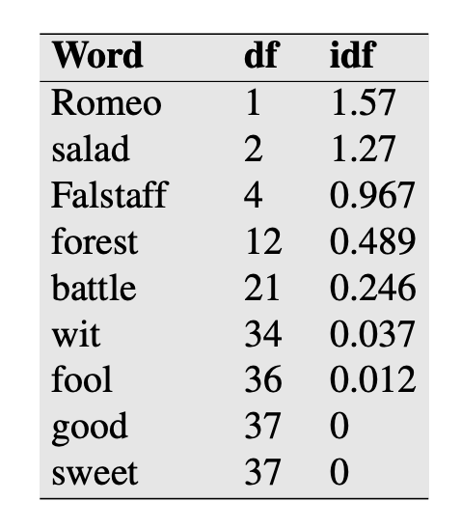
TF-IDF
N is the total number of documents
df(t) is the number of documents in which term t occurs
37 Shakespeare plays
idf: Gives a higher weight to words that occur only in a few documents. useful for discriminating those documents from the rest of the collection;

Slide 12
Scikit-learn: TfidfVectorizer
https://scikit-learn.org/stable/modules/generated/sklearn.feature_extraction.text.TfidfVectorizer.html
class sklearn.feature_extraction.text.TfidfVectorizer(input=’content’, encoding=’utf8’, decode_error=’strict’, strip_accents=None, lowercase=True, preprocessor=None, tokenizer=None, analyzer=’word’, stop_words=None, token_pattern=’(?u)\b\w\w+\b’, ngram_range=(1, 1), max_df=1.0, min_df=1, max_features=None, vocabulary=None, binary=False, dtype=<class ‘numpy.float64’>, norm=’l2’, use_idf=True, smooth_idf=True, sublinear_tf=False)
see also https://scikit-learn.org/stable/modules/classes.html#module-sklearn.feature_extraction.text

Slide 13
Applications TF-IDF
applications:
discovering meanings of words in different corpora. we can find the 10 most similar words to any target word w by computing the cosines between w and each of the V − 1 other words, sorting, and looking at the top 10.
decide if two documents are similar. We represent a document by taking the vectors of all the words in the document, and computing the centroid of all those vectors.
Clustering of documents
https://scikit-learn.org/stable/auto_examples/text/plot_document_clustering.html#sphx-glr-auto-examples-text-plot-document-clustering-py
https://github.com/MihailSalnikov/tf-idf_and_k-means/blob/master/main.ipynb

Slide 14
Exercice
Simpson's dataset or gutenberg (10 docs) or reuters with categories
3 different vectorizers: Count, Hashing, tf-IdF
document term matrix
k-means
reduce to dim 2
Visualization with colors per topic, character, …

