Slide 1
Text Classification

Slide 2
text classification
Spam Not Spam
Sentiment analysis Positive or negative movie review?
movies, products
public sentiment, politics
predictions
Topic classification: What is the subject / category of this article?
User classification from social media
Lexical markers for gender, age, political leanings

Slide 3
Process
Tokenization
Feature extraction - vectorization
Classification
https://web.stanford.edu/~jurafsky/slp3/4.pdf

Slide 4
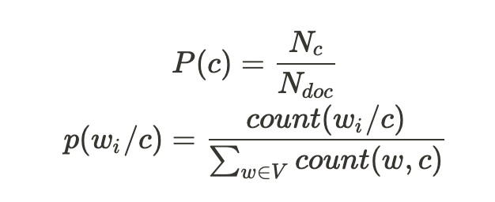
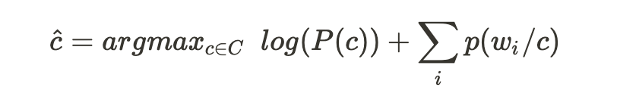
Naive Bayes
Generative classifiers like naive Bayes build a model of how a class could generate some input data. Given an observation, they return the class most likely to have generated the observation.
Naive bayes : jurafksy ch4
max likelihood estimate (Laplace smoothing required)
Binary NB: word exists (1 / 0) instead of p(w/c)

Slide 5
Naive Bayes
see https://sebastianraschka.com/Articles/2014_naive_bayes_1.html

Slide 6
Sentiment Analysis
https://web.stanford.edu/~jurafsky/slp3/4.pdf
Specific problems :negations:
I didn't like this movie vs I really like this movie.
Prefix all words from first negation until punctuation with NOT_
exemple:
I didn't like this movie, but I ...
I didn't NOT_like NOT_this NOT_movie but I ...

Slide 7
Sentiment on tweets
Exercise
load twitter sentiment dataset: US airlines
clean tweets
tokenize - bag of words
tag negations
Tf-Idf, countvectorizer, hashing vectorizer
Naive Bayes, split train test, evaluate
look at the samples wrongly classified
Goal: see how the initial pre processing influences on the model accuracy

Slide 8
Smoothing

Slide 9
Spam detection
Consider the task of spam detection, deciding if a particular piece of email is an example of spam (unsolicited bulk email) — and one of the first applications of naive Bayes to text classification (Sahami et al., 1998). A common solution here, rather than using all the words as individual features, is to predefine likely sets of words or phrases as features, combined these with features that are not purely linguistic. For example the open-source SpamAssassin tool1 predefines features like the phrase “one hundred percent guaranteed”, or the feature mentions millions of dollars, which is a regular expression that matches suspiciously large sums of money. But it also includes features like HTML has a low ratio of text to image area, that isn’t purely linguistic and might require some sophisticated computation, or totally non-linguistic features about, say, the path that the email took to arrive. More sample SpamAssassin features: • Email subject line is all capital letters • Contains phrases of urgency like “urgent reply” • Email subject line contains “online pharmaceutical” • HTML has unbalanced ”head” tags • Claims you can be removed from the list
https://web.stanford.edu/~jurafsky/slp3/4.pdf

Slide 10
Spam detection
Enron and. spam assassin datasets
https://www.cs.bgu.ac.il/~elhadad/nlp17/spam_classifier.html

Slide 11
Language identification
most effective naive Bayes features are not words at all, but byte n-grams, 2-grams (‘zw’) 3-grams (‘nya’, ‘ Vo’), or 4-grams (‘ie z’, ‘thei’)

Slide 12
Topic identification
see https://scikit-learn.org/stable/tutorial/text_analytics/working_with_text_data.html

