Slide 1
NER
Named Entity Recognition

Slide 2
The goal of NER is to find all of the named people, places, and things within a text document and correctly classify them.

Slide 3
Named Entity recognition
2 steps:
id the entity, ~ chunking : names are defined to be contiguous spans of tokens
classify the entity (person, place, ...)
Approaches:
Lexicon: match chunks of the text with entity names from lexicon
Rule base
Machine learning statistical approach: HMMs, CRFs, support vector machines (SVMs), and maximum entropy models
Problems include identifying a real entity, but:
with fewer tokens than desired (for example, missing the last token of "John Smith, M.D.")
with more tokens than desired (for example, including the first word of "The University of MD")
partitioning adjacent entities differently (for example, treating "Smith, Jones Robinson" as 2 vs. 3 entities)
assigning it a completely wrong type (for example, calling a personal name an organization)
assigning it a related but inexact type (for example, "substance" vs. "drug", or "school" vs. "organization"

Slide 4
GDELT
https://blog.gdeltproject.org/announcing-the-global-entity-graphs-geg-g1-baseline-dataset-8-billion-entities-from-2019/
dataset comprised of more than 8 billion entity annotations computed from 83 million English-language worldwide online news articles monitored by GDELT since January 1, 2019 and updated every 15 minutes through present.

Slide 5
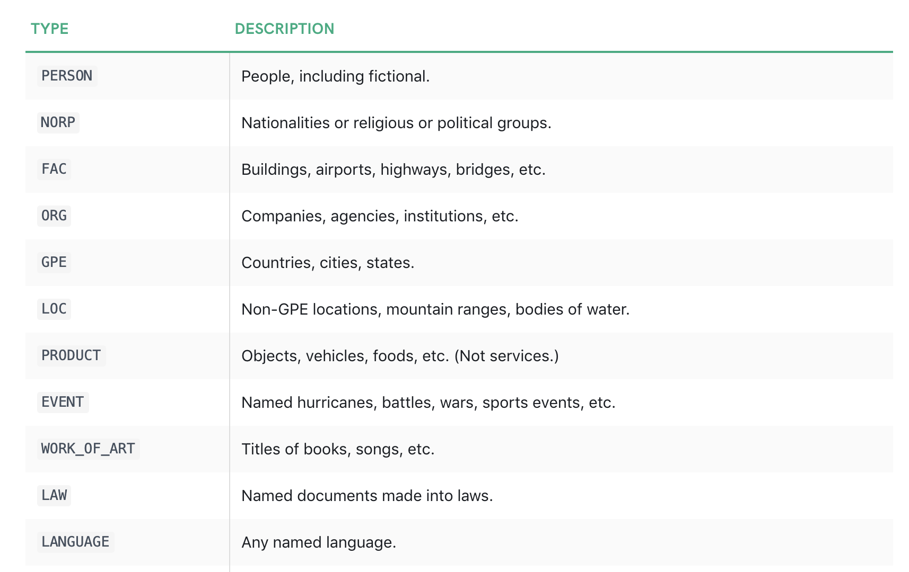
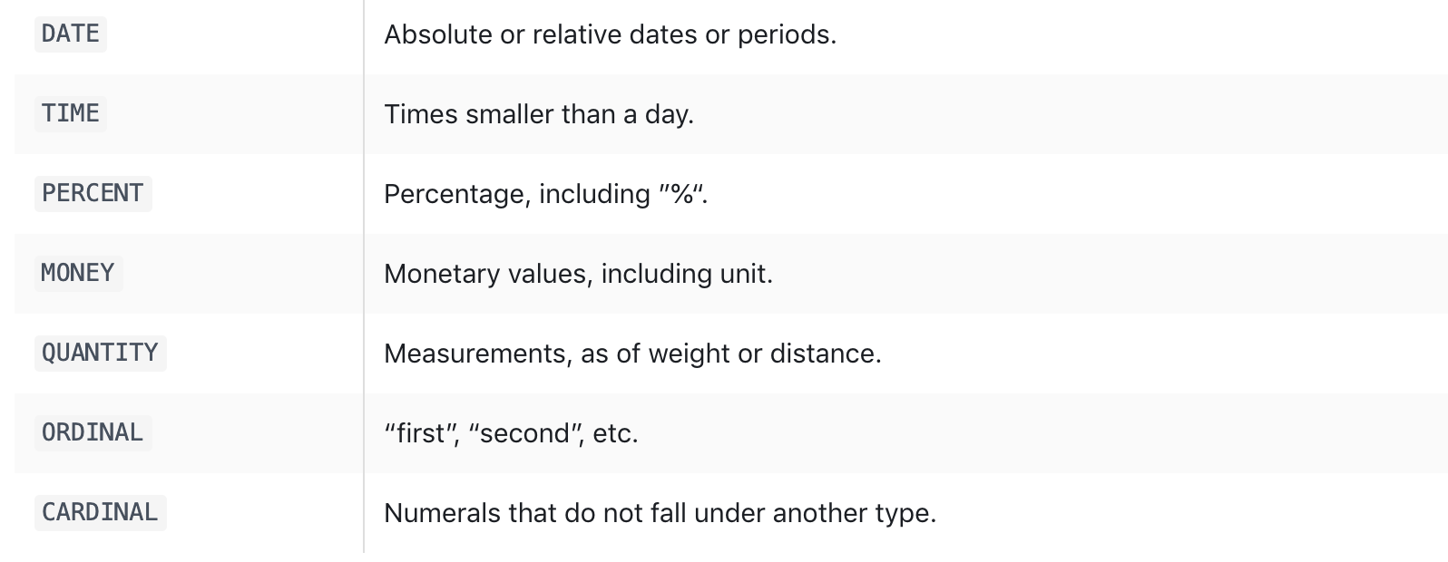
Spacy
https://spacy.io/api/annotation#named-entities

Slide 6
NER – how?
https://www.youtube.com/watch?v=sqDHBH9IjRU
https://towardsdatascience.com/a-review-of-named-entity-recognition-ner-using-automatic-summarization-of-resumes-5248a75de175

