Slide 1
n-gram language model

Slide 2
What?
Language models
Models that assign probabilities to sequences of words are called language models
goal: compute the probability of a sentence or sequence of words or of next word.
The intuition of the n-gram model is that instead of computing the probability of a word given its entire history in the corpus, we can approximate the history by just the last few words.
N-gram Language Models
also: Estimate the probability of the last word of an n-gram given the previous words in the n-gram

Slide 3
Applications of language model
first that comes to mind is the query completion on google
doit on avoir peur de …, should we be afraid of …
que faire a …, what to do in ….
machine translation, spelling correction, handwriting and speech recognition
text generation such as summarization, question answering or dialog systems
Among several candidates what sentence or word is the most probable
There are several choices vs Their are several choices
Comfortable vs Confortable; color vs colour
♫ iOS Autocomplete Song | Song A Day #2110 https://www.youtube.com/watch?v=M8MJFrdfGe0

Slide 4
Demo A2I GPT-2 text generation

Slide 5
Markov assumption

Slide 6
MLE as a Language Model
6.5 Jurafsky P40: exercise on small corpus , marmiton ?
bigram. model

Slide 7
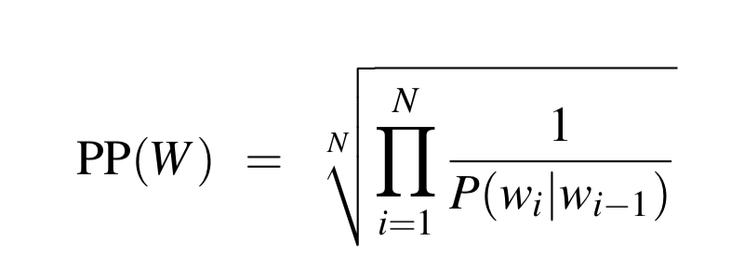
Evaluating with Perplexity
inverse probability of the test set, normalized by the number of words.
PP(W) = P(w w ...w )^− 1/N
https://stackoverflow.com/questions/54941966/how-can-i-calculate-perplexity-using-nltk

Slide 8
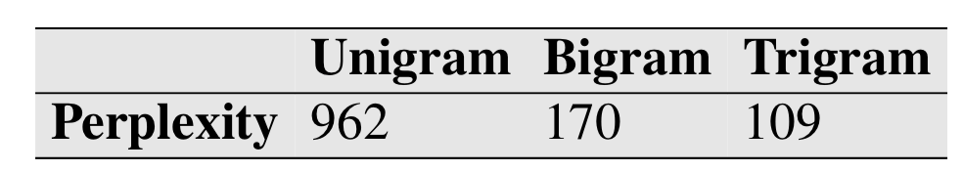
Perplexity Bi gram vs tri gram vs N gram
a 1.5 million word WSJ test set
the more information the N-gram gives us about the word sequence, the lower the perplexity
the higher the conditional probabil- ity of the word sequence, the lower the perplexity. Thus, minimizing perplexity is equivalent to maximizing the test set probability according to the language model.
The perplexity of two language models is only comparable if they use identical vocabularies.

Slide 9
Generating text with language models
demo, WSJ and shakespeare …
is word in testing is missing from training =>
In such a closed vocabulary system the test set can only contain words from this lexicon, and there will be no unknown words.
zero probability N-grams
In training set:
denied the allegations: 5
denied the speculation: 2
denied the rumors: 1
denied the report: 1
P(offer|denied the) is 0
if the probability of any word in the test set is 0, the entire probability of the test set is 0.
perplexity -> \infty

Slide 10
Unknown words
set a finite vocab < vocab (training, testing)
replace all words not in training by UNK

Slide 11
Smoothing
Laplace smoothing: add one to all the bigram counts (baseline not great perf)
Add-k smoothing : add a frac- tional count k (.5? .05? .01?). (still not great)
Katz Back off smoothing
Good-Turing backoff
Kneser-Ney Smoothing
The Web and Stupid Backoff (2006)
Another option is to build approximate language models using techniques like Bloom filters

Slide 12
char n-grams
n-grams model can also be applied to characters
ex: Football is a very famous game
The character bigrams for the above sentence will be: fo, oo, ot, tb, ba, al, ll, l, i, is and so on
trigrams: foo, oot, otb, tba and so on.

Slide 13
Bibliographical and Historical Notes

