Slide 1
Word Embeddings

Slide 2
What are word embeddings?
tl;dr: dense vector representation of tokens.
The idea is that two words that occur in very similar context are likely to have the same meaning.
Wittgenstein, 1953 “the meaning of a word is its use in the language”
John Firth 1957, "You shall know a word by the company it keeps"

Slide 3
Example of context for words
The cat jumped on the table to steal the chicken
Kids, please set the table, there's chicken for diner
What are we having for diner? Chicken again??
And your feet start kicking Then you know you doin' the funky chicken
Rufus Thomas

Slide 4
One-hot vectors – Tf-IdF
For a training data with n words, we will need n dimensional vectors. So you can imagine 1,000,000 dimensional vectors which are quite large and will be quite sparse.
There is no sense of context in one-hot vectors or with the bag of words approach

Slide 5
Embedding
An embedding is a relatively low-dimensional space into which you can translate high-dimensional vectors.
Embeddings make it easier to do machine learning on large inputs like sparse vectors representing words.
An embedding captures some of the semantics of the input by placing semantically similar inputs close together in the embedding space.
An embedding can be learned and reused across models.
https://developers.google.com/machine-learning/crash-course/embeddings/video-lecture

Slide 6
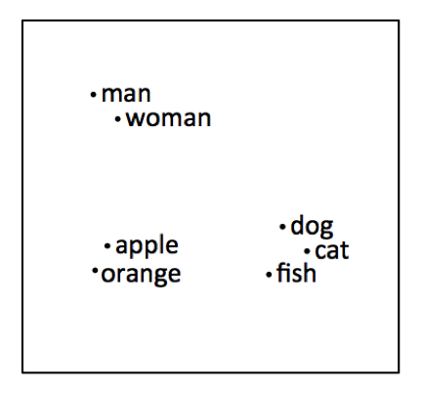
Word Embeddings
The idea of vector semantics is thus to represent a word as a point in some multi- dimensional semantic space.
Vectors for representing words are generally called embeddings, because the word is embedded in a particular vector space. [Jurafsky ch6 p6]
semantically similar

Slide 7
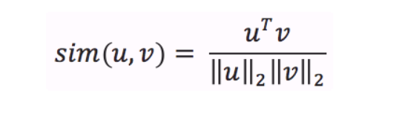
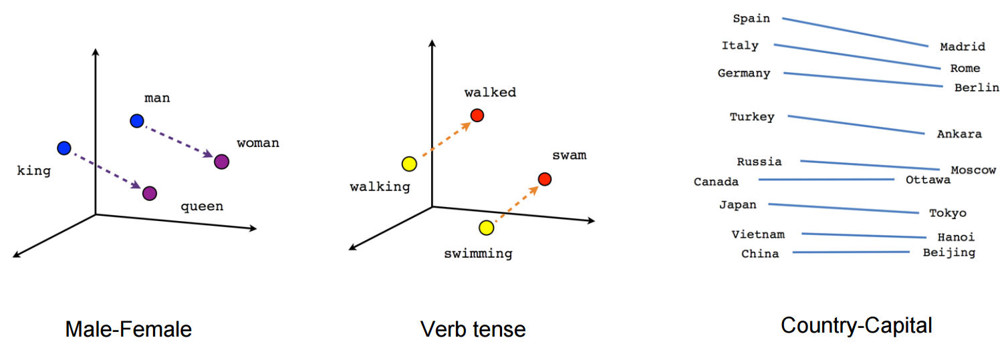
Cosine similarity
Distance between words given by the cosine similarity of their word embeddings

Slide 8
How to derive word embeddings
General Idea
Instead of counting word co-occurences, we train a classifier on a binary prediction task:
Is word "jam" or "building" likely to show up near "apricot"?
We don’t actually care about this prediction task;
Instead we take the learned classifier weights as the word embeddings.
Treat the target word and a neighboring context word as positive examples.
Randomly sample other words in the lexicon to get negative samples.
Use logistic regression to train a classifier to distinguish those two cases.
Use the regression weights as the embeddings.
In short: given a tuple (target,context) of a target word paired with a candidate context word,
train a binary classifier that returns the probability that context is a real context word

Slide 9
Neural – Fast Forward
train a simple neural network with a single hidden layer to perform a classification task
learn the weights of the hidden layer
the dimension of the output layer is the dimension of the word embedding

Slide 10
3 flavours
Word2Vec takes texts as training data for a neural network.
GloVe focuses on words co-occurrences over the whole corpus. matrix factorization
FastText improves on Word2Vec by taking word parts into account.

Slide 11
Word2Vec
Word2Vec is a predictive embedding model.
2 main Word2Vec architectures
Continuous bag-of-words (CBOW): CBOW is learning to predict the word by the context. Or maximize the probability of the target word by looking at the context.
str: yesterday was a really [????] day
favors: nice, beautiful, rainy
less frequent: delightful,
Continuous skip-gram Uses the current word to predict the surrounding window of context words + weighs nearby context words more heavily than more distant context words

Slide 12
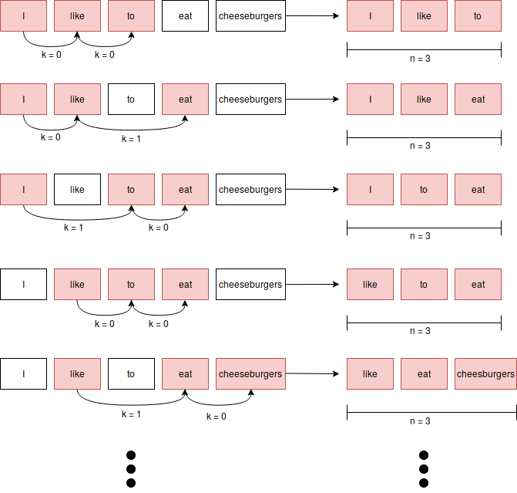
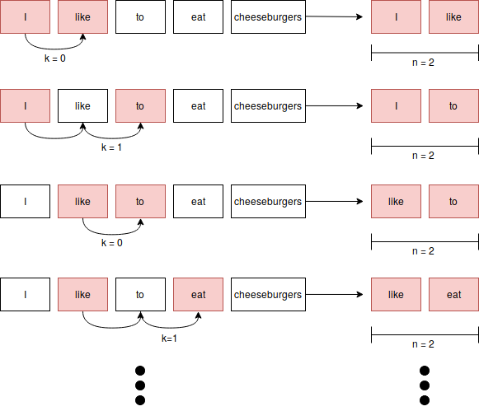
skip gram (k,n)
k = 0,1 n = 3 trigram
k = 0,1 n = 2 bigram

Slide 13
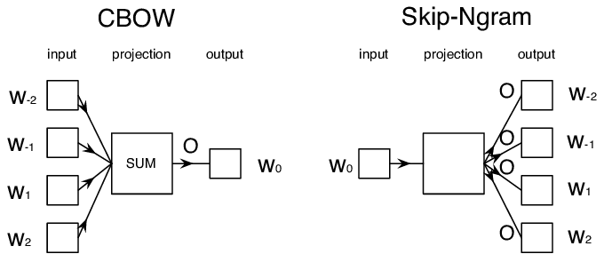
Skip Gram vs CBOW
Comparing Word Embeddings
https://towardsdatascience.com/comparing-word-embeddings-c2efd2455fe3

Slide 14
Skip Gram vs CBOW
Skip-gram: works well with small amount of the training data, represents well even rare words or phrases.
CBOW: several times faster to train than the skip-gram, slightly better accuracy for the frequent words

Slide 15
Skip-gram vs CBOW
The Word2Vec Skip-gram model, for example, takes in pairs (word1, word2) generated by moving a window across text data, and trains a 1-hidden-layer neural network based on the synthetic task of given an input word, giving us a predicted probability distribution of nearby words to the input. A virtual one-hot encoding of words goes through a ‘projection layer’ to the hidden layer; these projection weights are later interpreted as the word embeddings. So if the hidden layer has 300 neurons, this network will give us 300-dimensional word embeddings.
Continuous-bag-of-words Word2vec is very similar to the skip-gram model. It is also a 1-hidden-layer neural network. The synthetic training task now uses the average of multiple input context words, rather than a single word as in skip-gram, to predict the center word. Again, the projection weights that turn one-hot words into averageable vectors, of the same width as the hidden layer, are interpreted as the word embeddings.

Slide 16
GLove
GloVe stands for global vectors for word representation.
Unsupervised learning algorithm developed by Stanford for generating word embeddings by aggregating global word-word co-occurrence matrix from a corpus

Slide 17
Glove
Glove is an alternative to find the same weight - word matrices by directly optimizing a cost function.
count word co-occurence in a square matrix
compute SVD singular value decomposition ⇒ generates 2 similar word embeddings matrix as W2V.
Converges even on small corpus
SVD is highly optimzed
Glove vs Word2Vec:
Faster training
Better RAM/CPU efficiency (can handle larger documents)
More efficient use of data (helps with smaller corpora)
More accurate for the same amount of training

Slide 18
FastText
Facebook
Word2vec but predicts the surrounding n-character grams rather than just the surrounding words, like Word2vec does.
whisper ⇒ generates the following 2 and 3 character grams: wh, whi, hi, his, is, isp, sp, spe, pe, per, er
handles misspelled words, rare words, partial words
handles rare words much better than the original Word2vec approach
pretrained fastText models for 294 languages: https://github.com/facebookresearch/fastText/blob/master/docs/pretrained-vectors.md
https://fasttext.cc/

Slide 19
Build Word2Vec with Gensim

Slide 20
visualize wor2vec with t-sne
https://github.com/sismetanin/word2vec-tsne/blob/master/Visualizing%20Word2Vec%20Word%20Embeddings%20using%20t-SNE.ipynb

Slide 21
Exercize
https://github.com/yandexdataschool/nlp_course/blob/master/week01_embeddings/seminar.ipynb

