Slide 1
Exploration 2 & Régression linéaire

Slide 2
Programme: regression lineaire
Linearité
Correlation, pearson, spearman, causation
Regression Lineaire
Univariée
Multivariée
interprétation des résultats:
coef,
R^2,
Log Likelihood
OLS: calculer les coefficients
5 Hypothèses de la régression
diagnostiques et solutions
cas gaussien : log-likelihood
diagnostics graphiques

Slide 3
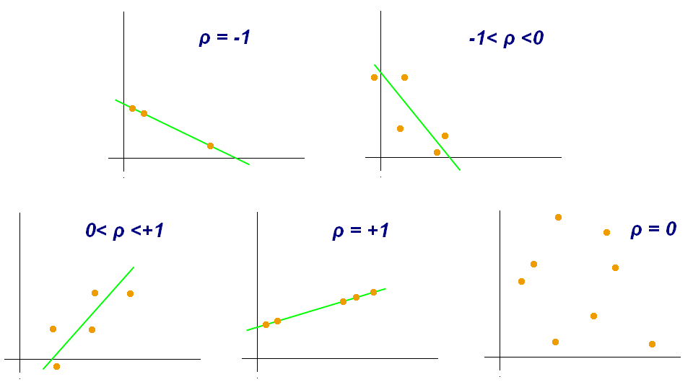
Corrélation
plot school weight vs height, correlés ? positifs ? negatifs ?
Définition: ?
positive vs negative
-1 < r < 1
Calculer la corrélation pour des variables discretes ?
The correlation coefficient is always a number between -1 and 1.
Positive correlation ( 0<r≤1 ) means that as one variable increases the other also increases. They move in the same direction.
Negative correlation ( −1≤r<0 ) means that as one variable increases the other decreases. They move in opposite directions.
A zero correlation ( r=0 ) means that the 2 variables are totally independent from each other.
Correlation of a variable with itself is always 1: corr(x,x)=1
Correlation is symmetric. For 2 variables x and y: corr(x,y)=corr(y,x)

Slide 4
Pearson correlation
Par defaut
Hypotheses
there is a linear relationship between the 2 variables i.e. y=ax+b
x and y both follow a normal distribution
Mais : the Pearson correlation is very robust with respect to these 2 assumptions

Slide 5
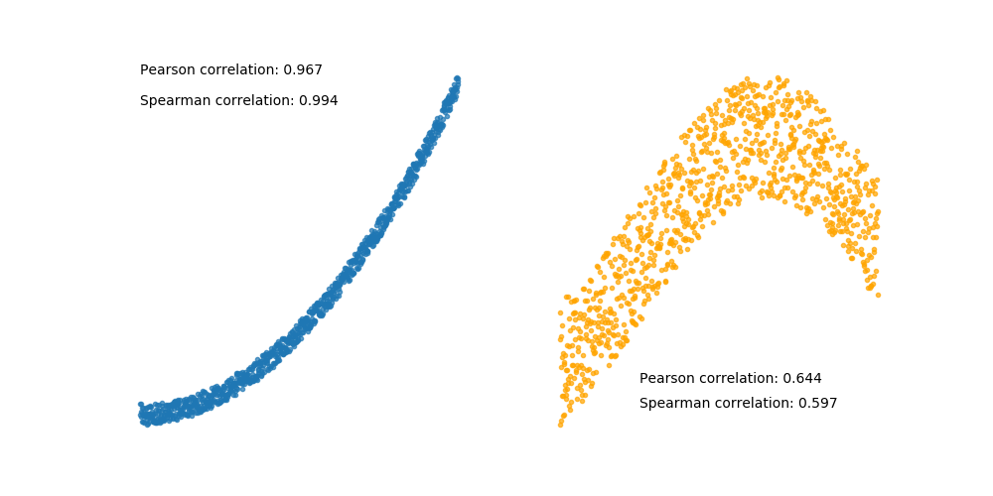
spearman: Spearman correlation doesn't make any assumptions on the distribution of the variables or on their relative linearity. Spearman is considered robust with respect to outliers while Pearson is more sensitive.
waldman: rank of the sample

Slide 6
Calculer correlation
Calcul
pandas: df.corr()
df.corr(method='pearson')
df.corr(method='spearman')
df.corr(method='kendall')
scipy

Slide 7
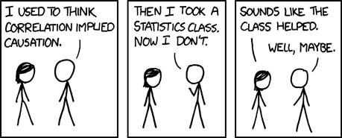
correlation is not causation
Context necessaire (suffisant?) pour que correlation => causation:

Slide 8
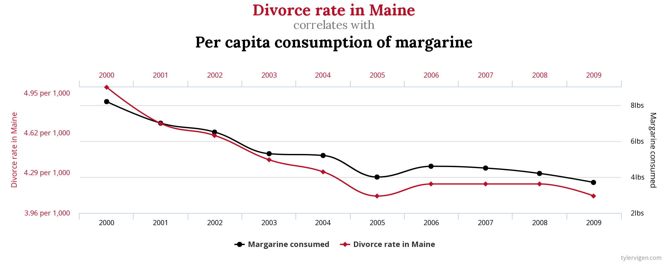

Slide 9
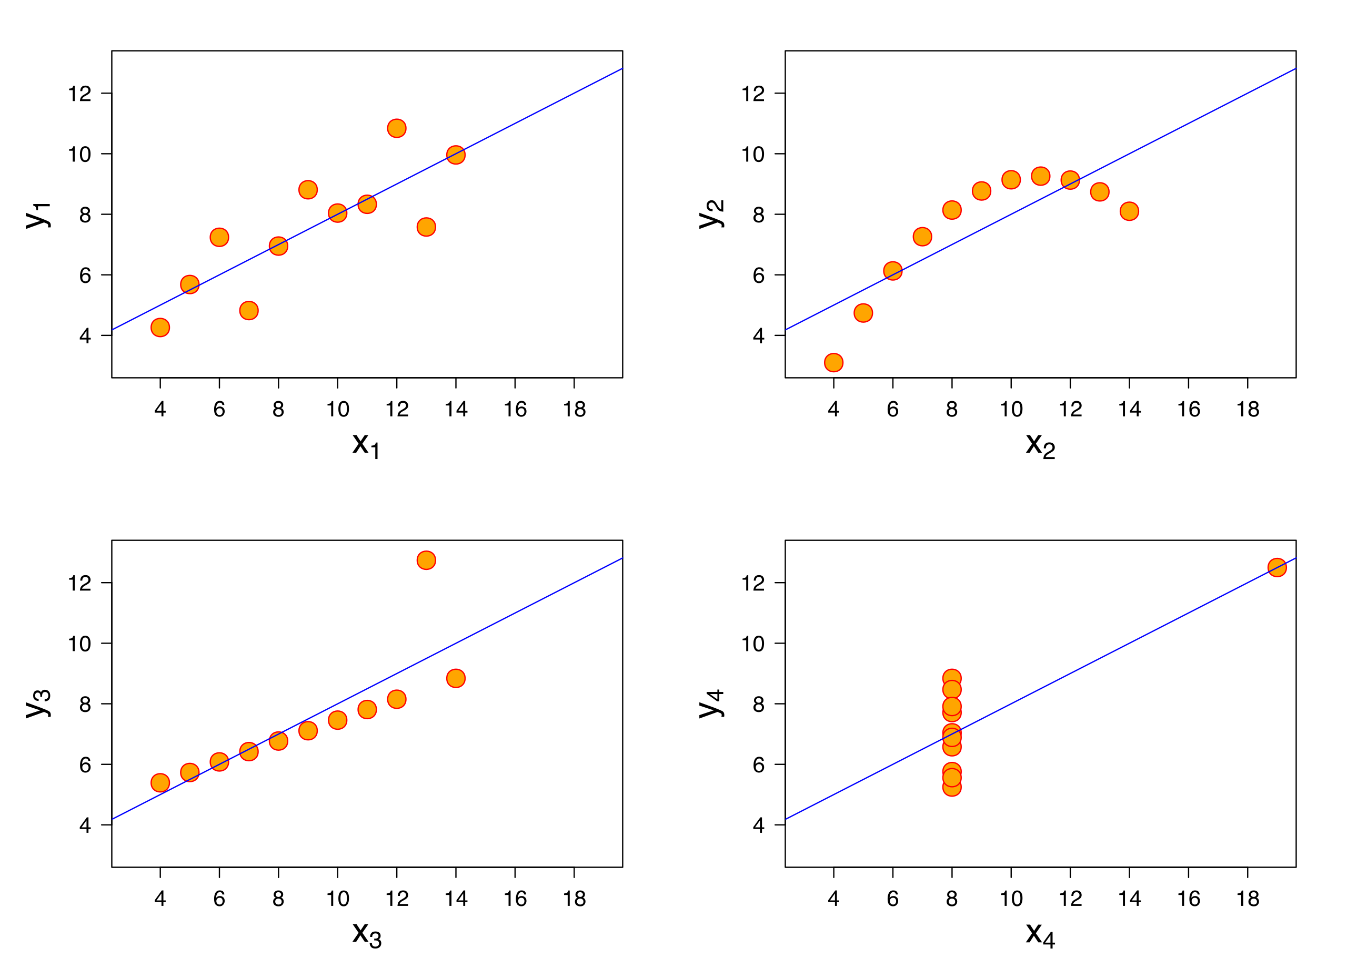
Anscombe Quartet
Francis Anscombe in 1973 to demonstrate the importance of visual exploration of the data.
All 4 datasets have only 11 points each. They look very different but share the same statistical properties:
mean and variance of x and y
correlation between x and y : r = 0.816
similar regression lines: y = 0.5 x + 3

Slide 10
A vous: datasaurus dataset
dans un notebook chargez le dataset datasaurus
plot les 12 datasets
calculer la correlation x,y pour chaque dataset
calculer la mean et variance des variables x et y
https://github.com/OpenClassrooms-Student-Center/Design-Statistical-Models/blob/master/P1CH3_02%20Anscombes%20Quartet%20DatasaurusDozen.ipynb

Slide 11
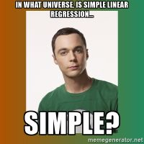
Régression Linéaire

Slide 12
Linéarité
Regression lineaire
f(x) est linéaire ssi
f(x + y) = f(x) + f(y)
f(a x) = a (fx)
y = ax + b
Non lineaire!
numpy
linear interpolation
seaborn : sns.regplot(x=df.TV, y=df.Sales)
plot mpg vs ….

Slide 13
Linear regression
Statsmodel library
univariate: y = ax + b
multivariate: y = a_1 x_1 + a_2 x_2 + … + a_n x_n + a_0
n predictors, variables, features, independent (exog) : x_1, … x_n
one target variable (dependent, endog): y
coefficients, regressors: a_0, a_1, …, a_n
y = w X
X design matrix
w : regression vector
http://www.statsmodels.org/stable/endog_exog.html#endog-exog

Slide 14
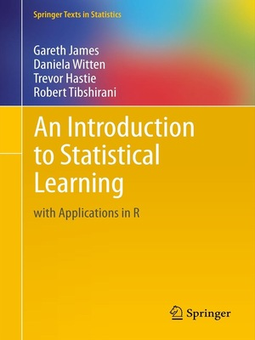
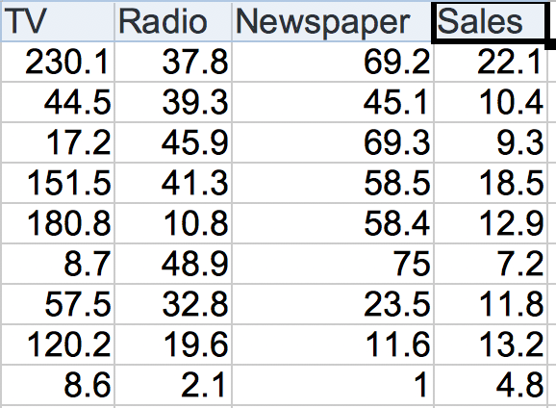
Advertising
200 échantillons avec 4 variables:
Target: Sales
Predictors: TV, Radio, Newspaper
Exploration:
Qualité des données
Correlation matrix
plot les variables les unes contre les autres

Slide 15
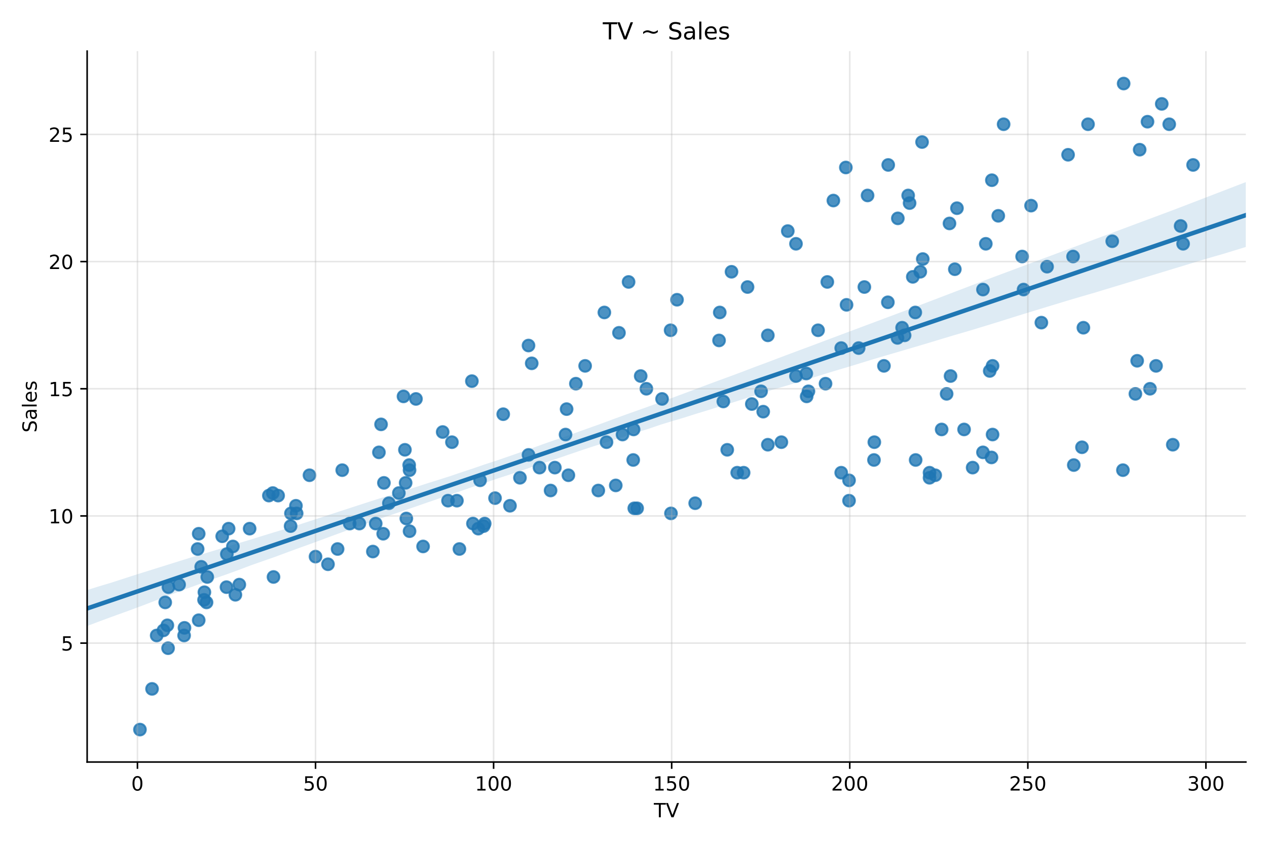
Application advertsing - statsmodel
statsmodel
conda / pip install statsmodel
Notation: definition du modele:
y ~ x
y ~ x_0 + x_1 + … + x_n
import statsmodels.api as sm
import pandas as pd
# Load the dataset
df = pd.read_csv('advertising.csv')
model = sm.OLS(y, X)
# Fit the model to the data
results = model.fit()
print(results.summary())

Slide 16
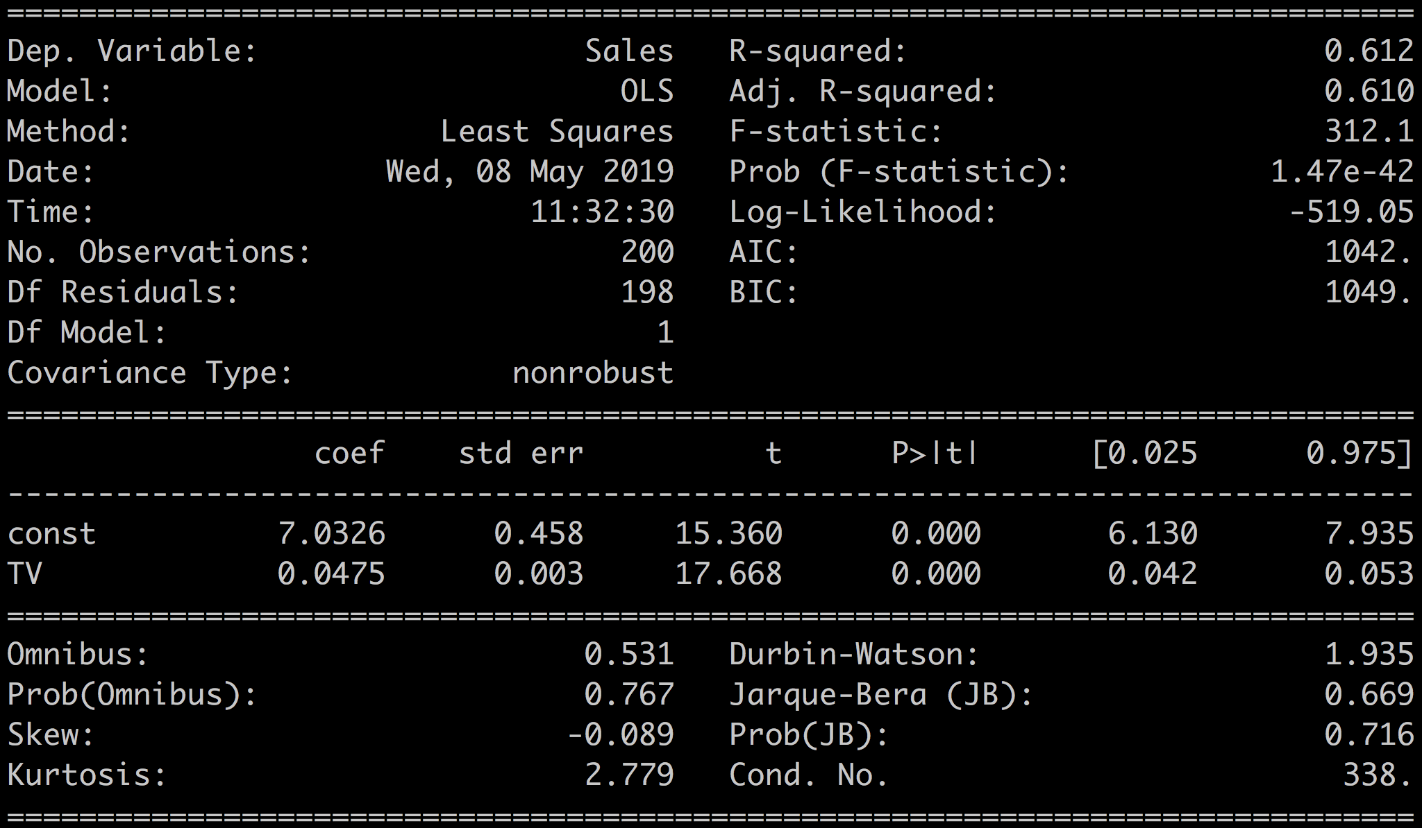
Sales ~ TV

Slide 17
Coefficients
coefficintes line

Slide 18
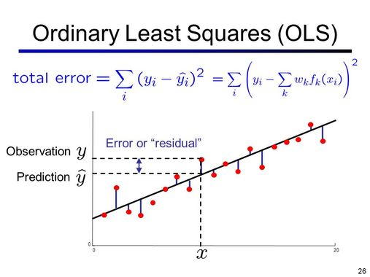
Ordinary Least Square

