Slide 1
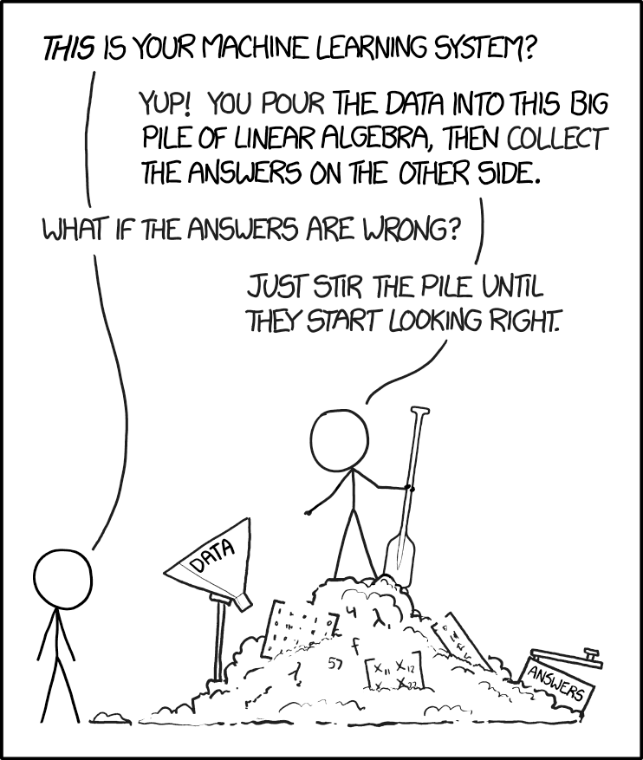
https://imgs.xkcd.com/comics/machine_learning.png

Slide 2
Présentations
Alexis Perrier
Data Scientist
PhD telecomParis 95' – Eric Moulines
Paris - Boston (Berklee) – DC (freelance)
Openclassrooms, UPEM, PCC @Polytechnique
alexis.perrier@pm.me
linkedin.com/in/alexisperrier
twitter: @alexip
Notes:
Tour de table

Slide 3
Programme Data Science 2019 -2020
Semaine | quoi | qui
23/09 au 27/09 | stats et regression | AP
30/09 au 04/10 | analyse predictive supervisée | AP
07/10 au 11/10 | non supervisé et intro au deep learning | Laurent Risser
14/10 au 18/10 | SVM – machines a vecteurs de support | Alice Martin
25/11 au 29/11 | NLP | AP
16/12 au 20/12 | Deep learning et datacamp | Chafik Samir et Eric Moulines
27/01 au 31/01 | Méthodes statistiques pour les expériences simulées | Fabrice Gamboa
24/02 au 28/02 | Analyse bayésienne et la programmation probabiliste | AP

Slide 4
Des stats au machine learning
L'approche statistique – 3 jours
L'approche machine learning – 5 jours
Python
jupyter notebook, colab, kaggle kernel, anaconda
librairies: numpy, scipy, statsmodel, scikit-learn, pandas
Analyse prédictive et performance
GLM & régression polynomiale
décomposition biais-variance
overfitting: détection et solutions
Linéarité et corrélation
tests statistiques
régression lineaire univariée, multivariée
classification, régression logistique
interpretation, diagnostique
hypothèses de la régression linéaire
bases mathématiques
Gradient stochastique
regularization
cross validation
Arbres de decisions
ensembling / bagging
random forests
feature engineering
imbalanced dataset
Boosting => Kaggle
XGBoost
LightGBM
CatBoost

Slide 5
Questions ?
Tour de table
C'est quoi le data science ?
Pourquoi avoir choisi cette option ?
Niveau en stats ?
Niveau en python ?
Github ?
Manque t il des choses dans ce programme ?
twitter ? kaggle ? insta ? linkedin ?
laptop ?
Votre question
alexis.perrier@pm.me
linkedin.com/in/alexisperrier
twitter: @alexip

Slide 6
Outils
Moodle
github
Slack ?

Slide 7
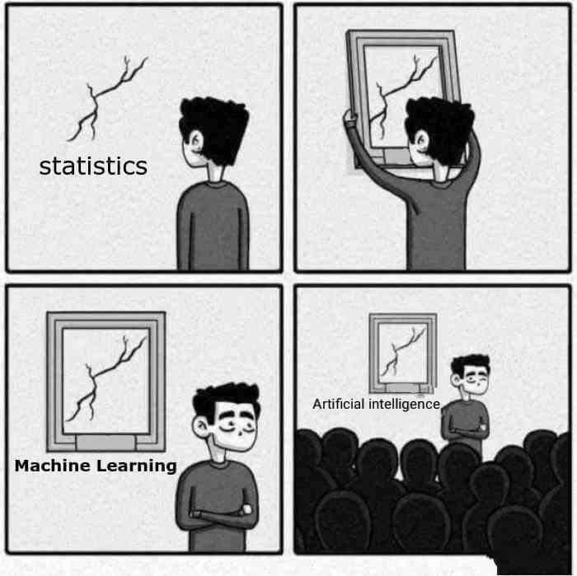
data science - machine learning - predictive analytics - intelligence artificielle - deep learning – statistiques ?

Slide 8
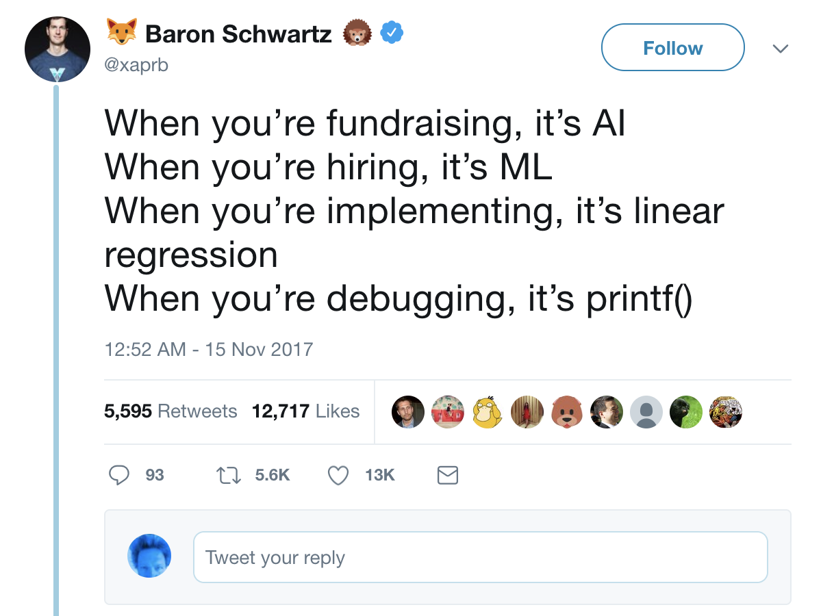

Slide 9
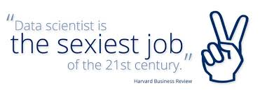
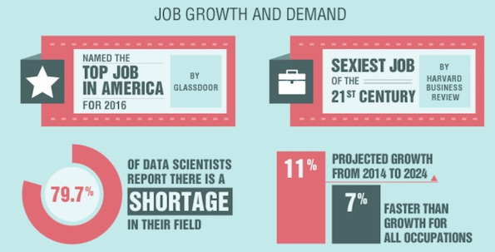
Don't believe the hype?

Slide 10
Application sur des données existantes
Data Analysis, Data Mining : Exploration, trouver les tendances, les evolutions, les anomalies, etudier les corrélations => data visualization, analyse non supervisée
Statistiques : Trouver le modèle qui explique au mieux toutes les données
Application a des données nouvelles (unseen data)
Machine learning : Le modèle apprend automatiquement à partir des données. apprentissage automatique
Analyse prédictive: Construire ou entrainer des modèles qui peuvent "prédire" sur des nouvelles données à partir de données existantes.
Deep Learning : Analyse prédictive supervisée avec des réseaux de neurones
Autres variantes: Transfer learning, reinforcement learning, …
Data Science:
Comprend toutes les techniques connues pour extraire de l'info des données
What is the difference between Data Analytics, Data Analysis, Data Mining, Data Science, Machine Learning, and Big Data?

Slide 11
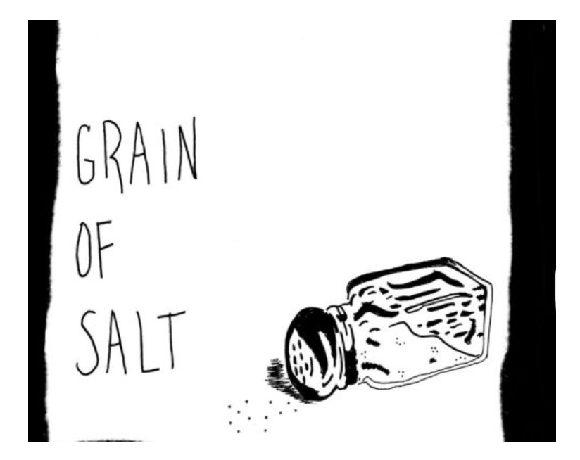
2001 Leo Breiman, Berkeley, publishes “Statistical Modeling: The Two Cultures”:
“There are two cultures in the use of statistical modeling to reach conclusions from data.
One assumes that the data are generated by a given stochastic data model. The other uses algorithmic models and treats the data mechanism as unknown.
The statistical community has been committed to the almost exclusive use of data models.
This commitment has led to irrelevant theory, questionable conclusions, and has kept statisticians from working on a large range of interesting current problems. Algorithmic modeling, both in theory and practice, has developed rapidly in fields outside statistics. It can be used both on large complex data sets and as a more accurate and informative alternative to data modeling on smaller data sets. If our goal as a field is to use data to solve problems, then we need to move away from exclusive dependence on data models and adopt a more diverse set of tools.”

Slide 12
la Data Science c'est quoi finallement?

Slide 13
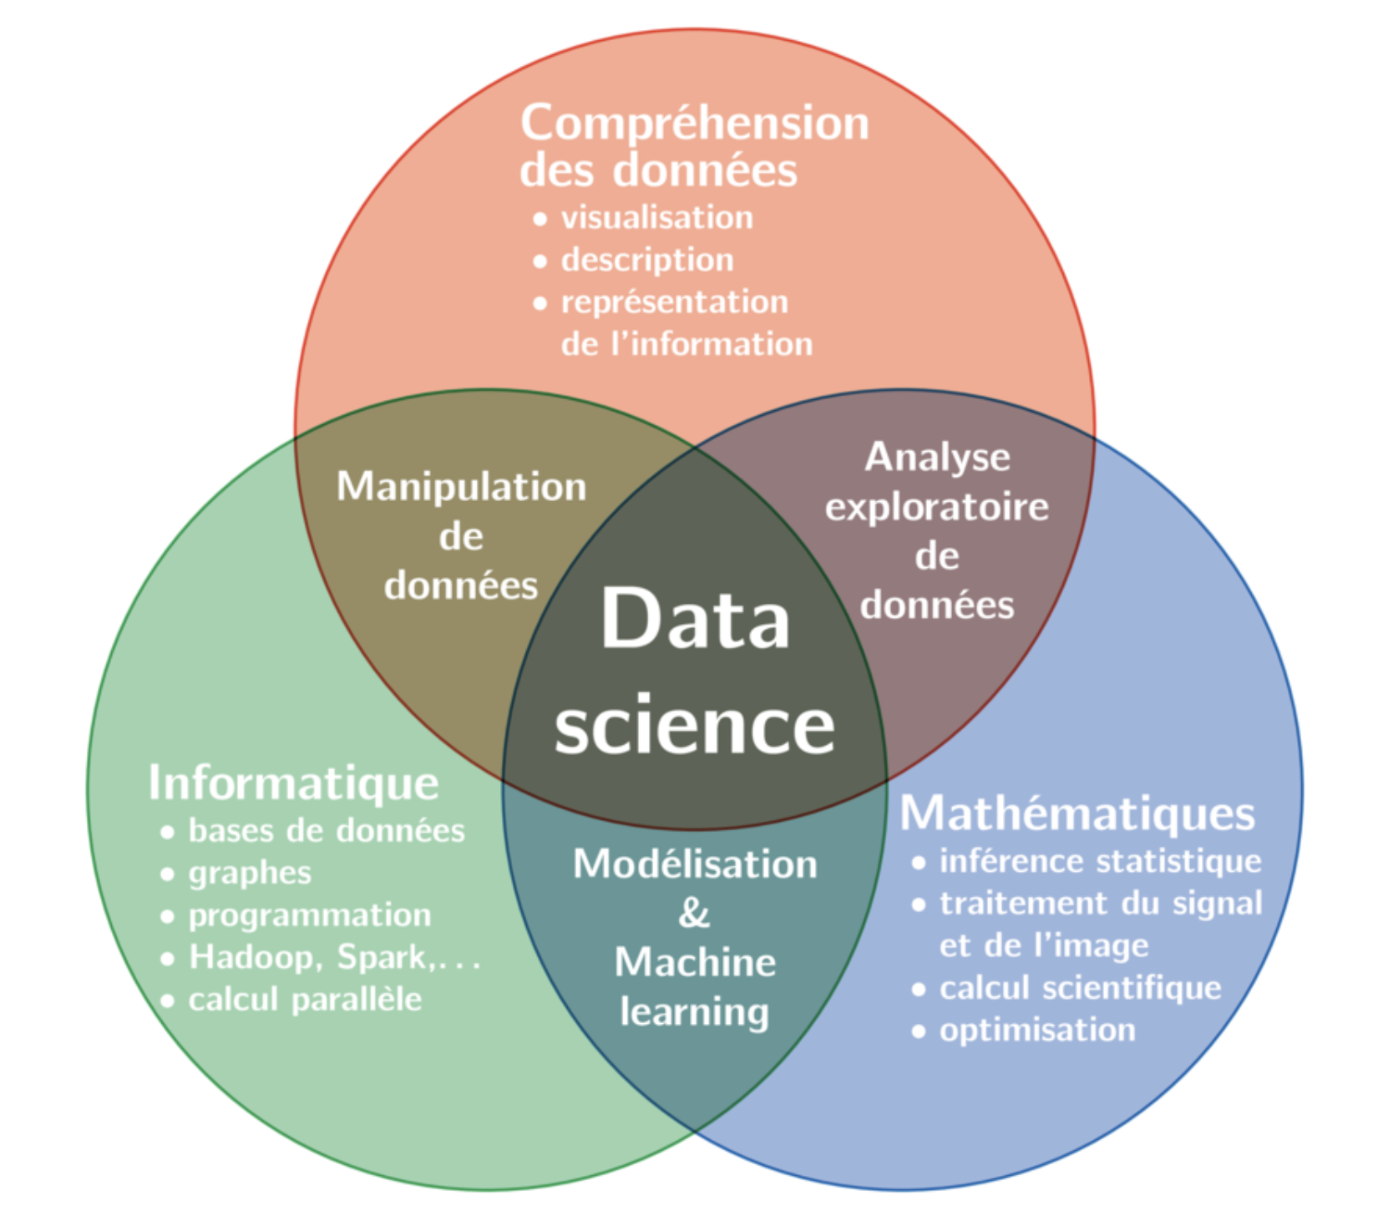
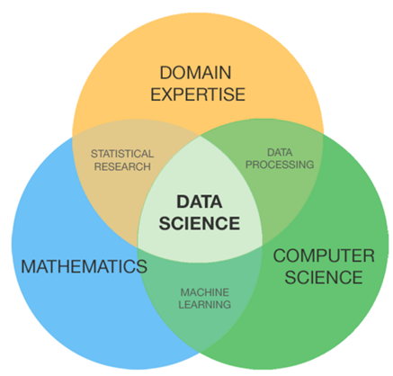

Slide 14
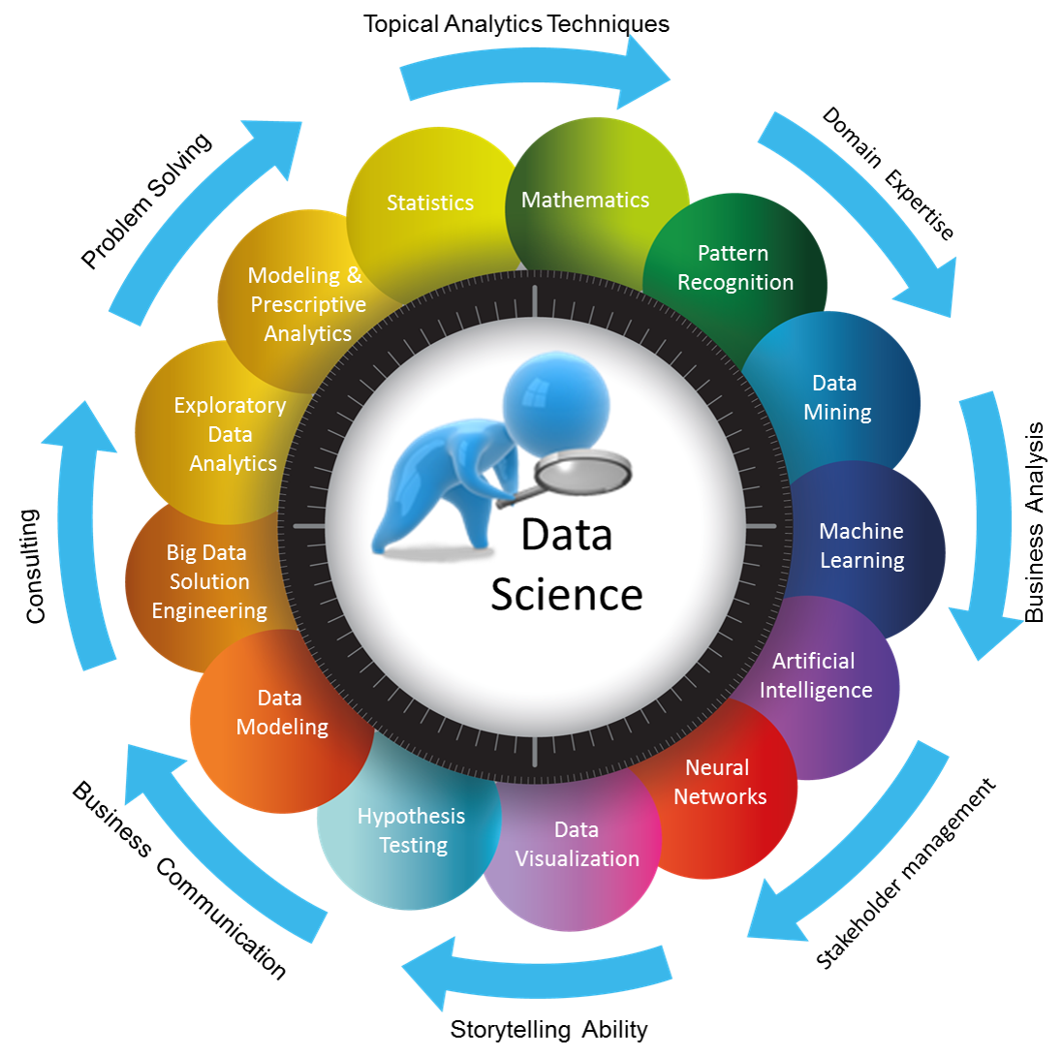

Slide 15
CHAMPS D'APPLICATIONS
Predictions: market, demand, supply prices, population, weather, earthquakes, ...
Patterns: customer behavior patterns
Detection: Spam, Fraud, Failures, Cyber attacks
Extracting meaning from large sets of data: handwritten health records, exoplanets
NLP: translation, speech to text, speech recognition, sentiment analysis, topic modeling, spell checking
Recommender systems: Netflix, Spotify, Amazon
Ranking systems: search results
Autonomous systems (reinforcement learning / AI): playing games, self driving cars, drones
Time series: algorithmic trading, signal processing, IoT, sales forecast
Image / Video: automatic captionning, face and object recognition, ...
deepindex

Slide 16
Questions?

Slide 17
Data science workflow

Slide 18
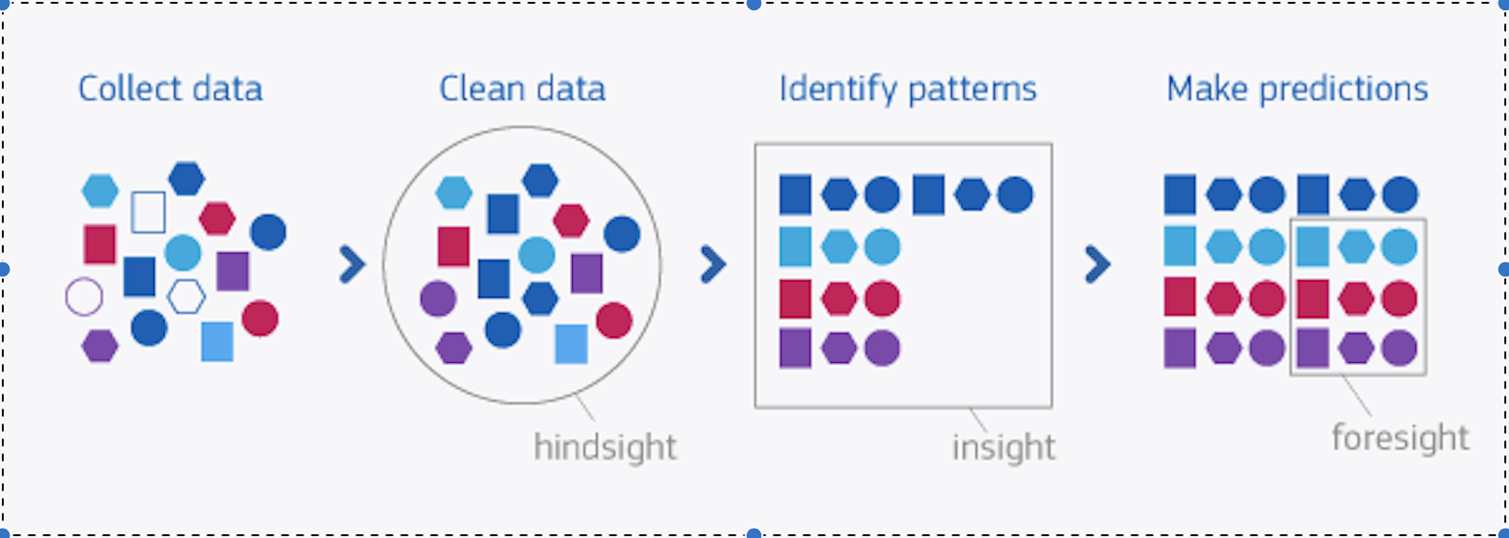

Slide 19
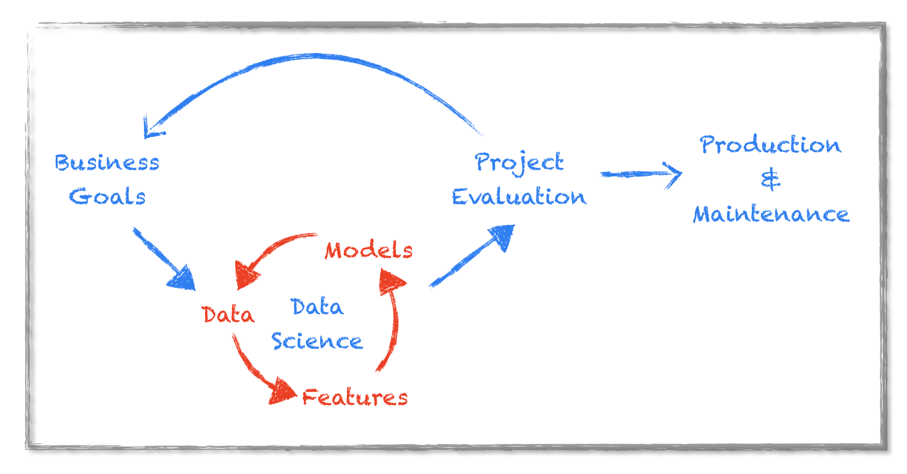

Slide 20
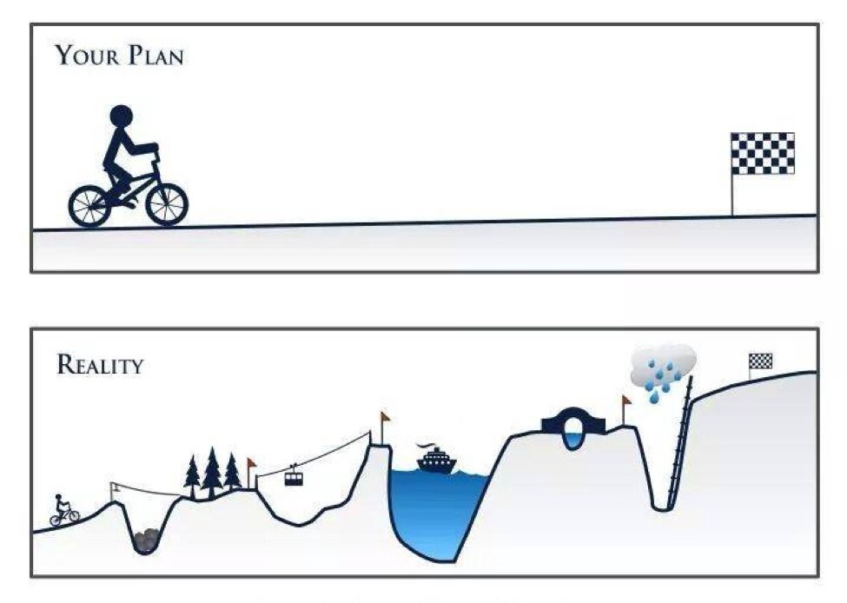
Les etapes d'un projet de Data Science
A) LES DONNÉES
1) Définir le problème 2) ETL: Extraction Transform Load 3) Travailler sur les variables
B) MACHINE LEARNING
4) Outils et plateforme 5) Modélisation 6) Le test des nouvelles données
C) NOUVELLE ITÉRATION 7) Présentation des résultats
8) reprendre le problème
D) MISE EN PRODUCTION

