Slide 1
Exploration 2 & Régression linéaire

Slide 2
Aujourd'hui: Régression linéaire
Linearité
Correlation, pearson, spearman, causation
Regression Lineaire
Univariée
Multivariée
interprétation des résultats:
coef,
R^2,
Log Likelihood
OLS: calculer les coefficients
5 Hypothèses de la régression
diagnostiques et solutions
cas gaussien : log-likelihood
diagnostics graphiques

Slide 3
Corrélation

Slide 4
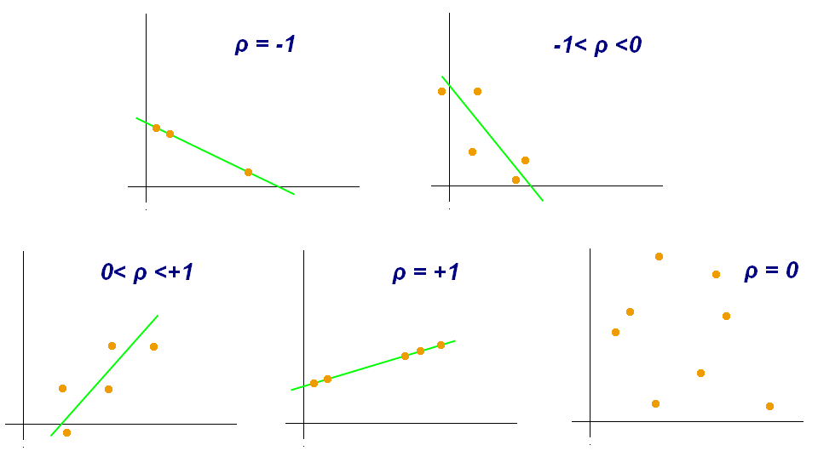
Corrélation
Mesure de la relation entre 2 variables
Le coefficient de correlation est toujours compris entre -1 et 1
Lorsque le coefficient est positif, les 2 variables varient de la meme façon
Lorsque le coefficient est négatif, les 2 variables varient de façon opposée
Une corrélation nulle (=0) indique que les 2 variables sont indépendantes l'une de l'autre
La corrélation d'une variable avec elle-meme est toujours =1: corr(x,x)=1
La corrélation est symétrique: corr(x,y)=corr(y,x)
Différentes corrélations: Pearson, Spearman, Kendall

Slide 5
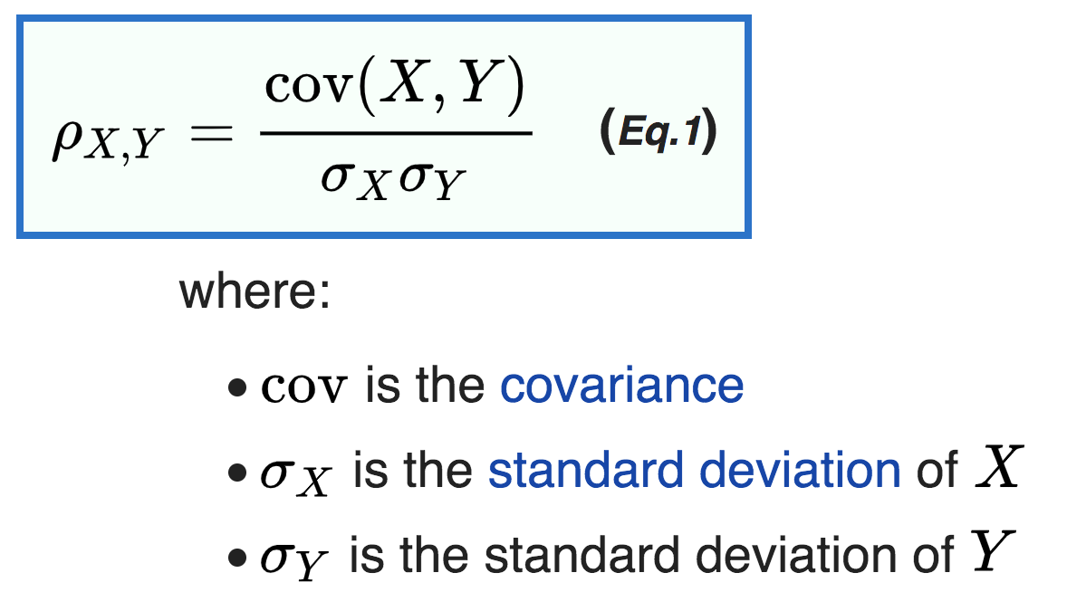
Corrélation de Pearson
Hypothèses
Il y a une relation linéaire entre les variables x et y: y=ax+b
x et y sont normallement distribuées ~N(mu, sigma)
Toutefois la corrélation de pearson est robuste vis a vis de ces hypothèses.

Slide 6
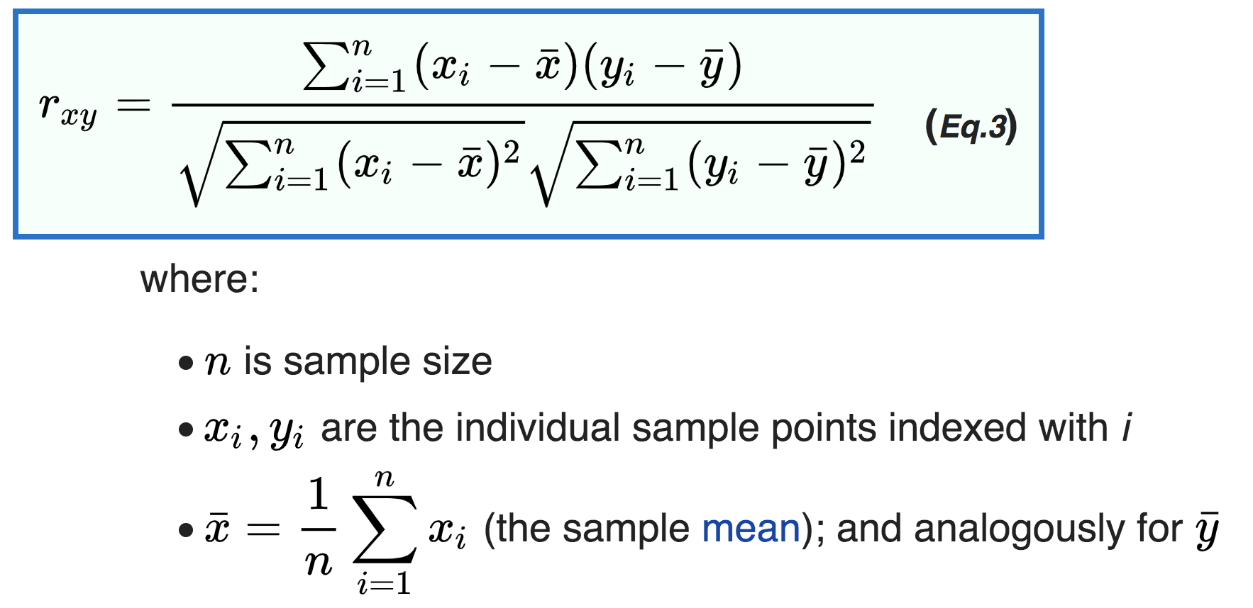
Corrélation de Pearson – cas discret

Slide 7
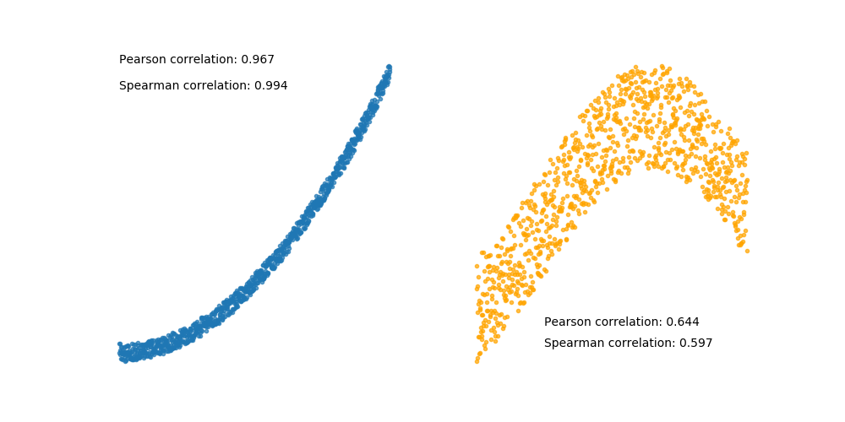
Corrélation de Spearman, de Kendall
Spearman:
Aucune hypothese sur la distribution des variables.
Plus robuste en présence d'outliers
Kendall
It is a measure of rank correlation: the similarity of the orderings of the data when ranked by each of the quantities.

Slide 8
Calcul de la Corrélation
Avec Pandas DataFrame, calcul de la matrice de corrélation
df.corr()
df.corr(method='pearson')
df.corr(method='spearman')
df.corr(method='kendall')
Avec Numpy
np.corrcoef(x, y) # Pearson
Visualisation de la corrélation
pd.scatter_matrix(df)
sns.pairplot(df)

Slide 9
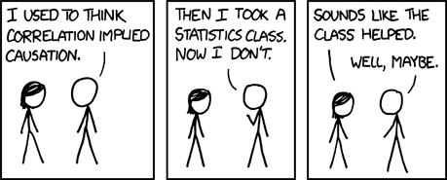
Correlation is not causation
Context necessaire (suffisant?) pour que correlation => causation:
Cependant:
La causalité implique la corrélation
https://medium.com/causal-data-science/if-correlation-doesnt-imply-causation-then-what-does-c74f20d26438

Slide 10
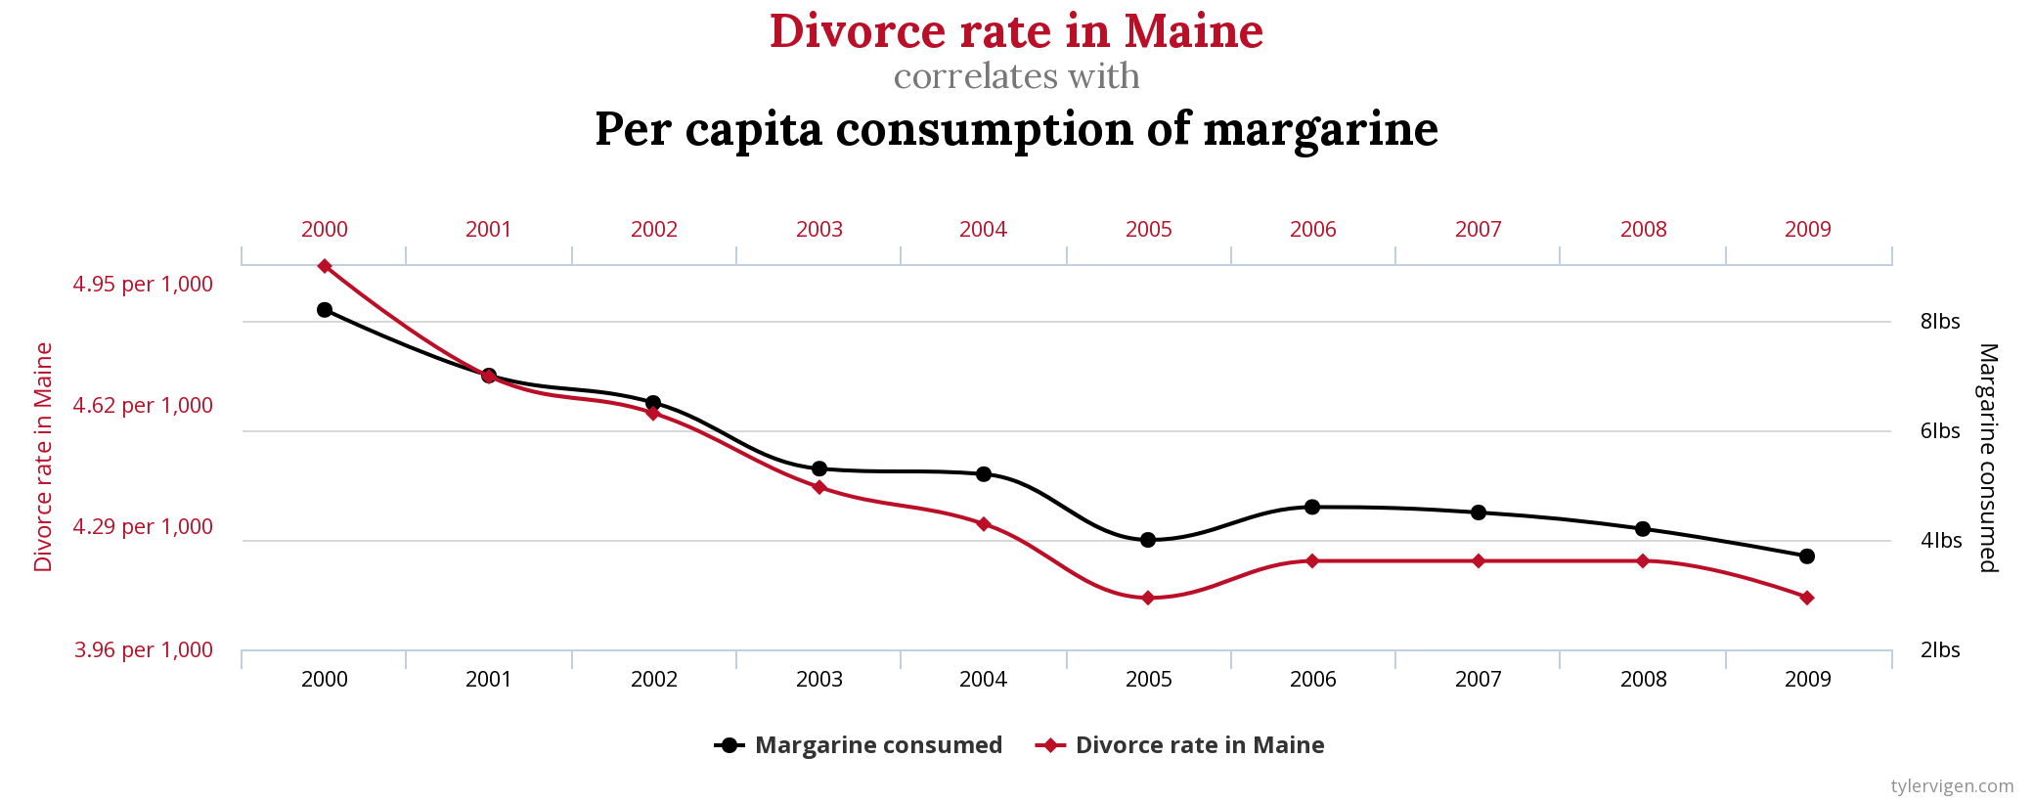
Correlation is not causation
https://www.tylervigen.com/spurious-correlations

Slide 11
Correlation pour des variables discretes?
Calculer la corrélation pour des variables discretes ?
oui quand les variables sont ordinales (ordonnées)
https://www.quora.com/Can-I-use-Pearsons-correlation-with-categorical-variables

Slide 12
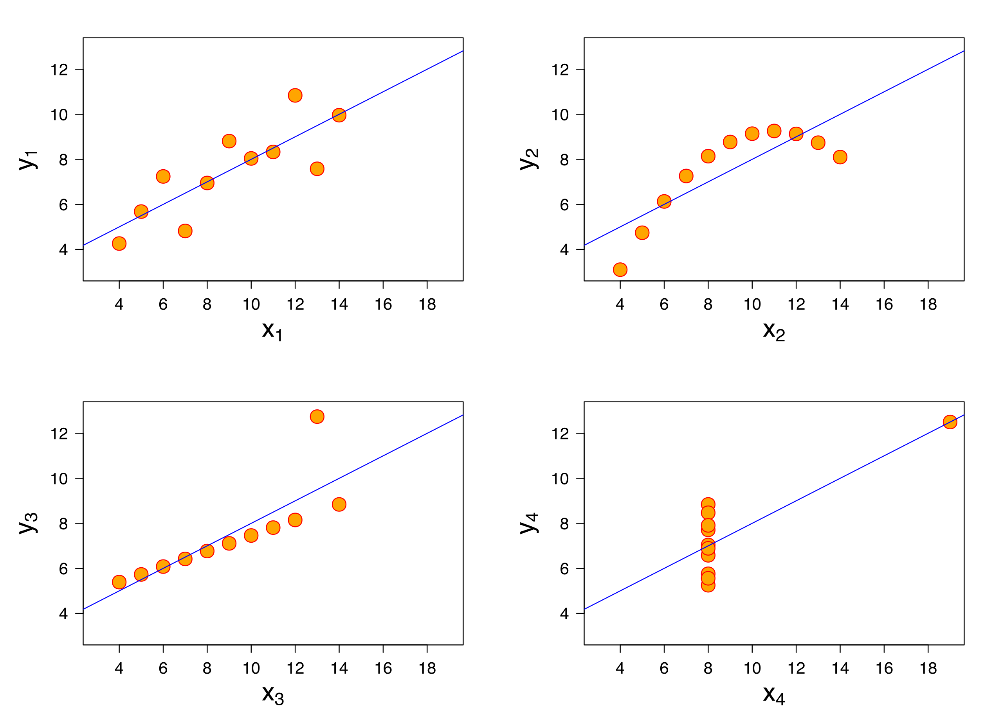
Anscombe Quartet
4 datasets créés par Francis Anscombe en 1973 pour montrer l'importance de la visualisation des données.
Les 4 datasets sont composés de 2 variables et 11 points:
meme moyenne et écart type
meme corrélation
meme ligne de régression

Slide 13
A vous: datasaurus
Dans un notebook, chargez le dataset datasaurus
plot les 12 datasets - plt.scatter()
calculer la correlation x,y pour chaque dataset
calculer la mean et variance des variables x et y
calculer la ligne de régression avec np.polyfit()
https://github.com/OpenClassrooms-Student-Center/Design-Statistical-Models/blob/master/P1CH3_02%20Anscombes%20Quartet%20DatasaurusDozen.ipynb

Slide 14
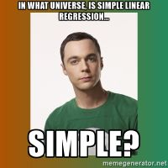
Régression Linéaire

Slide 15
Linéarité
f(x) est linéaire ssi
f(x + y) = f(x) + f(y)
f(a x) = a (fx)
y = ax + b
Non lineaire!
linear interpolation
np.polyfit(x=df.TV, y=df.Sales)
seaborn : sns.regplot(x=df.TV, y=df.Sales)

Slide 16
Linear regression - statsmodel
Statsmodel library
univariate: y = ax + b
multivariate: y = a_1 x_1 + a_2 x_2 + … + a_n x_n + a_0
y = w X
X design matrix
w : regression vector
http://www.statsmodels.org/stable/endog_exog.html#endog-exog

Slide 17
Linear regression - Vocabulaire
y = a_1 x_1 + a_2 x_2 + … + a_n x_n + a_0
y est la variable cible (target)
aussi appelée variable dépendente ou variable endogène (endog)
x_1, … x_n : predicteurs. regresseurs, variables, features,
mais aussi variables independentes, et variables exogènes (exog):
a_0, a_1, …, a_n sont les coefficients de la regression
y = w X
X design matrix
w : regression vector
http://www.statsmodels.org/stable/endog_exog.html#endog-exog

Slide 18
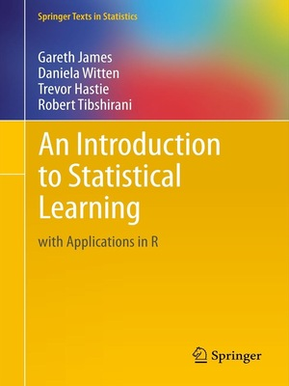
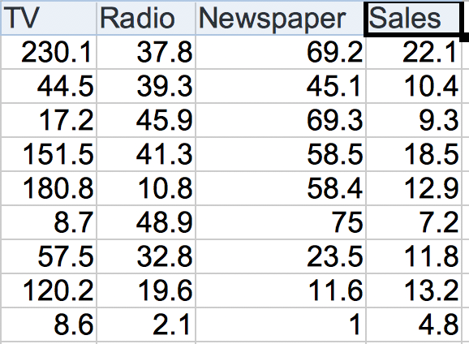
Advertising dataset
200 échantillons avec 4 variables:
Target: Sales
Predictors: TV, Radio, Newspaper
Exploration:
Qualité des données
Correlation matrix
plot les variables les unes contre les autres

Slide 19
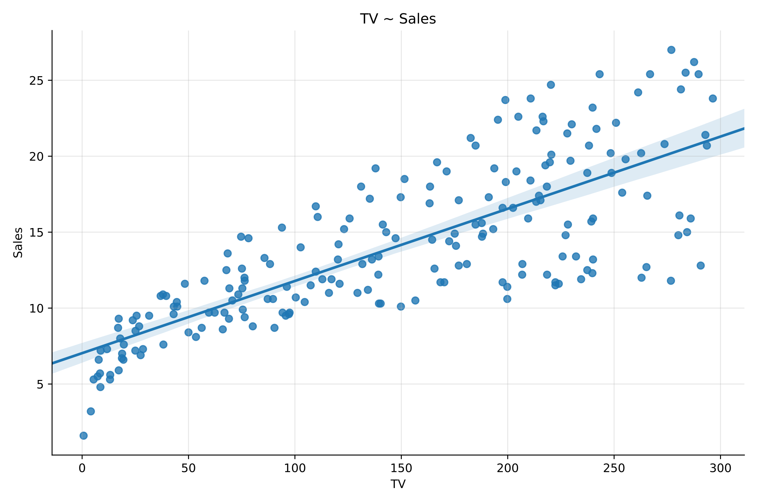
Application advertsing - statsmodel
statsmodel
conda / pip install statsmodel
Notation: definition du modèle:
y ~ x
y ~ x_0 + x_1 + … + x_n
import statsmodels.formula.api as smf
import pandas as pd
# Load the dataset
df = pd.read_csv('advertising.csv')
# définir le modèle
model = sms.ols( Sales ~ TV, data = df)
# Fit the model to the data
results = model.fit()
# Résultats
results.summary()

Slide 20
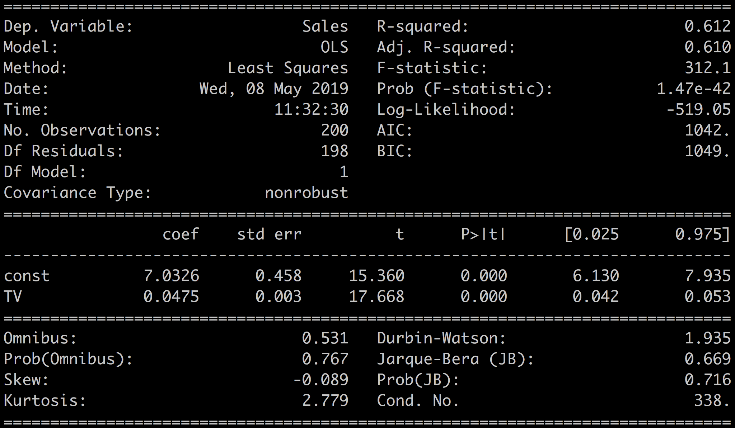
Sales ~ TV

Slide 21
Interpretation des Coefficients
results:
Fitted values: results.fittedvalues = results.params['TV'] * df['TV'] + results.params['const']
residuals: results.resid = df['Sales'] - results.fittedvalues
Les coefficients:
df.Sales = 0.0475 * df.TV + 7.0326
indication de la corrélation entre les variables
si on ne dépense rien en TV on vend quand meme 7.0326 unités
The coefficients are an indication of the correlation of your input variable(s) with the outcome.
The associated p-values and confidence intervals tell you how much trust you can put in these coefficient estimations. The p-value also tells you how confident you can be that each individual variable has some correlation with the outcome.
When the p-value > 0.05 or when the confidence interval contains 0, then the coefficients are not reliable.
The t and std error also give an indication of how much the coefficient varies around the estimated value. You want a high t and a low std error compared to the value of the coefficient.
std-error
t-test
p-value
confidence interval

Slide 22
The coefficients are an indication of the correlation of your input variable(s) with the outcome.
The associated p-values and confidence intervals tell you how much trust you can put in these coefficient estimations. The p-value also tells you how confident you can be that each individual variable has some correlation with the outcome.
When the p-value > 0.05 or when the confidence interval contains 0, then the coefficients are not reliable.
The t and std error also give an indication of how much the coefficient varies around the estimated value. You want a high t and a low std error compared to the value of the coefficient.

Slide 23
R^2
R-squared:
defined as the amount of variation of the target variable which is explained by your model.
R-squared is always positive and lower than 1. The rule of thumb is to have R-squared values around or superior to 0.75 but that truly depends on your data and your domain of application. In our case we have a R-squared of 0.612 which indicates that our very simple model only accounts for 61% of the variability in Sales. This can surely be improved.

Slide 24
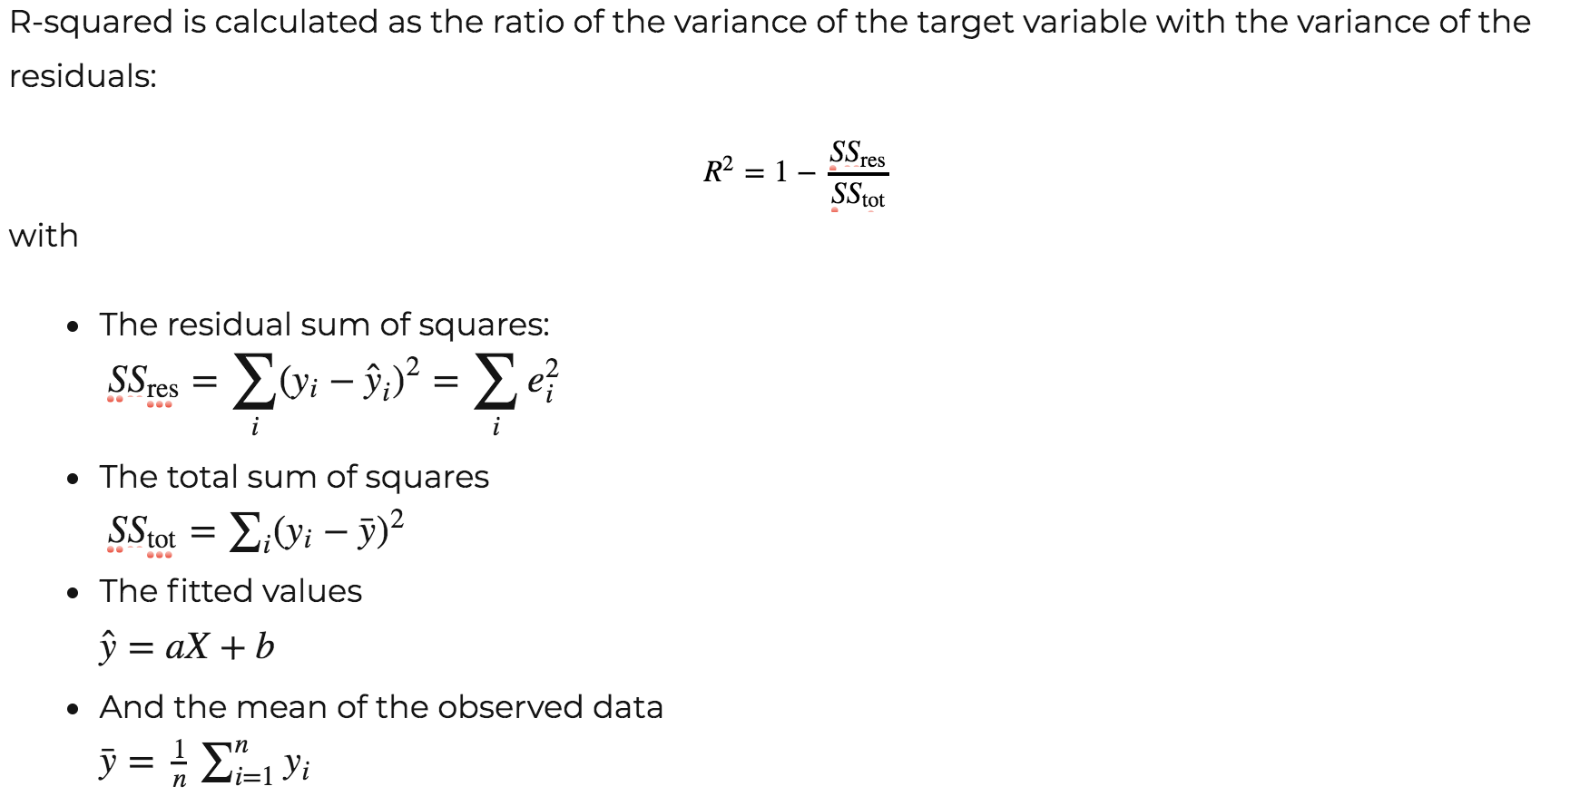

Slide 25
Diagnostiques graphiques

Slide 26
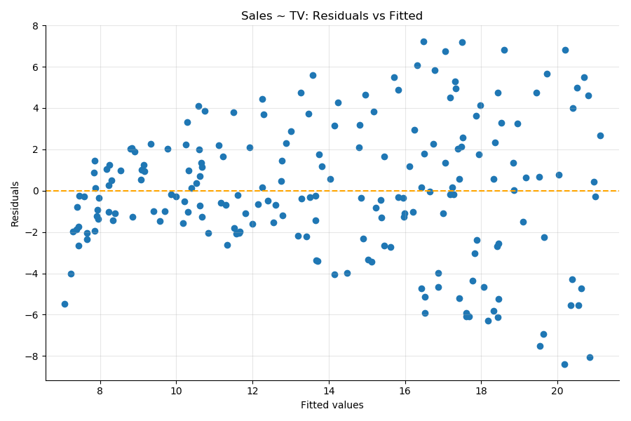
Residuals vs Fitted
expose non-linear relations between the input variables and the outcome. When your plot shows that the residuals are equally spread around a horizontal line without distinct patterns it's a good indication that your data does not have non-linear relationships.

Slide 27
Autres métriques
Adj. R-squared: R-squared avec une pénalité liée au nombres de variables du modèle, sa complexité.
Adj. R-squared permet de voir si un modèle plus complexe explique réellement mieux les données
Comparer Adj. R-squared et R-squared
The F-statistic et la p-value associée indique si le modèle est meilleur qu'un modèle vide
H0: les coefficients sont tous égaux à 0
F Stat permet de dire si le R-squared est significatif
Le Log-likelihood mesure la probabilité d'obtenir chaque échantillon des données avec le modèle en question.
toujours négatif
plus proche de 0 <=> meilleur modèle
AIC et BIC: estimation de la quantité d'information du dataset qui n'est pas pris en compte par le modèle
AIC = n – log-likelihood
BIC : k log(n) – log-likelihood
Discussion AIC vs BIC

Slide 28
Récapitulatif: pertinence du modèle
Coefficients | Influence of the predictor on the outcome when all other predictors are kept constant
P(t) | P-value of the coefficient | Smaller = better When p(t) > 0.05 the coefficient is unreliable
Confidence interval | The 2.5% - 97.5% interval for the coefficient | Smaller = better If the confidence interval contains 0, the coefficient is not reliable
Std Err. | The standard error is an estimate of the variations of the coefficient. | Smaller = better
t-statistic | The coefficient divided by its standard error. | Smaller = better

Slide 29
Récapitulatif: comparaison de modèles
R-squared | Amount of variation of the outcome explained by your model. | Bigger = Better
Adj. R-squared | R-squared adjusted for model complexity | Bigger = Better
Log-likelihood | A measure of the probability of observing the data samples if the dataset was generated by the model | Always negative Bigger = Better
F-statistic | Measures performance of the model compared to a constant only model | Bigger = Better Always > 1 if F = 1, the model is not better than a constant value
F-proba | P-value associated to the F-statistic | if F-proba > 0.05, the model is not better than a constant based model
AIC & BIC | Measure the performance of the model balancing the complexity and the log-likelihood | Bigger = Better Relative values

Slide 30
A vous
Definir, fitter et interpreter les 2 modeles:
Sales ~ Radio
Sales ~ Newspaper

Slide 31
The plot thickens

Slide 32
Regression versus correlation
Both regression and the correlation coefficients are a measure of the influence of the predictor on the outcome. However, they differ in the way they represent that influence.
In the univariate case, regression and correlation coefficients share the following properties:
The regression coefficient is equal to Pearson's correlation coefficient.
The square of Pearson's correlation coefficient is the same as the R-squared.
However, regression and correlation coefficients are different measures of the data. Here are a couple of differences:
Correlation is symmetrical while linear regression is not. Swapping the outcome with one of the predictor in multivariate regression will not give you the same coefficients.
Linear regression can be used to make predictions, correlation coefficient cannot.
Correlation works for non-linear relations between variables while linear regression works on linear relationships.
So correlation and regression are complementary but intrinsically different ways of measuring the coupling between variables.
Demo

Slide 33
Standardizing your data
In fact, standardizing the variables will change the value of the regression coefficients, but will not influence the conclusions of the regression.
Demo

Slide 34
Multivariate

Slide 35
Sales ~ TV + Radio + Newspaper
Quel est le meilleur modèle?
Sales ~ TV + Radio + Newspaper
ou
Sales ~ TV + Radio + Newspaper
Et le modèle:
Sales ~ TV + Radio + TV * Newspaper

Slide 36
Log likelihood dans le cas gaussien
Comment sont calculés les coefficients?

Slide 37
Log likelihood dans le cas gaussien

Slide 38
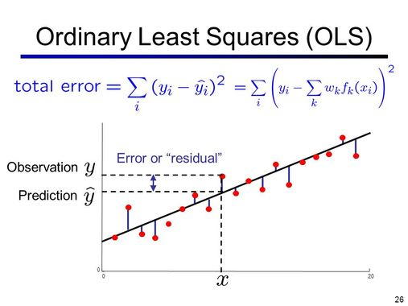
Ordinary Least Square

Slide 39
Loss-function of OLS
https://blog.algorithmia.com/introduction-to-loss-functions/

Slide 40
Les 5 hypothèses de la régression linéaire

Slide 41
Hypothèses de la régression linéaire
Linearité: la relation entre les prédicteurs et la cible est a peu près linéaire
Collinéarité: les prédicteurs ne sont pas corrélés
Autocorrelation des residus: les residus ne sont pas auto corrélés
Les residus sont normallement distribués
Homoskedasticité: la variance des résidus est stable

Slide 42
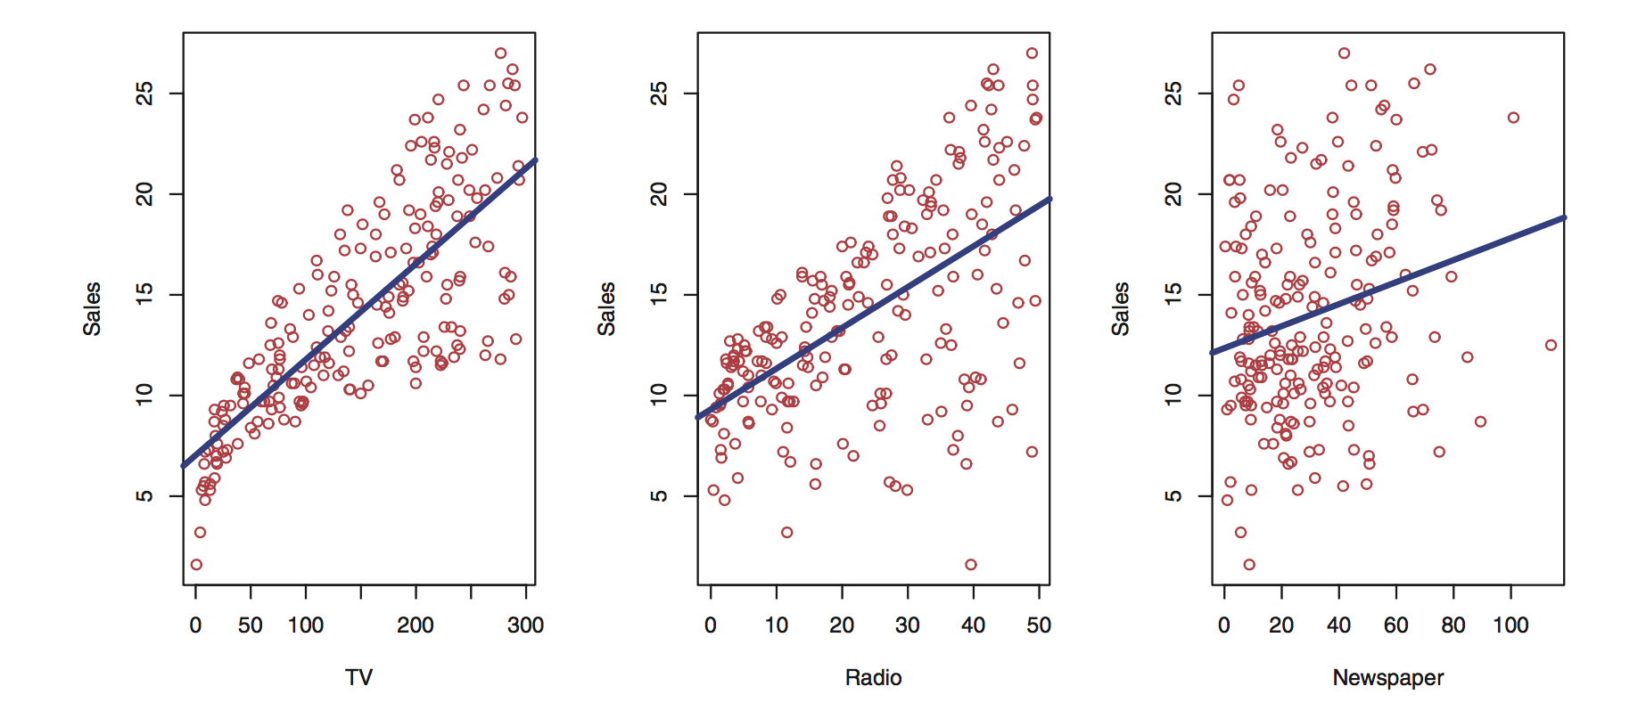
Linearité
Evaluation graphique avec
le scatterplot V1 ~ V2
le residus vs fitted
Correction:
Transformation du predicteur
A vous: Comparer
Sales ~ TV
Sales ~ sqrt(TV)
Sales ~ TV ^ 2
plot
fit model
R-squared, p-values, …
plot residuals vs fitted

Slide 43
Multi-Collinéarité
Les predicteurs sont corrélés – matrice de corrélation
Un facteur caché est commun a 2 predicteurs
Detection:
Condition Number (pour des variables normalisées):
valeur < 20
Variance Inflation Factor (VIF)
mesure le degré de multi collinéarité due a l'ajout d'un nouveau prédicteur
from statsmodels.stats.outliers_influence import variance_inflation_factor as vif
vif(df[['TV', 'Radio', 'Newspaper']].values, 0)
> 0.247
vif(df[['TV', 'Radio', 'Newspaper']].values, 2)
> 3.055

Slide 44
Autocorrelation des résidus
e_i = \hat{y_i} – y_i
corr(e_i, e_{i-j}) = 0 for j !=0
The Durbin Watson statistic, is a direct test of the correlation of the residuals.
It takes a value from 0 to 4, where:
2 means no autocorrelation.
0 to 2 means positive autocorrelation
2 to 4 means negative autocorrelation.
As a rule of thumb values in the range of 1.5 to 2.5 are relatively normal.

Slide 45
Normalité des résidus
plot the histogram of the residuals and compare it with the histogram of a normal distribution.
Using a Kolmogorov-Smirnov test for goodness of fit.
Shapiro test
Jarque-Bera statistic
Drawing the QQ plot

Slide 46
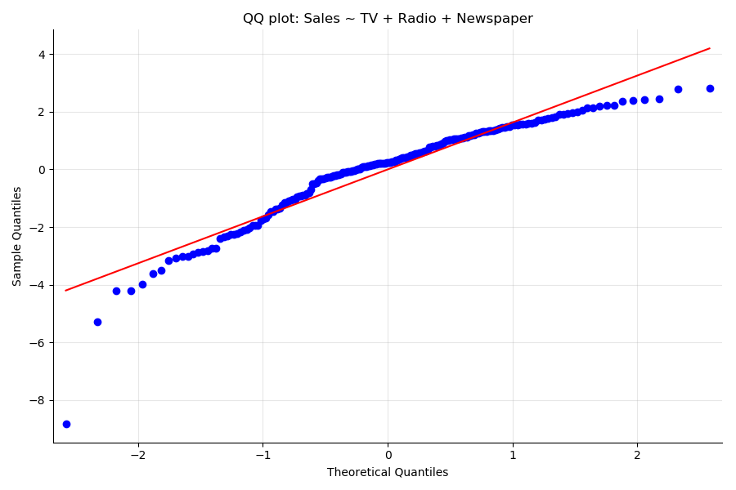
QQ plot
A QQ plot or quantile-quantile plot compares the probability distributions of 2 variables by plotting their quantiles against each other.
When the variables follow the same distribution, the points follow a straight line.
sm.qqplot(results.resid, line='r')
# Compare with a normally distributed variable
# Generate 200 points of a N(0,1) distributed variable with numpy
test = np.random.normal(0,1, 200)
# Plot the QQplot with statsmodel
sm.qqplot(test, line='r')

Slide 47
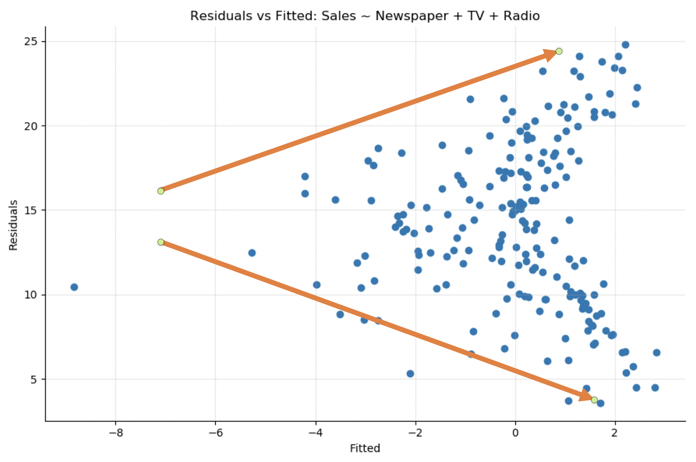
Stabilité de la variance des résidus Heteroskedasticité

Slide 48
Récapitulatif des hypothèses
Assumption | Meaning | Test
Linearity | There's a linear relation between the predictors and the outcome | plot predictor vs outcome plot residuals vs fitted
Collinearity | The predictors are not correlated to each other | Correlation matrix VIF Condition Number < 20
Autocorrelation | The residuals are not correlated to each other | Durbin-Watson, Ljung-Box tests
Normality | The residuals are normally distributed | Kolmogorov-Smirnoff or Jarque-Bera tests QQ-plot Histogram of residuals
Homoskedasticity | The variance of the residuals is constant | Residuals vs fitted plot ‎Breusch–Pagan test

Slide 49
Lab: Ozone
Ozone dataset
Analyse complete univariée et multivariée
meilleur modele?
transformation des predicteurs
log de la cible

