Slide 1
Arbres et Forets

Slide 2
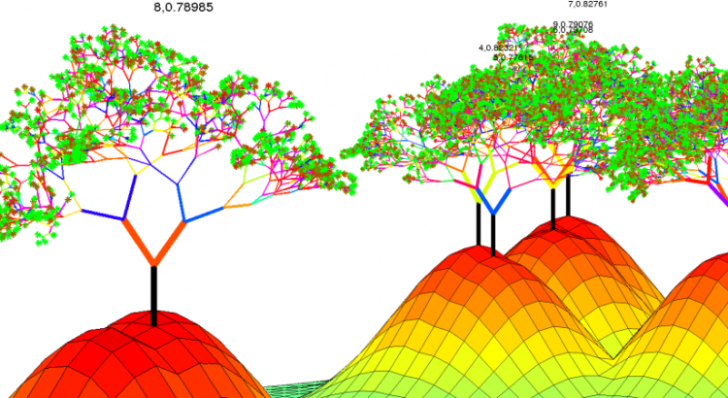
Programme
Arbres de décisions
Random Forest
Feature importance
Imbalanced datasets et sampling
Multinomial classification

Slide 3
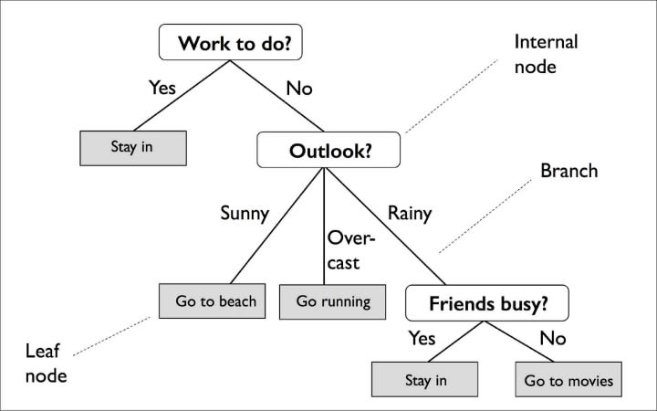
Arbres de décision

Slide 4
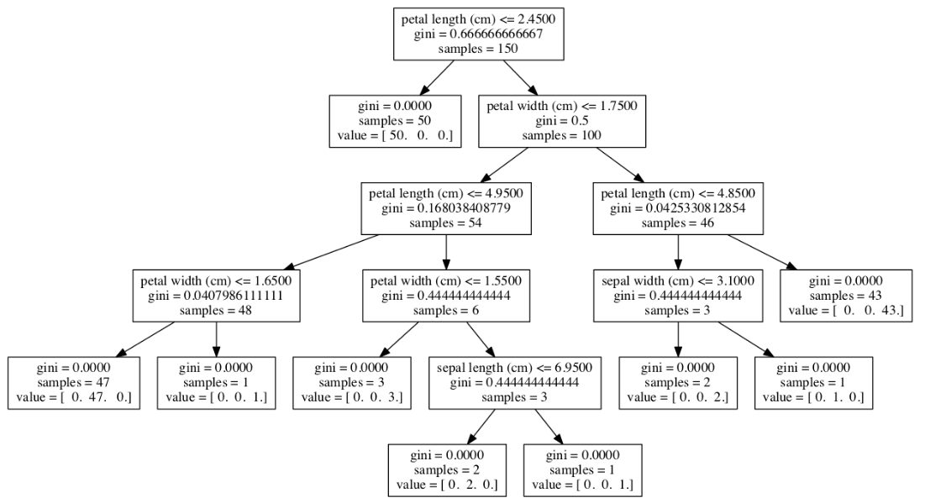
Arbres de décision
Appliqué au dataset Iris

Slide 5
Arbres de décision
AVANTAGES
Robustes, rapides et interpretables
Simple to understand and to interpret. Trees can be visualised.
Requires little data preparation. (missing values, scaling, dummy variables, ...)
Can handle both numerical and categorical data.
Possible to validate a model using statistical tests.
Uses a white box model. An observed situation can simply be explained by boolean logic.
MAIS
high overfitting for over-complex trees that do not generalise the data well.
Decision trees can be unstable because small variations in the data might result in a completely different tree being generated.
no globally optimal decision tree
Pruning: limiter la profondeur des arbres

Slide 6
Arbres de décision
Set these params to control the tree complexity
max_depth (pruning): The maximum depth of the tree
min_samples_split: The minimum number of samples required to split an internal node
min_samples_leaf: The minimum number of samples required to be at a leaf node.
max_features: The number of features to consider when looking for the best split

Slide 7
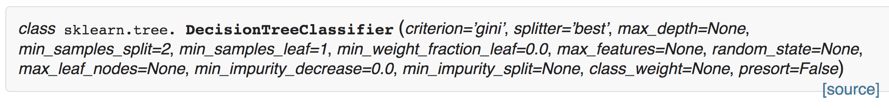
A vous – Arbres de décision
BIAIS - VARIANCE
DEEP
Low bias, high variance
Overfitting
SHALLOW (SHORT)
High bias, low variance
Underfitting
Shallow decision trees have high bias and low variance.
Deep decision trees have low bias and high variance.

Slide 8
Random Forests
Bagging decision trees

Slide 9
Bagging trees
Arbres profond => overfitting
Ensemble : moyenne de la prédiction de chaque arbre sur un echantillon bootstrappé
reduit l'overfit
Arbres peu profond
Ensemble: Réduit le biais, améliore la performance
=> lab / demo

Slide 10
OUT OF BAG - OOB
When boostrapping, in each experiment will use only approx. 2/3rd of the available samples.
Which leaves 1/3rd that we can use to estimate the validation error of each tree.
This is called OOB Out of Bag error.
It can be shown that with B sufficiently large, OOB error is virtually equivalent to leave-one-out cross-validation error.

Slide 11
Random Forests
Extension of bootstrapping to features
In random forests, each tree in the ensemble is built from a sample drawn with replacement (i.e., a bootstrap sample) from the training set.
In addition, when splitting a node during the construction of the tree, the split that is picked is the best split among a random subset of the features.
=> The bias slightly increases compared to the bias of a single non-random tree
=> but, due to averaging, its variance decreases,
usually more than compensating for the increase in bias, hence yielding an overall better model.
A Random Forest is a generalization of Bagging that is specific to Decision Trees.
At each branch in the decision tree, Random Forest training also subsamples the features in addition to the training examples.
Intuitively, this process further de-correlates the individual trees, which is good for Bagging.

Slide 12
Random Forests
FEATURE IMPORTANCE
When the max_features < total number of features.
=> Some features are left out of the splitting decision in each node.
Relative Feature importance can be deduced from the delta in MSE associated to the features included vs left out.

