Slide 1
Régression logistique

Slide 2
Programme: Regression logistique
Classification ≠ regression
Regression logistique
function logit
Stats vs ML, 2 cultures
Matrice de confusion
AUC
Logistic regression with scikit / numpy
Categorical predictors,
dummy encoding, binary encoding

Slide 3
Variable cible est catégorique – classification binaire
L'output de la regression linéaire est continue
Problème:
induire un ordre arbitraire entre les classes
Chats < Chien ? ou Chien < Chats
Comment choisir un seuil de separation ?
Classification binaire
Utiliser la régression linéaire
Contraindre l'output de la regression dans [0, 1]
logit function
Interpreter le resultat comme probabilité d'appartenance à une catégorie
Définir un seuil arbitraire Tau = 0.5
Appliquer la règle:
si T< 0.5 => \hat{y} appartient a classe 0
sinon => \hat{y} appartient a classe 1

Slide 4
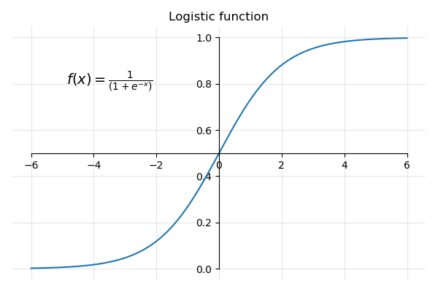
Logistic function

Slide 5
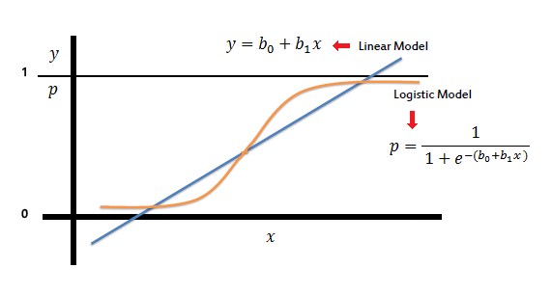

Slide 6
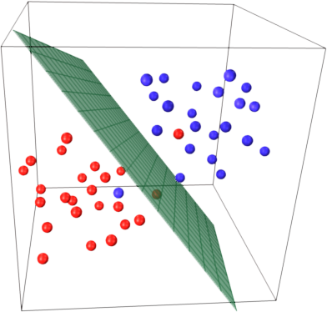
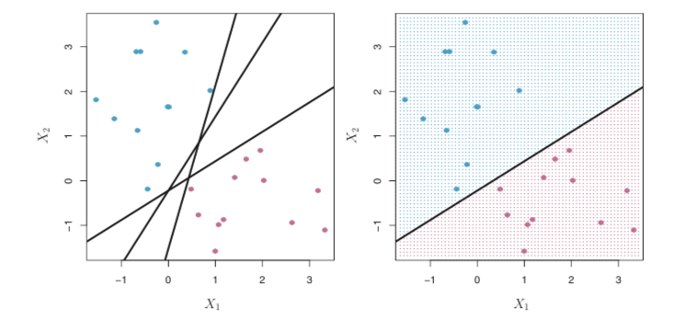
Trouver un hyperplan
2D
y = a_1 x_1 + a_0
3D
y = a_1 x_1 + a_2 x_2 + a_0

Slide 7
Credit default dataset
Predicteurs:
continuous variables: balance, and income
binary variable: student which indicates if the person is a student or not
Variable cible: default which indicates whether the person defaulted on his/her credit loan.
Default is a binary variable that takes the values yes and no. with the following counts:
No (0) 500
Yes (1) 333
import statsmodels.formula.api as smf
import pandas as pd
# Load the dataset
df = pd.read_csv(credit_default_sampled.csv')
# définir le modèle
model = smf.logit('default ~ income + balance', data = df)
# Fit the model to the data
results = model.fit()
# Résultats
results.summary()

Slide 8
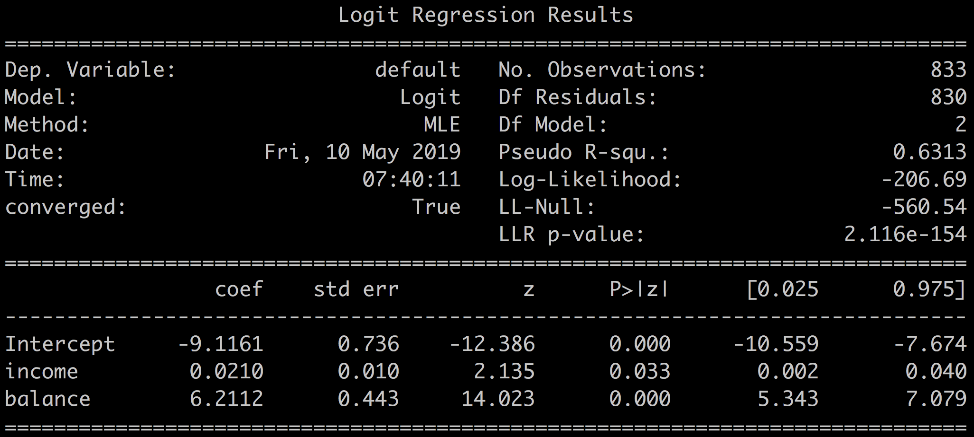
default ~ income + balance
R-squared
F-statistic
t-statistique

Slide 9
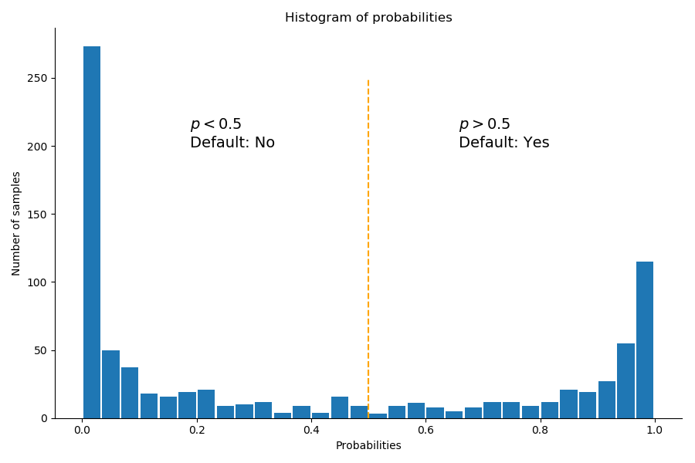
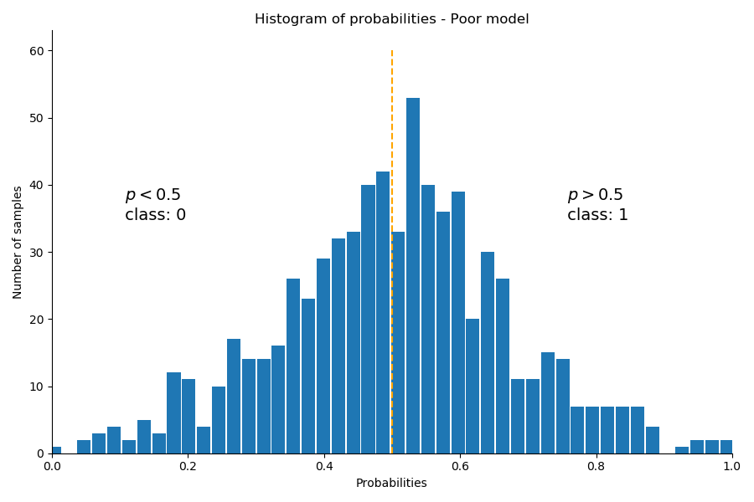
L'histogramme des valeurs estimées donne une bonne indication du pouvoir de séparation du modèle
yhat = results.predict(df[['income', 'balance']])
Mauvais modèle
Excellent modèle

Slide 10
Valeurs prédites
yhat = results.predict(df[['income', 'balance']])
threshold = 0.5
# transforms the list of booleans into an int with 1 = True, 0 = False
predicted_class = (yhat > threshold).astype(int)
print(predicted_class)
> [1,1,1,1...,0,0,0]

Slide 11
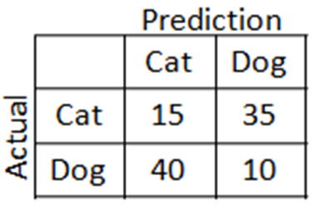
Matrice de confusion
 | Predicted 1 | Predicted 0
Actual 1 | True Positives | False Negatives
Actual 0 | False Positives | True Negatives
4 cas possibles
2 bons:
1 classé comme 1
0 classé comme 0
2 mauvais
1 classé comme 0
0 classé comme 1
results.pred_table()

Slide 12
 | Predicted Default | Predicted Non-Default
Actual Default | 286 | 47
Actual Non-Default | 40 | 460
Out of of 333 default samples:
286 were correctly predicted as default by our model (True positives)
47 were wrongly predicted as non-default by our model (False Negatives)
And out of 500 non-default samples,
460 were correctly predicted as non-default by our model (True Negatives)
40 were wrongly predicted as default by our model (False Positives)

Slide 13
 | Predicted Default | Predicted Non-Default
Actual Default | 286 | 47
Actual Non-Default | 40 | 460
number of samples correctly classified : 460 + 286 = 746
total number of samples : 833
so our accuracy is 746 / 833 = 90.0%
Pretty good score!
Accuracy = (TP + TN) / (P + N)
True Positive Rate = (TP) / (TP + FP)
False Positive Rate = (TP) / (TP + FP)

Slide 14
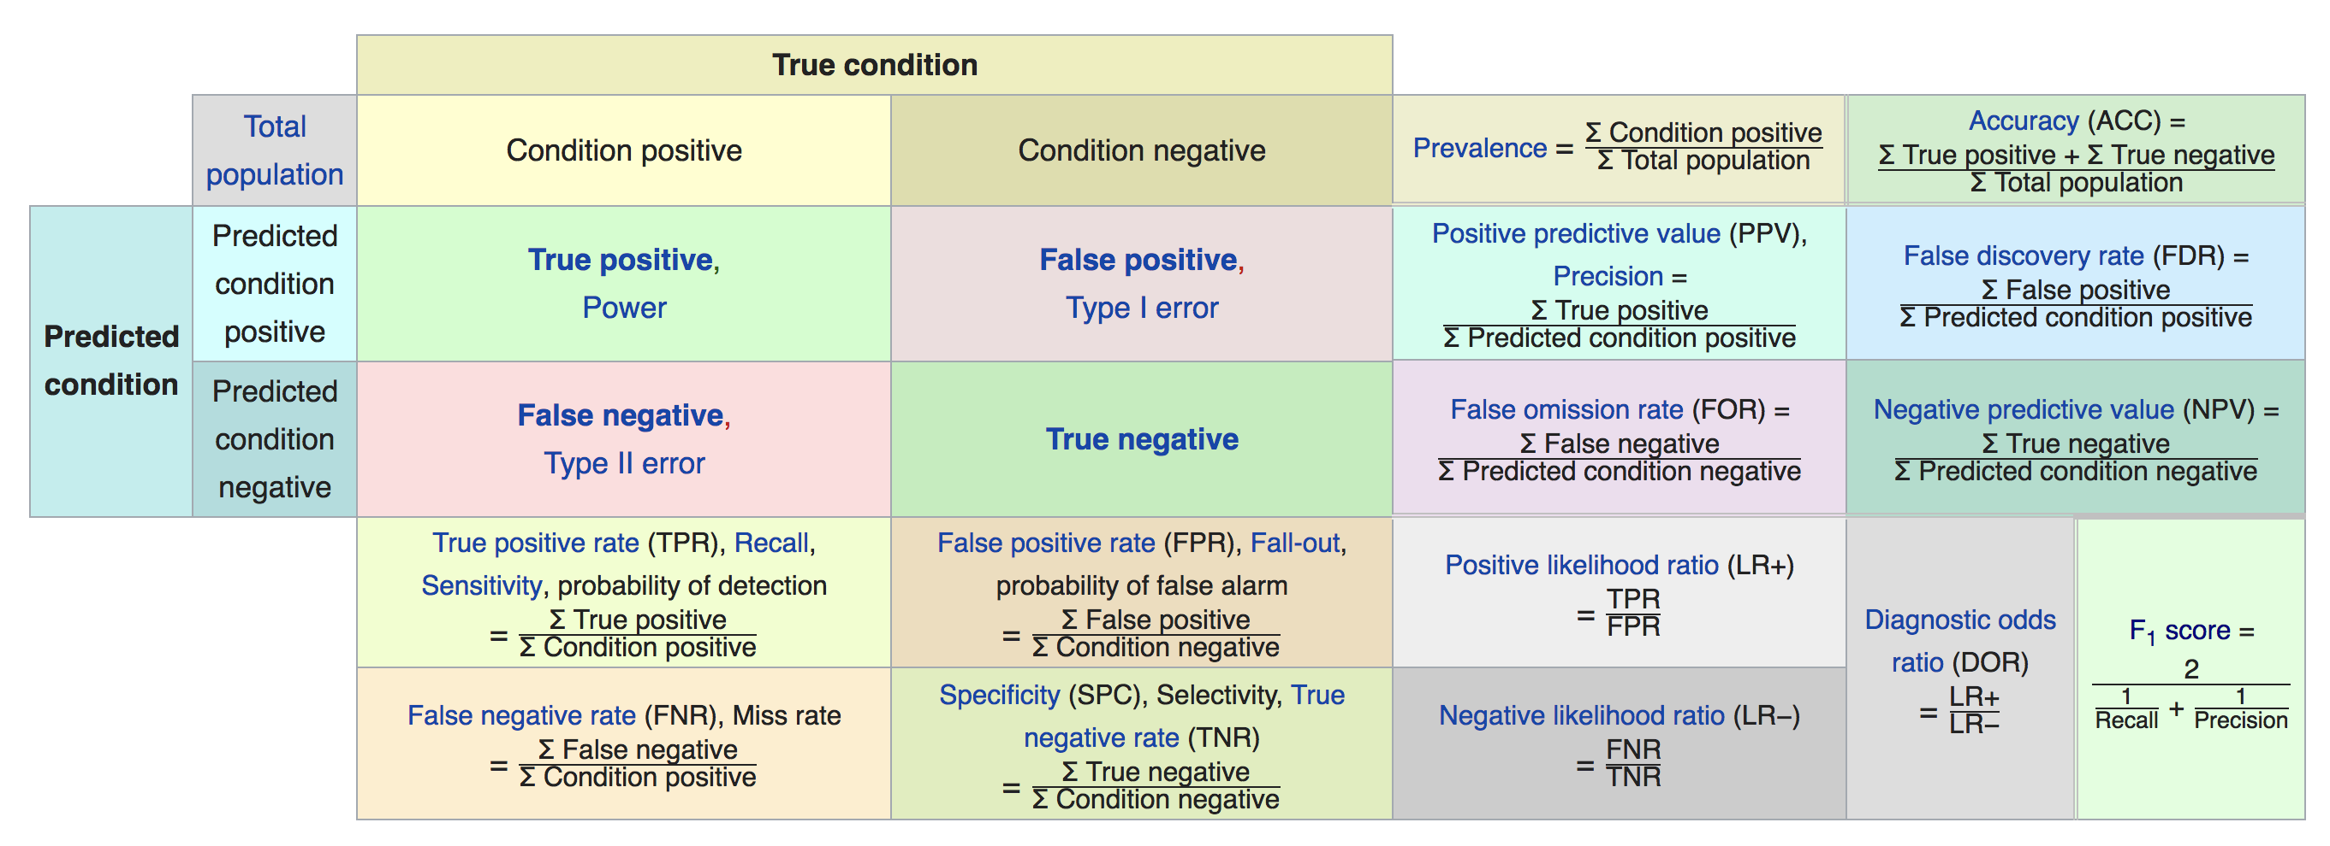

Slide 15
Au fait le seuil de classification?
Que se passe t il si on change le seuil de classification ?
La matrice de confusion change aussi
t = 0.75 | Predicted Default | Predicted Non-Default
Actual Default | 243 | 90
Actual Non-Default | 19 | 481
Accuracy(t =0.75) = (243 + 481) / 888 = 81 %

Slide 16
ROC - AUC

