Slide 1
Arbres et Forets

Slide 2
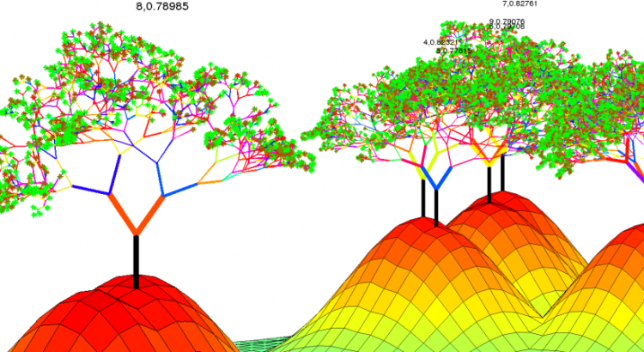
Programme
Arbres de décisions
Random Forest
Feature importance
Imbalanced datasets et sampling
Multinomial classification

Slide 3
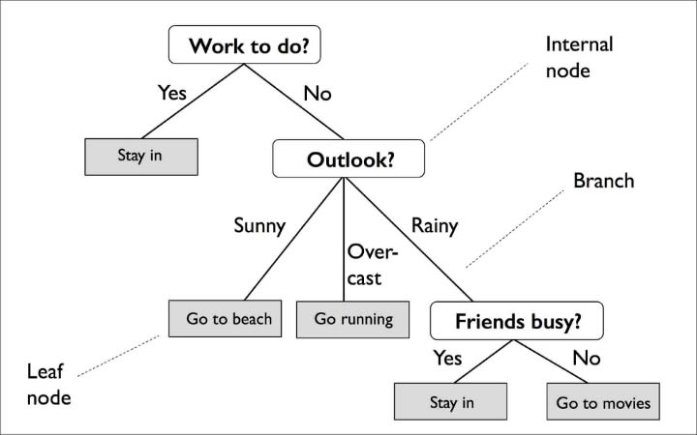
Arbres de décision

Slide 4
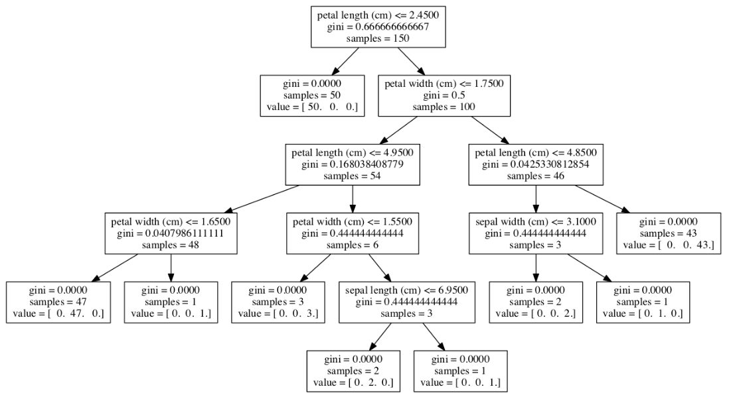
Arbres de décision
Appliqué au dataset Iris

Slide 5
Arbres de décision
AVANTAGES
Robustes, rapides et interpretables
Simple to understand and to interpret. Trees can be visualised.
Requires little data preparation. (missing values, scaling, dummy variables, ...)
Can handle both numerical and categorical data.
Possible to validate a model using statistical tests.
Uses a white box model. An observed situation can simply be explained by boolean logic.
MAIS
high overfitting for over-complex trees that do not generalise the data well.
Decision trees can be unstable because small variations in the data might result in a completely different tree being generated.
no globally optimal decision tree

