Slide 1

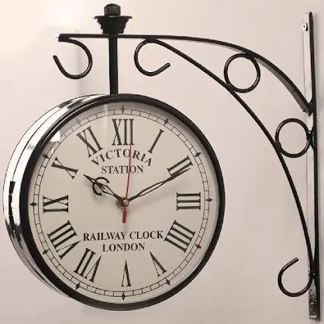
TIME SHERIFF
Where Every
Tick
Tells A Tale
Aastik Sharma
Adarsh Gaur
Aarush Arora
Aarav Thakran

Slide 2
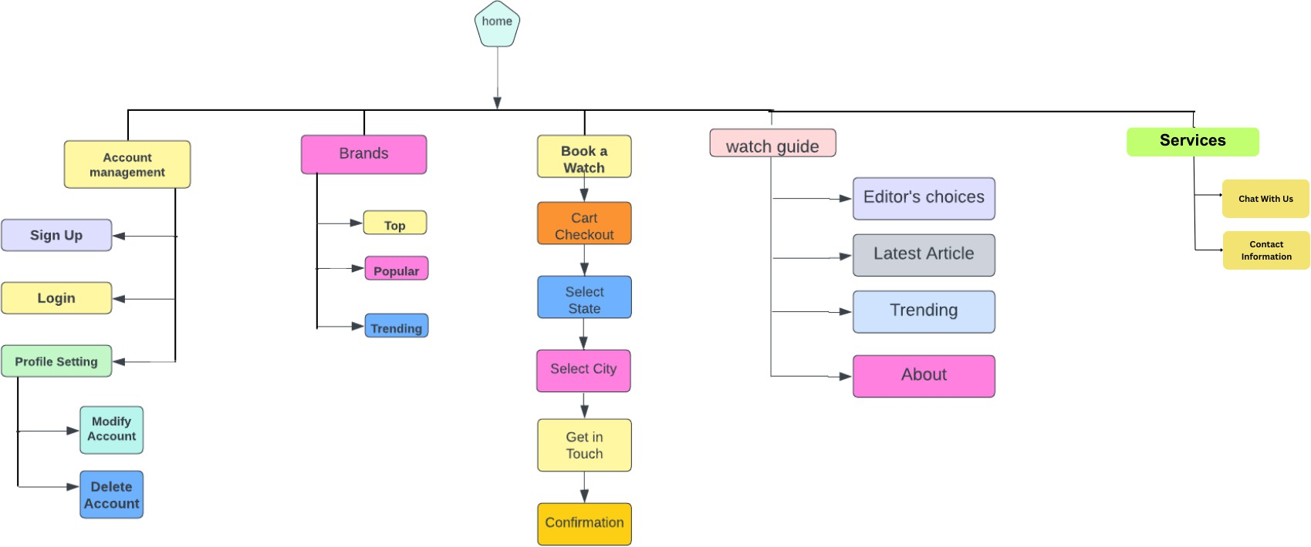
Information Architecture

Slide 3
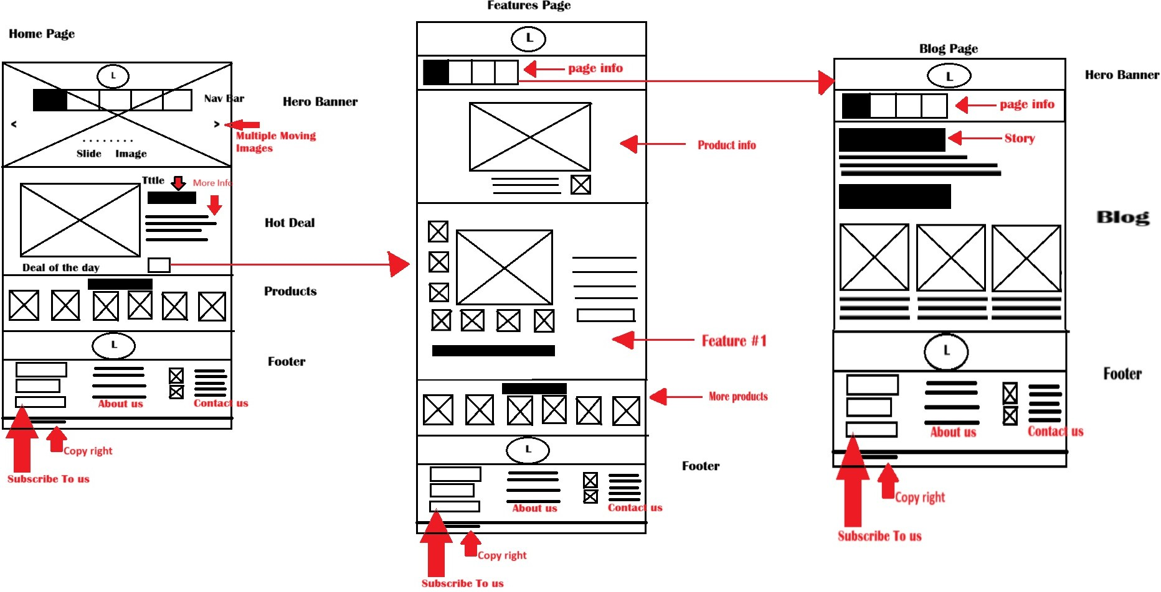

Slide 4
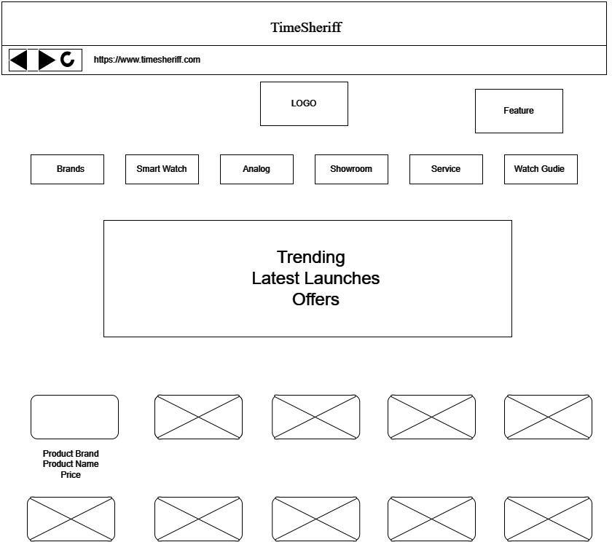

Slide 5
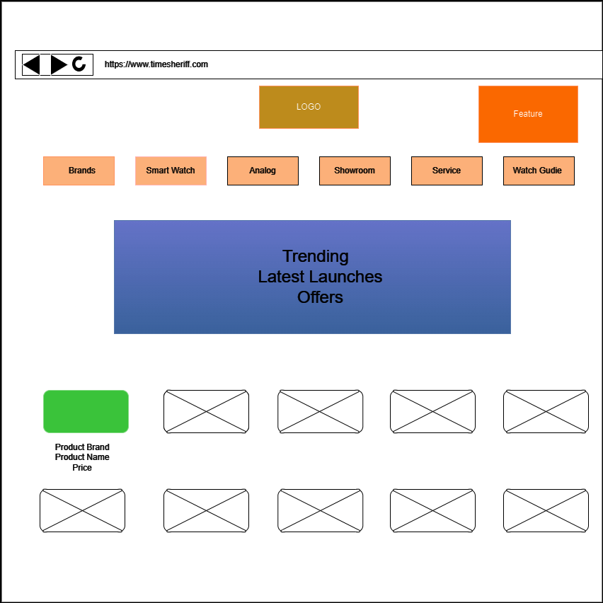

Slide 6
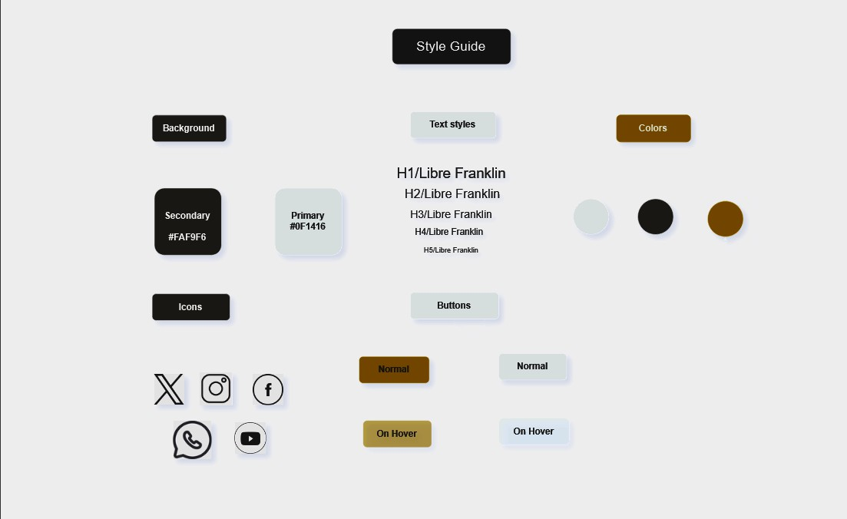
Style Guide

Slide 7
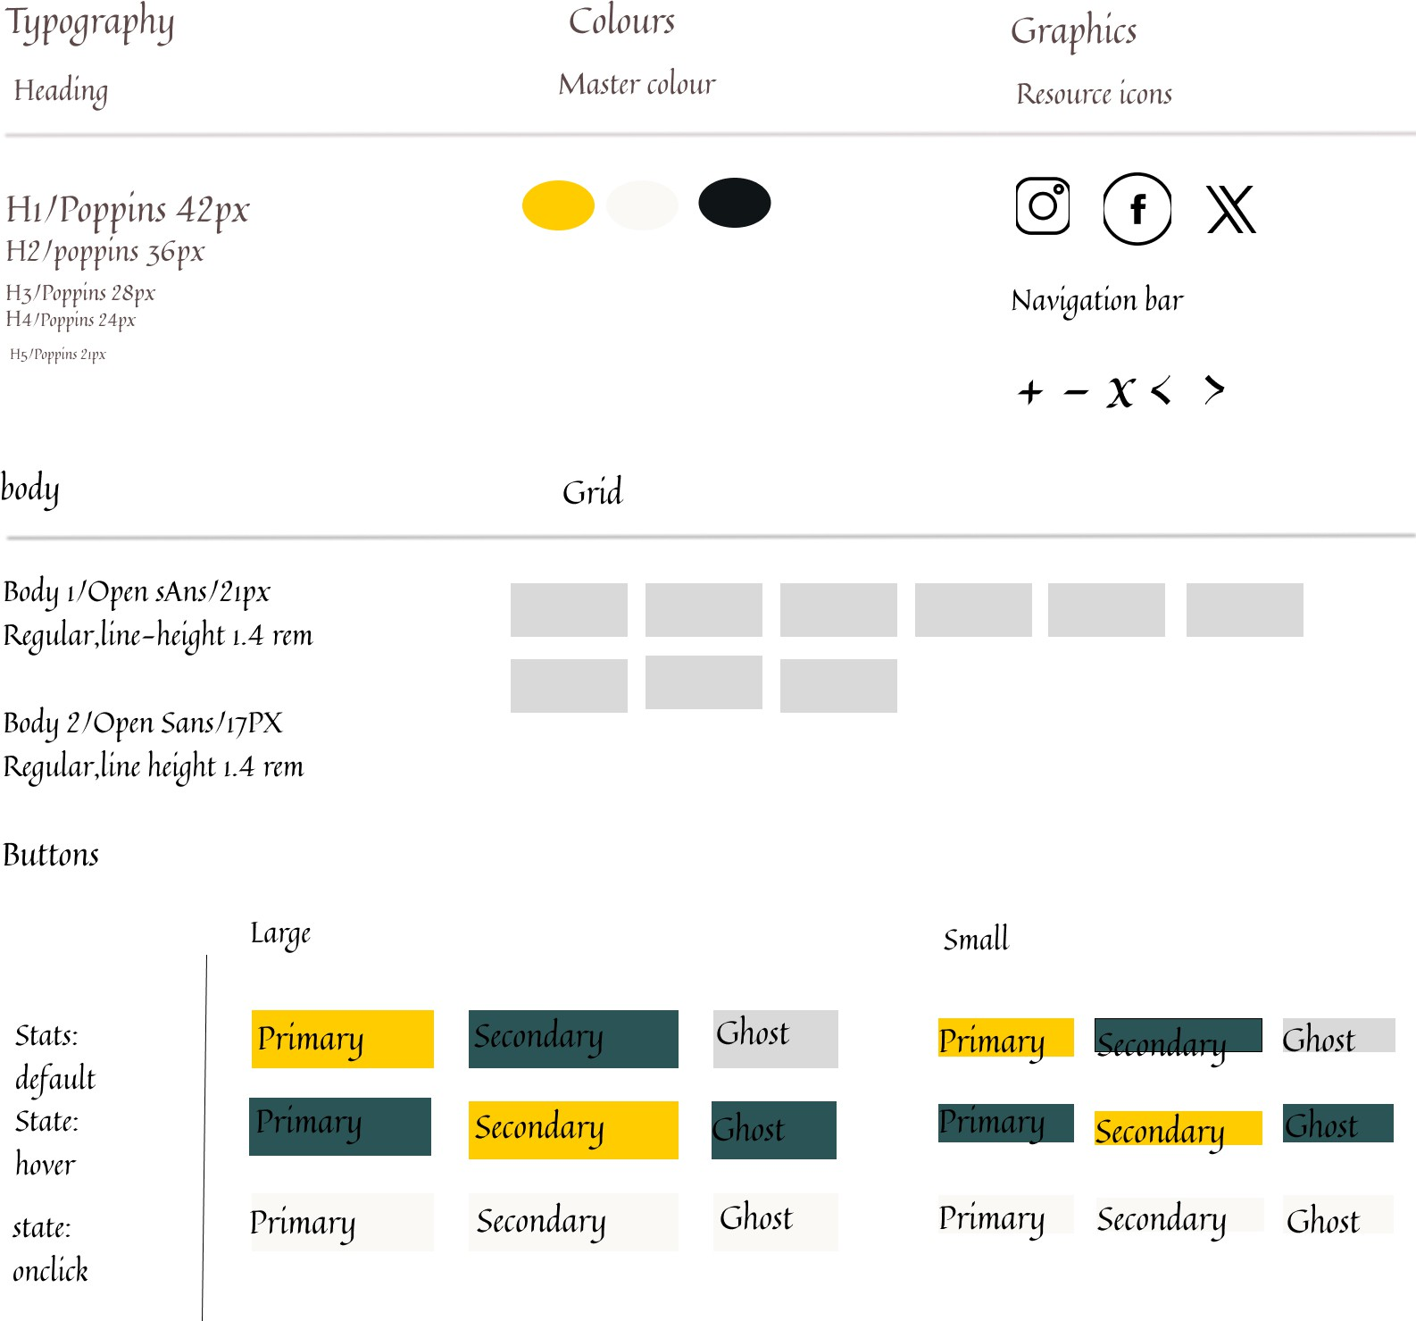

Slide 8
HOM E PAGE:
A c lear and int uit ive navigation menu that w ill allow to easily access different sect ions of the site.
There will be a slideshow, showcasing, featured watch es and latest watches.
.fi selecti on of popular, trendin g or new w atches will be there to grab attention.
There will be contact in form ation, entail address and a contact form to make easier to get in touch with us.
PRODUC T PA GE:
. The product page will include h igli quality image of the watch in multiple an gles including close up of the dial and the strap.
.fi thorough description of the watch includin g its specification, material and dim ensions including niovein ent type, case material and any otli er fun cti onality.
The price of the watch will be displayed on th is page and whether it is currently in stock or not
.fi prominent ‘.ADD TO C.ART’ button that allow the costuin ers to add the watch to the slioppin g cart.
''A TCH GU ID E:
.fi featured articles or blog posts th at cover a range of topics related to the latest watch es, watch li istory, notable w atcli collection and more.
Related articles and recommended post at the end of each article to encourage visitors to explore more content.
Visitors can leave comm ents and feedback on articles and blog post to encoura ge en gagem ent
and discussion.
CIHE CIKOU T PA CIE:
The summary of the costuin ers order includin g the item, quantity, price and any applicable tax or sli ipping cli arges will be displayed.
The costuniers will enter their billing information including n am e, address and phone nuin ber.
Multiple payment options will be offered to accommodate different preferences such as credi£'debit card, PayP at, Paytm or other secure payin ent gateways.
.fi cli eck box will be included for the costuniers to agree to the term s and conditions of the
sale, return policies and warranty informati on.
C0 STUMER SERV ICES:
.fi form will be there to li iglili glit the problems the costumes is facin g.
The costumes can fill out th eir cities,'towns to locate any consultin pniaintenance office to get the best services.
The costuniers can choose either to chat or talk w itli the costumes services.
Details will be provided on how costumers can book services includin g on line book ing form, phone num ber for scheduled appointm ent or inquiry.

