Slide 1
Project Presentation of CO-OP Project at Industry (Module-2) (22CS421)
On
Comparative Performance Analysis of Machine Learning Models for Flight Delay Prediction Using Evaluation Metrics
Adarsh Gaur : 2210991176
Shivam Jha : 2210992310
Aditi Singh : 2210991182
Devashish Chauhan : 2210991499
Supervised By
Dr. Isha Kansal
Department of Computer Science and Engineering,
Chitkara University, Punjab

Slide 2

Background & Motivation
Air transportation is a critical global pillar, yet flight delays remain a systemic challenge causing significant economic and operational strain.
Financial Impact: Increased fuel costs, crew rescheduling, and operational inefficiencies.
Passenger Experience: Inconvenience, missed connections, and reduced satisfaction.
ML Advantage: Traditional statistical methods fall short; Machine Learning offers pattern recognition at scale.
2

Slide 3
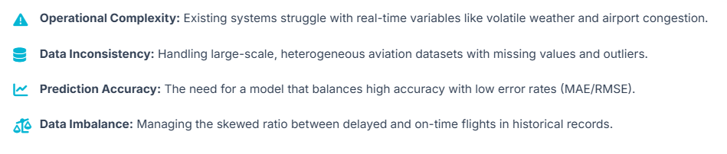
Problem Statement

Slide 4
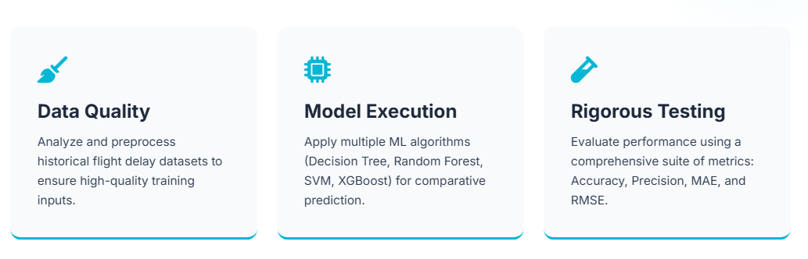
Project Objectives

Slide 5
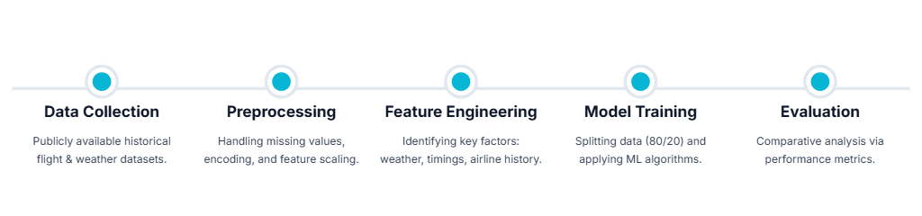
System Methodology

Slide 6
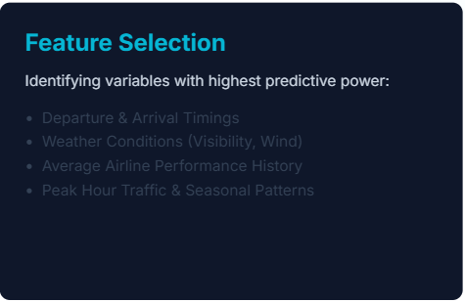
Data Preprocessing & Engineering
Core Preprocessing
Standardizing the dataset for optimal model consumption:
Outlier Removal: Detecting and purging anomalies in timing records.
Encoding: Converting categorical names (Airlines, Airports) to numerical vectors.
Normalization: Scaling features to a uniform range for SVM efficiency.

Slide 7

Tools & Technology Stack

Slide 8
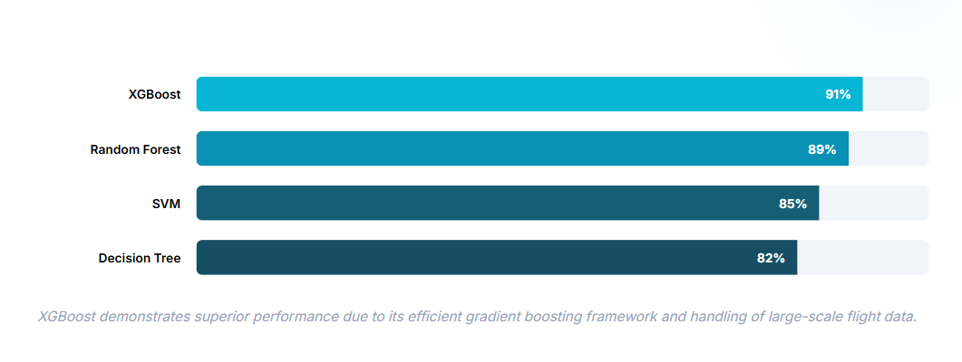
Model Accuracy Comparison

Slide 9
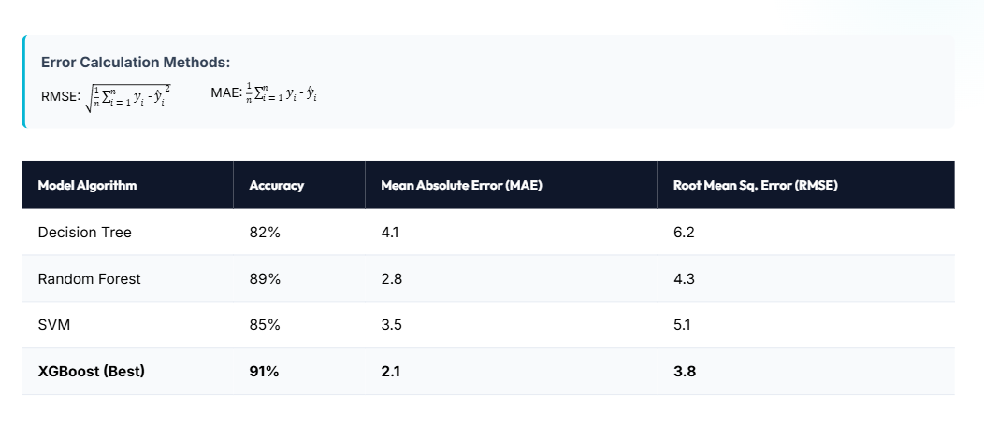
Comparative Performance Metrics

Slide 10
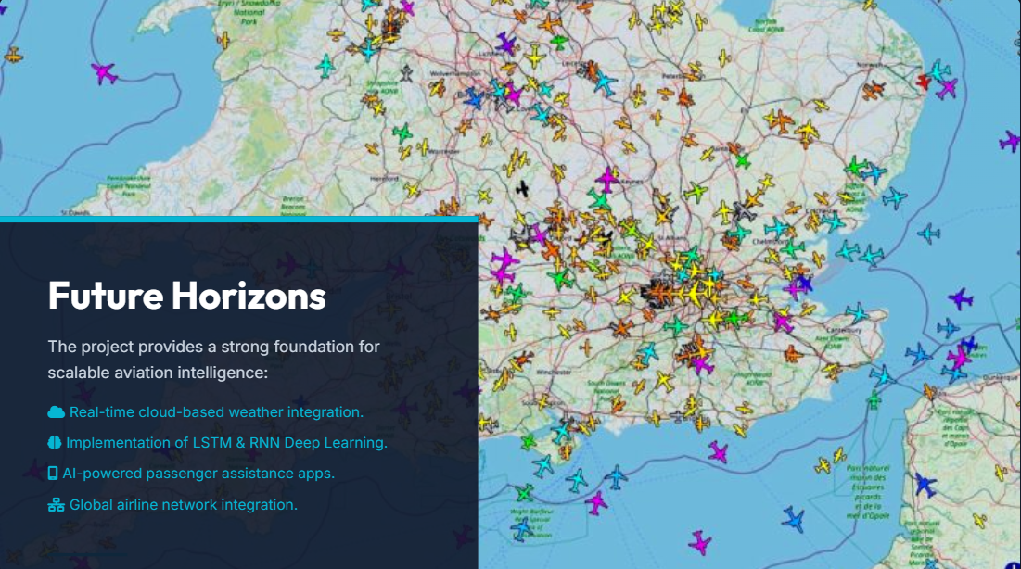
Future Scope

Slide 11
Thank You

