Slide 1

Data Analytics with Python
Lecture 1: Introduction to data analytics
Dr. A. Ramesh
DEPARTMENT OF MANAGEMENT IIT ROORKEE

Slide 2
Objective of the course
The principle focus of this course is to introduce conceptual understanding using simple and practical examples rather than repetitive and point click mentality
This course should make you comfortable using analytics in your career and your life
You will know how to work with real data, and might have learned many different methodologies but choosing the right methodology is important

Slide 3

Objective of the course Contd…
The danger in using quantitative method does not generally lie in the inability to perform the calculation
The real threat is lack of fundamental understanding of:
Why to use a particular technique of procedure
How to use it correctly and,
How to correctly interpret the result

Slide 4
Learning objectives
Define data and its importance
Define data analytics and its types
Explain why analytics is important in today’s business environment
Explain how statistics, analytics and data science are interrelated
Why python?
Explain the four different levels of Data:
Nominal
Ordinal
Interval and
Ratio

Slide 5
1. Define Data and its importance
Variable, Measurement and Data
What is generating so much data?
How data add value to the business?
Why data is important?

Slide 6
1.1 Variable, Measurement and Data
Variables – is a characteristic of any entity being studied that is capable of taking on different values
Measurements – is when a standard process is used to assign numbers to particular attributes or characteristic of a variable
Data – data are recorded measurements

Slide 7
1.2 What is generating so much data?
Data can be generated by
Humans,
Machines or
Humans-machines combines
It can be generated anywhere where any information is generated and stored in structured or unstructured formats

Slide 8






1.3 How data add value to business?
Data warehouse
Development of Data Product
Algorithm solutions in production, marketing and sales etc.(e.g. Recommendation Engines)
Discovery of Data Insight
Quantitative data analysis to help steer strategic business decision
Business value
Source:https://datajobs.com/

Slide 9


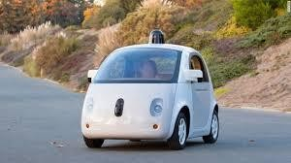
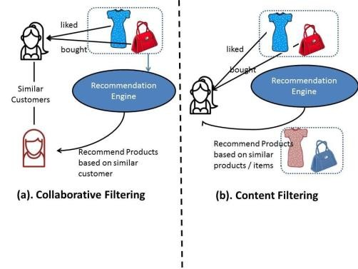

Data Products

Slide 10
1.4 Why Data is important?
Data helps in make better decisions
Data helps in solve problems by finding the reason for underperformance
Data helps one to evaluate the performance.
Data helps one improve processes
Data helps one understand consumers and the market

Slide 11
2. Define data analytic and its types
Define data analytics
Why analytics is important?
Data analysis
Data analytics vs. Data analysis
Types of Data analytics

Slide 12
2.1. Define data analytics
Analytics is defined as “the scientific process of transforming data into insights for making better decisions”
Analytics, is the use of data, information technology, statistical analysis, quantitative methods, and mathematical or computer-based models to help managers gain improved insight about their business operations and make better, fact-based decisions – James Evans
Analysis = Analytics ?

Slide 13


2.2 Why analytics is important?
Opportunity abounds for the use of analytics and big data such as:
Determining credit risk
Developing new medicines
Finding more efficient ways to deliver products and services
Preventing fraud
Uncovering cyber threats
Retaining the most valuable customers

Slide 14
2.3 Data analysis
Data analysis is the process of examining, transforming, and arranging raw data in a specific way to generate useful information from it
Data analysis allows for the evaluation of data through analytical and logical reasoning to lead to some sort of outcome or conclusion in some context
Data analysis is a multi-faceted process that involves a number of steps, approaches, and diverse techniques

Slide 15
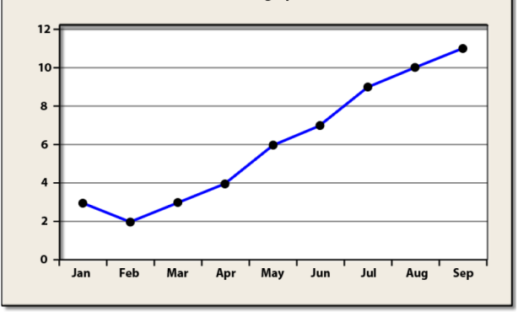
2.4 Data analytics vs. Data analysis
Analysis
Past
Explain
How?
Why?

Slide 16
2.4 Data analytics vs. Data analysis
Analytics
Future
Explore potential future events

Slide 17


2.4 Data analytics vs. Data analysis
Analytics
Qualitative
Quantitative
ll
ll
Intuition + analysis
Formulas + algorithms

Slide 18


Analysis
Quantitative
ll
Qualitative
Data + how the sale decreased last summer
ll
Explains How And Why Story ends the way it did ?

Slide 19
Analysis =/ Analytics
Data Analysis =/ Data analytics
Business Analysis =/ Business analytics

Slide 20
2.5 Classification of Data analytics
Based on the phase of workflow and the kind of analysis required, there are four major types of data analytics.
Descriptive analytics
Diagnostic analytics
Predictive analytics
Prescriptive analytics

Slide 21
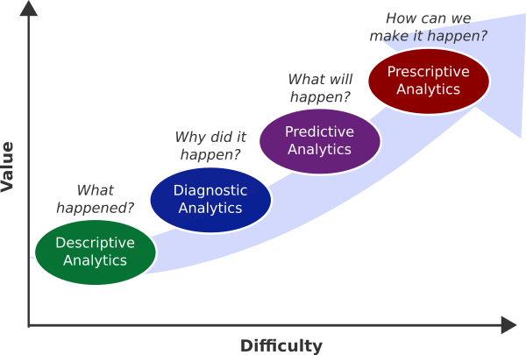
Classification of Data analytics
https://www.governanceanalytics.org/knowledge- base/Main_Tools/Data_classification_and_analysis

Slide 22
Descriptive Analytics
Descriptive Analytics, is the conventional form of Business Intelligence and
data analysis
It seeks to provide a depiction or “summary view” of facts and figures in an understandable format
This either inform or prepare data for further analysis
Descriptive analysis or statistics can summarize raw data and convert it into a form that can be easily understood by humans
They can describe in detail about an event that has occurred in the past

Slide 23
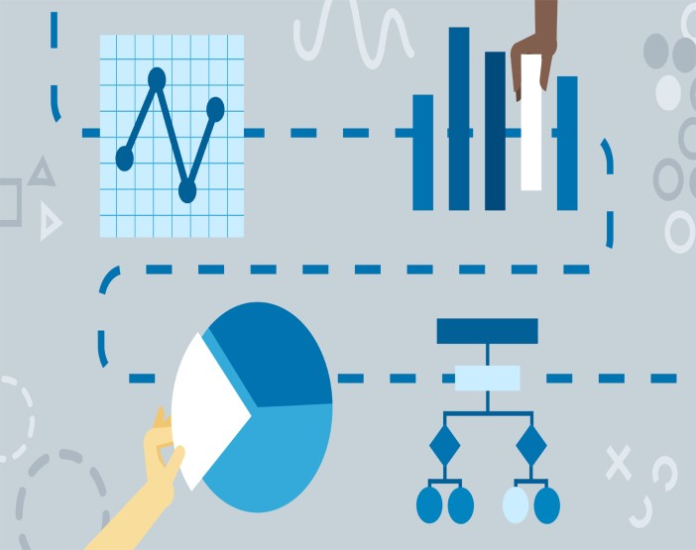
Example
A common example of Descriptive Analytics are company reports that simply provide a historic review like:
Data Queries
Reports
Descriptive Statistics
Data Visualization
Data dashboard
Source: https://www.linkedin.com/learning/478e9692-d13d-338f-907e-d76f0724d773

Slide 24
Diagnostic analytics
Diagnostic Analytics is a form of advanced analytics which examines data or content to answer the question “Why did it happen?”
Diagnostic analytical tools aid an analyst to dig deeper into an issue so that they can arrive at the source of a problem
In a structured business environment, tools for both descriptive and
diagnostic analytics go parallel

Slide 25
Example
It uses techniques such as:
Data Discovery
Data Mining
Correlations

Slide 26
Predictive analytics
Predictive analytics helps to forecast trends based on the current events
Predicting the probability of an event happening in future or estimating the accurate time it will happen can all be determined with the help of predictive analytical models
Many different but co-dependent variables are analysed to predict a trend
in this type of analysis

Slide 27
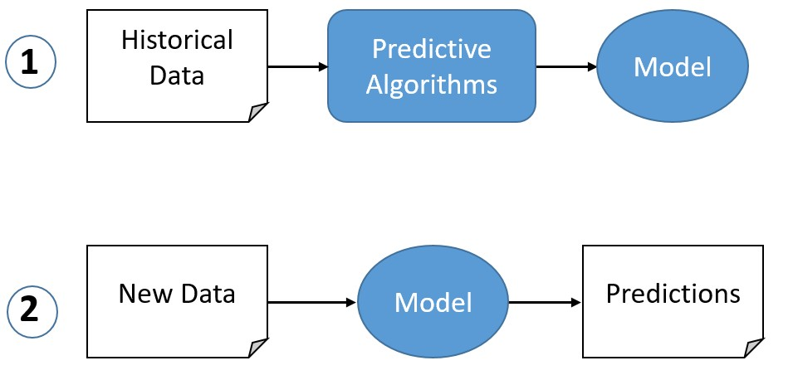
Source: https://www.logianalytics.com/wp-content/uploads/2017/11/predictive-1.png

Slide 28
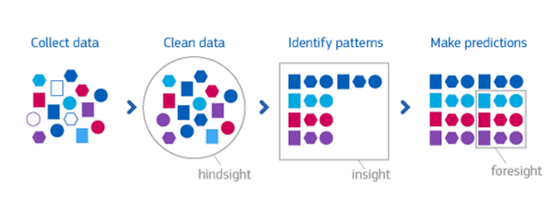
Example
Set of techniques that use model constructed from past data to predict the future or ascertain impact of one variable on another:
Linear regression
Time series analysis and forecasting
Data mining
Source: https://bigdata-madesimple.com/5-examples-predictive-analytics-travel-industry/

Slide 29
Prescriptive analytics
Set of techniques to indicate the best course of action
It tells what decision to make to optimize the outcome
The goal of prescriptive analytics is to enable:
Quality improvements
Service enhancements
Cost reductions and
Increasing productivity

Slide 30
Prescriptive analytics: Example
Optimization Model
Simulation
Decision Analysis

Slide 31
3. Explain why analytics is important
Demand for Data Analytics
Element of data Analytics

Slide 32
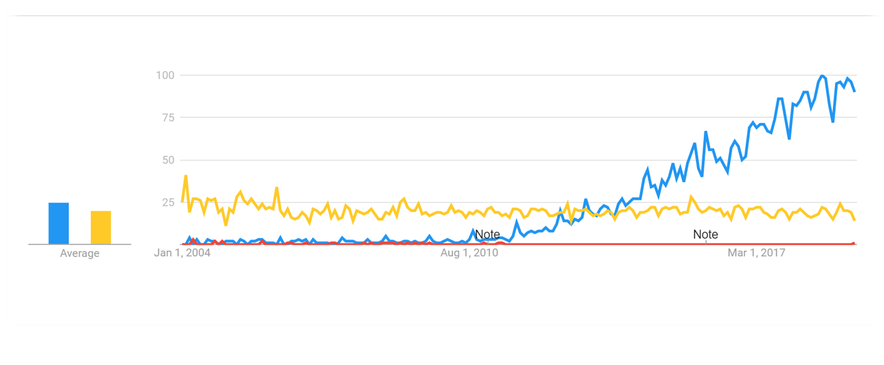
3. Explain why analytics is important
Search Trends
Data Scientist
Statistician, Operations Researcher

Slide 33
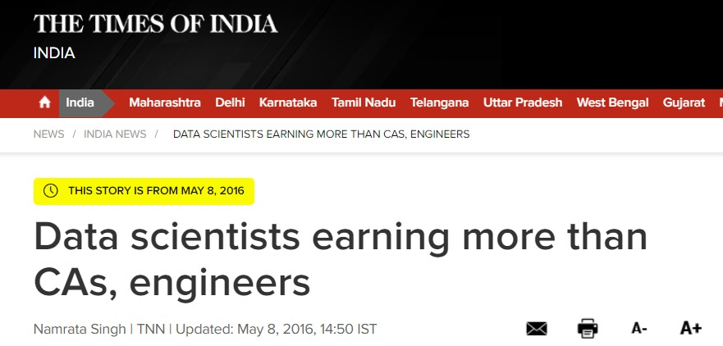
https://timesofindia.indiatimes.com/india/Data-scientists-earning-more-than- CAs-engineers/articleshow/52171064.cms

Slide 34
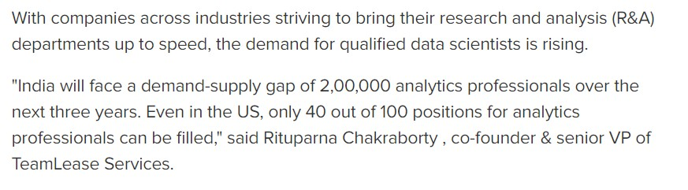
3.1 Demand for Data Analytics
http://timesofindia.indiatimes.com/articleshow/52171064.cms?utm_source= contentofinterest&utm_medium=text&utm_campaign=cppst

Slide 35
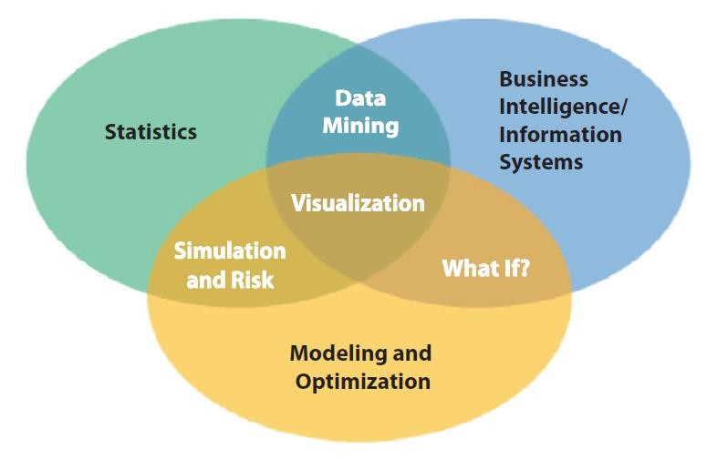
3.2 Element of data Analytics

Slide 36
4. Data analyst and Data scientist
The requisite skill set
Difference between Data analyst and Data Scientist

Slide 37

4.1 The requisite skill set
Technology; Hacking Skill
Mathematic Expertise
Business and strategy acumen
Data Science

Slide 38
4.1 The requisite skill set
Mathematic Expertise
Technology;
Hacking Skill
Business and strategy acumen
Data Science

Slide 39

4.1 The requisite skill set
Mathematic Expertise
Technology;
Hacking Skill
Business and strategy acumen
Data Science

Slide 40






4.2 Difference between Data analyst and Data Scientist
Analyst
Business Administration
Domain specific responsibility : For Example marketing analyst, Financial analyst etc.
Data Scientist
Data exploration analysis and insight
Advance algorithms and machine learning
Data product engineering
Source:https://datajobs.com/

Slide 41


5. Why python?
Features
Simple and easy to learn
Freeware and Open source
Interpreted
Dynamically Typed
Extensible
Embedded
Extensive library

Slide 42

5. Why python?
Usability
Desktop and web applications
Database applications
Networking applications
Data analysis (Data Science)
Machine learning
IoT and AI applications
Games

Slide 43








Companies using Python

Slide 44



Why Jupyter NoteBook?
Why?
Client – Server Application
Edit code on web browser
Easy in documentation
Easy in demonstration
User- friendly Interface

Slide 45
6. Explain the four different levels of Data
Types of Variables
Levels of Data Measurement
Compare the four different levels of Data: Nominal
Ordinal Interval and Ratio
Usage Potential of Various Levels of Data
Data Level, Operations, and Statistical Methods

Slide 46
6.1 Types of Variables
Data
Categorical
Numerical
Examples:
Marital Status
Political Party
Eye Color
Discrete
Continuous
Examples:
Number of Children
Defects per hour (Counted items)
Examples:
(Defined categories)
Weight
Voltage
(Measured characteristics)

Slide 47
6.2 Levels of Data Measurement
Nominal — Lowest level of measurement
Ordinal
Interval
Ratio — Highest level of measurement

Slide 48

6.3.1 Nominal
A nominal scale classifies data into distinct categories in which no ranking is implied
Example : Gender, Marital Status

Slide 49
6.3.2 Ordinal scale
An ordinal scale classifies data into distinct categories in which ranking is implied
Example:
Product satisfaction → Satisfied, Neutral, Unsatisfied
Faculty rank → Professor, Associate Professor, Assistant Professor
Student Grades → A, B, C, D, F

Slide 50
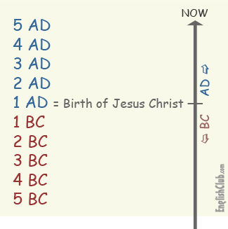
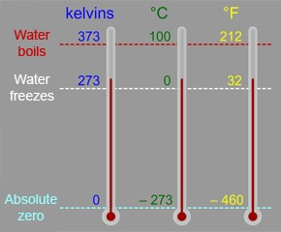
6.3.3. Interval scale
An interval scale is an ordered scale in which the difference between measurements is a meaningful quantity but the measurements do not have a true zero point.
Example
Temperature in Fahrenheit and Celsius
Year

Slide 51
6.3.4 Ratio scale
A ratio scale is an ordered scale in which the difference between the measurements is a meaningful quantity and the measurements have a true zero point.
Example
Weight
Age
Salary

Slide 52
6.4 Usage Potential of Various Levels of Data
Ratio
Interval
Ordinal
Nominal

Slide 53
6.5 Impact of choice of measurement scale
Statistical
Methods
Data Level
Meaningful Operations
Nominal
Classifying and Counting
Nonparametric
Ordinal
All of the above plus Ranking
Nonparametric
Interval
All of the above plus
Addition, Subtraction
Parametric
Ratio
All of the above plus multiplication and division
Parametric

Slide 54
Thank You

