Slide 1

Course: Operating system
Subject code : 24BTDS145
KrishiRakshak: AI-Based Early Detection and
Management of Crop Diseases & Pest Infestations
Member PRN No | Name
24BTDSXXX | [Member name]
24BTDSXXX | [Member name]
24BTDSXXX | [Member name]
24BTDSXXX | [Member name]

Slide 2
Introduction
INTRODUCTION
Context and background
• Plant pests and diseases destroy up to 40% of global crop production every year (FAO).
• Farmers usually notice a disease only after visible damage has spread across the field.
• Extension officers cover very large areas; lab diagnosis and expert advice are slow to reach villages.
• Weather, crop stage, variety, soil and local pest history drive outbreaks — but are rarely combined into farm-level alerts.
• Wrong or late diagnosis leads to excess pesticide use, higher cost, residues and yield loss.
40%
of crop production lost to pests & diseases (FAO)
38
crop disease & health classes recognised by our AI
6
languages: English, हिन्दी, తెలుగు, தமிழ், ಕನ್ನಡ, मराठी
KrishiRakshak · Crop disease & pest early-warning system
2

Slide 3
Problem Statement
INTRODUCTION
Early detection and management of crop diseases and pest infestations
Why is this project necessary?
Late detection
Limited expert reach
Symptoms are recognised only after the damage spreads.
Few extension staff and labs for many farmers.
Scattered risk signals
Wrong treatment
Weather, crop stage, soil and pest history are not combined.
Misdiagnosis → excess or wrong pesticide, cost, residues.
No surveillance picture
Language barrier
Officials lack real-time outbreak maps and data.
Advice is rarely available in the farmer's language.
KrishiRakshak · Crop disease & pest early-warning system
3

Slide 4
Objectives and Key Goals
INTRODUCTION
1. Detect
2. Forecast
3. Monitor
Identify diseases from a leaf photo with a CNN model (>95% target accuracy).
7-day weather-based disease & pest risk for each farm.
Pest-trap counts and IoT sensors with economic-threshold (ETL) alerts.
4. Map
5. Validate
6. Advise
Automatic geospatial hotspot detection and alerts to nearby farms.
Expert confirmation / correction of every AI diagnosis; lab referral.
Integrated Pest Management (IPM) advice with safe pesticide use, in 6 languages with audio.
7. Follow up
8. Learn
9. Inform
3/7-day follow-up checks; escalate cases that are not improving.
Retrain the model from field-confirmed images (continual learning).
Dashboards with surveillance KPIs for agriculture officials.
KrishiRakshak · Crop disease & pest early-warning system
4

Slide 5
Methodology: Approach
METHODOLOGY
Three-tier web system: browser front-end → Flask server with six intelligence modules → data & external services
Farmer
scan · farms · traps · alerts
Extension officer
validation · referral · map
Agriculture official
dashboard · KPIs · model
Chrome front-end: HTML5 · CSS3 · JavaScript · Jinja2 · Leaflet.js · Chart.js · Web Speech API
AI diagnosis
MobileNetV2
Risk forecast
weather models
Trap / IoT
ETL engine
Hotspots
DBSCAN
IPM advisory
6 languages
Validation &
learning
Flask (Python) · role-based auth · alert engine · follow-up scheduler · REST APIs
SQLite
database
Model store
Keras heads v1..vN
Knowledge base
39 diseases · 7 pests
Open-Meteo · OSM
IoT devices
Approach: combine computer vision (what the farmer sees) with agro-meteorological risk models (what is likely next) and human expert validation (trust).
KrishiRakshak · Crop disease & pest early-warning system
5

Slide 6
Methodology: Tools & Technologies
METHODOLOGY
Layer | Technology | Purpose
Front-end | HTML5, CSS3, JavaScript, Jinja2 | Responsive pages that run in Chrome (desktop & mobile)
Maps & charts | Leaflet.js + OpenStreetMap, Leaflet.heat, Chart.js | Hotspot map, heatmap, dashboards, weather chart
Back-end | Python 3.12, Flask 3 | Routes, auth, REST APIs, alert & follow-up engine
Deep learning | TensorFlow 2.18 / Keras, MobileNetV2 | Leaf image classification (transfer learning)
ML utilities | scikit-learn, NumPy, Pillow, Matplotlib | DBSCAN hotspots, metrics, image quality, plots
Database | SQLite | Users, farms, reports, traps, sensors, alerts
Weather | Open-Meteo forecast API (free) | Hourly temperature, humidity, rain for 10 days
Voice | Web Speech API (browser) | Read advisories aloud in the farmer's language
Hardware (sim.) | IoT weather station / smart trap via /api/sensor | Sensor & trap-count input
KrishiRakshak · Crop disease & pest early-warning system
6

Slide 7
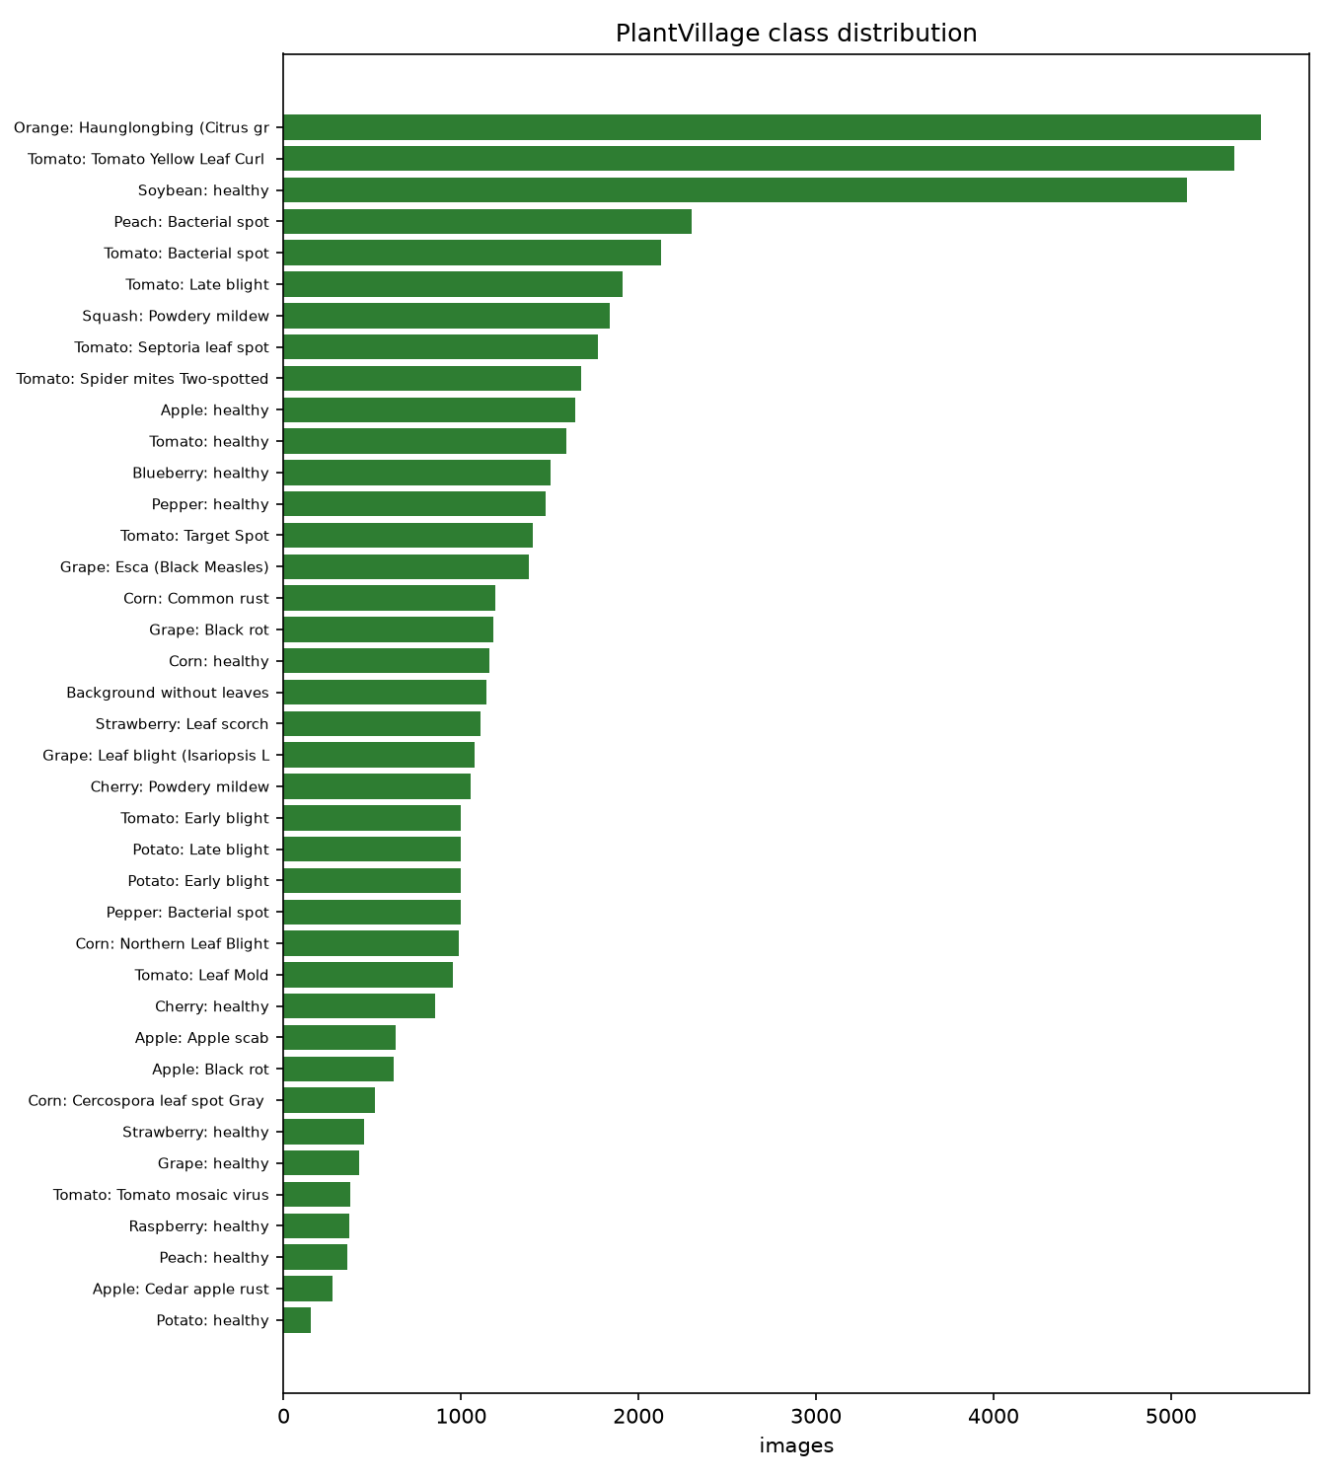
Methodology: Data Collection
METHODOLOGY
• Image dataset: PlantVillage (Mendeley Data, without augmentation) — 55,448 leaf images, 39 classes (38 crop/disease classes of 14 crops + background).
• Split: stratified 70 / 15 / 15 → 38,813 train, 8,317 validation, 8,318 test images.
• Weather: Open-Meteo hourly forecast (past 3 + next 7 days) for each farm's GPS location.
• Knowledge base: 39 disease and 7 pest profiles — pathogen, symptoms, IPM actions, doses, pre-harvest intervals, ETLs — compiled from IPM package-of-practice literature.
• Field data: farm profiles, trap counts, sensor readings and reports entered through the app. Demo database: 107 farms, 425 reports (synthetic, for evaluation).
KrishiRakshak · Crop disease & pest early-warning system
7

Slide 8
Process: Workflow
PROCESS
1. Capture
leaf photo
2. Quality
check
3. AI
diagnosis
4. Risk
context
5. IPM
advisory
10. Dashboard
for officials
9. Continual
learning
8. Follow-up
3 / 7 days
7. Hotspot
alerts
6. Expert
validation
• Farmer: registers farm (GPS, crop, variety, sowing date, soil, irrigation) → gets daily risk alerts → scans a sick leaf → receives advice + audio.
• System: stores the image embedding, schedules a follow-up, refers to the nearest lab when confidence < 60% or disease is notifiable/viral.
• Officer: confirms or corrects the diagnosis and sets severity → farmer notified → hotspots recomputed → confirmed image added to training data.
KrishiRakshak · Crop disease & pest early-warning system
8

Slide 9
Process: AI Diagnosis Model
PROCESS
Leaf image
224×224×3
MobileNetV2
(ImageNet, frozen)
1280-d
feature
Dropout 0.3 →
Dense 256 ReLU
Softmax
39 classes
• Transfer learning: ImageNet-pretrained MobileNetV2 is used as a frozen feature extractor — light enough for a CPU-only laptop and mobile deployment.
• Two-stage training: features of all 55,448 images are computed once (~40 min on CPU); the classification head then trains in 274 s.
• Imbalance: balanced class weights (classes range from 152 to 5,507 images); early stopping on validation accuracy; learning-rate decay on plateau.
• Crop-aware inference: if the farmer selects the crop, probabilities are re-normalised over that crop's classes; a strong mismatch is flagged.
• Image quality gate: Laplacian-variance blur check and exposure check ask the farmer to retake poor photos.
• Continual learning: each expert-confirmed image's embedding is stored; retraining fine-tunes the head (field samples ×5) and activates the new version only if held-out test accuracy does not drop > 0.5 pt.
KrishiRakshak · Crop disease & pest early-warning system
9

Slide 10
Process: Risk, Hotspots & Advisory Logic
PROCESS
Risk score = 85 × weather favourability × crop-stage factor × variety resistance × drainage/irrigation factor
+ 6 × confirmed cases within 10 km in 21 days (max +25) → Low / Moderate / High / Severe
• Weather models: 12 disease models, e.g. late blight — Hutton criteria (Tmin ≥ 10 °C and ≥ 6 h RH ≥ 90%); apple scab — Mills wet-hour table; spider mites — hot & dry spells.
• Crop factors: seedling 0.85 · vegetative 1.0 · flowering 1.15 · maturity 0.75; resistant variety 0.5, moderately resistant 0.75; poor drainage ×1.15, sprinkler ×1.1.
• Pest traps & sensors: counts normalised per trap per day/week and compared with ETL (e.g. pink bollworm 8 moths/trap/night, BPH 10/hill); IoT leaf-wetness raises humid-disease risk.
• Hotspots: DBSCAN with haversine distance (eps 5 km, ≥ 3 cases, last 30 days) per disease; farms of the same crop within radius + 5 km are alerted.
• IPM advisory: cultural → biological → chemical (last resort, dose + pre-harvest interval) → safety → referral → follow-up; composed from 47 translated action phrases.
KrishiRakshak · Crop disease & pest early-warning system
10

Slide 11
Process: Challenges & Adaptations
PROCESS
No GPU available
Frozen-backbone feature caching: one-time CPU feature extraction, then seconds-long head training and retraining.
Class imbalance (152–5,507 images)
Balanced class weights and per-class F1 reporting instead of accuracy alone.
Lab images vs field photos
Image-quality gate, crop-aware re-normalisation, low-confidence referral and expert validation loop.
Translating advice to 6 languages
Phrase library of 47 IPM actions with templated doses — new diseases reuse translated phrases.
Weather API may be offline
Hourly caching + seasonal offline fallback clearly labelled in the UI.
Bad labels could harm the model
New model versions are activated only if held-out accuracy does not drop.
KrishiRakshak · Crop disease & pest early-warning system
11

Slide 12
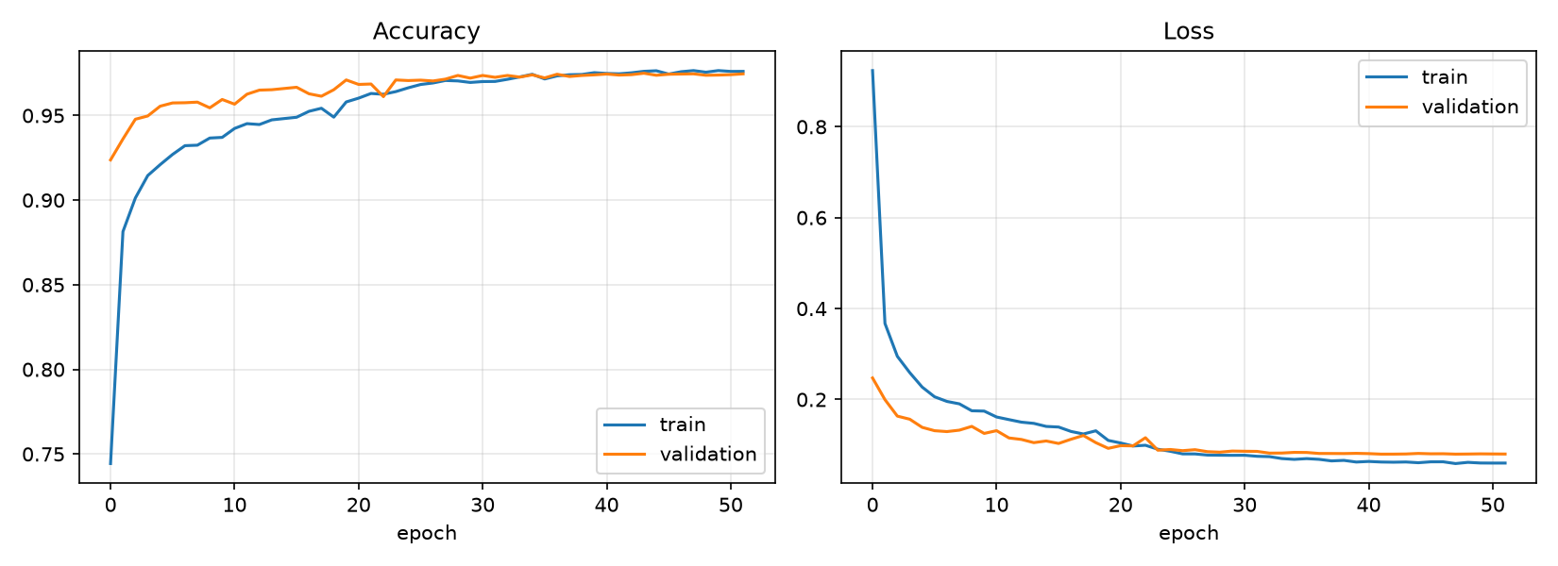
Results: Model Performance
RESULTS
97.01%
99.82%
0.963
8,318
Test accuracy
Top-3 accuracy
Macro F1-score
Unseen test images
Weakest classes | F1
Tomato – Early blight | 0.843
Maize – Gray leaf spot | 0.857
Tomato – Target spot | 0.867
Tomato – Mosaic virus | 0.904
Tomato – Septoria leaf spot | 0.915
• Validation curves track training curves closely — no over-fitting; early stopping after 52 epochs.
• Most errors are between visually similar leaf-spot diseases of the same crop (e.g. maize gray leaf spot vs northern leaf blight).
• Low-confidence predictions are routed to experts, so residual errors are caught before advice is finalised.
KrishiRakshak · Crop disease & pest early-warning system
12

Slide 13
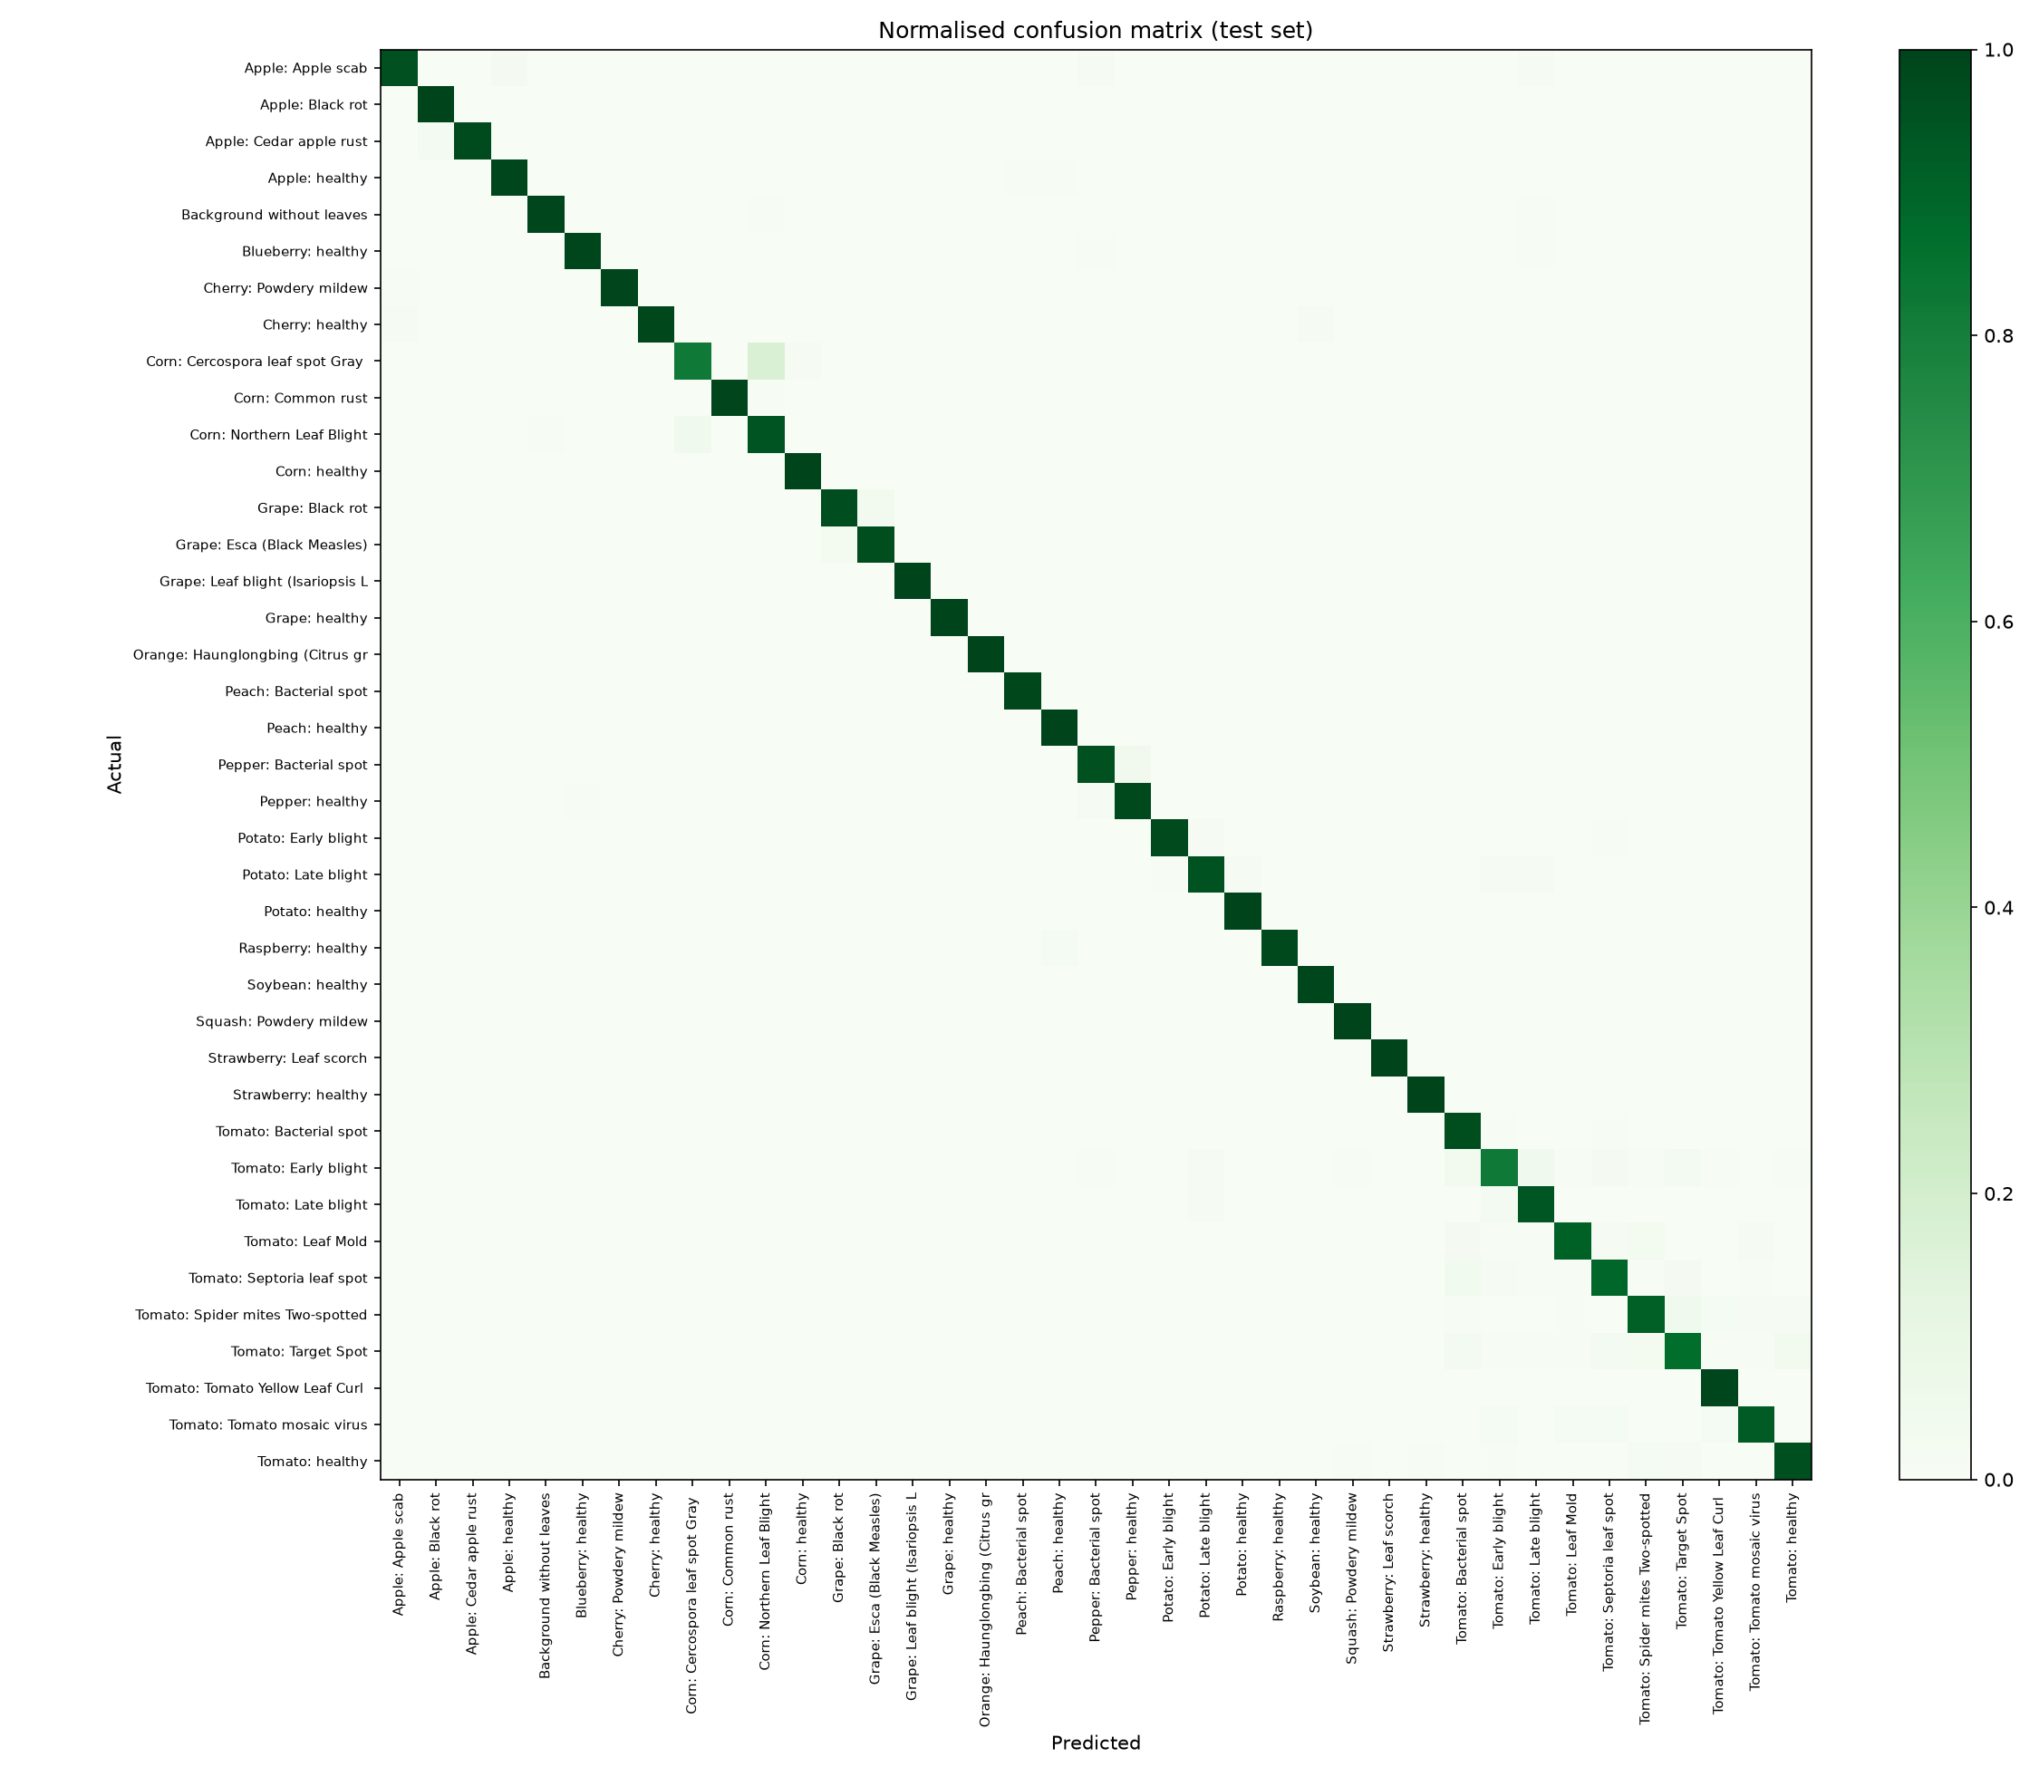
Results: Confusion Matrix
RESULTS
• Strong diagonal: almost every class is recognised correctly on unseen test images.
• Background class: non-leaf photos are detected and the farmer is asked to retake.
• Confusions: mainly within the same crop — the crop-aware mode and the top-3 list help the expert decide.
• Benchmark: Mohanty et al. (2016) reached 99.35% with fully fine-tuned GoogLeNet on PlantVillage; our frozen MobileNetV2 is far lighter and trains on a laptop CPU.
KrishiRakshak · Crop disease & pest early-warning system
13

Slide 14
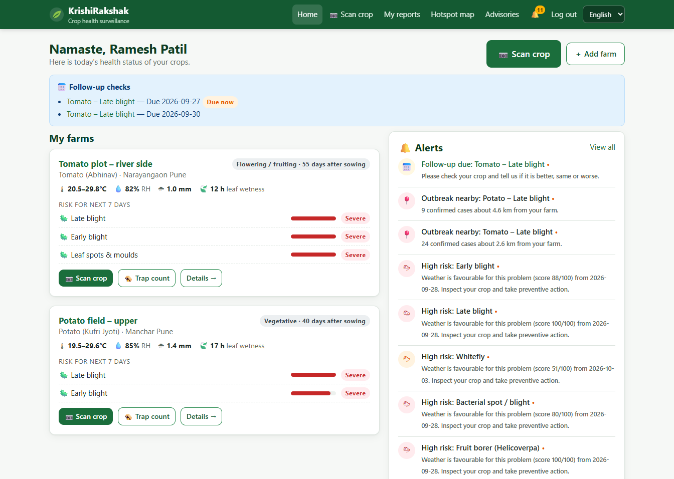
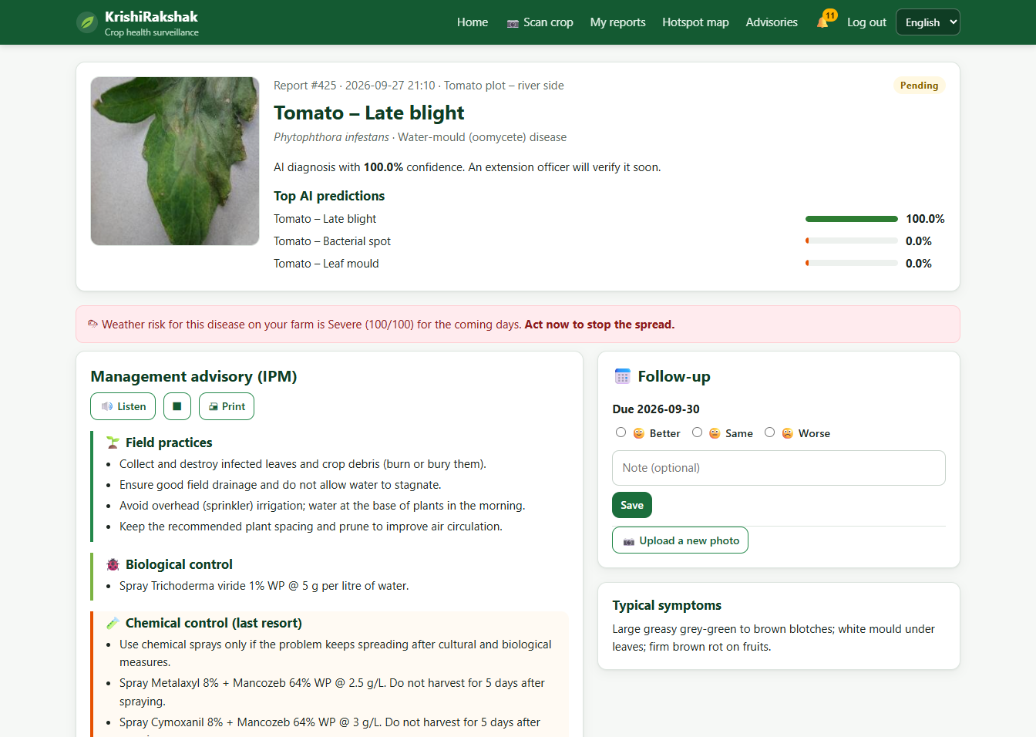
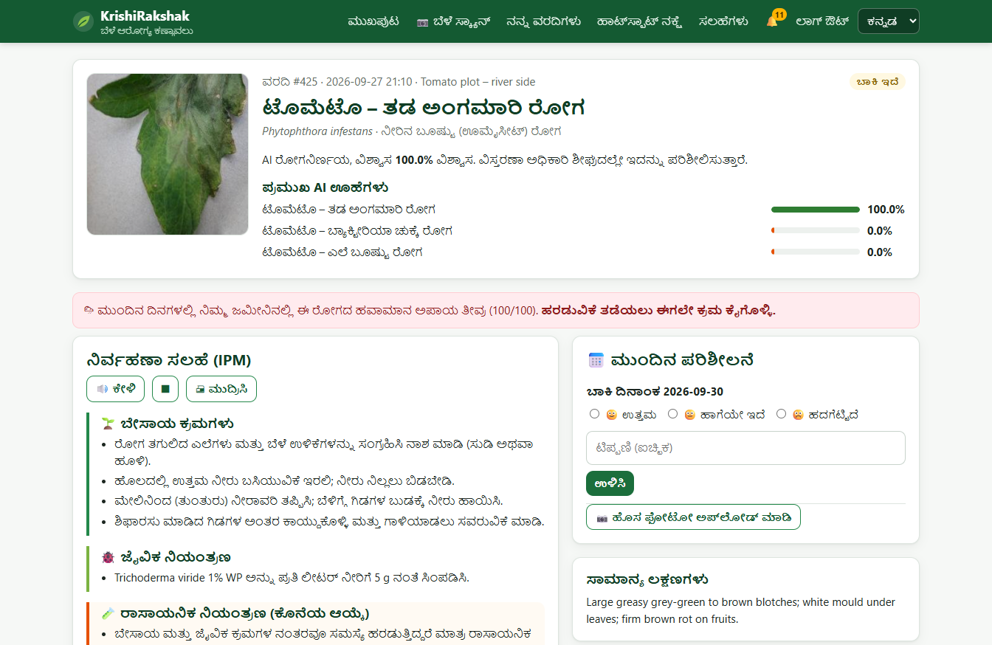
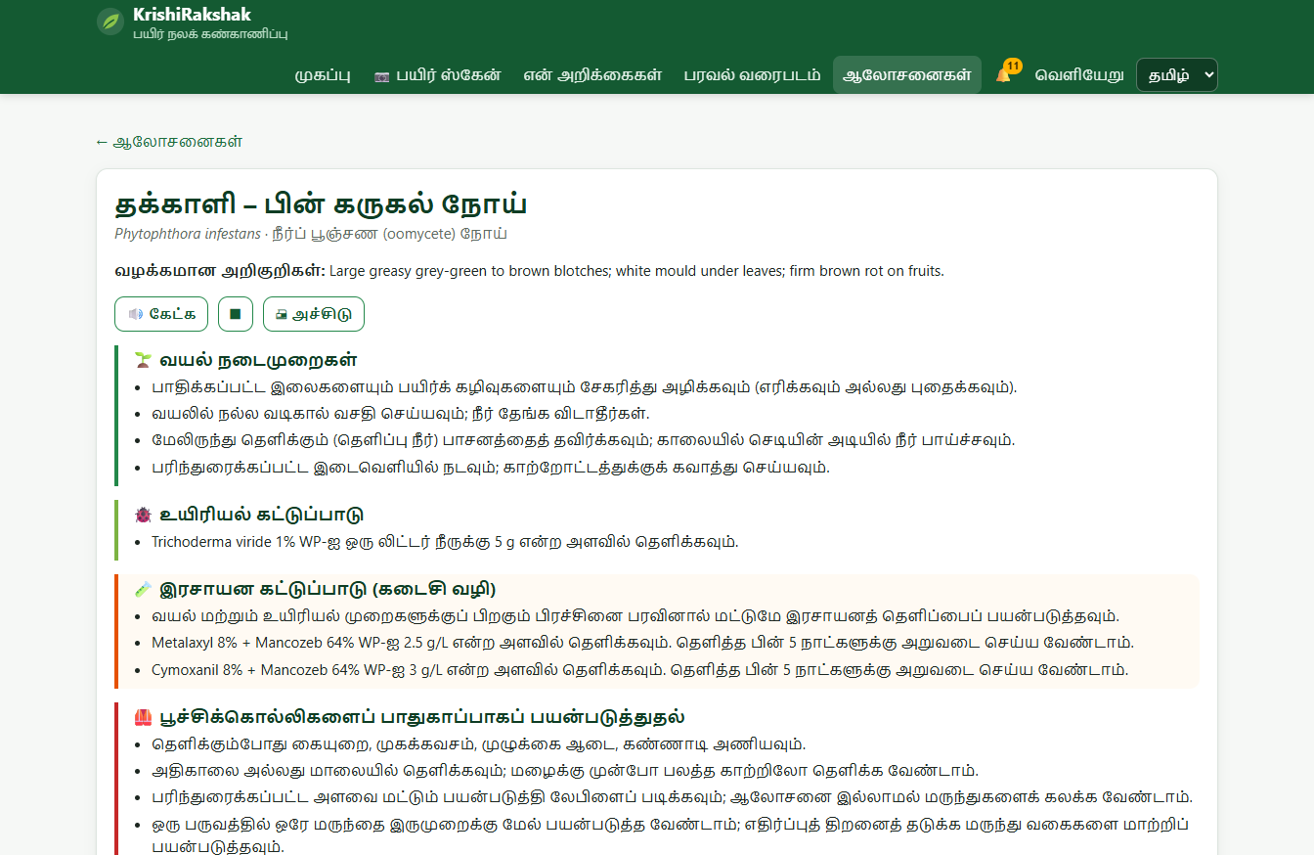
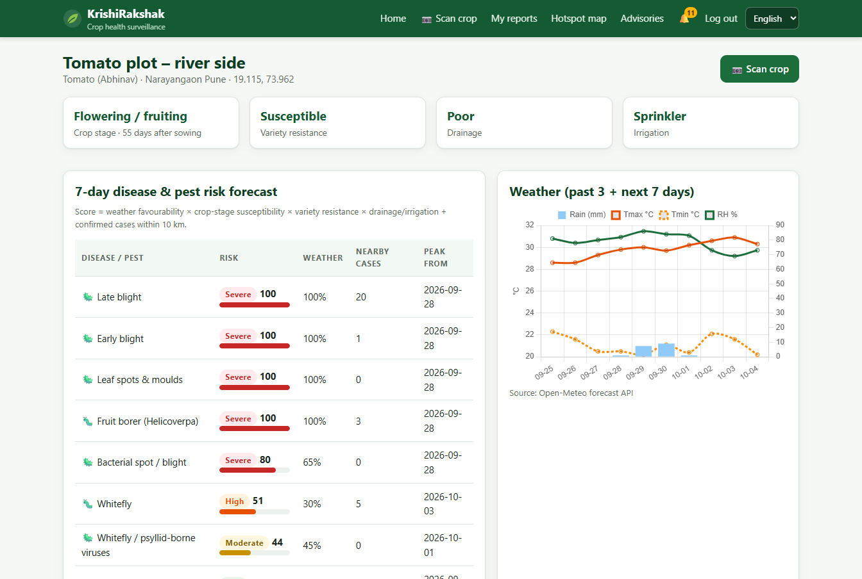
Results: Farmer Application
RESULTS
Farmer home: 7-day risk per farm, live weather, alerts
Diagnosis: top-3 predictions, weather link, IPM advisory
KrishiRakshak · Crop disease & pest early-warning system
14

Slide 15
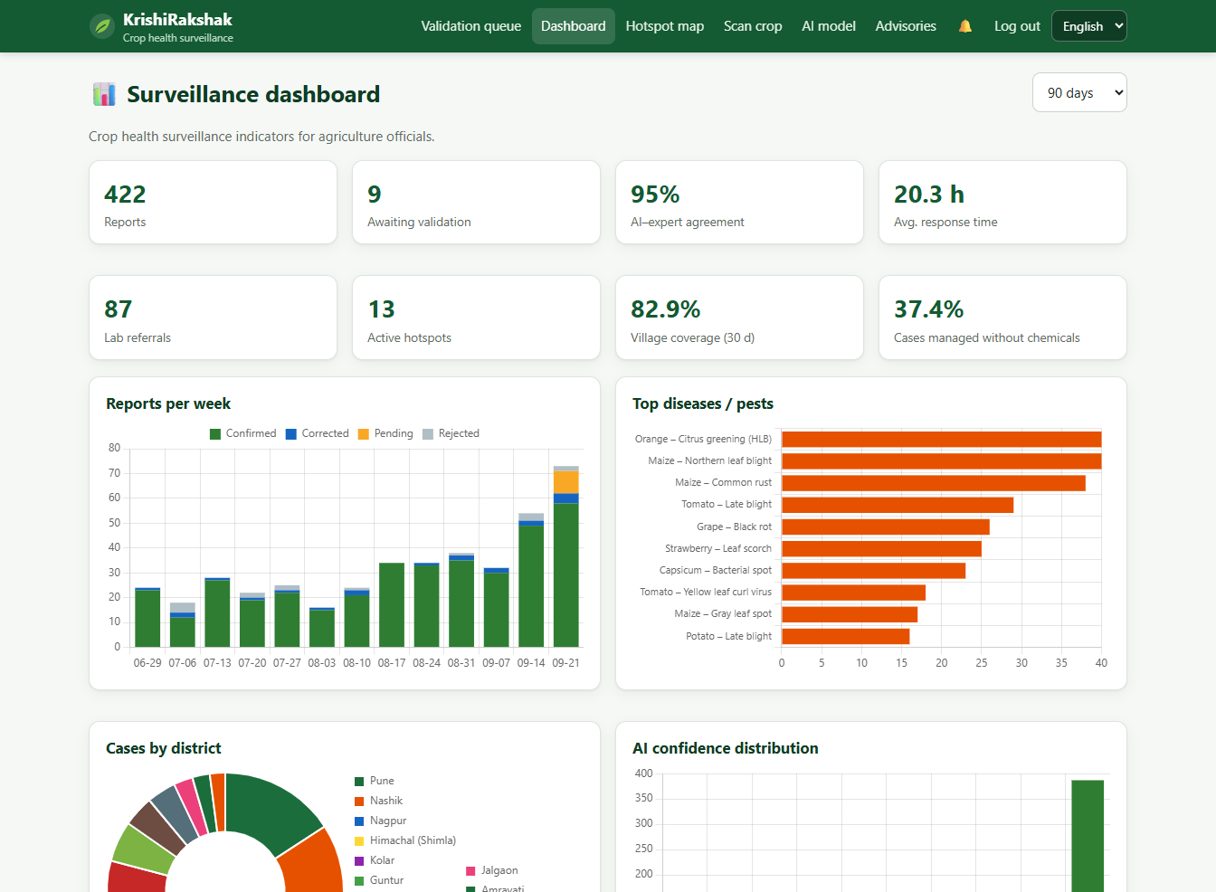
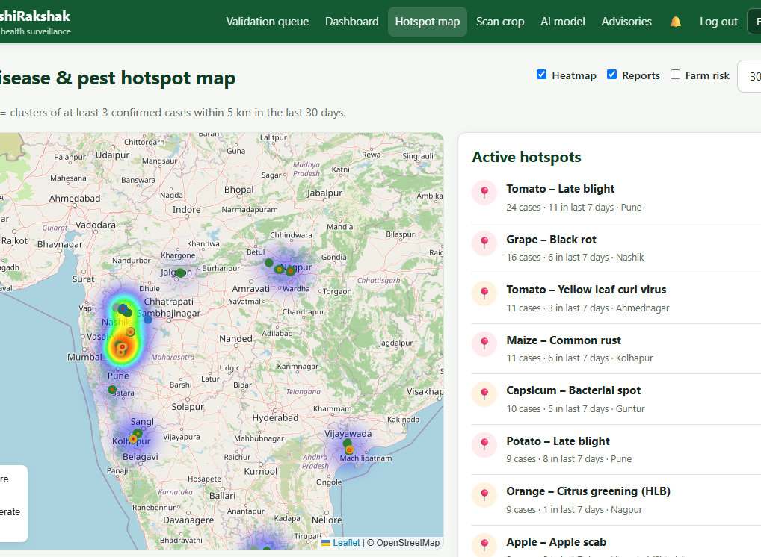
Results: Officer & Official Views
RESULTS
Surveillance dashboard (KPIs & charts)
Hotspot map: DBSCAN clusters + heatmap
95.0%
20.3 h
13
37.4%
AI–expert agreement
avg. validation time
hotspots detected
cases managed without chemicals
Measured on the demo database (425 reports over 90 days; AI predictions are real model outputs on held-out validation images, field context is simulated).
KrishiRakshak · Crop disease & pest early-warning system
15

Slide 16
Results: Comparison with Existing Approaches
RESULTS
Capability | Manual extension | Photo-ID apps | KrishiRakshak
Image-based diagnosis | ✗ (visit needed) | ✓ | ✓ 38 classes + top-3
Weather risk forecast per farm | ✗ | ✗ / generic | ✓ 12 models, 7 days
Crop stage / variety / soil | partly | ✗ | ✓
Pest traps & IoT sensors | manual | ✗ | ✓ ETL alerts + API
Hotspot mapping | ✗ | ✗ | ✓ DBSCAN + heatmap
Expert validation loop | ✓ (slow) | rare | ✓ prioritised queue
Learns from field confirmations | — | ✗ | ✓ versioned retraining
Multilingual + audio advice | partly | partly | ✓ 6 languages
Officials' dashboard | ✗ | ✗ | ✓ KPIs & charts
KrishiRakshak · Crop disease & pest early-warning system
16

Slide 17
Discussion
DISCUSSION
Interpretation of results
Limitations
• A lightweight CNN reaches 97.01% accuracy — enough for a first-line screening tool.
• Combining the photo diagnosis with weather risk tells the farmer not only what the problem is but how urgent it is.
• The expert loop turns AI into a decision-support tool, not a replacement for extension staff.
• IPM ordering and severity-based chemical advice support more targeted pesticide use.
• PlantVillage images are lab photos on plain backgrounds; accuracy on real field photos will be lower until field data is collected.
• Only 14 crops / 38 classes; major Indian crops like rice, cotton and chilli need their own image data.
• Weather rules are simplified and not yet calibrated with local outbreak records.
• Demo field data is synthetic; IoT devices are simulated.
• Needs internet for live weather and map tiles.
KrishiRakshak · Crop disease & pest early-warning system
17

Slide 18
Future Work & Conclusion
DISCUSSION
Future work
Conclusion
• Collect field images for rice, cotton, chilli, pulses; fine-tune the full network.
• Offline Android app with on-device TensorFlow Lite model.
• SMS / WhatsApp / IVR voice alerts for farmers without smartphones.
• Calibrate risk models with state pest-surveillance data; add soil-health cards.
• Real LoRa/GSM smart traps with automatic insect counting.
• Satellite (NDVI) crop-stress layers on the hotspot map.
KrishiRakshak delivers a complete crop-health system that runs in Chrome: image-based diagnosis, weather-based risk forecasting, pest-trap and sensor monitoring, hotspot mapping, expert validation, multilingual IPM advice, follow-up and continual learning, with dashboards for officials.
It supports the expected outcomes of the problem statement: earlier detection, reduced crop loss, more targeted pesticide use, faster extension response, wider surveillance coverage and better planning of preventive interventions.
KrishiRakshak · Crop disease & pest early-warning system
18

Slide 19
References
DISCUSSION
• Hughes, D. P. & Salathé, M. (2015). An open access repository of images on plant health (PlantVillage). arXiv:1511.08060.
• Mohanty, S. P., Hughes, D. P. & Salathé, M. (2016). Using deep learning for image-based plant disease detection. Frontiers in Plant Science, 7:1419.
• Sandler, M. et al. (2018). MobileNetV2: Inverted residuals and linear bottlenecks. CVPR.
• Ester, M. et al. (1996). A density-based algorithm for discovering clusters (DBSCAN). KDD.
• Hutton criteria for potato late blight risk — AHDB / UK Met Office (2017).
• Mills, W. D. (1944). Efficient use of sulfur dusts and sprays during rain to control apple scab. Cornell Ext. Bull. 630.
• Open-Meteo weather forecast API — open-meteo.com.
• FAO (2021). Scientific review of the impact of climate change on plant pests.
Thank you
KrishiRakshak · Crop disease & pest early-warning system
19

