Slide 1


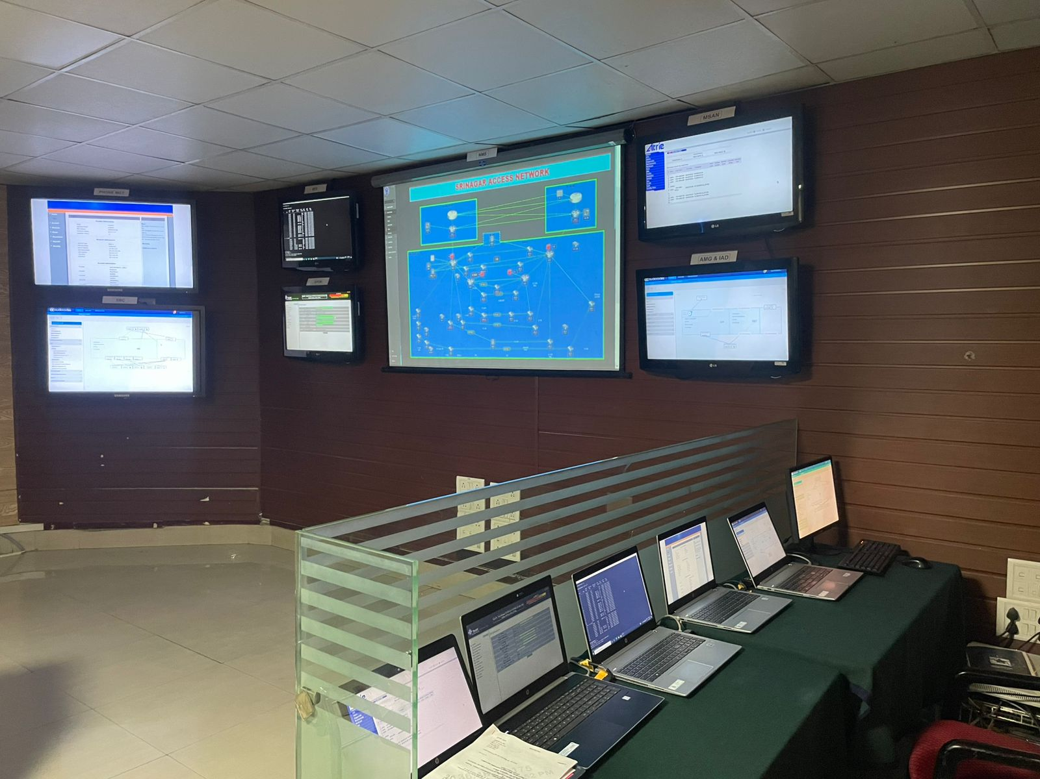
NETWORK MANAGEMENT CENTRE : 15 CORPS
Aim. Real Time Monitoring, Mgt and Maint of NFS Access Network in 15 Corps Z
  Eqpt Visibility.
  SBC
  MER
  MSAN
  GPON
  IAD
  AMG
  Responsibility.
    Real Time Network Monitoring
    Access Network Mgt
    Cyber Monitoring and Hardening
    VLAN and Logical Network Creation
    Root Cause Analysis (RCA) - Network Issues
    Demand and Hotline creation
    Fault Detection, Troubleshooting and Service Restoration
NMC 15 Corps

Slide 2
NETWORK MANAGEMENT CENTRE : 15 CORPS
Aim. Real Time Monitoring, Mgt and Maint of Backbone & Access Network in 15 Corps Z
  Eqpt Visibility.
  SBC
  MER
  MSAN
  GPON
  IAD
  AMG
  MCCS
  Satl Media
  Legacy- MSP, STM, RRF
  Responsibility.
    Real Time Network Monitoring
    Access Network Mgt
    Backbone/ Legacy Network Mgt\
    MCCS Network Mgt
    Cyber Monitoring and Hardening
    VLAN and Logical Network Creation
    Root Cause Analysis (RCA) - Network Issues
    Demand and Hotline creation
    Fault Detection, Troubleshooting and Service Restoration
NMC 15 Corps

Slide 3
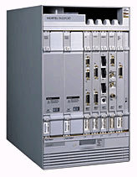
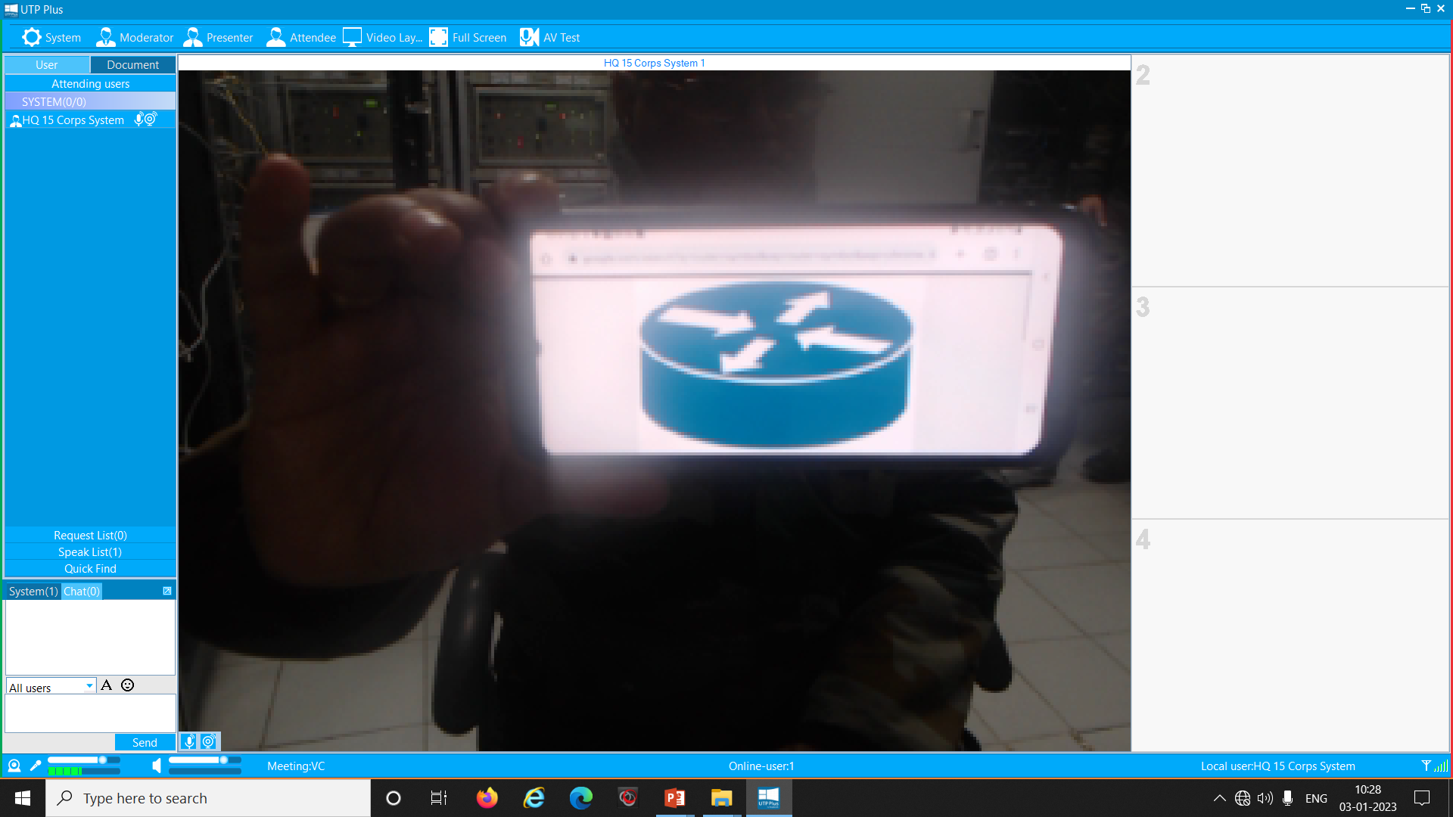
MSP NW : 15 CORPS Z
MSP NETWORK : 15 CORPS Z
Corps MSP
Loc | Ccts
Srinagar | 38 x E1
OAF | 06 x E1
SCN | 21 x E1
Baramulla | 10 x E1
Kupwara | 10 x E1
Sharifabad | 10 x E1
Awantipura | 08 x E1
DELHI
NFS CLOUD
Rear MSP
Loc | Ccts
Delhi | 02 x E1 | -
Udh’pur | 01 x E1 | 01 x E3
Nagrota | 01 x E1 | -
SAR
01 X E1
01 X E3
UDHAMPUR
01 X E1
SAR
NAGROTA
SAR
NFS CLOUD
02 X E1 on NFS
SAR
05 X E1
01 X E1
05 X E1
04 X E1
01 X E1
01 X E1
07 x E1
05 x E1
02 X E1
01 X E1
SRINAGAR
01 X E1
01 X E1
05 X MVPE
15 COSR EXCH
BARAMULLA
01 X MVPE
01 X E1
KUPWARA
GULMARG
OAF
01 X MVPE
03 X MVPE
03 X MVPE
SHARIFABAD
01 X MVPE
AWANTIPURA
BADGAM 5 SECT*
01 X MVPE
19 DIV EXCH
28 DIV EXCH
02 X MVPE
SONAMARG
02 X MVPE
RAMPUR 161 BDE*
01 X MVPE
CIF(K) EXCH
01 X MVPE
CIF(V) EXCH
01 X MVPE
RAMPUR 161 BDE*
01 X MVPE
01 X MVPE
TREHGAM 68 MTN*
KHUNMOH
02 X MVPE
01 X MVPE
Z-GALI 53 BDE*
MANASBAL 3 SECT*
02 X MVPE
01 X MVPE
URI MAIN
NAUGAM 17 BDE*
01 X MVPE
01 X MVPE
BALAPUR 12 SECT*
KHREW
01 X MVPE
DRUGMULLA
01 X MVPE
1 SECT (KHANABAL)
79 MTN BDE* (UPLONA)
01 X MVPE
POHRUPET 7 SECT*
01 X MVPE
URI 12 BDE*(U/G)
01 X MVPE
2 SECT (WUZUR)
01 X MVPE
01 X MVPE
TANGDHAR 104 BDE*
01 X MVPE
268 INF BDE* (P GALI)
URI FWD (2 TREE)
01 X MVPE
21 FAD (KHUNDRU)
01 X MVPE
CHARKUT 8 SECT*
30 RR* (LANGAIT)
01 X MVPE
LEGENDS
NFS MEDIA -
BSNL MEDIA -
MCCS NW -
109 INF BDE* (DAWAR)
01 X MVPE
03 X E1
02 X E1
02 X E1
08X E1
19 DIV REAR (PATTAN)
01 X MVPE
SINGHPURA
01 X E1
10 SECT RR* (HYDERBEIG)

Slide 4
STM NETWORK : 15 CORPS Z
03 x E1 & 12 MB Data
STM
STM
STM
STM
04 MB Data
02 x E1 & 02 MB Data
01 x E1
STM
KUPWARA
DAWAR
04 x E1 & 14 MB Data
KIMSAR
STM
C'TEL
STM
LANGAIT
10 MB Data (Leh Alt Route)
C'TEL
03 x E1 & 04 MB Data
KANJALWAN
BARAUB
STM
05 x E1 & 16 MB Data
BARAMULLA
01 x E1 & 04 MB Data
02 x E1 & 04 MB Data
01 x E3, 12 x E1 & 04 MB Data
OAF STM RING
05 x E1 & 10 MB Data
ALTERNATE ROUTE
STM
09 x E1 & 14 MB Data
STM
STM
STM
STM
DRASS
01 x E1
C'TEL
SINGHPURA
To Leh
GULMARG
LEH STM RING
01 x E3, 13 x E1 & 04 MB Data
01 x E1 & 04 MB Data
STM
STM
STM
04 x E1 & 04 MB Data
C'TEL
C'TEL
MAIN ROUTE
STM
05 x E1
17 x E1 & 04 MB Data
SONAMARG
SHARIFABAD
STM
C'TEL
9 x E1 & 14 MB Data
PATTAN
STM
AWANTIPUR
05 x E1 & 08 MB Data
SRINAGAR
24 x E1 & 04 MB Data
03 x E1 & 08 MB Data
15 x E1
STM
04 x E1 & 08 MB Data
03 x E1
STM
STM
STM
STM
STM
LEGEND
LEH STM RING -
OAF STM RING -
C’TEL ALT CONTV-
C'TEL
C’TEL
C'TEL
08 E1 & 12 MB Data
C'TEL
OAF
WUSAN
GUND
SRINAGAR

