Slide 1



Slide 3
COFFA
3D Viewer

Slide 4


Slide 7
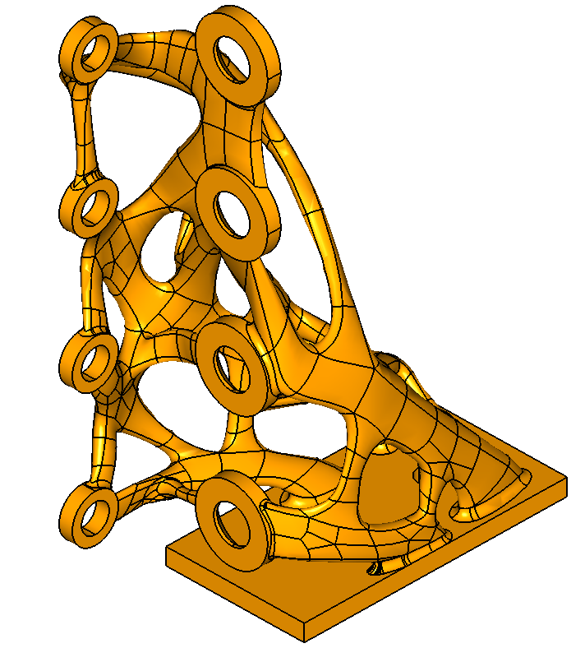
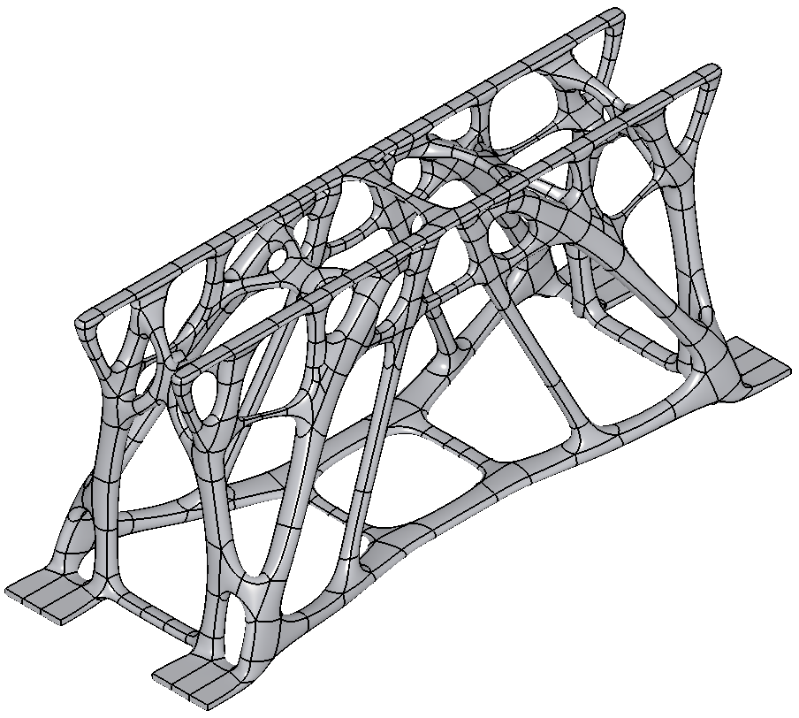

COFFA
The Knowledge-based CAM Tool for Additive Manufacturing

