Slide 1
Real Dream Team
The team's internal auction app — enter the site code, pick your name, and every lot you care about finds you.
Real Dream Team · Auction app — Mark Porter + Devin
github.com/COG-GTM/realdreamteam · rdt-auction.marklovestech.com · 20 PRs · Sep 14–15, 2026
Internal · Cognition GTM
1 / 6

Slide 2
THE ORIGINAL PLAN
A live auction app for the team, built in under 12 hours
One always-on URL the whole team can open at once — bid against each other, get matched to lots they care about, and watch an auction close live during the demo.
Who it is for
The Real Dream Team — 28 team members signing in from their own browsers with one shared site code and a name picker. Admins hold a second code.
Nothing runs on a laptop: one Node process on EC2 plus a shared Supabase Postgres, both up 24/7.
Must-have scope (the 8 demo beats)
• Access code → user picker → summary with Matches + Discover
• Preferences change → matches change
• Browse auctions and lot detail with bid history
• Two users bid on one lot; low bids rejected
• Admin adds a lot → matching users get notified
• Outbid notification; History of bids and favorites
• Auction closes → SOLD, hammer price, sound
Definition of done
• Node 20 · Express · EJS · pg, ~6 dependencies, no build step
• Data model frozen in db/schema.sql (#34)
• Each step = one reviewed PR with screenshots
• Deployed behind a public URL under systemd
Left out on purpose: search, pagination, lot editing, realtime push.
Shipped the plan and then some: 250 seeded lots across 8 auctions, a 5 s poller that closes auctions on time, Caddy TLS in front, and session cookies that re-ask for the code.
Plan
2 / 6

Slide 3
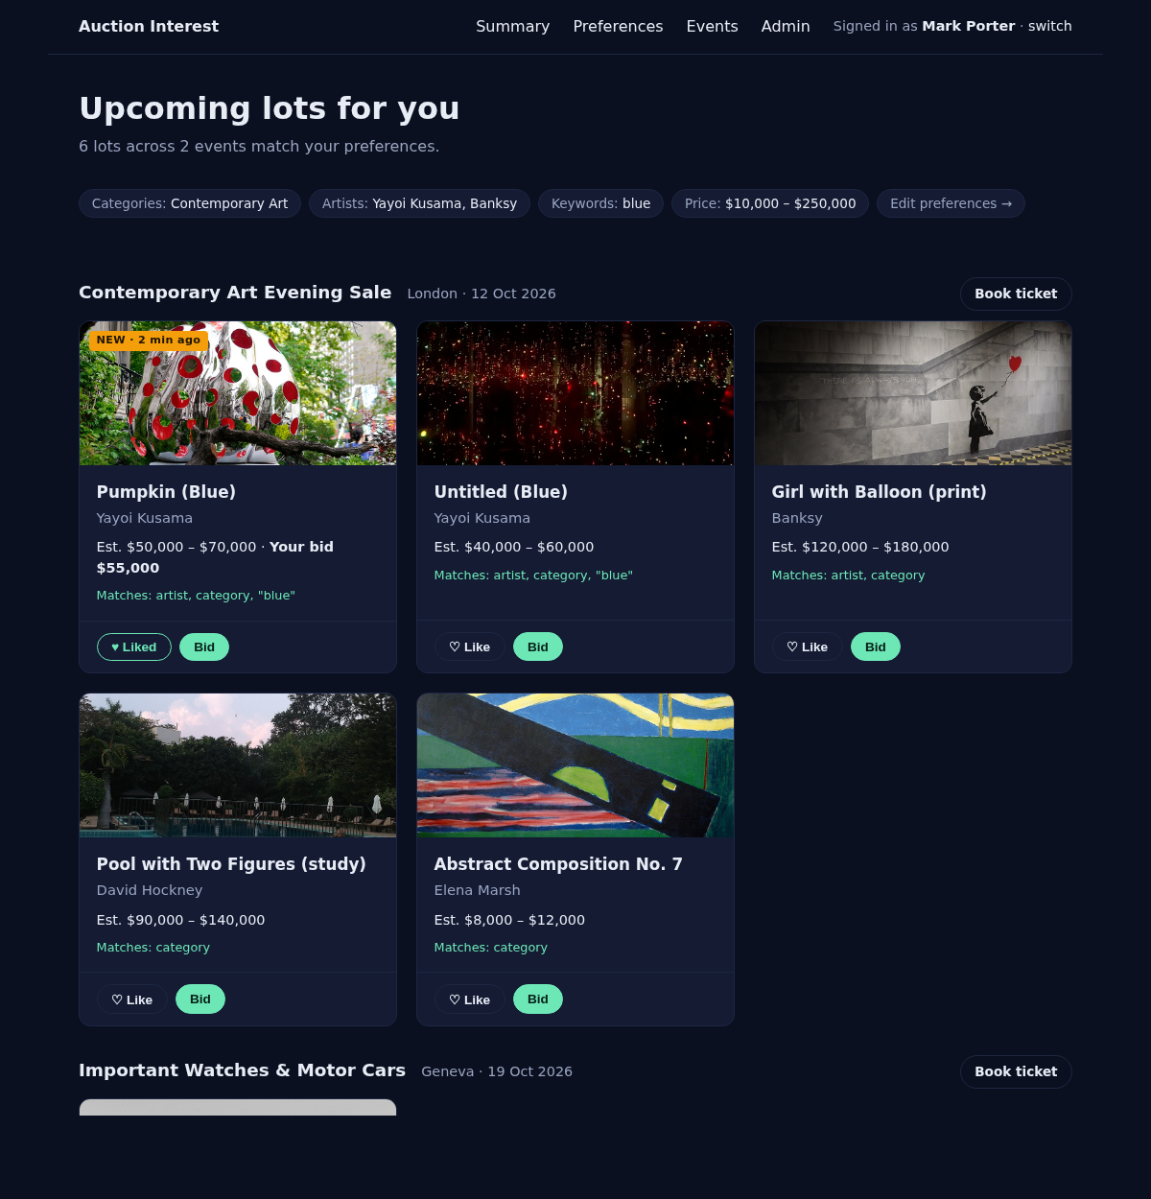
THE PRODUCT · LIVE AT RDT-AUCTION.MARKLOVESTECH.COM
The auction app, today
Sign in with the site code, then pick your name.
Summary shows Notifications, “Matches your interests”, and Discover — 5 random open lots, fresh on every refresh.
Browse auctions and lots, ★ favorite, and place whole-number bids that must beat the current high bid.
Matching by category, artist or keyword, with “why it matched” chips on every card.
Auction close → SOLD ribbon, hammer price, winner, a sound, and Won/Lost notifications for every bidder.
/admin (second code): add lots, edit close times, close/reopen auctions, ban users.
Lot images are hotlinked from Wikimedia Commons; all state lives in Postgres.
Open the app →
auction-app/ · npm start
docs/mockup-summary.html
Demo · github.com/COG-GTM/realdreamteam
3 / 6

Slide 4
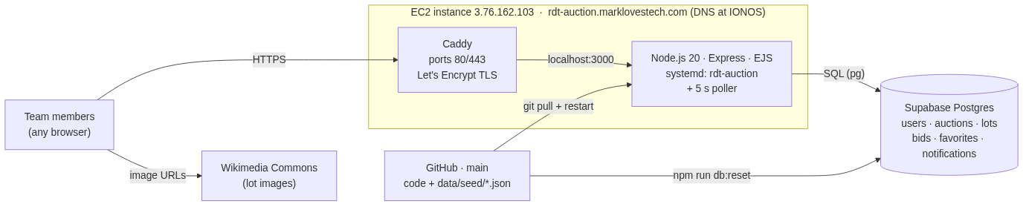
HOW IT RUNS · THREE MOVING PARTS, ALL ALWAYS ON
Architecture
docs/architecture.mmd · rendered with mermaid-cli
Stack
• Node.js 20 + Express + EJS + hand-written SQL (pg)
• No build step, no frontend framework, no API layer — the server renders HTML
• Stateless Node process under systemd, with a 5 s poller that closes auctions on time
• State only in Postgres; npm run db:reset reloads data/seed/*.json
Request flow
• IONOS DNS → EC2 instance
• Caddy terminates TLS on 80/443 (Let’s Encrypt) → Node on :3000
• Node runs a few SQL queries against Supabase Postgres → plain HTML
• Browser fetches lot images straight from Wikimedia Commons
Architecture
4 / 6

Slide 5
HOW WE DELEGATED · ONE DEVIN SESSION PER CONCERN
One builder, eight Devin sessions, twenty PRs
Design
v1 design, build design, mockups; decided the 8 demo beats and the stack.
Data Model
Frozen Postgres schema (9 tables), schema-review changes, auction-house survey.
Backend database work · RDT Synthetic Data
Supabase setup; 4 houses, 28 users, 8 auctions, 250 lots with images, bids, favorites.
Permissions & access · RDT-Quality · RDT-Security · Links & References
Access codes and session cookies, review passes, secrets moved to a private note, session index.
#3
#17
#20
#36
#22
#34
#39
#18
#47
#41
#51
#52
#53
#59
Execution — every change landed as a reviewed PR into main
devin/* branches · feature:/bug: commits + screenshots · opened by devin-ai-integration[bot] · reviewed & merged by CognitionMark
WHEN
PRS
WHAT CHANGED
Sep 14, 15:59–18:43
#1–#3, #17, #18
Static site, v1 design proposal, review fixes, mock seed data
Sep 14, 21:18–23:25
#22, #20, #34, #39, #36
v2 schema, summary mockup, Postgres data model, build design
Sep 15, 00:20–00:33
#47, #51, #41
Full seed data, session index, the app itself (scaffold, summary, bidding, admin, poller)
Sep 15, 00:37–01:00
#52, #53, #55, #56, #57
Secrets out of the repo, Caddy TLS, README + architecture, static site removed
Sep 15, 01:19–08:57
#59, #63
Session cookies + Sign out; “Portrait of Devin” lot
Delegation & execution · 20 of 20 PRs merged
5 / 6

Slide 6
NEXT STEPS · PATH FORWARD
From a demo-night build to something the team keeps
1 · Own the images
Lot images are hotlinked from Wikimedia/Wikipedia today. Upload them to the Supabase lots bucket (needs a service-role key) before treating the deployment as public.
2 · Real avatars and local time
Seed users still use gravatar fallbacks (#42) and times render in UTC rather than US Central (#45).
3 · Bring back the deferred v1 features
Search and filters, pagination, lot edit/delete, and realtime updates instead of refresh were all cut on purpose for the demo window.
4 · Slack notifications
The in-app feed is the source of truth; the Slack webhook is wired but optional. Turn it on for new-lot and outbid events once the channel is agreed.
What has to come with it
Infrastructure details stay in the private “RDT infrastructure access” knowledge note and the org secrets (AUCTION_DATABASE_URL, AUCTION_DATABASE_PASSWORD, RDT_EC2_SSH_KEY); the repo has node --test unit tests but no CI yet — the gap today is a PR check that runs them.
Path forward
6 / 6

