Slide 1
Introductions
Learning goals:
Understand what Jupyter is
Accessing Jupyter with datahub
Q&A, and start thinking of final project ideas
COGS 108 Winter 2024
Yueyan Tang
Discussion 1
yyt005@ucsd.edu
OH: Mon 9a-10a at M.O.M’s Cafe
Discussion slides and materials adapted from Will McCarthy (TA: SP20)

Slide 2
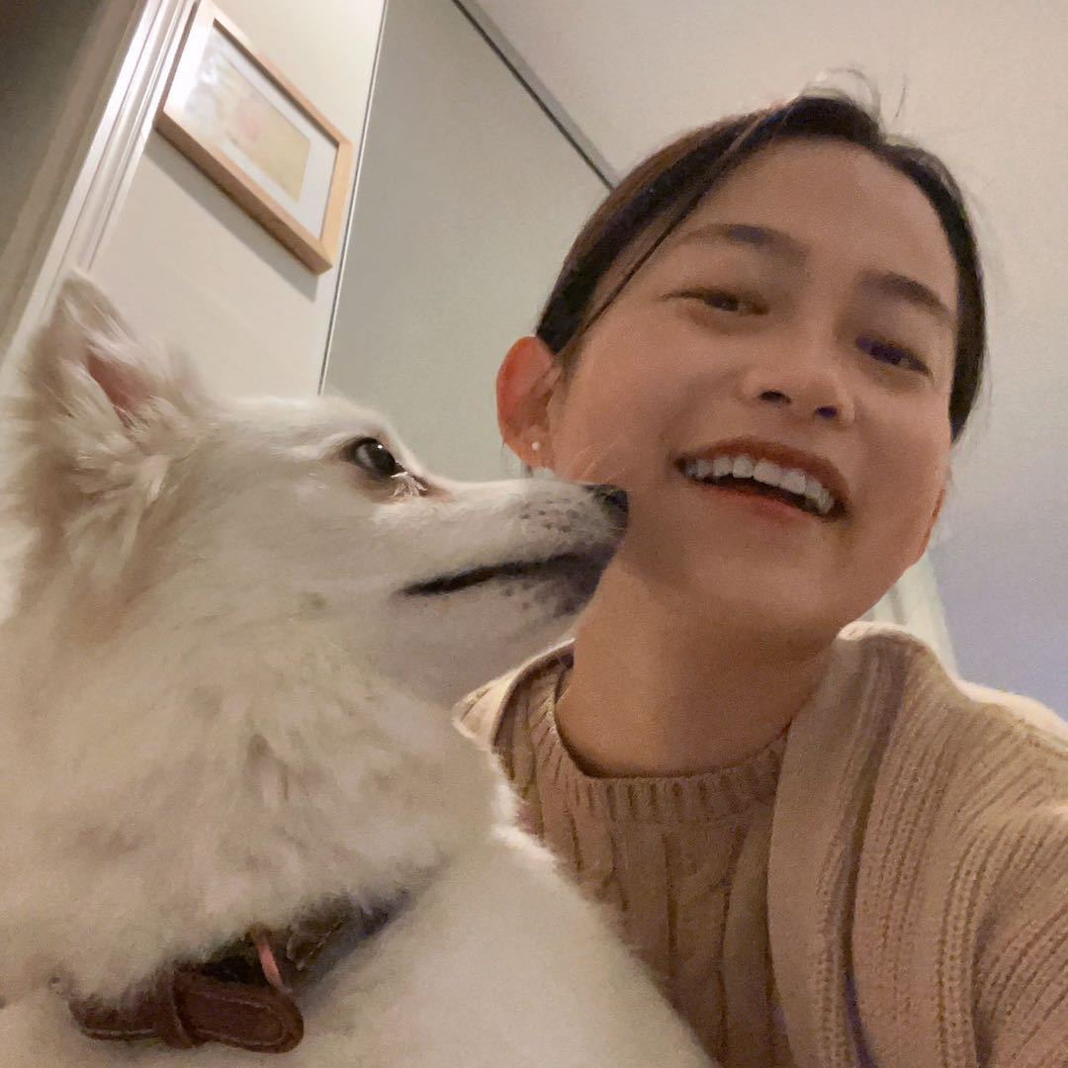
Welcome to COGS 108!
Yueyan Tang yyt005@ucsd.edu OH: Mon 9a-10a at M.O.M’s Cafe
3rd year Ph.D. student in Cog Sci advised by Gedeon Deak
Research: understanding infants’ joint attention development

Slide 3
Section Philosophy
Sections are not recorded
Attendance is not required
Goal: 1 hour in section ≥ 2 hours working alone. How?
Mini-recap (first ~10 mins)
Demos for project inspiration (~5 mins)
Personalized help while you work (last ~35 mins)

Slide 4
Meet New Friends!
Share your name, year, major, and a fun fact about yourself

Slide 5
Let’s log in to datahub
https://github.com/COGS108/Overview (It’ll be worth bookmarking this page ^. You’ll use it a lot)
Log in
Go to assignments
‘fetch’ assignments you have access to

Slide 6
Programming
This course assumes programming knowledge
But not much
Resources:
codeacademy
https://jakevdp.github.io/PythonDataScienceHandbook/
https://www.dataschool.io/python-pandas-tips-and-tricks/
Cheatsheets
Google: ‘python cheatsheet’, ‘pandas cheatsheet’ (find one that’s good for you)

Slide 7
Resources
For a long list of interesting datasets: https://tinyletter.com/data-is-plural
All Course Discussion Materials: https://github.com/COGS108/Lectures-Ellis/tree/wi24

