Slide 1
Data Visualization & A2
COGS 108 Winter 2024
Yueyan Tang
Discussion 3
yyt005@ucsd.edu
OH: Mon 10-11am at M.O.M’s Cafe

Slide 2
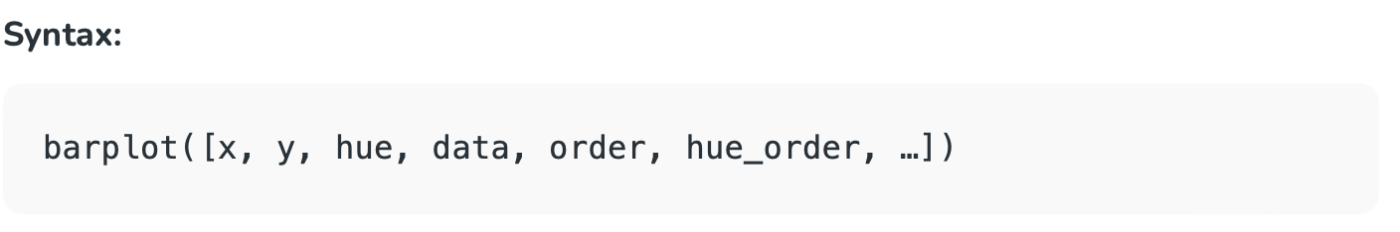
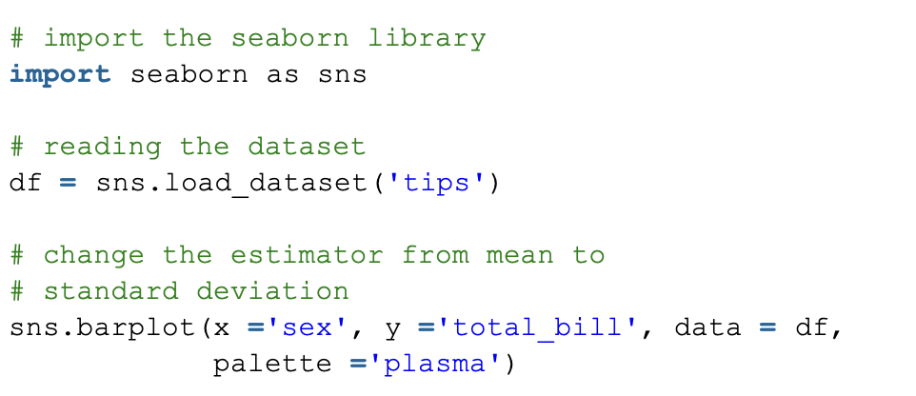

Slide 3
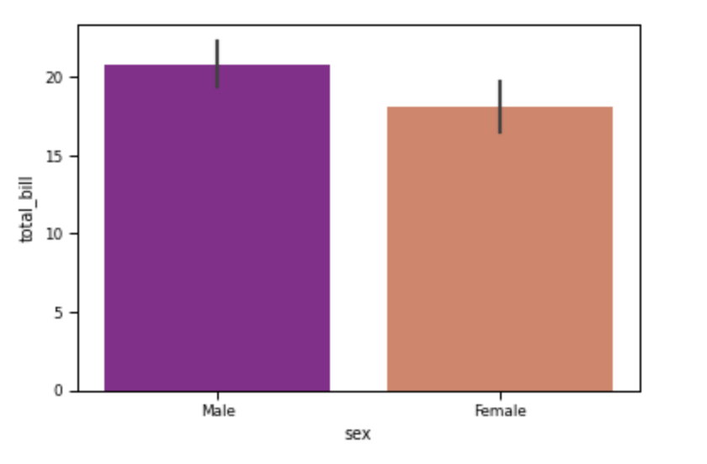

Slide 4
Let’s plot some figures! https://github.com/COGS108/Lectures-Ellis/tree/wi24/XX_section

Slide 5
3 skills that will save you 5+ hours on A2:
Knowing the difference between a pandas Series and Data Frame.
Knowing how to use Google effectively.
Knowing how to read the pandas documentation.

Slide 6
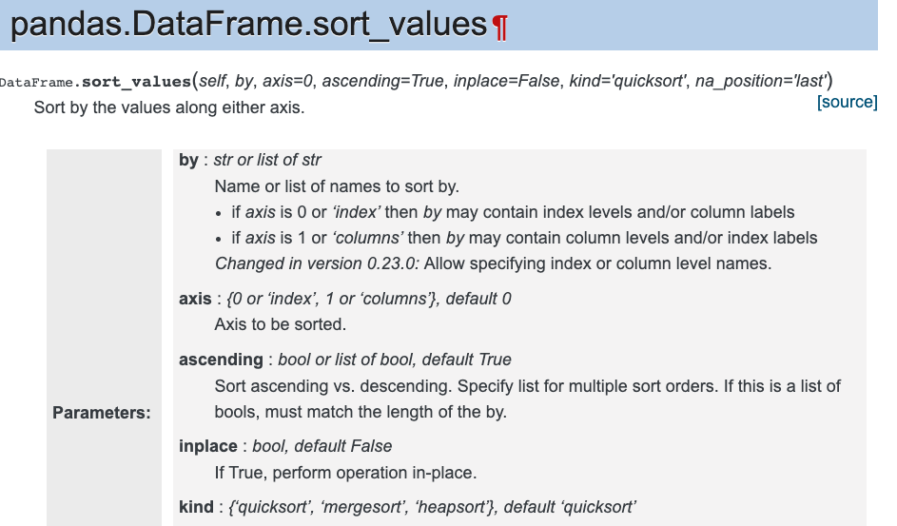
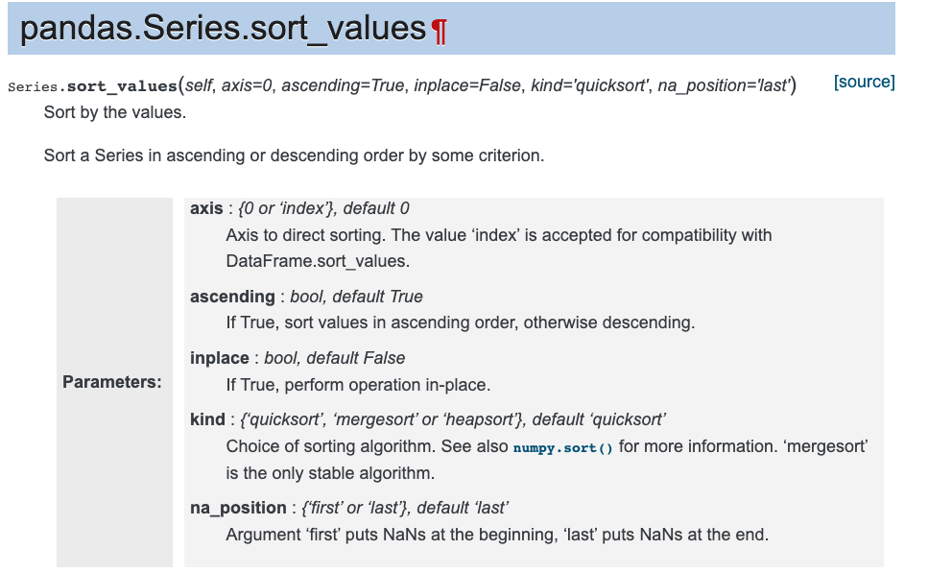
Why is this important?
Most pandas methods work differently between Data Frames and Series.
The documentation will tell you what type of object the method is for.

Slide 7
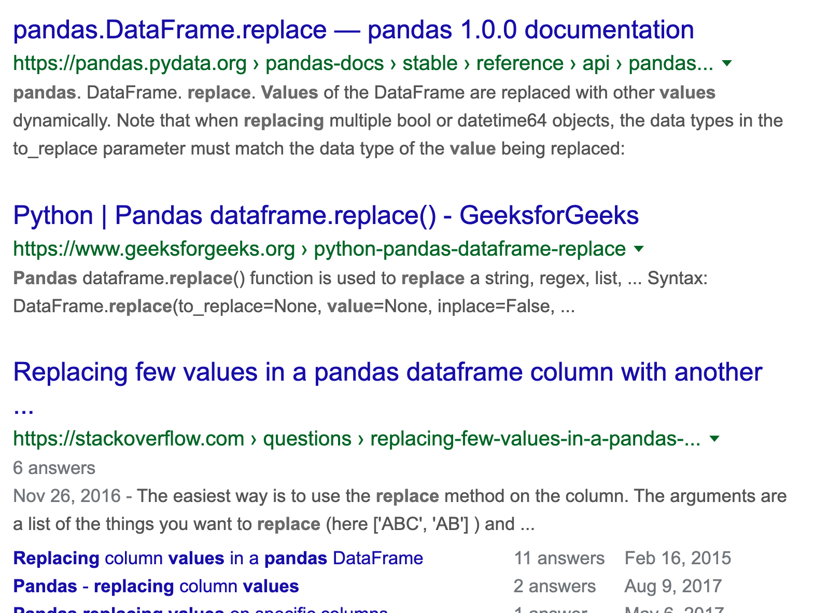
How to use Google properly
State your task: “I need to replace 0 with False and 1 with True.”
Remove question-specific details: “replace values”
Add the package name to the front: “pandas replace values”
If you already know the right method, just google “pandas replace”
Cheatsheets can help you find the right method

Slide 8
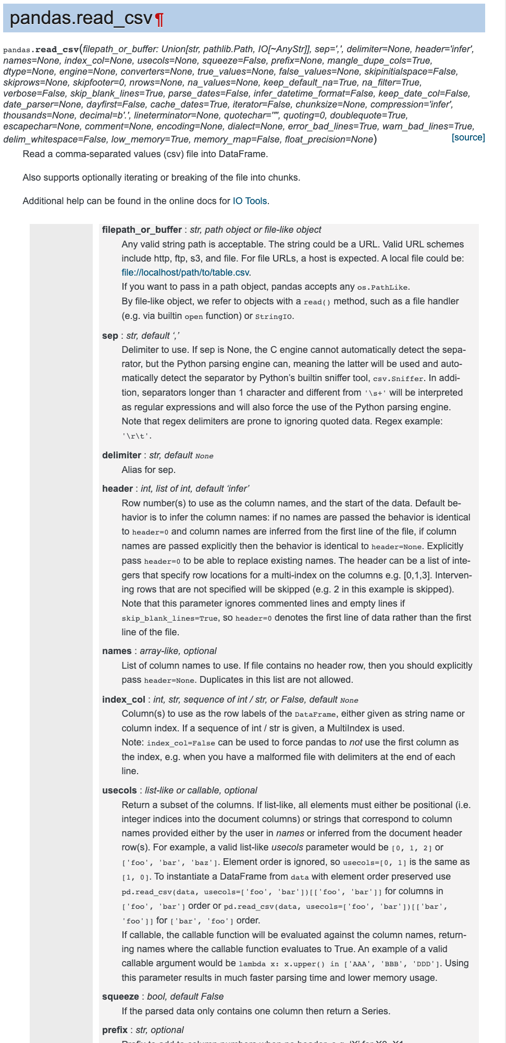
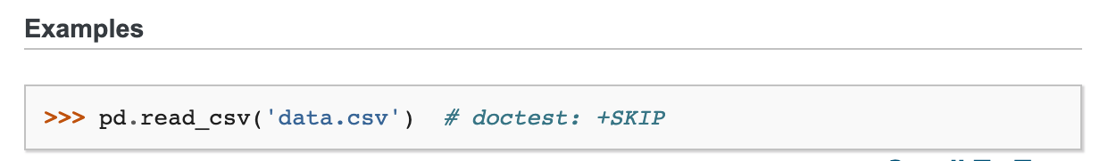
How to read pandas documentation
Skip the table of method parameters and look at the examples.
Copy example, then modify it to work for your notebook.
If needed, refer back to the method parameters for fine-tuning.
(The method in the picture on the right solves Q2.)

Slide 9
Extra resources:
Ch3 of textbook.ds100.org
10 minutes to pandas: pandas.pydata.org/pandas-docs/stable/getting_started/10min.html

Slide 10
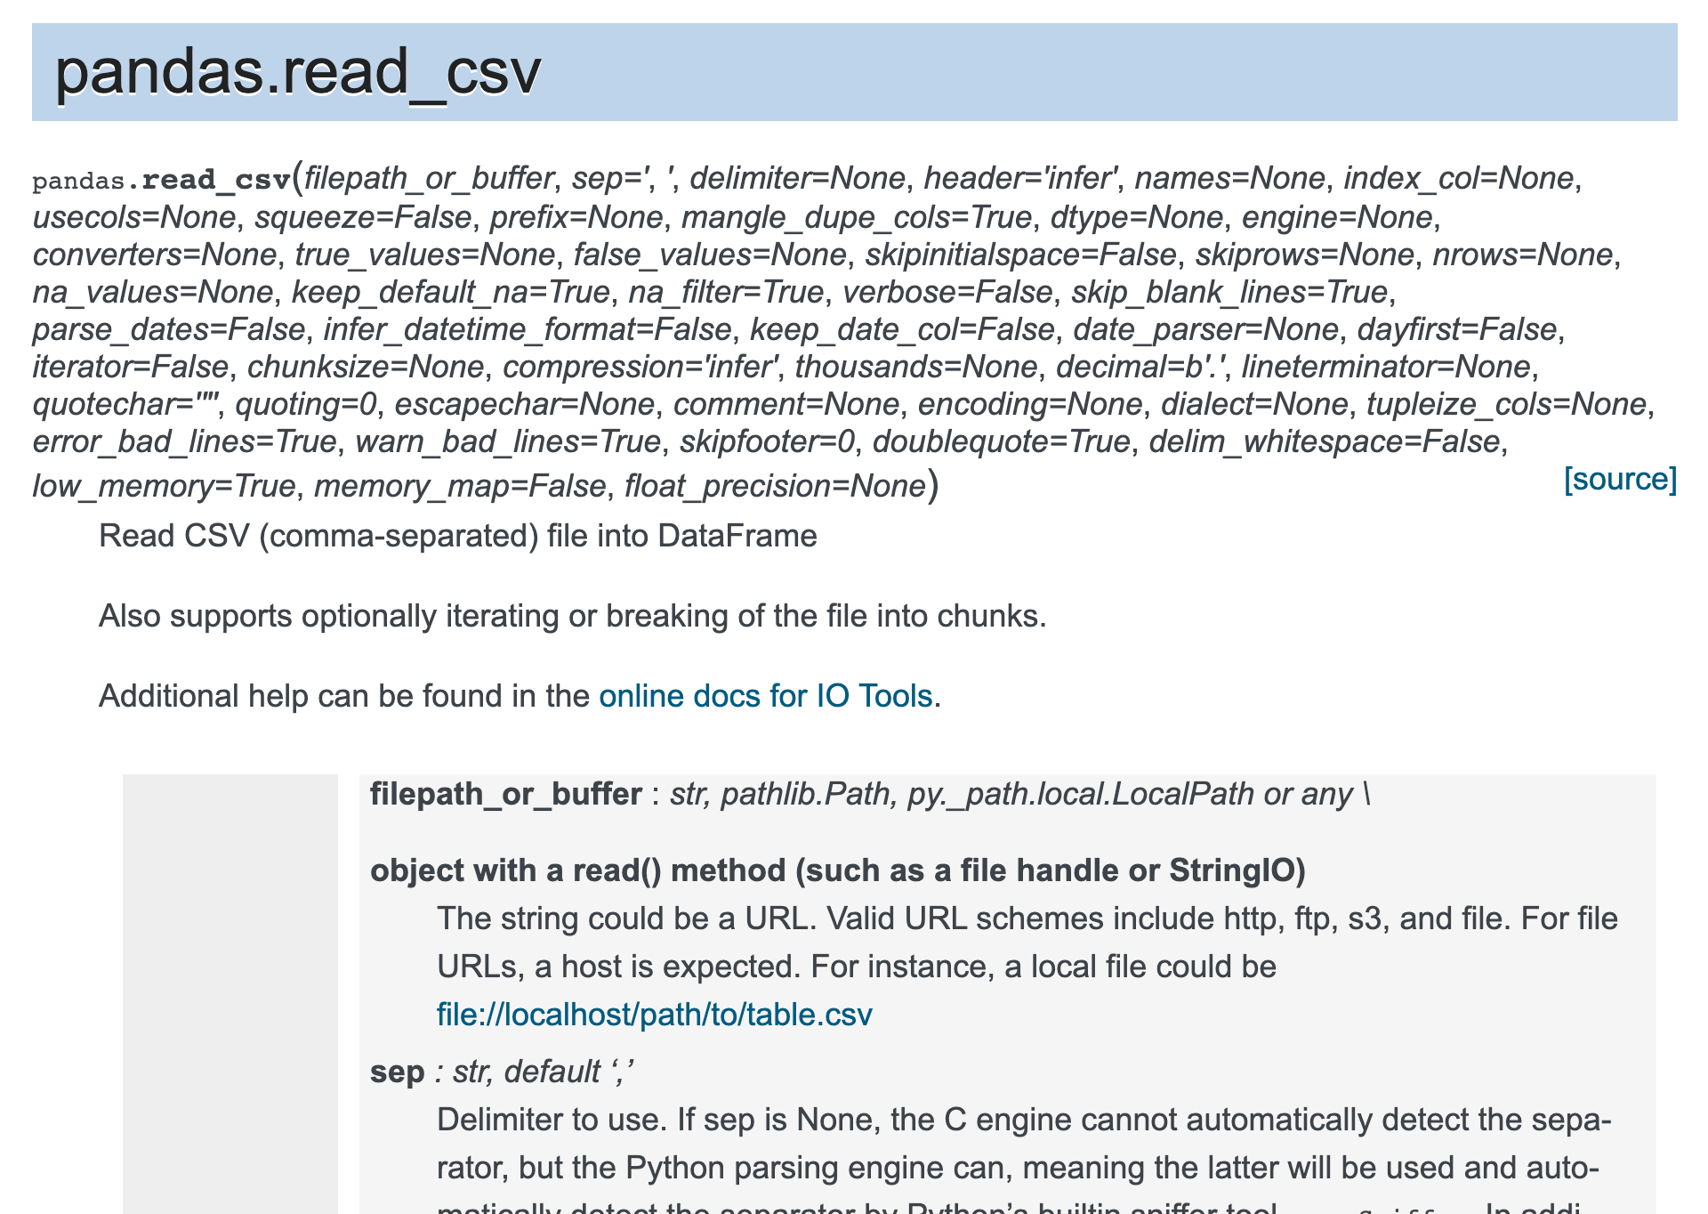
Why is this important?
df.sort_values(…)
df[‘names’].sort_values(…)
pd.read_csv(…)

Slide 11
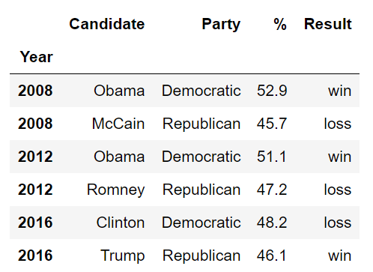
What’s a Data Frame?
Data Frame: two-dimensional table of data.
All columns are the same type (but not rows).
Every row and every column has a label.
We call the set of row labels the Index of a DataFrame
Index

Slide 12
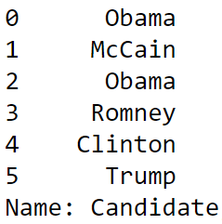
What’s a Series?
Series: one-dimensional sequence of data.
Usually created by taking a single column from a Data Frame.
Index

Slide 13
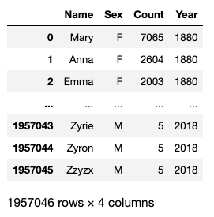
Pandas is really useful!
It converts python into a usable (and good!) data analysis tool

Slide 14
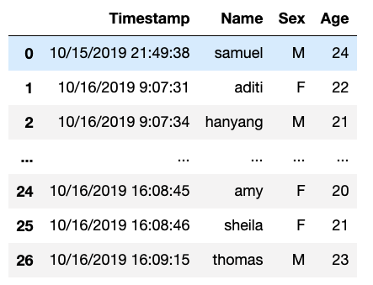
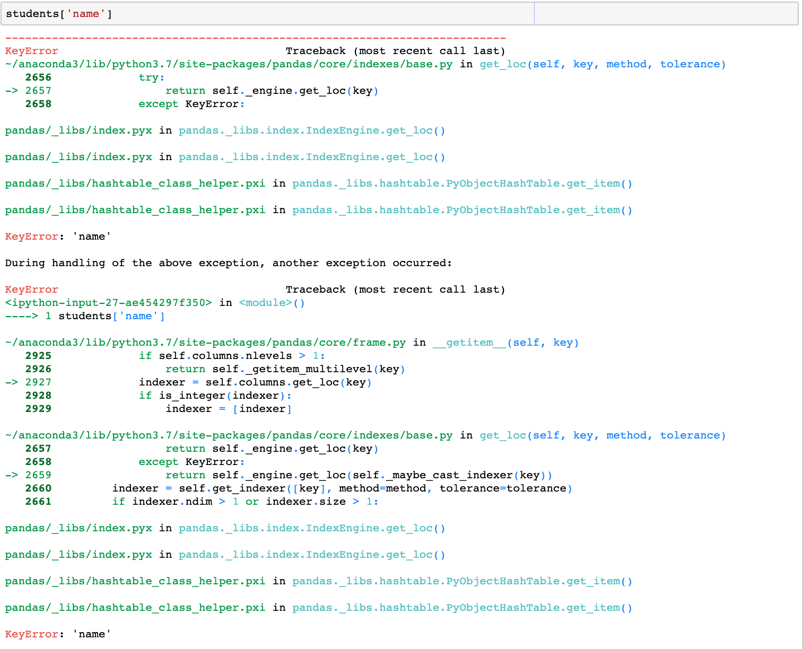
Pandas has terrible error messages

Slide 15
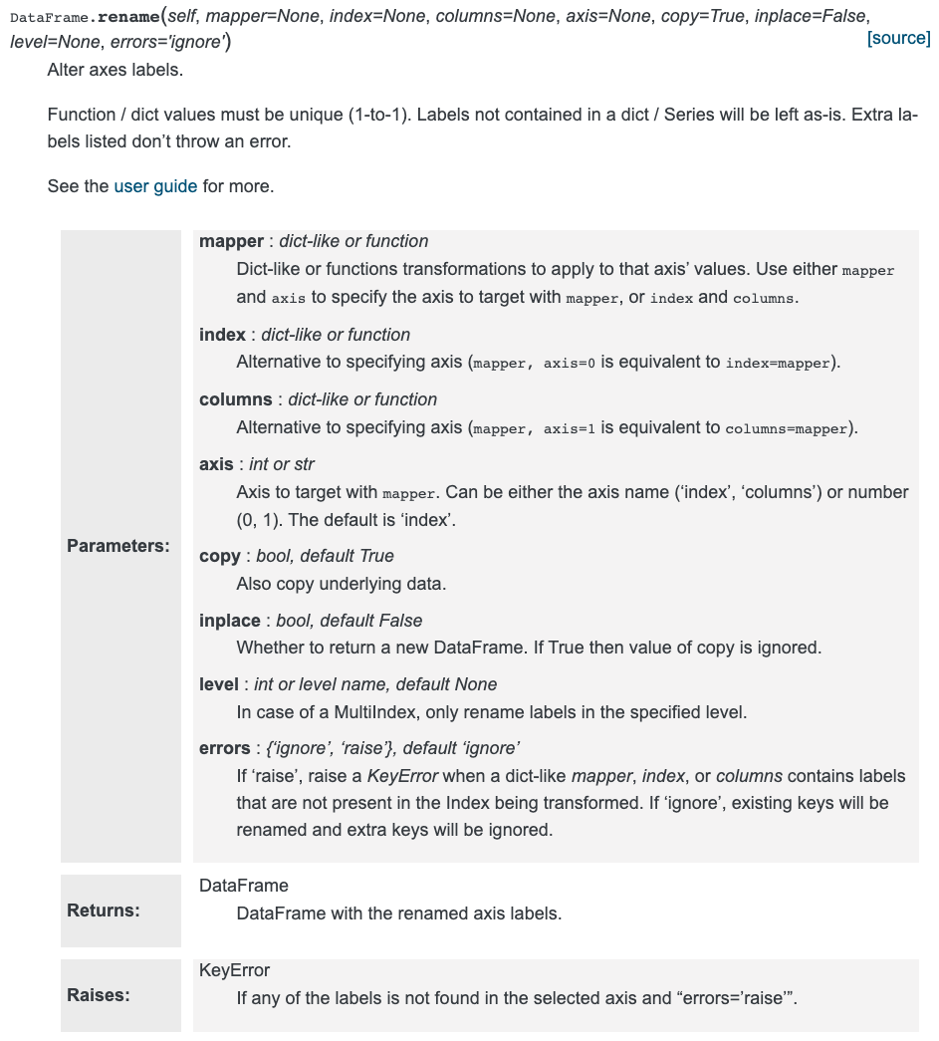
Pandas has unfriendly documentation
Also, there are typically many ways to do the same thing in pandas.

Slide 16
Finally: don’t use loops
If you find yourself trying to write a for/while loop when working with pandas, you’re almost definitely doing it wrong.
Look for the right pandas method. And ask your friend + staff for help.

Slide 17
A2 tips
Q3b: The average of a column of 0/1s is the proportion of 1s.
Q5b: Use a list of dtypes instead of a single string to select multiple dtypes
Q5d: Adding two Series together sums each element in the two Series. Use df.assign to create a new column.
Q6a: I’ll walk through this one
Q8b: Use a list of strings in .agg to call multiple aggregation methods

