Slide 1
A4 and project help
COGS 108 Winter 2024
Yueyan Tang
Discussion 7
yyt005@ucsd.edu
OH: Mon 10-11am at M.O.M’s Cafe
Materials adapted from Sam Lau WI20

Slide 2
SVM
A binary linear classifier: SVM builds a model that assigns new examples to one of the two categories.
What do you need?
Numpy
Pandas
matplotlib
sklearn

Slide 3
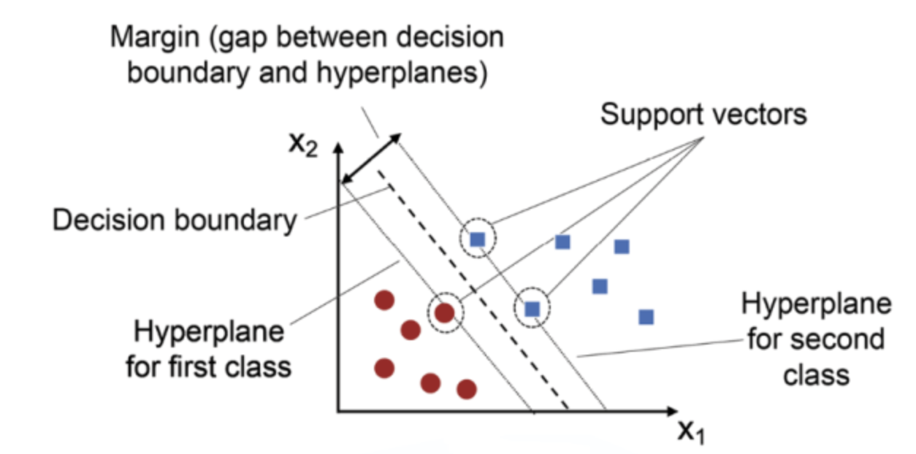

Slide 4
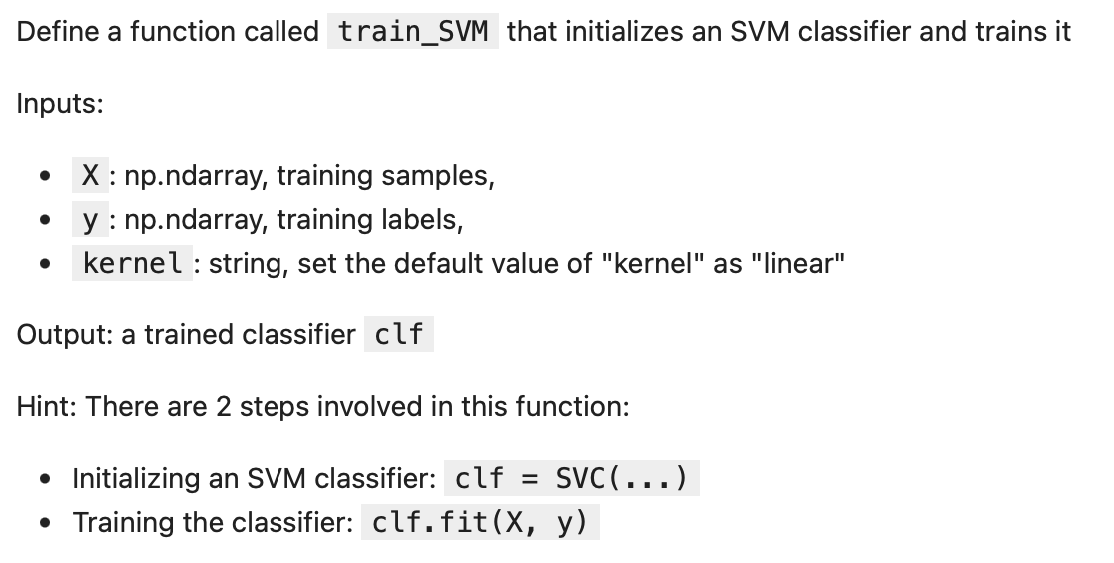

Slide 5
Next…
Project help – data checkpoint & EDA

