Slide 1
A4, Final Projects
Learning goals:
Make progress on A4
Make progress on final projects
yyt005@ucsd.edu
OH: Mon 10-11am at https://ucsd.zoom.us/j/91239338091

Slide 2
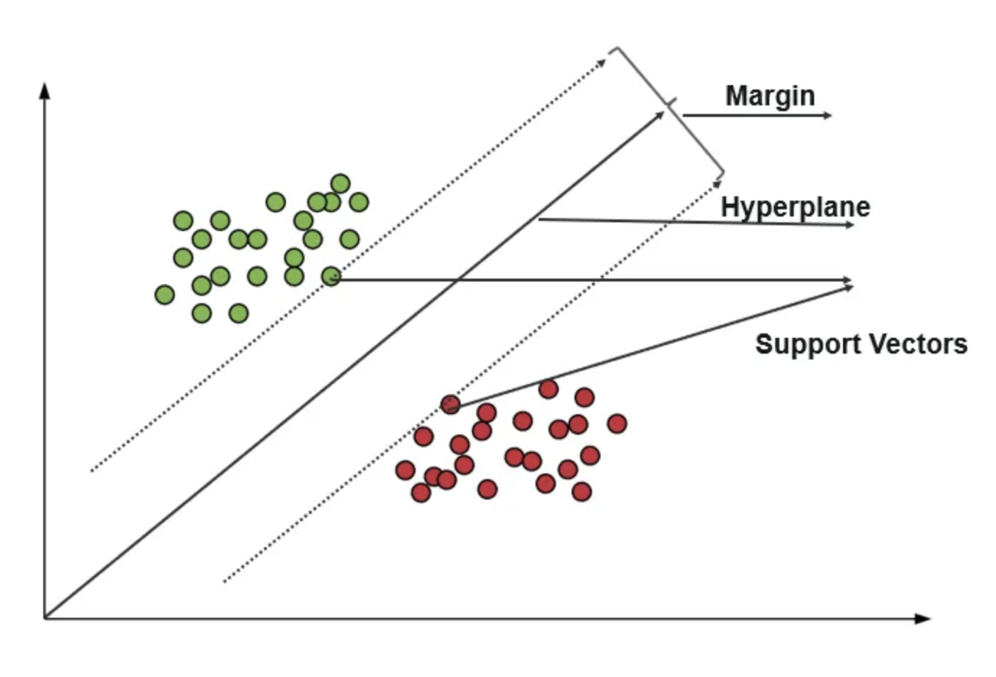
SVM
Explore data
Splitting data
Generating the model
Evaluating the model

Slide 3
Next week
CAPEs!
Work on final projects

