Slide 1
State, Slicing, and A3
Learning goals:
Understand how state works within a notebook.
Understand slicing DataFrames.
Get hints for a bunch of questions on A3.
COGS 108 Winter 2024
Yueyan Tang
Discussion 4
yyt005@ucsd.edu
OH: Mon 10-11am at M.O.M’s Cafe
Materials adapted from Sam Lau WI20

Slide 2
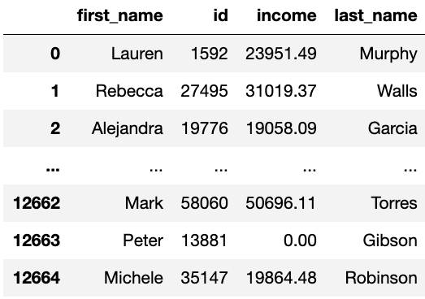

What is df_income?
What happens if you run the first cell one time? Two times?

Slide 3
What is df_income?
Edited to ->

Slide 4
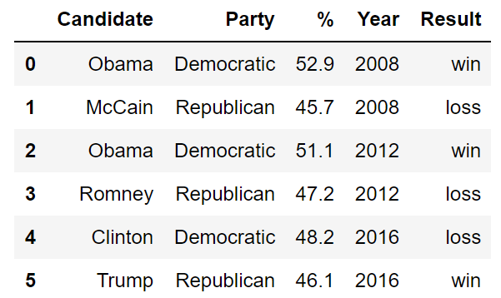
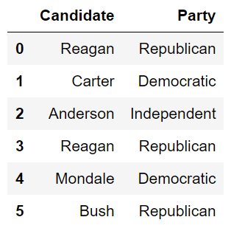
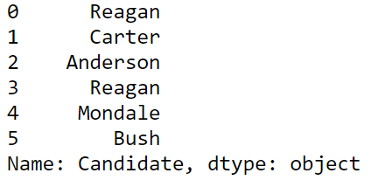
Use brackets when taking slices (subsets) of a DF
Key idea: Only one value goes into the brackets.
How do I grab a single column?
How do I grab multiple columns?
This is a Series!
This is a DF!

Slide 5

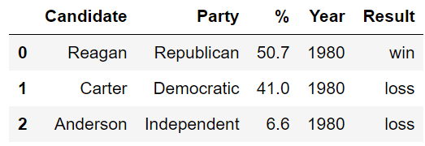
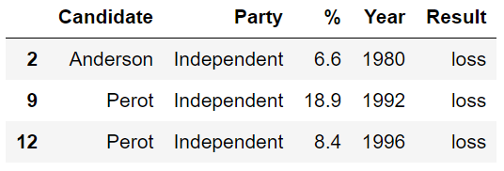
Use brackets when taking slices (subsets) of a DF
How do I grab rows?
This is a DF!
Whoa, what’s going on here?

Slide 6
Bracket Takeaways?
Brackets = slicing a DF. Parentheses = calculating something about a DF.
Strings in brackets = grabbing column (Series) List of strings in brackets = grabbing columns (DF)
Slice in brackets = grabbing rows (DF) Boolean expression in brackets = grabbing rows (DF) (You will need this last one for question 4b.)

Slide 7
Demo with Elections Data

