Slide 1
A4, Final Projects
Learning goals:
Make progress on A4
Make progress on final projects

Slide 2
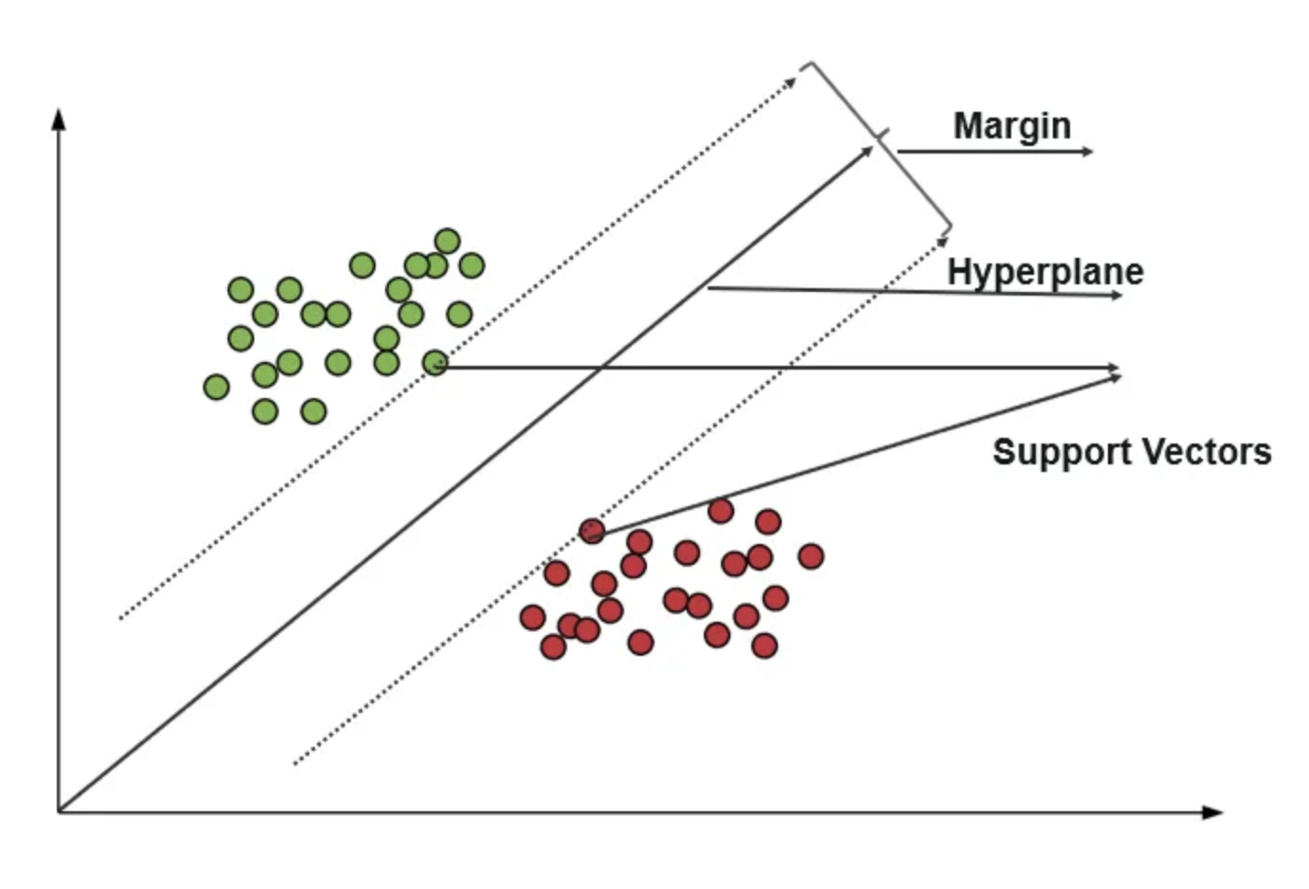
SVM
Explore data
Splitting data
Generating the model
Evaluating the model

Slide 3
Next week
CAPEs!
Work on final projects

