Slide 1
Interpreting results in context
COGS 108 Winter 2024
Yueyan Tang
Discussion 5
yyt005@ucsd.edu
OH: Mon 10-11am at M.O.M’s Cafe
Materials adapted from Sam Lau WI20

Slide 2
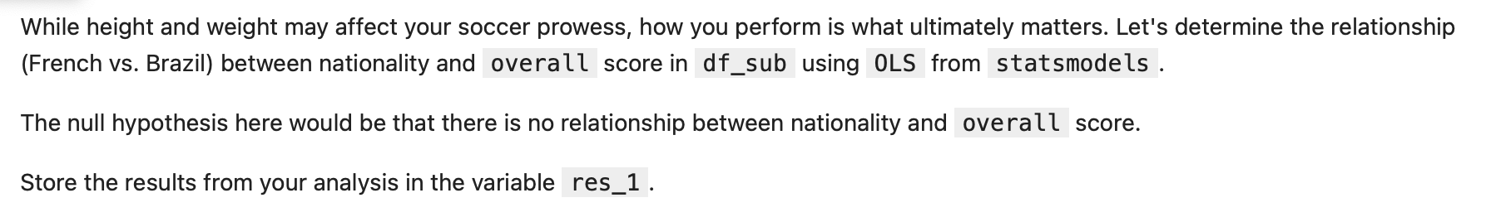
D5 results

Slide 3
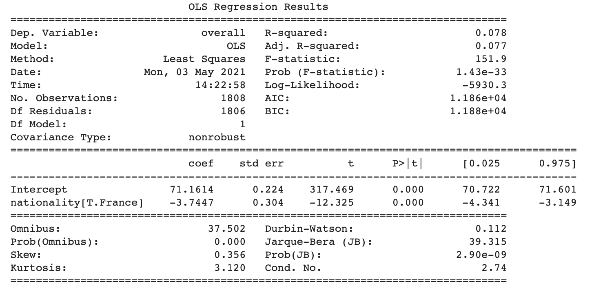
D5 results

Slide 4
R-squared measures the percentage of how much of the variance is described by the model

Slide 5
coef is the predicted coefficient value for the parameter.

Slide 6
std error is the standard error for the predicted value of the coefficient
t is the t-statistic value. It is a measure of how significant the coefficient is.
P>|t| is the P-value for the null hypothesis that the coefficient is equal to zero. If the value is less than the confidence level, usually 0.05, it means that the null hypothesis can be rejected and there is a significant relationship between the coefficient value and the parameter.

Slide 7
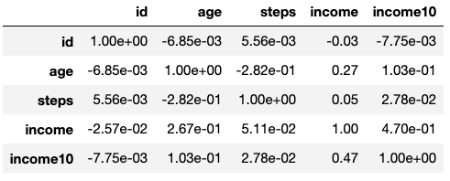
Correlations
Values in correlation table are correlations between pairs of variables.
Most correlated = correlation furthest away from 0. Not always the most positive value!
Most correlated with age? Steps
Most correlated with income? Age
Notes:
The lab code and syntax would be helpful for A3!

