Slide 1
More inference and D6
COGS 108 Winter 2024
Yueyan Tang
Discussion 6
yyt005@ucsd.edu
OH: Mon 10-11am at M.O.M’s Cafe
Materials adapted from Sam Lau WI20

Slide 2
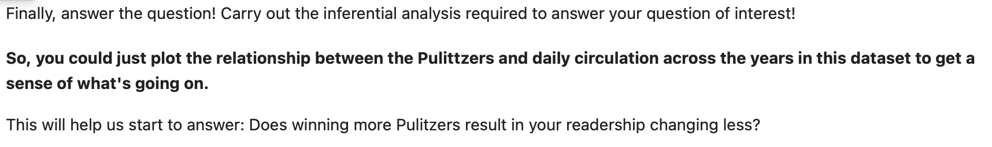
D6 results

Slide 3
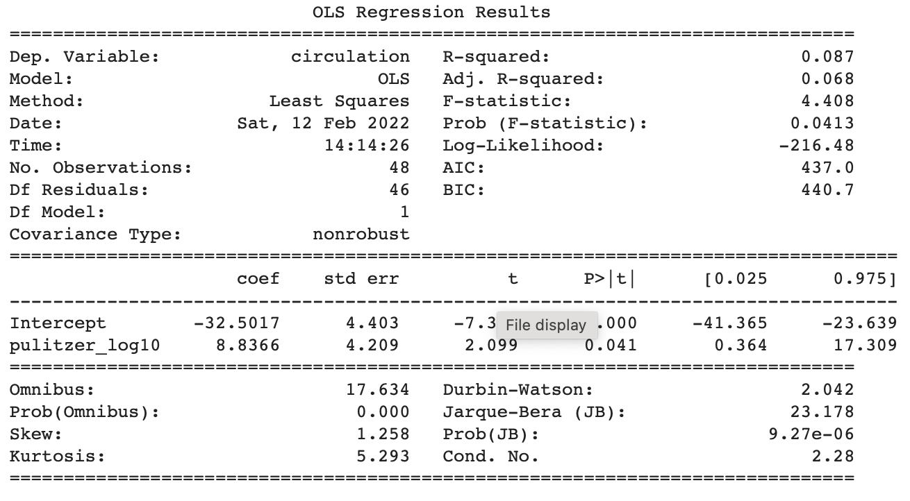
How to interpret the results?

Slide 4
Next…
D6 help
Can also give final project advice

