Slide 1
Last Discussion: Projects
Goals:
General Project Guidelines
Atman Patel
a2patel@eng.ucsd.edu OH: Tue 11:30am-12:30pm

Slide 2
Some general guidelines
Follow up on project proposal comments.
Go through all the material at https://github.com/COGS108/Projects
Look at last year’s projects: https://voyteklab.com/data%20science/data-projects/
Group Projects: Should have done EDA by now! Start analysis
Explain your thinking process behind different decisions (like why did you decide to remove certain fields?)

Slide 3
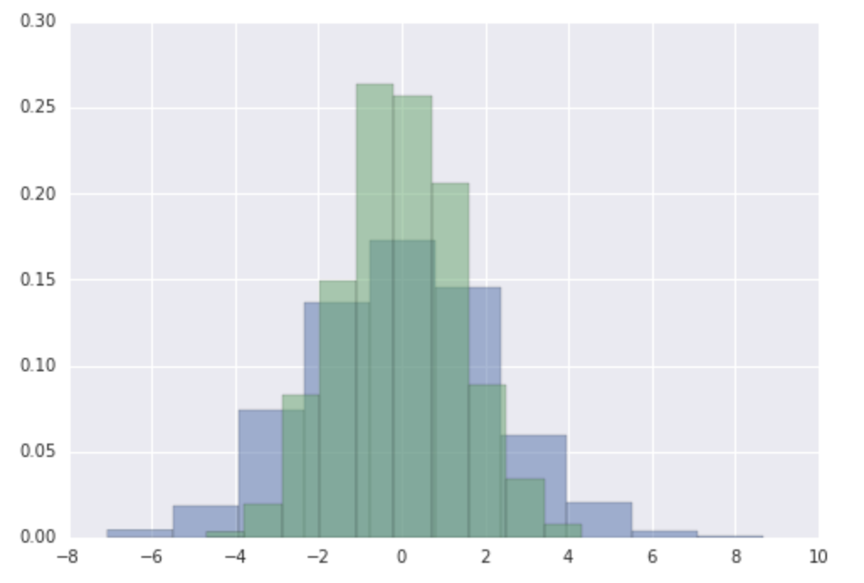
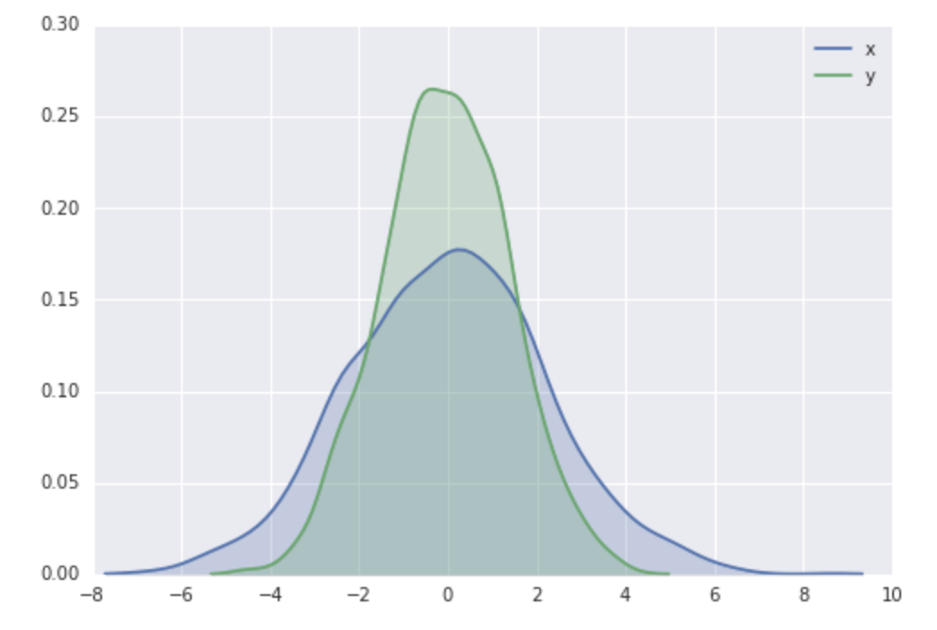
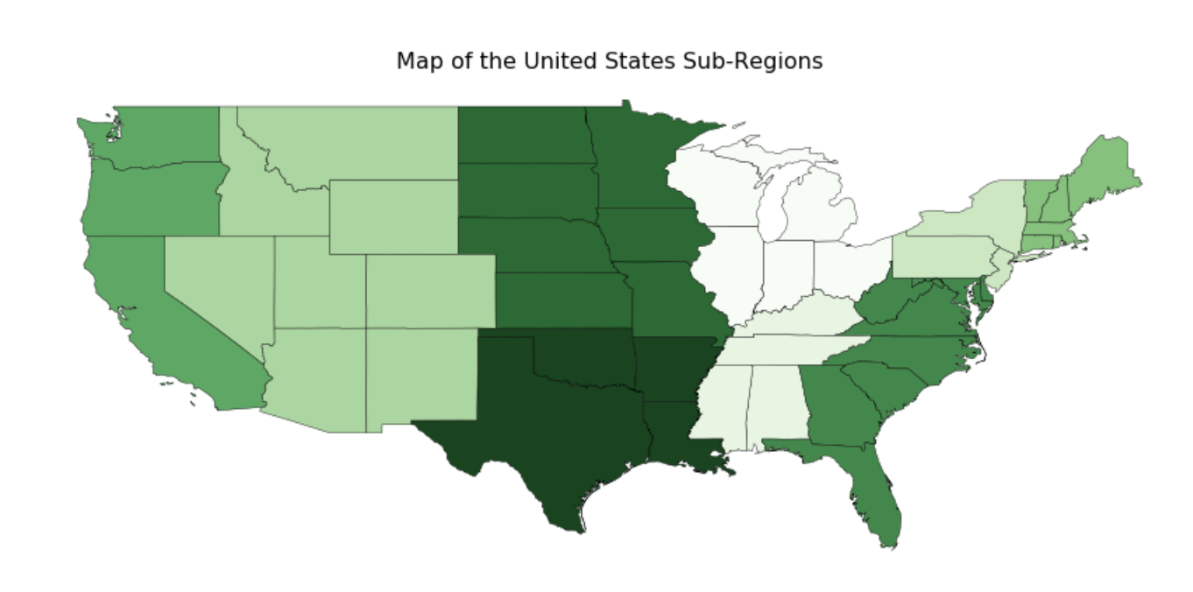
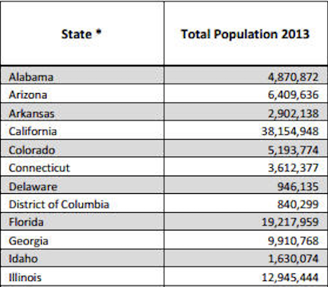
Good Visualizations
VS
VS
What makes a visualization good:
Easily interpretable
Impactful
Conveys the intended message without having to look at the caption

Slide 4
Thank you for a great quarter! Please fill out CAPE! http://cape.ucsd.edu/students/

