Slide 1
State, Slicing, and A3
Learning goals:
Understand how state works within a notebook.
Understand slicing DataFrames.
Get hints for a bunch of questions on A3.
COGS 108 Spring 2020
Will McCarthy
Discussion 4
wmccarthy@ucsd.edu
OH: Fri 10a-11a on Zoom
Materials adapted from Sam Lau WI20

Slide 2
Why does my code sometimes break?
Keeping track of notebook state is subtle!

Slide 3
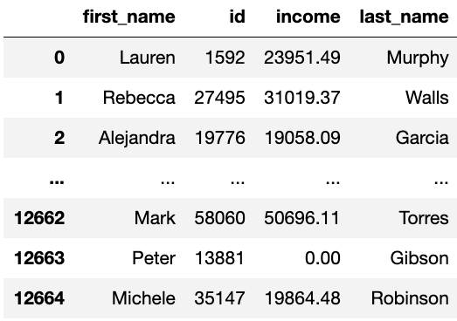
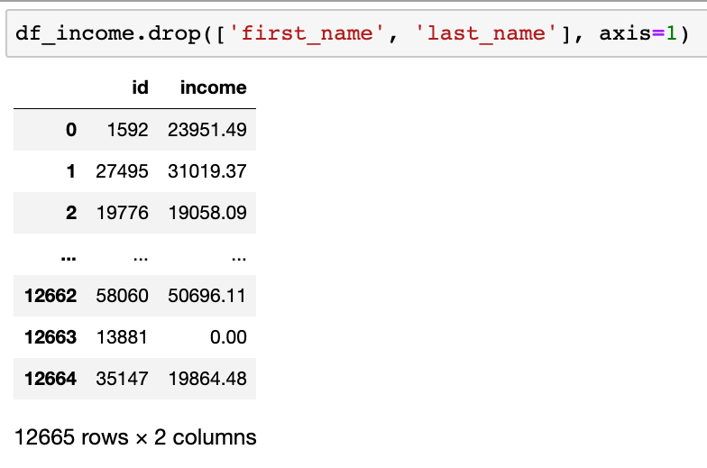

What is df_income?

Slide 4
What is df_income?
What happens if you run the first cell one time? Two times?

Slide 5
What is df_income?
What happens if you run the first cell one time? Two times?

Slide 6
What is df_income?

Slide 7
What is df_income?
Edited to ->
You will pass the local tests but fail the autograder! Be very careful when editing cells that mutate variables.

Slide 8
Okay, so I how do not screw things up?
Avoid mutation until absolutely necessary!
Use temporary variables to work around this.
If a cell has code that results in mutation, only run it once.
If you need to run it again (e.g. because of a bug), run all cells above it first.
Restart kernel and run all cells often, and especially before you turn in your assignment.

Slide 9
What’s the deal with brackets?
Why do I need brackets? When do I use parentheses and when do I use brackets?
Why do I sometimes put strings in brackets but other times an expression?
Why do I sometimes need double brackets??
For more on this: http://bit.ly/sam-pandas-01

Slide 10
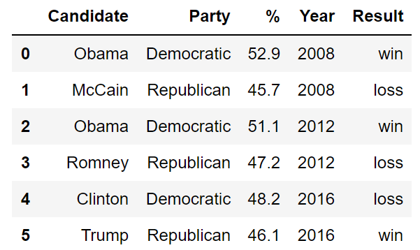
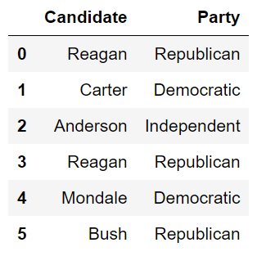
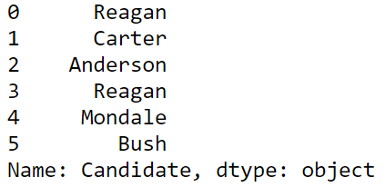
Use brackets when taking slices (subsets) of a DF
Key idea: Only one value goes into the brackets.
How do I grab a single column?
How do I grab multiple columns?
This is a Series!
This is a DF!

Slide 11

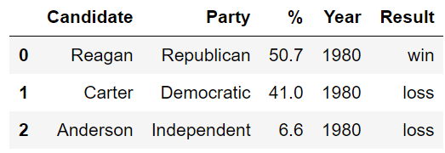
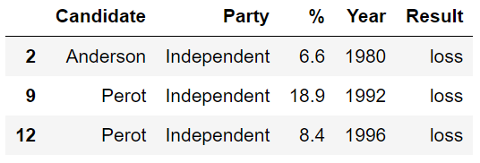
Use brackets when taking slices (subsets) of a DF
How do I grab rows?
This is a DF!
Whoa, what’s going on here?

Slide 12
Demo with Elections Data

Slide 13
Bracket Takeaways?
Brackets = slicing a DF. Parentheses = calculating something about a DF.
Strings in brackets = grabbing column (Series) List of strings in brackets = grabbing columns (DF)
Slice in brackets = grabbing rows (DF) Boolean expression in brackets = grabbing rows (DF) (You will need this last one for question 4b.)

Slide 14
Preview of next week
String methods: how do I work with text?
Using last letter of a person’s first name to predict birth sex

Slide 15
A3 quick tips
1b: Use pd.read_json
1e: Leave blank if your columns are already in the right order.
2a: Use Series.isna()
Part 3: Use plt.hist(). Ignore warnings for 3d.
4b, 4f, 5e: Use boolean slicing
4d: Use np.log10(), not np.log()
6i: the better predictor is the one with the most non-zero correlation.

