Slide 1
Projects
Learning goals:
Get some tips for feasible and interesting project proposals.
See some examples of interesting research questions.
Pause to talk about Pandas
COGS 108 Winter 2020
Will McCarthy
Discussion 3
wmccarthy@ucsd.edu
OH: Fri 10a-11a on Zoom

Slide 2
Individual vs. Group
You should have already chosen and filled out a form (either way!)
Individual: your job throughout the quarter will be to learn the concepts well enough to deploy them quickly and effectively
Group: your job throughout the quarter will be to come up with interesting idea, collaborate, and produce something more in-depth than is possible in just a couple of days

Slide 3
Guide for a Good Project Proposal
Find 3 interesting datasets.
I suggest looking at Data is Plural.
Come up with 3 research questions for each dataset.
Pick one.
Why does this work? Quantity > quality for brainstorming.

Slide 4
How do I pick a question?
Ask a question that would be interesting to a friend.
Many good questions relate two quantities that are not obviously related.
Boring: What’s the most common name in COGS 108?
Boring: Can you predict a person’s sex from their name?
Fun: Can you predict a person’s age from their name?
Fun: Can you predict a person’s sex from the last letter of their name?

Slide 5
Baby names demo:
https://github.com/COGS108/Section-Sp20/blob/master/Will/disc03/disc03.ipynb
[We will also recap Pandas here]
(The demo is based off of https://www.textbook.ds100.org/ch/01/lifecycle_intro.html)

Slide 6
Example research questions from Data is Plural newsletter:
Does China primarily loan to countries with low GDP? Or countries that are military / economic allies?
Are there more radio stations per capita for mountainous areas?
Do cities with more disconnected streets have worse health conditions?
Are cannabis testing labs consistent with each other?
Does the number of backyard ice skating rinks change with global temperature patterns?

Slide 7
Rest of time: Work on project proposals/ A2.
I will virtually walk around and give feedback.

Slide 8
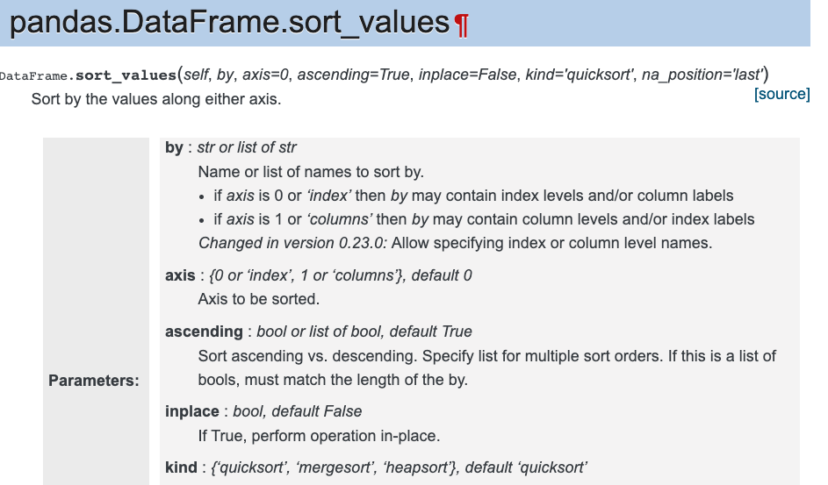
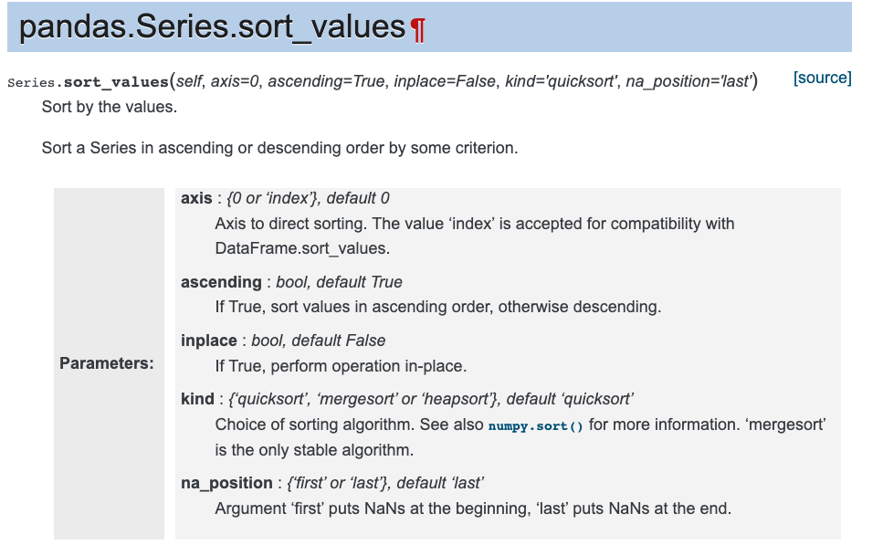
Preview of Next week
Difference between pandas DataFrames and Series.
How to use Google to solve problems on A2.
How to read the pandas documentation.
A2 problem walkthroughs.

