Slide 1
A3 Recap, Plotting, A4
Learning goals:
Go over commonly asked questions for A3.
Understand how common Python plotting libraries relate with each other.
Walk through questions on A4
COGS 108 Winter 2020
Will McCarthy
Discussion 6
wmccarthy@ucsd.edu
OH: Fri 10a-11a on Zoom
Materials adapted from Sam Lau WI20

Slide 2
A3 Recap

Slide 3
Question 1f: merging DataFrames
df_steps has 11k rows, df_income has 12k rows, but merging the two gets 9k rows. Why?
Goal: Get you to understand how merging works in pandas.
Default in pandas is to drop rows without matching values!
This is a very easy way to mess up your data.
Answer: Some id values were missing in the other DF.

Slide 4
Inner join vs. Left join
Email | Name
sam@ucsd.edu | Sam
jen@ucsd.edu | Jen
kay@ucsd.edu | Kay
min@ucsd.edu | Min
Email | Order
jen@ucsd.edu | Keyboard
sam@ucsd.edu | Mouse
kay@ucsd.edu | Cable
wade@ucsd.edu | Lamp
Inner joins drop all rows without a matching value.
Left joins keep all rows in the left table, even if values do not have a match.
Inner join:
Email | Name | Order
sam@ucsd.edu | Sam | Mouse
jen@ucsd.edu | Jen | Keyboard
kay@ucsd.edu | Kay | Cable
Left join:
Email | Name | Order
sam@ucsd.edu | Sam | Mouse
jen@ucsd.edu | Jen | Keyboard
kay@ucsd.edu | Kay | Cable
min@ucsd.edu | Min | NULL

Slide 5
Question 4a: counting -1
How to count number of rows that have -1 in steps column?
Simplest method: keep only rows that have -1 in steps, then count how many rows: len(df[df['steps'] == -1])
Or, create boolean Series and count number of Trues: sum(df['steps'] == -1)

Slide 6
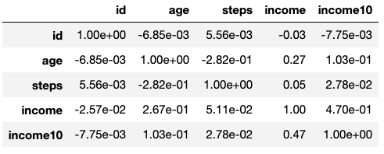
Question 5c: Correlations
Values in correlation table are correlations between pairs of variables.
Most correlated = correlation furthest away from 0. Not always the most positive value!
Most correlated with age? Steps
Most correlated with income? Age

Slide 7
Plotting

Slide 8
Why are there so many ways to make the same plot?
All of these do the same thing: plt.hist(df['income10'], 25) df['income10'].hist(bins=25) df.hist('income10', bins=25)
In Python, most image-based plots created using Matplotlib.
plt.hist plt.bar plt.plot etc.
Pandas gives shortcuts for matplotlib plots. Lines 2 and 3 are shortcuts for line 1.

Slide 10
Seaborn
My personal favorite is the seaborn library.
Makes common statistical charts easy to create, like bar plots with confidence intervals.
Again, seaborn is really just a bunch of shortcuts for matplotlib.
https://seaborn.pydata.org/tutorial.html

Slide 11
For more details
Making good plots is a key skill! This just scratches surface.
You can get many great jobs just by being able to make informative data visualizations.
For more, see Ch 6 of textbook.ds100.org.

Slide 12
A4 Walkthroughs

Slide 13
Working with Text

Slide 14
Text is useful!
Turns out that the last letter of a person’s first name is a good predictor of sex.
Demo: bit.ly/108-sam06

Slide 15
Sentiment analysis
Basic idea:
1. Match each word with its sentiment.
2. Average the word sentiments together.
See VADER package for Python.
For example, Trump tweets more positively about Fox than NYT:

Slide 16
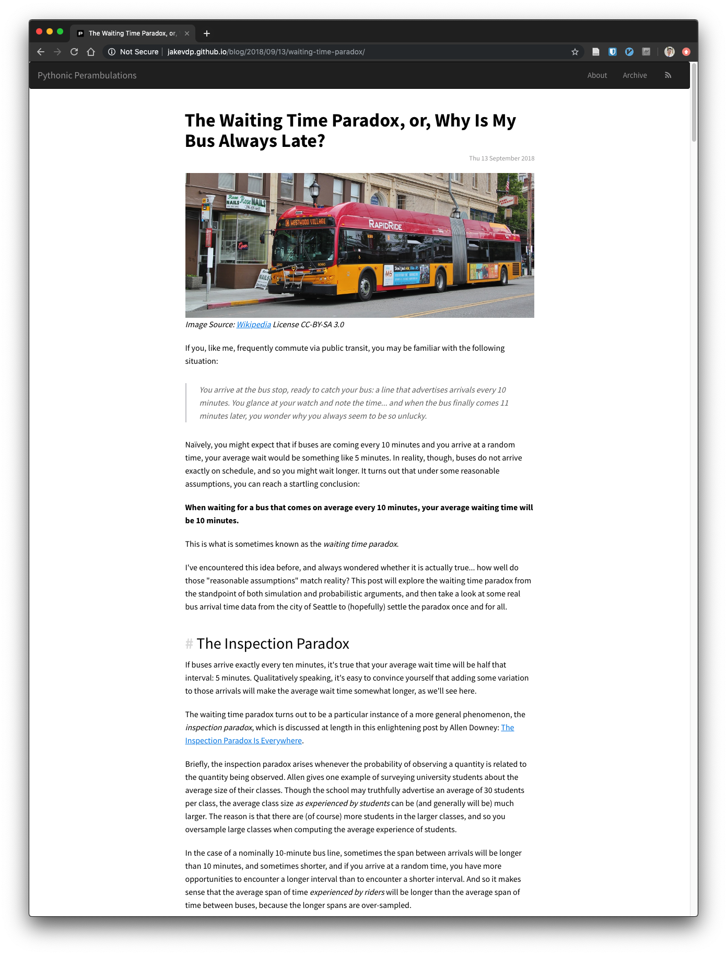
Preview of next week
An easy way to set up a personal website using Jupyter notebooks and GitHub.
A5 question walkthroughs

Slide 17
A4 quick tips
1d: Your DF cells should have `\n` at the end (same for 1e)
2b: Don’t manually make a new Series — slice a column out of a DF
2e: Use a slice with multiple boolean expressions
2f: Your for loop should loop through the index of a DF
3b: Don’t do anything to the zip column
3f: Loop through the DF’s index again. Your 3-digit zip codes should be stored as strings, not ints.

