Slide 1
Introductions
Learning goals:
Understand what Jupyter is
Accessing Jupyter with datahub
Q&A, and start thinking of final project ideas
COGS 108 Spring 2020
Will McCarthy
Discussion 1
wmccarthy@ucsd.edu
OH: Fri 10a-11a on Zoom
Discussion slides and materials adapted from Sam Lau (TA: WI20)

Slide 2

Welcome to COGS 108!
Will McCarthy wmccarthy@ucsd.edu OH: Fri 10a-11a on Zoom
2nd year Ph.D. student in Cog Sci advised by David Kirsh and Judy Fan
Research: Understanding the cognitive tools required to build things, using behavioral experiments and AI models

Slide 3
Section Philosophy
Sections are not recorded- it’s the place for dumb questions
Attendance is not required
Goal: 1 hour in section ≥ 2 hours working alone. How?
Mini-lectures on nuts and bolts (first ~10 mins)
Demos for project inspiration (~5 mins)
Personalized help while you work (last ~35 mins)

Slide 4
Zoom format
0-10: lecture 11-15: demo? 15-50: work, Q&A
First 10-15 minutes will be lecture style. Please mute your microphone, but feel free to unmute and ask questions! (this might change if there are too many people)
Then, while we’re working, chat will become a question queue. Please don’t ask questions out loud here unless they’re follow ups to the answer.
I’ll answer out-loud to everyone. You can zone out/ mute me if you’re not interested in the answer.

Slide 5
Programming
This course assumes programming knowledge
But not much
Resources:
codeacademy
Tutorials repo https://github.com/COGS108/Tutorials/blob/master/03-Python.ipynb
https://jakevdp.github.io/PythonDataScienceHandbook/
https://www.dataschool.io/python-pandas-tips-and-tricks/
Cheatsheets
Google: ‘python cheatsheet’, ‘pandas cheatsheet’ (find one that’s good for you)

Slide 6
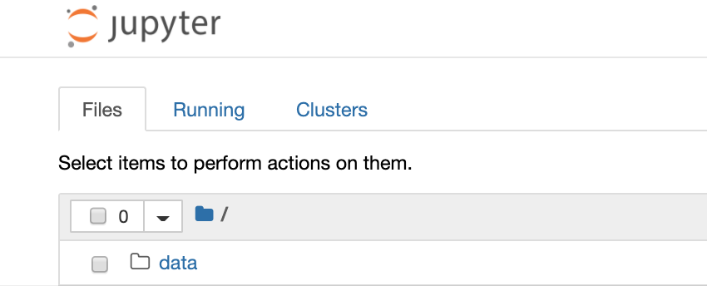
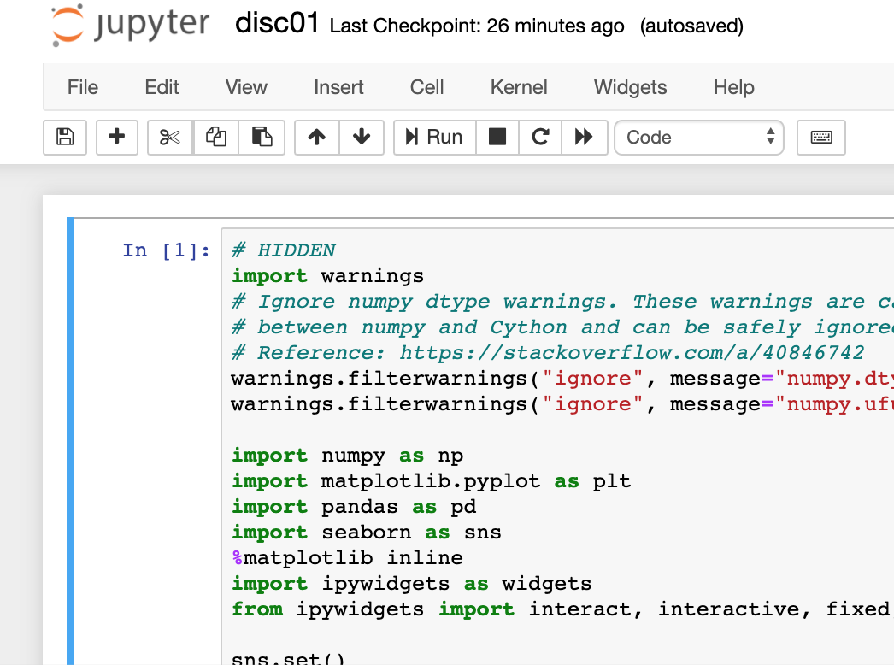
Jupyter
Python code is run on a python interpreter
Jupyter is a program that creates an interface for typing python code in a browser, that also runs that code in a python interpreter
What does this mean?!
Jupyter is a way of running python programs from a browser (like chrome) (hooray!)

Slide 7
Jupyter Intro and Oakland License Plates
An example of what you can do with Jupyter
For today’s demo (includes both code and data): https://github.com/COGS108/Section-Sp20

Slide 8
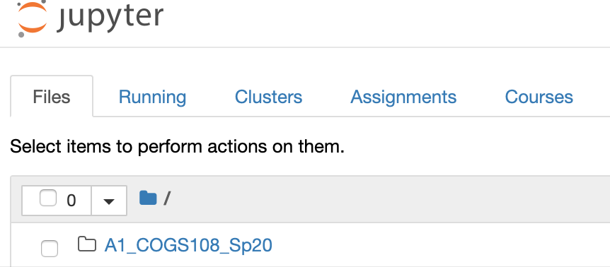
datahub
Jupyter runs python code in a browser.
But Jupyter is itself just a program that’s running on a computer somewhere.
datahub lets you interact with Jupyter that’s running somewhere else.
What does this mean?!
You don’t need to worry about installing Jupyter
You can use datahub to create and run python programs (online)
You can use this interface to fetch and submit assignments

Slide 9
Let’s log in to datahub
https://github.com/COGS108/Overview (It’ll be worth bookmarking this page ^. You’ll use it a lot)
Log in
Go to assignments
‘fetch’ assignments you have access to

Slide 10
Resources
For a long list of interesting datasets: https://tinyletter.com/data-is-plural
All Course Discussion Materials: https://github.com/COGS108/Section-Sp20
(Page above also has links to today’s demo and extra practice with Python.)
Next week: A1 help, git walkthrough

