Slide 2
Reproducible Workflow and R Markdown
Genelle Denzin, Coalition on Homelessness and Housing in Ohio (COHHIO)

Slide 3
Intro
Genelle Denzin she/hers
Data Anaylst
Coalition on Homelessness and Housing in Ohio (COHHIO)
LSU BA in English Lit. Came to this position from a data background almost 10 years ago.
Special thanks to everyone who helped me put this together.

Slide 4
Agenda
Workflows for HMIS Data Analysts
What is Reproducibility?
Reproducibility With Current Tools
What is R Markdown?
How to Get Started with R (if you want)

Slide 5
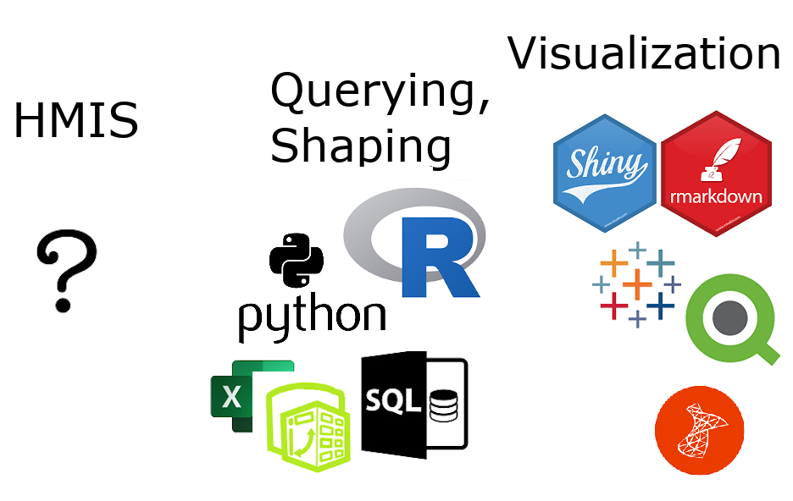
Workflows for Data Analysts
What workflows are we using to get from raw data -> visualization?
Notes:
raw data = unfiltered unformatted data straight from your HMIS that you (the data analyst) cannot alter from within the system.

Slide 6

Our workflows are important
Stay grounded

Slide 7
An Example
Analysis on how many DV survivors were served in our CoC’s projects during 2018. My theoretical year-ago workflow:
Create custom report named “DV Analysis 2018” in HMIS, export to Excel, name it “Domestic Violence 2018”
Rename columns, remove last row
Import into visualization software
Create visualization with the results

Slide 8
The Problem(s)
Will Future You be able to work back from the visualization to the raw data?
If the results of your analysis are questioned, can you explain your results without stress or difficulty?
A well-meaning co-worker repurposes your custom report in HMIS called “DV Analysis 2018”, renames it “DV Analysis 2019”, and modifies the logic. Could you recreate it?

Slide 9
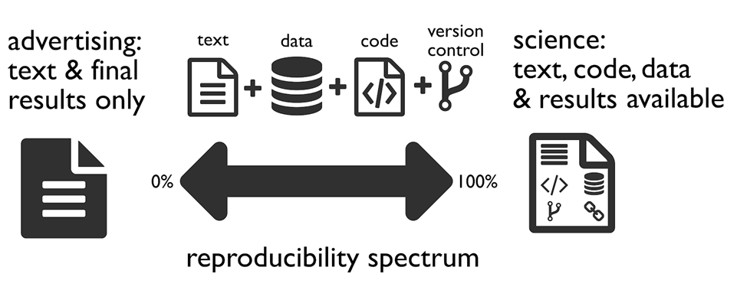
What is Reproducibility?
We cannot get to 100% as HMIS Data Analysts but we can make progress.
Notes:
talk about it in general, we can’t get to 100% go through the four icons version control: Word -> Track Changes, Google docs -> versioning, git -> steep learning curve but worth it

Slide 10
Ways to Achieve Better Reproducibility with Current Tools
Data from HMIS should be as raw as possible
Document your workflow for each visualization
file paths, names, and document types
every action you do in your intermediary data shaping tool
any further actions you take inside your visualization tool
if your data from HMIS is custom, document each action you take to create the data export
Notes:
The HUD CSV Export specs are great documentation of your data source. Also you can’t edit the export from within HMIS (also good!).

Slide 11
What is Markdown
created by John Gruber and Aaron Swartz
a simplified version of markup languages
simple intuitive formatting elements
easily converted to valid HTML and other formats
a quick look at the syntax

Slide 12
What is R Markdown
allows you to include R code in a markdown document (or SQL, or python and others)
the R code is evaluated in the processing of the markdown file
results from the code are displayed in the final markdown document
can handle parameters

Slide 13
What is R Markdown (continued)
can be written in any basic text editor
must be rendered using the R packages called knitr and rmarkdown
works very well with R Studio

Slide 14
What R Markdown Can Create
HTML, pdf, Word, and PowerPoint documents
interactive documents
slide decks (not PowerPoint)
websites, articles, and blogs
books
See the Gallery

Slide 15
How Does R Markdown Get Us to Reproducibility?
Every step you take in shaping your data and creating the visualization will be contained in your R Markdown document. Your work documents itself!
Your data manipulation tool = your visualization tool. No need to copy-paste results into final documents and then later wonder where it came from and how it was built.

Slide 16
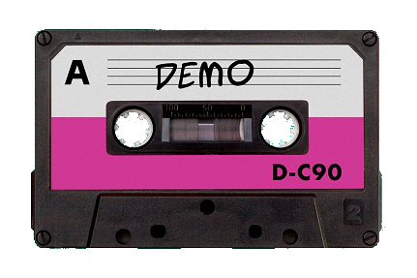
Let’s Create an Analysis in R Markdown
Notes:
should be about 15 minutes. the plan is to open a fresh .Rmd file in R Studio, point out the structure of it, run it, make some quick edits to make it look better, rerun to see changes.

Slide 17
Why Move Toward a Reproducible Workflow?
Easier to find and correct errors
Helps you create comparison data later
Helps others to check your logic, which helps validate your work
Whether or not our data is ever questioned, we should always be prepared to back up our numbers.
Notes:
(We should welcome this kind of interest and be prepared to respond with integrity.)

Slide 18
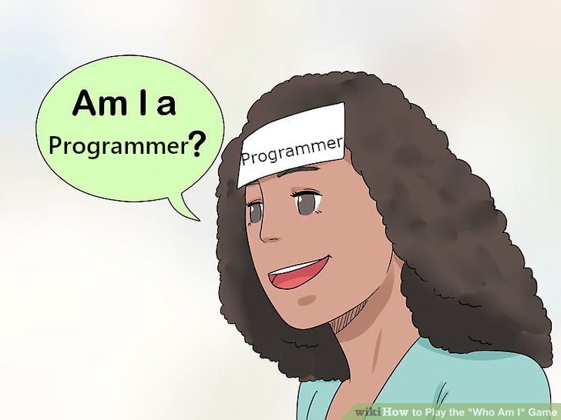
A Note about “Coding” and “Programming”
Identity crisis…?
Notes:
What does a programmer look like? Can programmers ALSO be good at people?
You are most likely, in SOME way, already programming. It might look different, but all the concepts are there. You know your data. You know how you want to see it.

Slide 19

The R Community
Artwork by Allison Horst

Slide 20
Disclaimer
I work in a supportive workplace.
I am part of a 3 1/2 person HMIS team.

Slide 21
To Get Started in R
My three favorite ways:
Get R for Data Science or access it for free online here: https://r4ds.had.co.nz/
Use the R package called Swirl by going here: https://swirlstats.com/students.html (also free)
R-Ladies meetups

Slide 22
We Can Work Together
Most of my code is available on GitHub: https://github.com/kiadso You are welcome to use it to manipulate your own HMIS data (within the terms).

Slide 23
Questions?
First: Let’s take two minutes to share your questions with your neighbor.
Then: Questions

Slide 24
Contact Info
Genelle Denzin (she/hers)
HMIS Data Analyst
Coalition on Homelessness and Housing in Ohio (COHHIO)
genelledenzin@cohhio.org
Twitter: @gh_firefly
GitHub: kiadso

Slide 26
Reproducible Workflow and R Markdown
Genelle Denzin, Coalition on Homelessness and Housing in Ohio (COHHIO)

Slide 27
Intro
Genelle Denzin she/hers
Data Anaylst
Coalition on Homelessness and Housing in Ohio (COHHIO)
LSU BA in English Lit. Came to this position from a data background almost 10 years ago.
Special thanks to everyone who helped me put this together.

Slide 28
Agenda
Workflows for HMIS Data Analysts
What is Reproducibility?
Reproducibility With Current Tools
What is R Markdown?
How to Get Started with R (if you want)

Slide 29
Workflows for Data Analysts
What workflows are we using to get from raw data -> visualization?
Notes:
raw data = unfiltered unformatted data straight from your HMIS that you (the data analyst) cannot alter from within the system.

Slide 30
Our workflows are important
Stay grounded

Slide 31
An Example
Analysis on how many DV survivors were served in our CoC’s projects during 2018. My theoretical year-ago workflow:
Create custom report named “DV Analysis 2018” in HMIS, export to Excel, name it “Domestic Violence 2018”
Rename columns, remove last row
Import into visualization software
Create visualization with the results

Slide 32
The Problem(s)
Will Future You be able to work back from the visualization to the raw data?
If the results of your analysis are questioned, can you explain your results without stress or difficulty?
A well-meaning co-worker repurposes your custom report in HMIS called “DV Analysis 2018”, renames it “DV Analysis 2019”, and modifies the logic. Could you recreate it?

Slide 33
What is Reproducibility?
We cannot get to 100% as HMIS Data Analysts but we can make progress.
Notes:
talk about it in general, we can’t get to 100% go through the four icons version control: Word -> Track Changes, Google docs -> versioning, git -> steep learning curve but worth it

Slide 34
Ways to Achieve Better Reproducibility with Current Tools
Data from HMIS should be as raw as possible
Document your workflow for each visualization
file paths, names, and document types
every action you do in your intermediary data shaping tool
any further actions you take inside your visualization tool
if your data from HMIS is custom, document each action you take to create the data export
Notes:
The HUD CSV Export specs are great documentation of your data source. Also you can’t edit the export from within HMIS (also good!).

Slide 35
What is Markdown
created by John Gruber and Aaron Swartz
a simplified version of markup languages
simple intuitive formatting elements
easily converted to valid HTML and other formats
a quick look at the syntax

Slide 36
What is R Markdown
allows you to include R code in a markdown document (or SQL, or python and others)
the R code is evaluated in the processing of the markdown file
results from the code are displayed in the final markdown document
can handle parameters

Slide 37
What is R Markdown (continued)
can be written in any basic text editor
must be rendered using the R packages called knitr and rmarkdown
works very well with R Studio

Slide 38
What R Markdown Can Create
HTML, pdf, Word, and PowerPoint documents
interactive documents
slide decks (not PowerPoint)
websites, articles, and blogs
books
See the Gallery

Slide 39
How Does R Markdown Get Us to Reproducibility?
Every step you take in shaping your data and creating the visualization will be contained in your R Markdown document. Your work documents itself!
Your data manipulation tool = your visualization tool. No need to copy-paste results into final documents and then later wonder where it came from and how it was built.

Slide 40
Let’s Create an Analysis in R Markdown
Notes:
should be about 15 minutes. the plan is to open a fresh .Rmd file in R Studio, point out the structure of it, run it, make some quick edits to make it look better, rerun to see changes.

Slide 41
Why Move Toward a Reproducible Workflow?
Easier to find and correct errors
Helps you create comparison data later
Helps others to check your logic, which helps validate your work
Whether or not our data is ever questioned, we should always be prepared to back up our numbers.
Notes:
(We should welcome this kind of interest and be prepared to respond with integrity.)

Slide 42
A Note about “Coding” and “Programming”
Identity crisis…?
Notes:
What does a programmer look like? Can programmers ALSO be good at people?
You are most likely, in SOME way, already programming. It might look different, but all the concepts are there. You know your data. You know how you want to see it.

Slide 43
The R Community
Artwork by Allison Horst

Slide 44
Disclaimer
I work in a supportive workplace.
I am part of a 3 1/2 person HMIS team.

Slide 45
To Get Started in R
My three favorite ways:
Get R for Data Science or access it for free online here: https://r4ds.had.co.nz/
Use the R package called Swirl by going here: https://swirlstats.com/students.html (also free)
R-Ladies meetups

Slide 46
We Can Work Together
Most of my code is available on GitHub: https://github.com/kiadso You are welcome to use it to manipulate your own HMIS data (within the terms).

Slide 47
Questions?
First: Let’s take two minutes to share your questions with your neighbor.
Then: Questions

Slide 48
Contact Info
Genelle Denzin (she/hers)
HMIS Data Analyst
Coalition on Homelessness and Housing in Ohio (COHHIO)
genelledenzin@cohhio.org
Twitter: @gh_firefly
GitHub: kiadso

Slide 49
Reproducible Workflow and R Markdown
Genelle Denzin, Coalition on Homelessness and Housing in Ohio (COHHIO)

Slide 50
Intro
Genelle Denzin she/hers
Data Anaylst
Coalition on Homelessness and Housing in Ohio (COHHIO)
LSU BA in English Lit. Came to this position from a data background almost 10 years ago.
Special thanks to everyone who helped me put this together.

Slide 51
Agenda
Workflows for HMIS Data Analysts
What is Reproducibility?
Reproducibility With Current Tools
What is R Markdown?
How to Get Started with R (if you want)

Slide 52
Workflows for Data Analysts
What workflows are we using to get from raw data -> visualization?
Notes:
raw data = unfiltered unformatted data straight from your HMIS that you (the data analyst) cannot alter from within the system.

Slide 53
Our workflows are important
Stay grounded

Slide 54
An Example
Analysis on how many DV survivors were served in our CoC’s projects during 2018. My theoretical year-ago workflow:
Create custom report named “DV Analysis 2018” in HMIS, export to Excel, name it “Domestic Violence 2018”
Rename columns, remove last row
Import into visualization software
Create visualization with the results

Slide 55
The Problem(s)
Will Future You be able to work back from the visualization to the raw data?
If the results of your analysis are questioned, can you explain your results without stress or difficulty?
A well-meaning co-worker repurposes your custom report in HMIS called “DV Analysis 2018”, renames it “DV Analysis 2019”, and modifies the logic. Could you recreate it?

Slide 56
What is Reproducibility?
We cannot get to 100% as HMIS Data Analysts but we can make progress.
Notes:
talk about it in general, we can’t get to 100% go through the four icons version control: Word -> Track Changes, Google docs -> versioning, git -> steep learning curve but worth it

Slide 57
Ways to Achieve Better Reproducibility with Current Tools
Data from HMIS should be as raw as possible
Document your workflow for each visualization
file paths, names, and document types
every action you do in your intermediary data shaping tool
any further actions you take inside your visualization tool
if your data from HMIS is custom, document each action you take to create the data export
Notes:
The HUD CSV Export specs are great documentation of your data source. Also you can’t edit the export from within HMIS (also good!).

Slide 58
What is Markdown
created by John Gruber and Aaron Swartz
a simplified version of markup languages
simple intuitive formatting elements
easily converted to valid HTML and other formats
a quick look at the syntax

Slide 59
What is R Markdown
allows you to include R code in a markdown document (or SQL, or python and others)
the R code is evaluated in the processing of the markdown file
results from the code are displayed in the final markdown document
can handle parameters

Slide 60
What is R Markdown (continued)
can be written in any basic text editor
must be rendered using the R packages called knitr and rmarkdown
works very well with R Studio

Slide 61
What R Markdown Can Create
HTML, pdf, Word, and PowerPoint documents
interactive documents
slide decks (not PowerPoint)
websites, articles, and blogs
books
See the Gallery

Slide 62
How Does R Markdown Get Us to Reproducibility?
Every step you take in shaping your data and creating the visualization will be contained in your R Markdown document. Your work documents itself!
Your data manipulation tool = your visualization tool. No need to copy-paste results into final documents and then later wonder where it came from and how it was built.

Slide 63
Let’s Create an Analysis in R Markdown
Notes:
should be about 15 minutes. the plan is to open a fresh .Rmd file in R Studio, point out the structure of it, run it, make some quick edits to make it look better, rerun to see changes.

Slide 64
Why Move Toward a Reproducible Workflow?
Easier to find and correct errors
Helps you create comparison data later
Helps others to check your logic, which helps validate your work
Whether or not our data is ever questioned, we should always be prepared to back up our numbers.
Notes:
(We should welcome this kind of interest and be prepared to respond with integrity.)

Slide 65
A Note about “Coding” and “Programming”
Identity crisis…?
Notes:
What does a programmer look like? Can programmers ALSO be good at people?
You are most likely, in SOME way, already programming. It might look different, but all the concepts are there. You know your data. You know how you want to see it.

Slide 66
The R Community
Artwork by Allison Horst

Slide 67
Disclaimer
I work in a supportive workplace.
I am part of a 3 1/2 person HMIS team.

Slide 68
To Get Started in R
My three favorite ways:
Get R for Data Science or access it for free online here: https://r4ds.had.co.nz/
Use the R package called Swirl by going here: https://swirlstats.com/students.html (also free)
R-Ladies meetups

Slide 69
We Can Work Together
Most of my code is available on GitHub: https://github.com/kiadso You are welcome to use it to manipulate your own HMIS data (within the terms).
These slides and more resources are available there as well: https://github.com/kiadso/rmarkdown_talk

Slide 70
Questions?
First: Let’s take two minutes to share your questions with your neighbor.
Then: Questions

Slide 71
Contact Info
Genelle Denzin (she/hers)
HMIS Data Analyst
Coalition on Homelessness and Housing in Ohio (COHHIO)
genelledenzin@cohhio.org
Twitter: @gh_firefly
GitHub: kiadso

