Slide 1
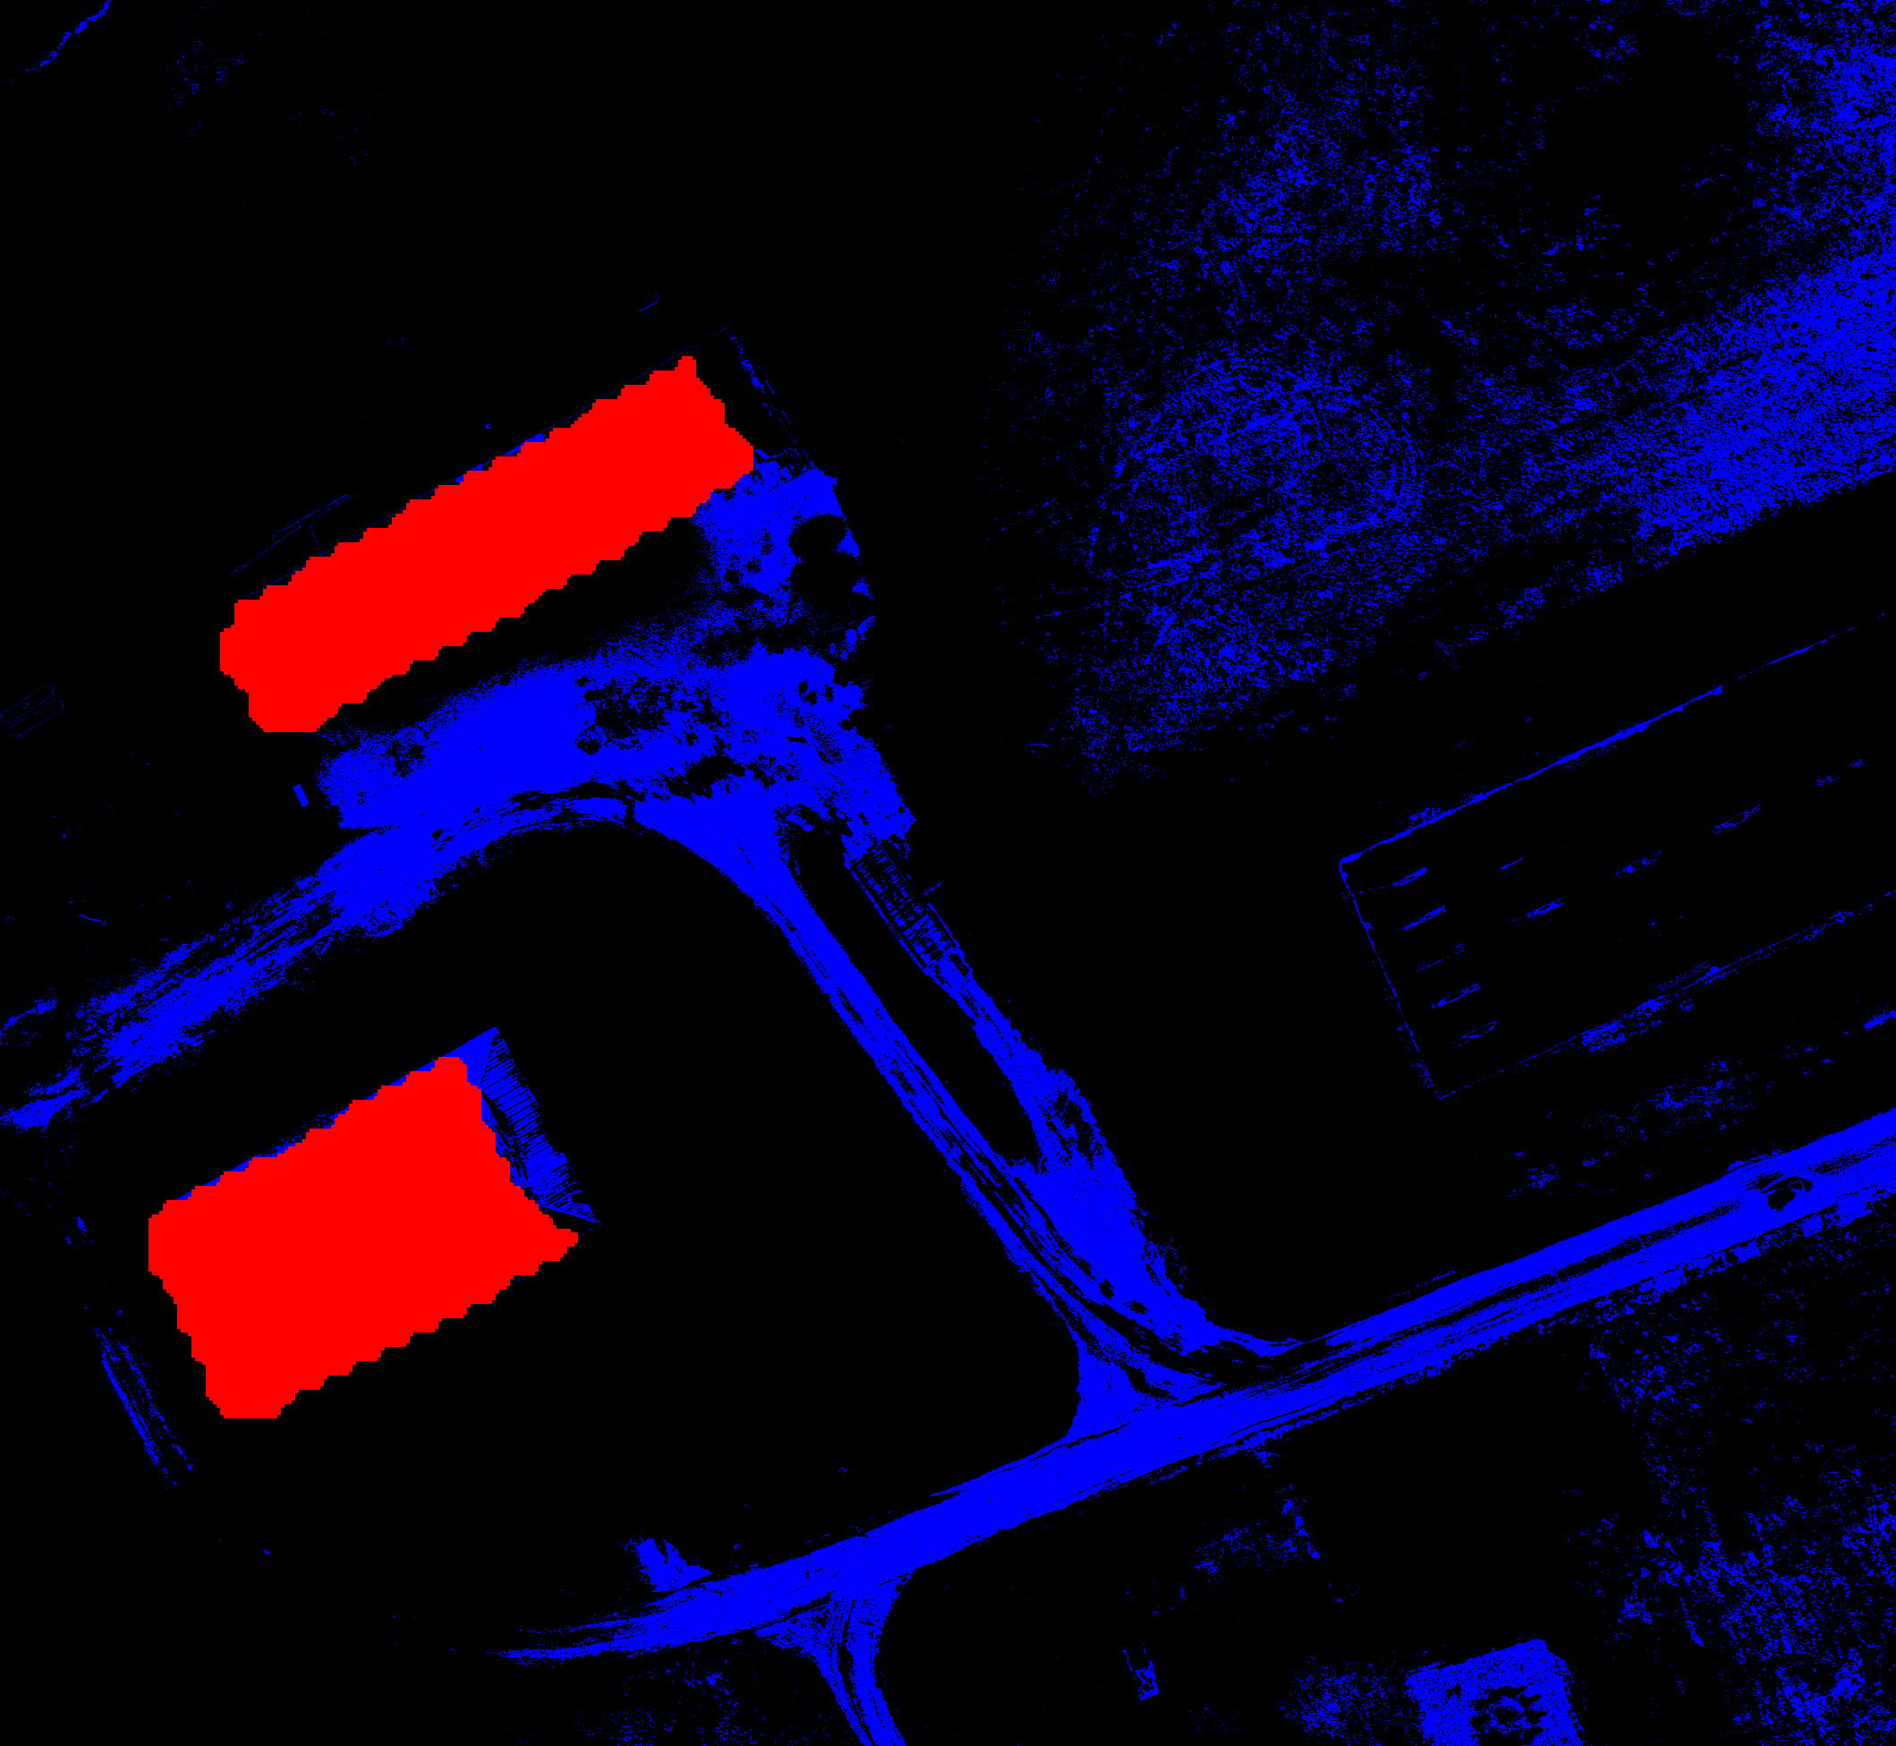
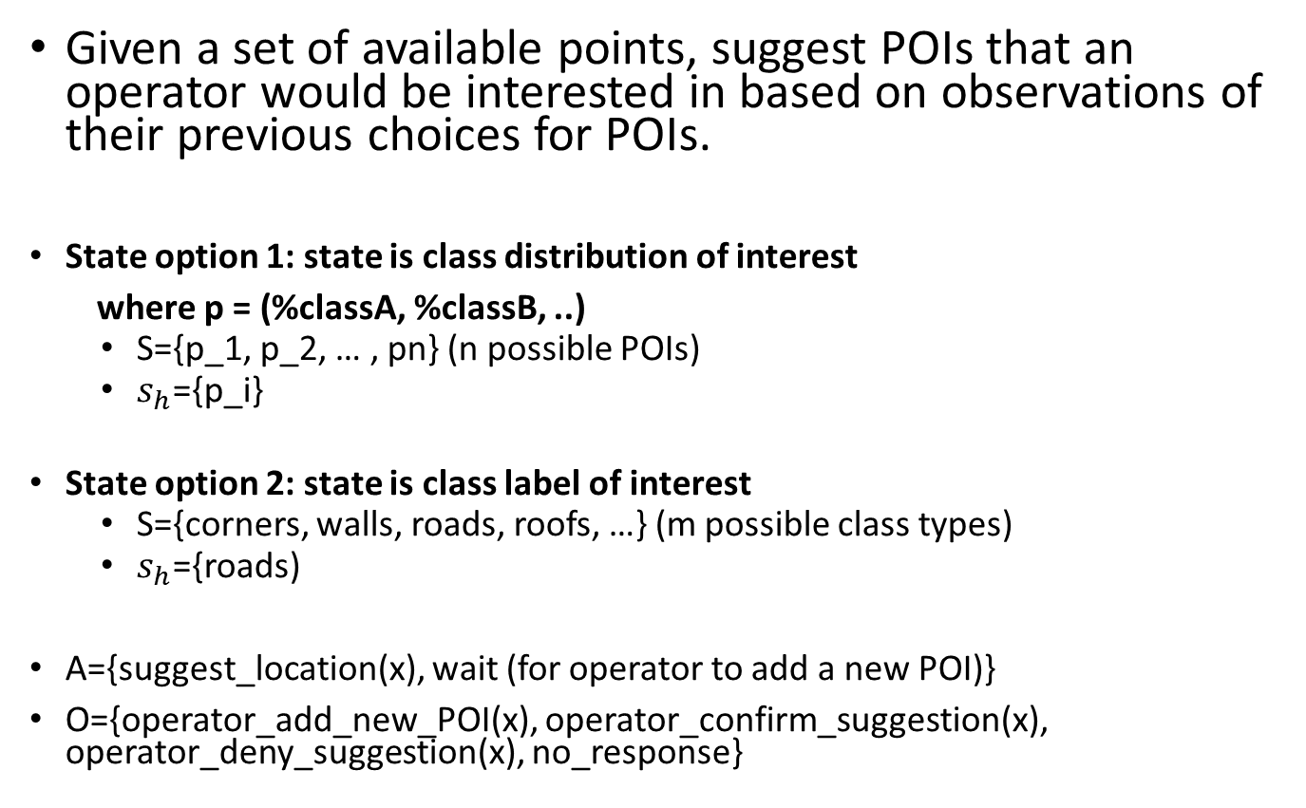
POI suggestion with POMDP
Given a set of available points, suggest POIs that an operator would be interested in based on observations of their previous choices for POIs.
State option 1: state is class distribution of interest
where p = (%classA, %classB, ..)
S={p_1, p_2, … , pn} (n possible POIs)
$s_{h}$={p_i}
State option 2: state is class label of interest
S={corners, walls, roads, roofs, …} (m possible class types)
$s_{h}$={roads)
A={suggest_location(x), wait (for operator to add a new POI)}
O={operator_add_new_POI(x), operator_confirm_suggestion(x), operator_deny_suggestion(x), no_response}
This building corner is a good spot for a camera
How about this corner?

