Slide 1
A Statistical Framework for Low-bitwidth Training of Deep Neural Networks
2023-5-14
李帆

Slide 2
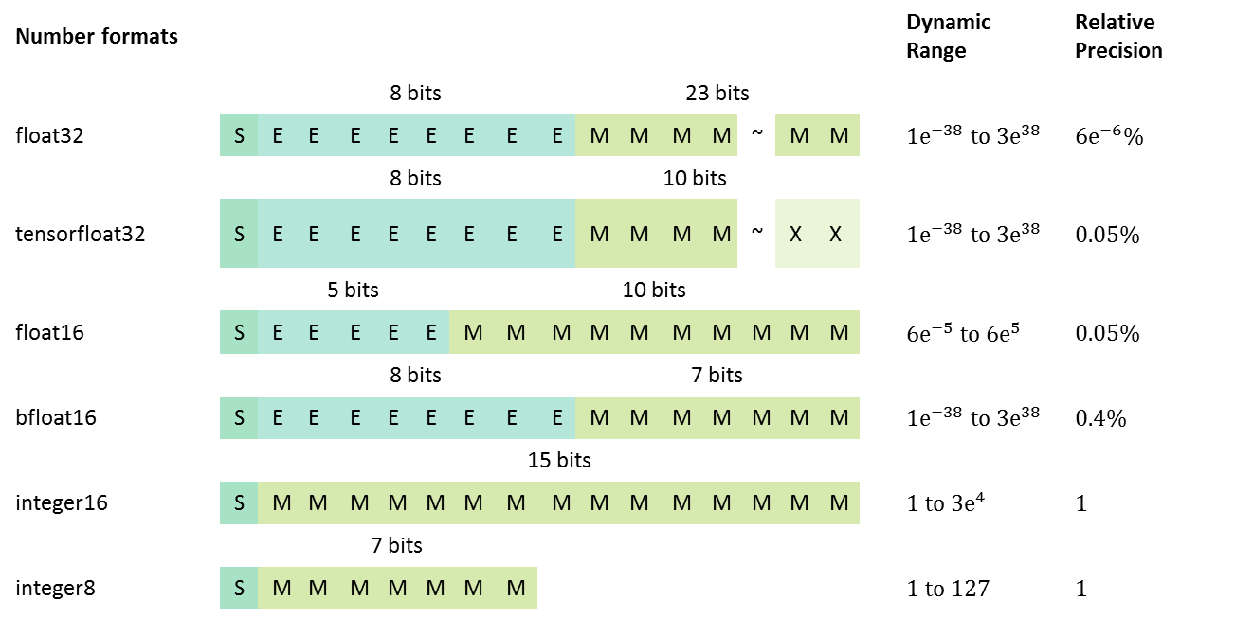
Why Quantization in DNN？
What is quantization?
Quantization is the process of mapping input values from a large set (often a continuous set) to output values in a smaller set, often with a finite number of elements.
Rounding and truncation are typical examples of quantization processes.
Number formats |  |  |  |  |  |  |  |  |  |  |  |  |  |  |  |  |  |  | Dynamic Range | Relative Precision
 |  |  | 8 bits |  |  |  |  |  |  |  | 23 bits
float32 |  | S | E | E | E | E | E | E | E | E | M | M | M | M | ~ | M | M |  | $${1\text{e}}^{−38} \text{to} {3\text{e}}^{38}$$ | $${6\text{e}}^{−6}\%$$
 |  |  | 8 bits |  |  |  |  |  |  |  | 10 bits
tensorfloat32 |  | S | E | E | E | E | E | E | E | E | M | M | M | M | ~ | X | X |  | $${1\text{e}}^{−38} \text{to} {3\text{e}}^{38}$$ | $$0.05\%$$
 |  |  | 5 bits |  |  |  |  | 10 bits
float16 |  | S | E | E | E | E | E | M | M | M | M | M | M | M | M | M | M |  | $${6\text{e}}^{−5} \text{to} {6\text{e}}^{5}$$ | $$0.05\%$$
 |  |  | 8 bits |  |  |  |  |  |  |  | 7 bits
bfloat16 |  | S | E | E | E | E | E | E | E | E | M | M | M | M | M | M | M |  | $${1\text{e}}^{−38} \text{to} {3\text{e}}^{38}$$ | $$0.4\%$$
 |  |  | 15 bits
integer16 |  | S | M | M | M | M | M | M | M | M | M | M | M | M | M | M | M |  | $${1 \text{to} 3\text{e}}^{4}$$ | $$1$$
 |  |  | 7 bits
integer8 |  | S | M | M | M | M | M | M | M |  |  |  |  |  |  |  |  |  | $$1 to 127$$ | $$1$$

Slide 3
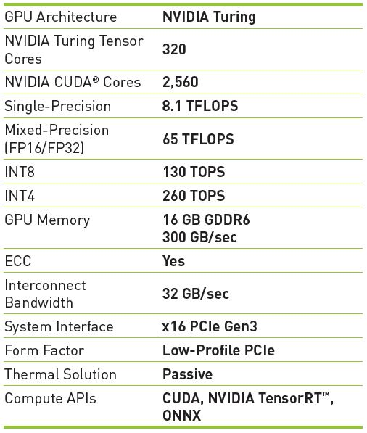
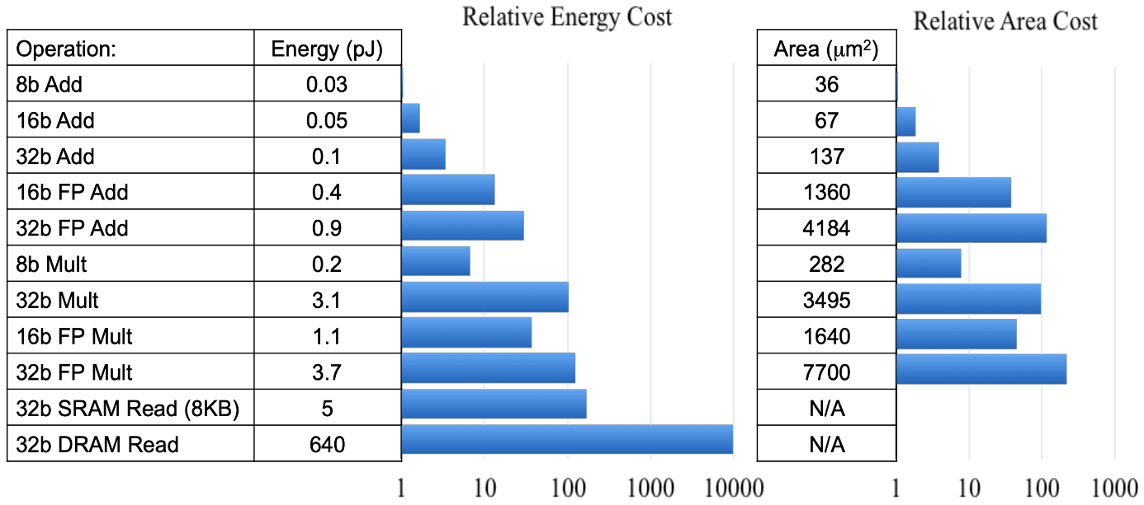
Why Quantization in DNN？
图1.NVIDIA T4 GPU 算力参数
图2. 各种Op能耗与占用面积
结论
图1：在Nvidia T4 GPU上INT8算力是单精度算力的16倍。
图2：FP32 Mult运算能耗是INT8 Mult运算的18.5倍，芯片占用面积是INT8的27.3倍。
优点
减小模型的size: 4x decrease when using 8-bit parameters
提升模型在cpu/gpu等硬件的推理计算效率
减少计算成本
缺点
模型精度损失

Slide 4


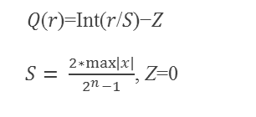



How to quantize?
Linear (uniform)
Symmetric/asymmetric
$$−\text{max}\left|\text{x}\right|$$
0
$$\text{max}\left|\text{x}\right|$$
Per-tensor/per-channel
Non-linear (non-uniform)
-128
0
127
Power-of-two
Logarithmic
$$\text{min}\left|\text{x}\right|$$
0
z
$$\text{max}\left|\text{x}\right|$$
Codebook quantization
Symmetric mode: Quantization range is symmetric around 0
-128
-z
0
127
𝑄(𝑟)=Int(𝑟/𝑆)−𝑍
$S= \frac{2∗max\left|x\right|}{2^{n}−1}$, Z=0
Asymmetric mode:useful when the distribution of values is not symmetric around 0
$$S= \frac{\max{x}−\min{x}}{2^{n}−1}$$

Slide 5
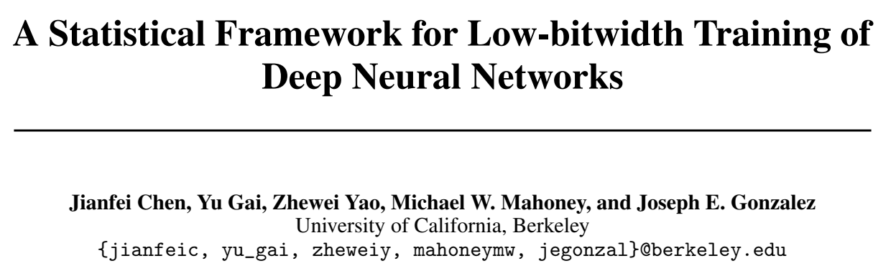
Motivation
Inference quantization: quantization-aware training (QAT) fine-tunes the quantized model on the training dataset. However, QAT computes the gradients in full precision, so the training phase is not accelerated.
Training quantization: fully quantized training (FQT), further quantize the Gradients.
There is not yet a bound on how the quantization scheme (bitwidth, type of quantizer) affects the quality of the quantized gradient.
Chen J, Gai Y, Yao Z, et al. A statistical framework for low-bitwidth training of deep neural networks[J]. Advances in Neural Information Processing Systems, 2020, 33: 883-894.

Slide 6
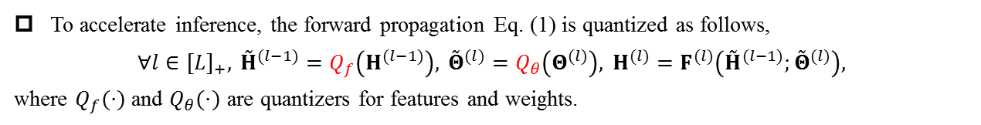
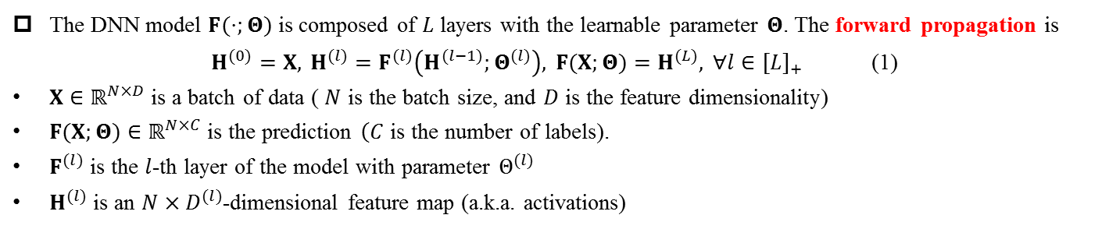
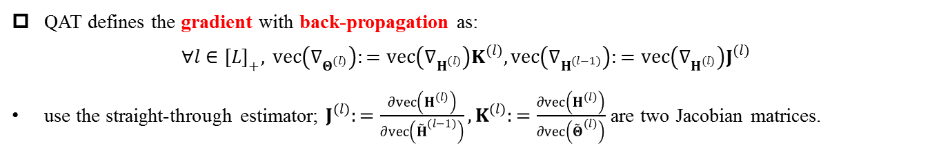
Quantization Aware Training
The DNN model $F(⋅;Θ)$ is composed of $L$ layers with the learnable parameter $Θ$. The forward propagation is
$H^{(0)}=X, H^{(l)}=F^{(l)}\left(H^{(l−1)};Θ^{(l)}\right), F(X;Θ)=H^{(L)}, ∀l∈[L]_{+}$ (1)
$X∈ℝ^{N×D}$ is a batch of data ( $N$ is the batch size, and $D$ is the feature dimensionality)
$F(X;Θ)∈ℝ^{N×C}$ is the prediction $\left(C\right.$ is the number of labels).
$F^{(l)}$ is the $l$-th layer of the model with parameter $Θ^{(l)}$
$H^{(l)}$ is an $N×D^{(l)}$-dimensional feature map (a.k.a. activations)
To accelerate inference, the forward propagation Eq. (1) is quantized as follows,
$$∀l∈[L]_{+}, {\overset{˜}{H}}^{(l−1)}=Q_{f}\left(H^{(l−1)}\right), {\overset{˜}{Θ}}^{(l)}=Q_{θ}\left(Θ^{(l)}\right), H^{(l)}=F^{(l)}\left({\overset{˜}{H}}^{(l−1)};{\overset{˜}{Θ}}^{(l)}\right),$$
where $Q_{f}(⋅)$ and $Q_{θ}(⋅)$ are quantizers for features and weights.
QAT defines the gradient with back-propagation as:
$$∀l∈[L]_{+}, vec\left(∇_{Θ^{(l)}}\right):=vec\left(∇_{H^{(l)}}\right)K^{(l)},vec\left(∇_{H^{(l−1)}}\right):=vec\left(∇_{H^{(l)}}\right)J^{(l)}$$
use the straight-through estimator; $J^{(l)}:=\frac{∂vec\left(H^{(l)}\right)}{∂vec\left({\overset{˜}{H}}^{(l−1)}\right)},K^{(l)}:=\frac{∂vec\left(H^{(l)}\right)}{∂vec\left({\overset{˜}{Θ}}^{(l)}\right)}$ are two Jacobian matrices.
Jacob B, Kligys S, Chen B, et al. Quantization and training of neural networks for efficient integer-arithmetic-only inference[C]//Proceedings of the IEEE conference on computer vision and pattern recognition. 2018: 2704-2713.
Yoshua Bengio, Nicholas Léonard, and Aaron Courville. Estimating or propagating gradients through stochastic neurons for conditional computation. arXiv preprint arXiv:1308.3432, 2013.

Slide 7
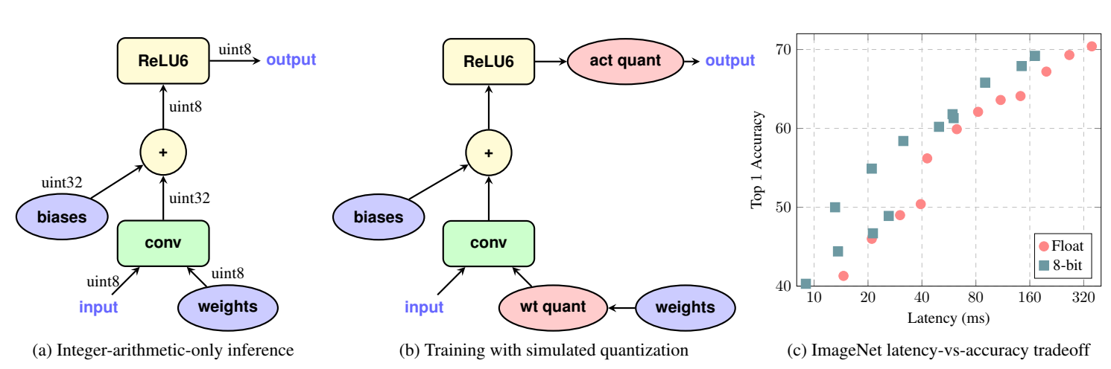
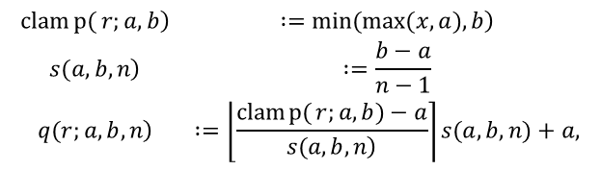
Quantization Aware Training
步骤
首先在数据集上以FP32精度进行模型训练，得到训练好的baseline模型；
在baseline模型中插入伪量化节点，得到QAT模型，并且在数据集上对QAT模型进行finetune；
伪量化节点会模拟推理时的量化过程并且保存finetune过程中计算得到的量化参数；
finetune完成后，使用得到的量化参数对QAT模型进行量化得到INT8模型，并部署至推理框架中进行推理
伪量化是quantization+dequantization的结合，模拟量化round引起的误差
$$\begin{matrix}\left.clamp{(}r;a,b\right) & \left. :=min(max(x,a),b\right) \\ \left.s(a,b,n\right) & :=\frac{b−a}{n−1} \\ \left.q(r;a,b,n\right) & :=\left\lfloor \frac{clamp{(}r;a,b)−a}{\left.s(a,b,n\right)}\right\rceil s(a,b,n)+a,\end{matrix}$$
Jacob B, Kligys S, Chen B, et al. Quantization and training of neural networks for efficient integer-arithmetic-only inference[C]//Proceedings of the IEEE conference on computer vision and pattern recognition. 2018: 2704-2713.

Slide 8
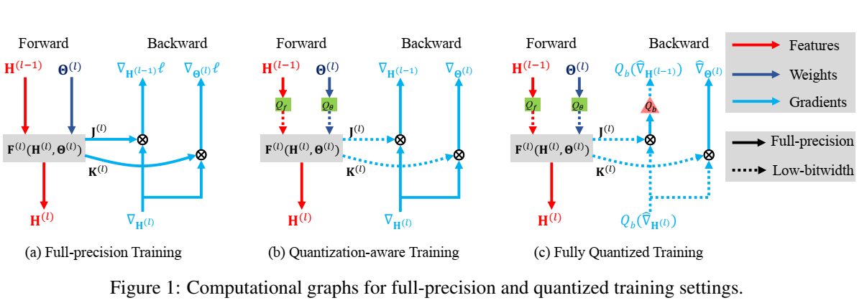
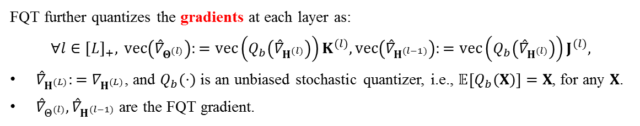
Fully Quantized Training
FQT further quantizes the gradients at each layer as:
$$∀l∈[L]_{+}, vec\left({\overset{ˆ}{∇}}_{Θ^{(l)}}\right):=vec\left(Q_{b}\left({\overset{ˆ}{∇}}_{H^{(l)}}\right)\right)K^{(l)},vec\left({\overset{ˆ}{∇}}_{H^{(l−1)}}\right):=vec\left(Q_{b}\left({\overset{ˆ}{∇}}_{H^{(l)}}\right)\right)J^{(l)},$$
${\overset{ˆ}{∇}}_{H^{(L)}}:=∇_{H^{(L)}}$, and $Q_{b}(⋅)$ is an unbiased stochastic quantizer, i.e., $𝔼\left[Q_{b}(X)\right]=X$, for any $X$.
${\overset{ˆ}{∇}}_{Θ^{(l)}},{\overset{ˆ}{∇}}_{H^{(l−1)}}$ are the FQT gradient.
Full-precision training and QAT solve different learning problems, since full-precision training optimizes the exact model, while QAT approximately optimizes the quantized model.
QAT and FQT aim to optimize the same model, but with different gradient estimators.

Slide 9
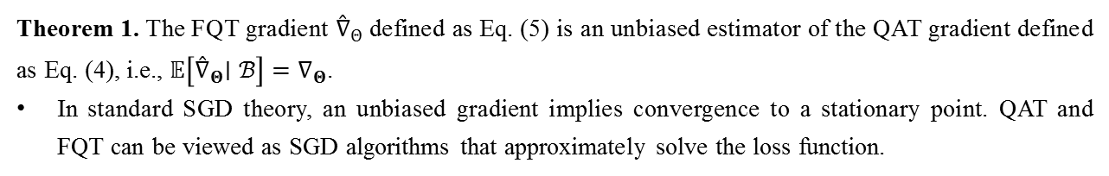
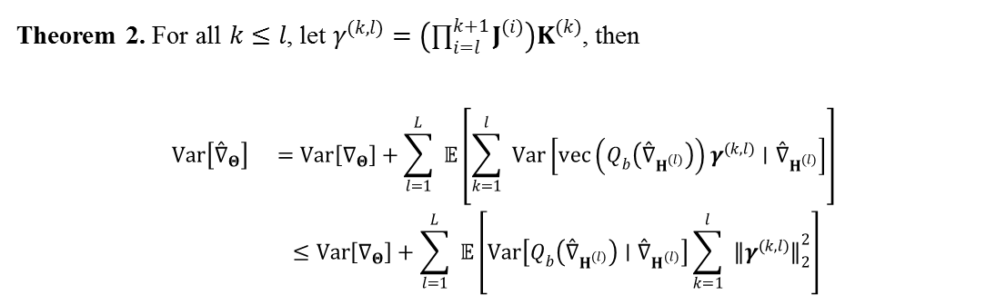
Fully Quantized Training
Gradient Bias
Theorem 1. The FQT gradient ${\overset{ˆ}{∇}}_{Θ}$ defined as Eq. (5) is an unbiased estimator of the QAT gradient defined as Eq. (4), i.e., $𝔼\left[{\overset{ˆ}{∇}}_{Θ}∣ℬ\right]=∇_{Θ}$.
In standard SGD theory, an unbiased gradient implies convergence to a stationary point. QAT and FQT can be viewed as SGD algorithms that approximately solve the loss function.
Gradient Variance
Theorem 2. For all $k≤l$, let $γ^{(k,l)}=\left(∏_{i=l}^{k+1} J^{(i)}\right)K^{(k)}$, then
$$\begin{matrix}Var\left[{\overset{ˆ}{∇}}_{Θ}\right] & =Var\left[∇_{Θ}\right]+\sum_{l=1}^{L}{ } 𝔼\left[\sum_{k=1}^{l}{ } Var\left[vec\left(Q_{b}\left({\overset{ˆ}{∇}}_{H^{(l)}}\right)\right)γ^{(k,l)}∣{\overset{ˆ}{∇}}_{H^{(l)}}\right]\right] \\ & ≤Var\left[∇_{Θ}\right]+\sum_{l=1}^{L}{ } 𝔼\left[Var\left[Q_{b}\left({\overset{ˆ}{∇}}_{H^{(l)}}\right)∣{\overset{ˆ}{∇}}_{H^{(l)}}\right]\sum_{k=1}^{l}{ } {∥γ^{(k,l)}∥}_{2}^{2}\right]\end{matrix}$$
variance of the QAT gradient
variance from gradient quantization
For SGD with nonconvex and smooth objective functions, the convergence rate of the gradient norm $𝔼{∥∇_{Θ_{t}}∥}^{2}$ is $O(σ/\sqrt{T})$ w.r.t. the numbers of total iterations $T$, if the gradient variance is bounded by $σ^{2}$.

Slide 10
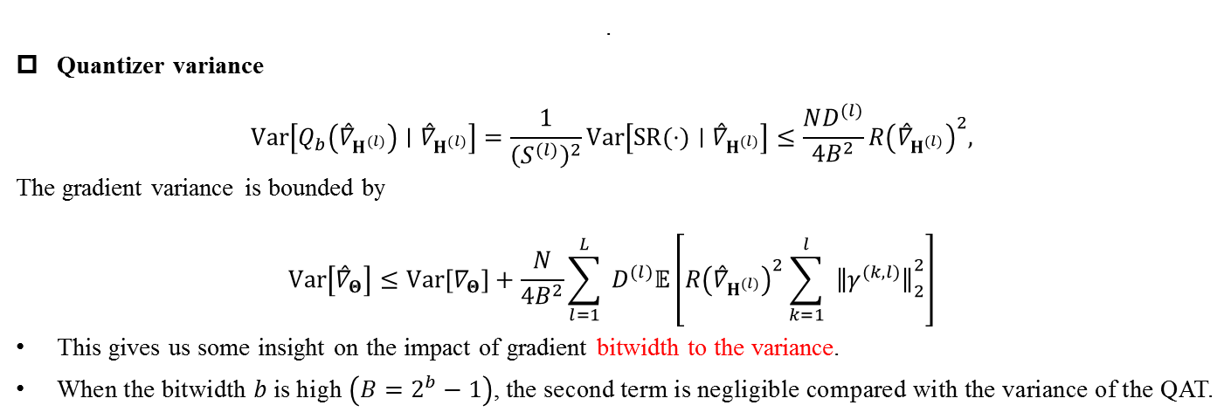
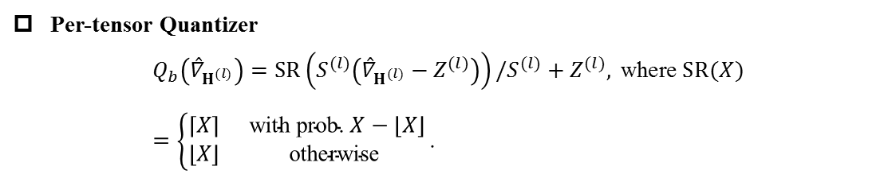
Fully Quantized Training with Per-tensor Quantizer
It is widely adopted in existing INT8 training approaches.
Per-tensor Quantizer
$$Q_{b}\left({\overset{ˆ}{∇}}_{H^{(l)}}\right)=SR⁡\left(S^{(l)}\left({\overset{ˆ}{∇}}_{H^{(l)}}−Z^{(l)}\right)\right)/S^{(l)}+Z^{(l)}, \text{where} SR⁡(X)=\left\{\begin{matrix}⌈X⌉ & \text{with} \text{prob}\text{. }X−⌊X⌋ \\ ⌊X⌋ & \text{otherwise} \end{matrix}\right.\text{. }$$
$$\text{. }$$
Quantizer variance
$$Var⁡\left[Q_{b}\left({\overset{ˆ}{∇}}_{H^{(l)}}\right)∣{\overset{ˆ}{∇}}_{H^{(l)}}\right]=\frac{1}{{\left(S^{(l)}\right)}^{2}}Var⁡\left[SR⁡(⋅)∣{\overset{ˆ}{∇}}_{H^{(l)}}\right]≤\frac{ND^{(l)}}{4B^{2}}R{\left({\overset{ˆ}{∇}}_{H^{(l)}}\right)}^{2},$$
The gradient variance is bounded by
$$Var⁡\left[{\overset{ˆ}{∇}}_{Θ}\right]≤Var⁡\left[∇_{Θ}\right]+\frac{N}{4B^{2}}\sum_{l=1}^{L}{ }D^{(l)}𝔼\left[R{\left({\overset{ˆ}{∇}}_{H^{(l)}}\right)}^{2}\sum_{k=1}^{l}{ } {∥γ^{(k,l)}∥}_{2}^{2}\right]$$
This gives us some insight on the impact of gradient bitwidth to the variance.
When the bitwidth $b$ is high $\left(B=2^{b}−1\right)$, the second term is negligible compared with the variance of the QAT.

Slide 11
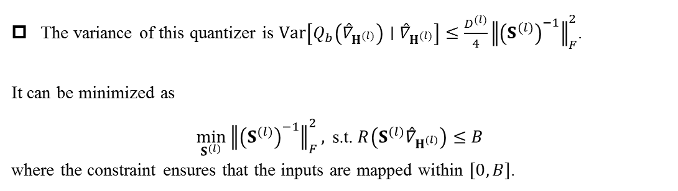
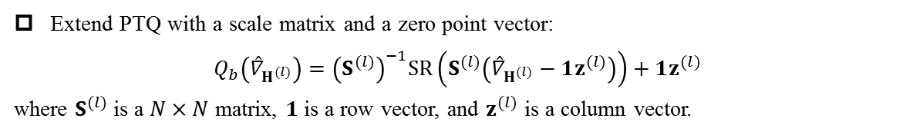
Variance Reduced Quantizers
Motivation: to reduce gradient variance, we propose a new family of gradient quantizers that have smaller variance than existing PTQ.
Extend PTQ with a scale matrix and a zero point vector:
$$Q_{b}\left({\overset{ˆ}{∇}}_{H^{(l)}}\right)={\left(S^{(l)}\right)}^{−1}SR⁡\left(S^{(l)}\left({\overset{ˆ}{∇}}_{H^{(l)}}−1z^{(l)}\right)\right)+1z^{(l)}$$
where $S^{(l)}$ is a $N×N$ matrix, $1$ is a row vector, and $z^{(l)}$ is a column vector.
The variance of this quantizer is $Var⁡\left[Q_{b}\left({\overset{ˆ}{∇}}_{H^{(l)}}\right)∣{\overset{ˆ}{∇}}_{H^{(l)}}\right]≤\frac{D^{(l)}}{4}{∥{\left(S^{(l)}\right)}^{−1}∥}_{F}^{2}$.
It can be minimized as
$$\min_{S^{(l)}} {∥{\left(S^{(l)}\right)}^{−1}∥}_{F}^{2}, \text{s}\text{.}\text{t}\text{. }R\left(S^{(l)}{\overset{ˆ}{∇}}_{H^{(l)}}\right)≤B$$
where the constraint ensures that the inputs are mapped within $[0,B]$.

Slide 12
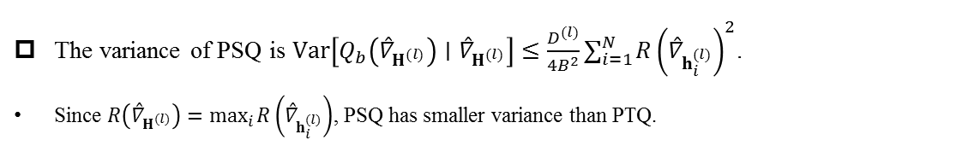
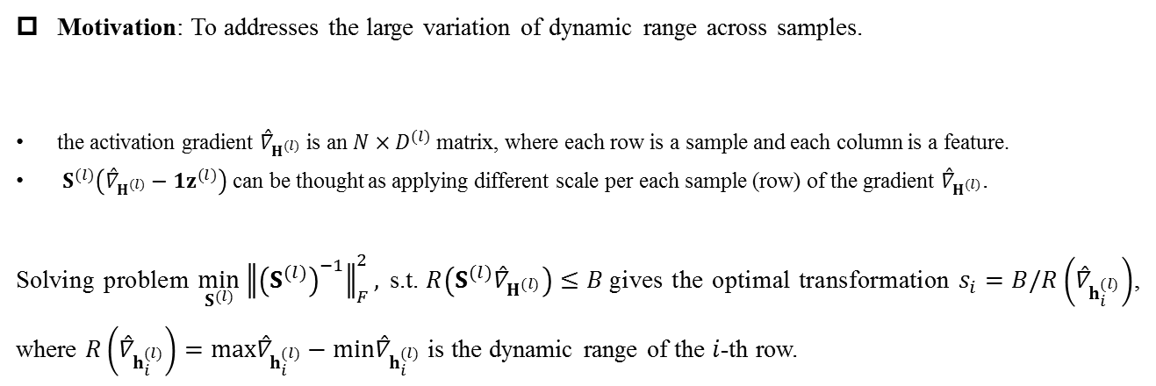

Per-sample Quantizer
Motivation: To addresses the large variation of dynamic range across samples.
the activation gradient ${\overset{ˆ}{∇}}_{H^{(l)}}$ is an $N×D^{(l)}$ matrix, where each row is a sample and each column is a feature.
$S^{(l)}\left({\overset{ˆ}{∇}}_{H^{(l)}}−1z^{(l)}\right)$ can be thought as applying different scale per each sample (row) of the gradient ${\overset{ˆ}{∇}}_{H^{(l)}}$.
Solving problem $\min_{S^{(l)}} {∥{\left(S^{(l)}\right)}^{−1}∥}_{F}^{2}, \text{s}\text{.}\text{t}\text{. }R\left(S^{(l)}{\overset{ˆ}{∇}}_{H^{(l)}}\right)≤B$gives the optimal transformation $s_{i}=B/R\left({\overset{ˆ}{∇}}_{h_{i}^{(l)}}\right)$, where $R\left({\overset{ˆ}{∇}}_{h_{i}^{(l)}}\right)=max{\overset{ˆ}{∇}}_{h_{i}^{(l)}}−min{\overset{ˆ}{∇}}_{h_{i}^{(l)}}$ is the dynamic range of the $i$-th row.
$$S^{\left(l\right)}=\operatorname{diag}\left\{s_{1},…,s_{N}\right\}$$
The variance of PSQ is $Var⁡\left[Q_{b}\left({\overset{ˆ}{∇}}_{H^{(l)}}\right)∣{\overset{ˆ}{∇}}_{H^{(l)}}\right]≤\frac{D^{(l)}}{4B^{2}}∑_{i=1}^{N} R{\left({\overset{ˆ}{∇}}_{h_{i}^{(l)}}\right)}^{2}$.
Since $R\left({\overset{ˆ}{∇}}_{H^{(l)}}\right)=\max_{i} R\left({\overset{ˆ}{∇}}_{h_{i}^{(l)}}\right)$, PSQ has smaller variance than PTQ.

Slide 13
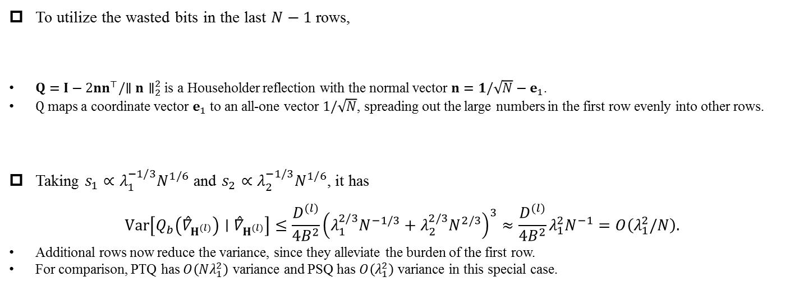
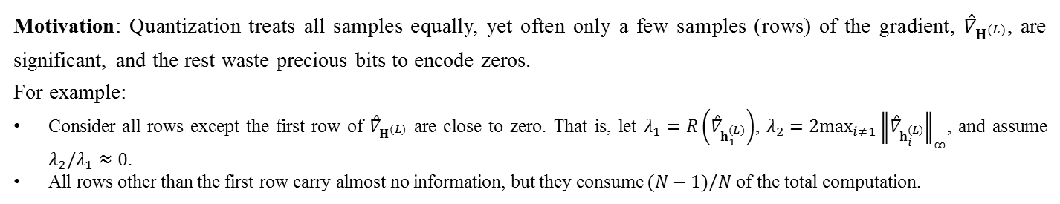

Block Householder Quantizer
Motivation: Quantization treats all samples equally, yet often only a few samples (rows) of the gradient, ${\overset{ˆ}{∇}}_{H^{(L)}}$, are significant, and the rest waste precious bits to encode zeros.
For example:
Consider all rows except the first row of ${\overset{ˆ}{∇}}_{H^{(L)}}$ are close to zero. That is, let $λ_{1}=R\left({\overset{ˆ}{∇}}_{h_{1}^{(L)}}\right)$, $λ_{2}=2\max_{i≠1} {∥{\overset{ˆ}{∇}}_{h_{i}^{(L)}}∥}_{∞}$, and assume $λ_{2}/λ_{1}≈0$.
All rows other than the first row carry almost no information, but they consume $(N−1)/N$ of the total computation.
To utilize the wasted bits in the last $N−1$ rows,
$Q=I−2nn^{⊤}/∥n∥_{2}^{2}$ is a Householder reflection with the normal vector $n=1/\sqrt{N}−e_{1}$.
$Q$ maps a coordinate vector $e_{1}$ to an all-one vector $1/\sqrt{N}$, spreading out the large numbers in the first row evenly into other rows.
Taking $s_{1}∝λ_{1}^{−1/3}N^{1/6}$ and $s_{2}∝λ_{2}^{−1/3}N^{1/6}$, it has
$$Var\left[Q_{b}\left({\overset{ˆ}{∇}}_{H^{(l)}}\right)∣{\overset{ˆ}{∇}}_{H^{(l)}}\right]≤\frac{D^{(l)}}{4B^{2}}{\left(λ_{1}^{2/3}N^{−1/3}+λ_{2}^{2/3}N^{2/3}\right)}^{3}≈\frac{D^{(l)}}{4B^{2}}λ_{1}^{2}N^{−1}=O\left(λ_{1}^{2}/N\right).$$
Additional rows now reduce the variance, since they alleviate the burden of the first row.
For comparison, PTQ has $O\left(Nλ_{1}^{2}\right)$ variance and PSQ has $O\left(λ_{1}^{2}\right)$ variance in this special case.
$$S^{\left(l\right)}=Q\operatorname{diag}\left(s_{1},s_{2},…,s_{2}\right)$$

Slide 14
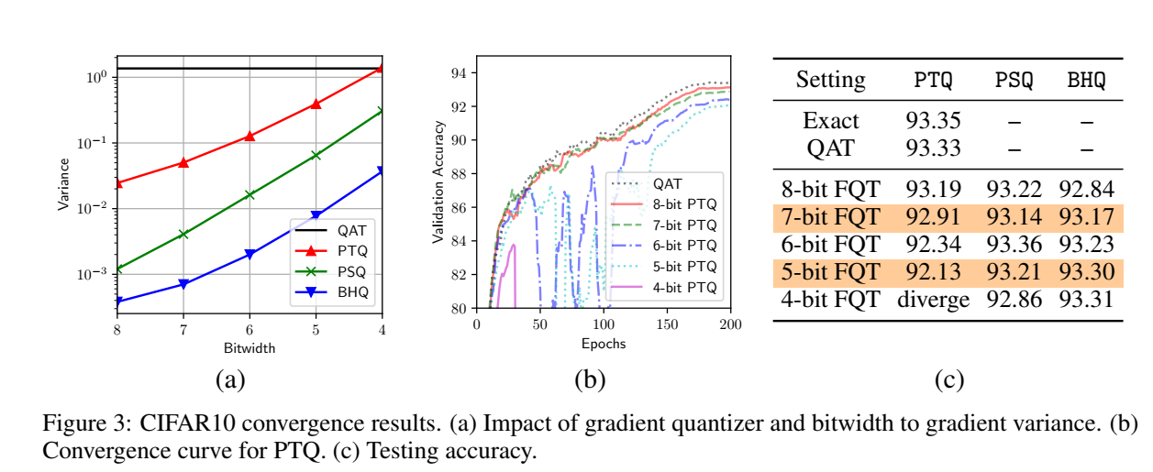
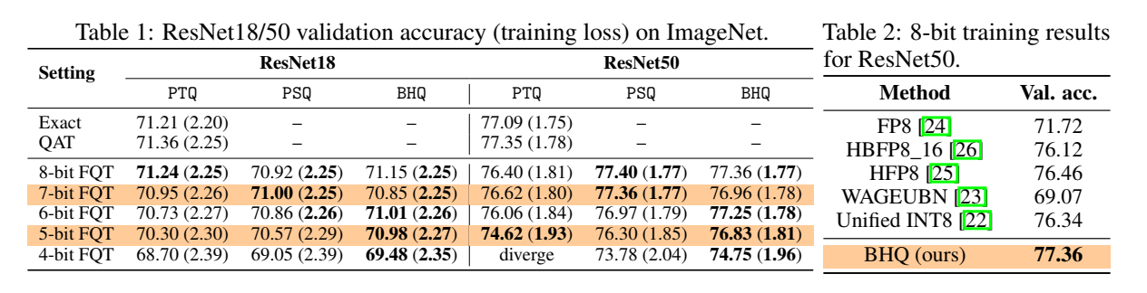
Experiments

Slide 15
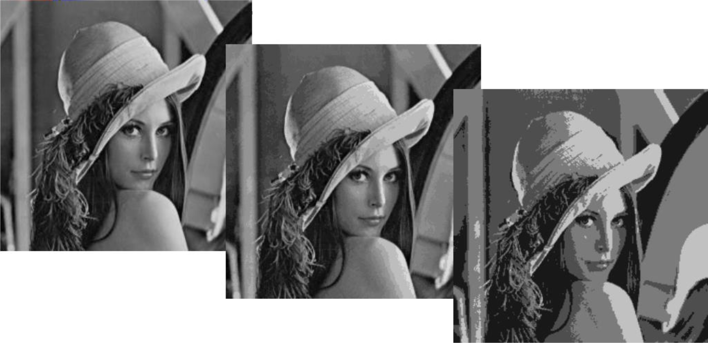
Conclusion
现有研究主要在设计量化方法在low bitwidth 上得到精确的模型
利用量化方法提高HPO的优化
8 bits/pixel
4 bits/pixel
2 bits/pixel

Slide 16
Thank you ! Q & A

